Slide 1
Modulating Visual Attention Influences Problem Solving
Tiffani Ng
Creative Cognition (Beeman) Lab
CBMG Data Blitz
April 18th, 2019

Slide 2




pine
crab
sauce
tree
tree
(analysis)
tree
i.e., Compound Remote Associates problems
(mental impasse)
pine
crab
sauce
apple
apple
(insight)
apple
Notes:
This is Jerry and he is working on a really difficult problem.
He has three words – pine, crab, and sauce – and he needs to come up with a fourth word that can form a compound word or phrase with each of these three words - these are known as Compound Remote Associates problems.
He tries a deliberate analytic strategy, and tests whether a word like “tree” might work with all three words. But he reaches a mental impasse and cannot come up with any more solutions. Suddenly, the solution – apple – pops into Jerry’s mind. Jerry has had an insight experience.

Slide 3
(analysis)
more selective
attention
less selective
or distributed
(insight)
Notes:
Attention that is more selective tends to be conducive to analytic solving.
Whereas attention that is less selective or is distributed tends to be conducive to insight solving.

Slide 4
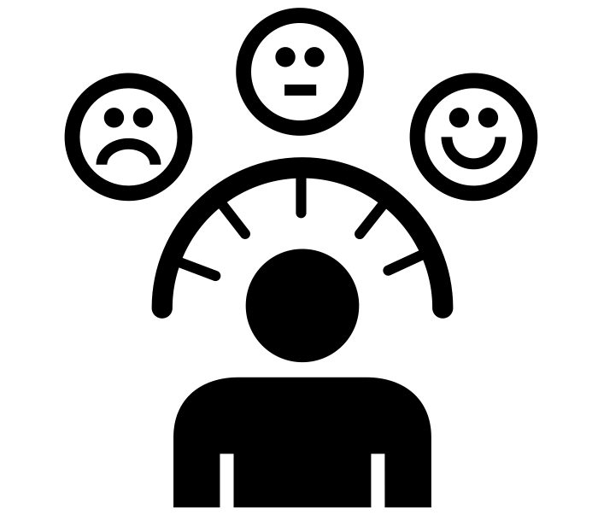
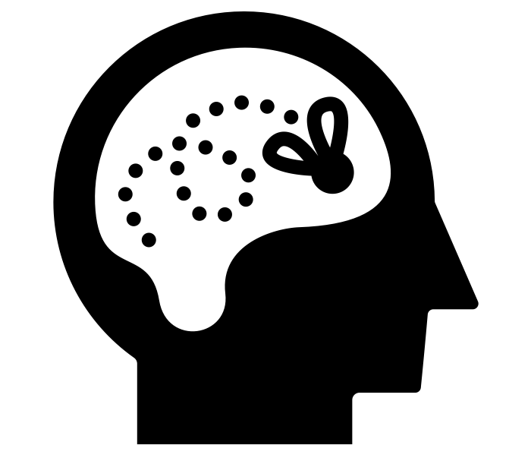
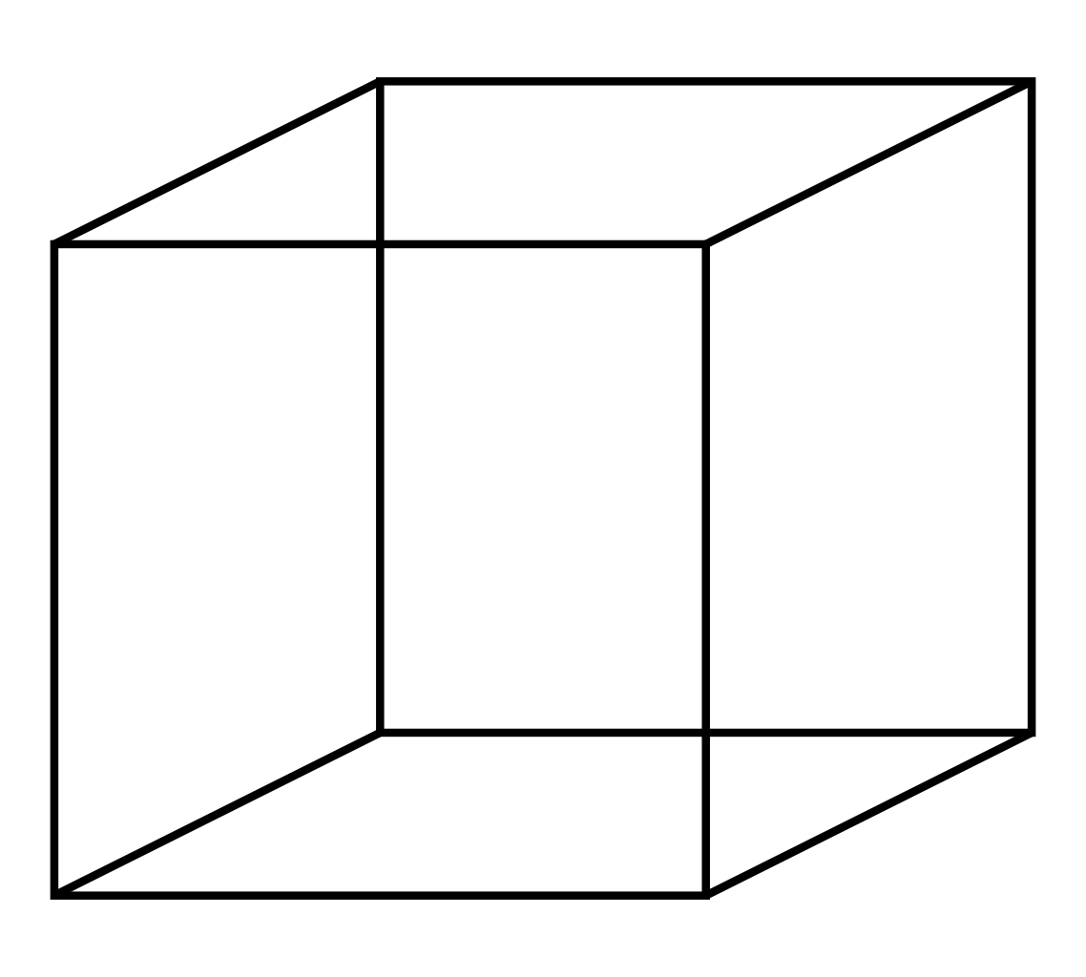
(analysis)
(analysis)
indirect
more selective
attention
less selective
or distributed
direct
> > > < > > >
(insight)
Notes:
Some studies have INDIRECTLY looked at the effect of the selectivity of attention on problem solving by investigating mood effects or frequency of mind wandering.
Other studies have DIRECTLY manipulated the SELECTIVITY of attention to affect subsequent problem solving by asking people to perform visual tasks like the CENTRAL FLANKER TASK or observing different perspectives of a NECKER CUBE.

Slide 5
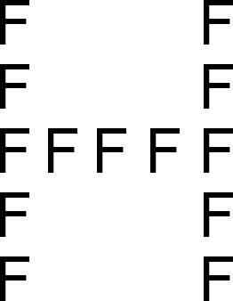
(analysis)
(analysis)
indirect
more selective
attention
less selective
or distributed
direct
(insight)
Navon task
Notes:
In our first study, we used a modified version of the Navon to modulate the selectivity of attention and subsequent problem solving. We predicted that this task should induce more selective attention, which should be conducive to analytic solving.

Slide 6

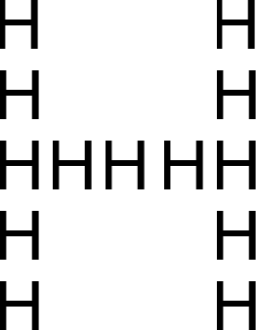
1) 50 Baseline Compound Remote Associates (CRA) problems
Solution?
Insight or Analysis?
+
pine
crab
sauce
(1 s)
(12 s)
2) (Modified) Navon Task
Judge GLOBAL (big) letter is H or S
+
Judge LOCAL (small) letter is H or S
OR
(1 s)
(2 s)
(2 s)
INCONGRUENT
CONGRUENT
3) 50 Compound Remote Associates (CRA) problems
DV: Change in insight and analysis
Notes:
Participants first completed a baseline set of Compound Remote Associates problems. They were also asked how they solved the problems – with insight or with analysis.
Then, to manipulate the selectivity of attention, participants completed a version of the modified Navon task.
They were asked to either judge whether the GLOBAL or BIG letter is an H or S, or whether the LOCAL or SMALL letter is an H or S.
The hierarchical letters were either incongruent – that is a different letter at global and local levels – or congruent.
Finally, they received another set of CRA problems, and we measured the change in insight and analysis.

Slide 7

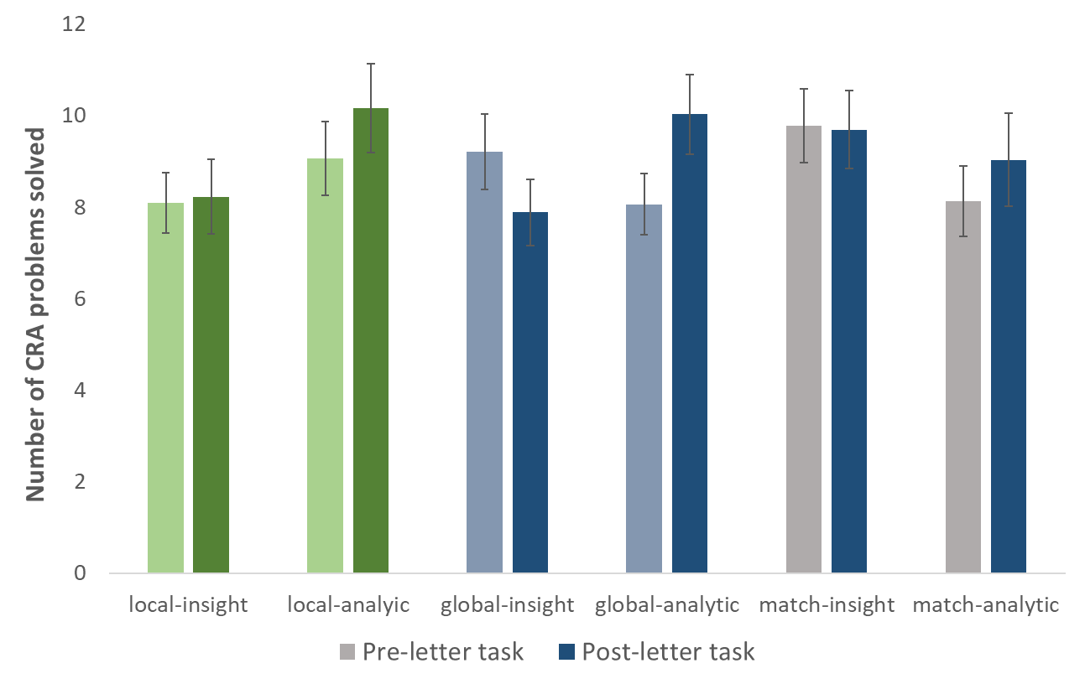
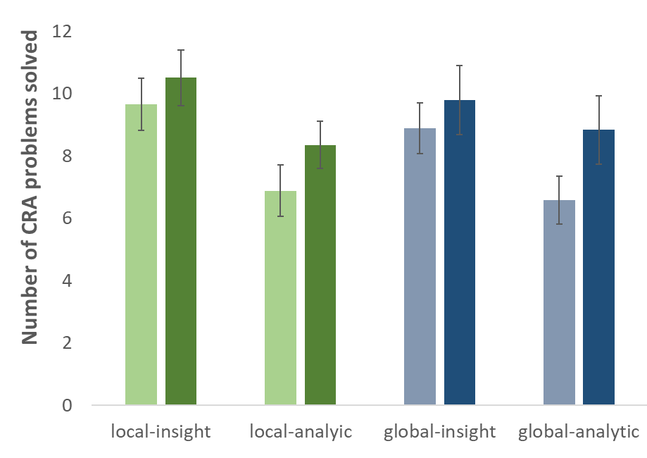


Participants who attended to the global level of hierarchical letter stimuli subsequently produced more analytic solutions
Judge GLOBAL (big) letter is H or S
(analysis)
more selective
more selective
attention
experiment 1
experiment 2
*
*
*
Notes:
Judging the big letter requires filtering out interfering representations from the small letters, so this task should demand more selective attention, which should be conducive to analytic solving. Our findings from two experiments supported this prediction. Although we found that attending to the local level induced more analytic solving in experiment 1, this finding did not replicate.

Slide 8
(analysis)
indirect
more selective
attention
less selective
or distributed
direct
(insight)
Ensemble Statistics task
Notes:
In another study, we used an Ensemble Statistics Task to modulate the selectivity of attention and subsequent problem solving. We predicted that this task would require distributed attention that would be conducive to insight solving.

Slide 9
1) 50 Baseline Compound Remote Associates (CRA) problems
2) Ensemble Statistics Task (adapted from Chong & Treisman, 2005)
Mean size of
the circles?
+
(500 ms)
(200 ms)
OR: Central Circle Task
Size of the
central circle?
+
(500 ms)
(200 ms)
3) 50 Compound Remote Associates (CRA) problems
DV: Change in insight and analysis
Notes:
Again, participants completed a baseline set of CRA problems.
Then, to manipulate the selectivity of attention, participants performed an ensemble statistics task in which they were asked to judge the average size of a display of 16 circles of varying sizes that was displayed very quickly.
Or, they were asked to judge the size of the circle that appeared in the center of the display, as marked by the fixation cross that appeared previously, and is filled in here for illustrative purposes.
Once again, we measured change in insight and analysis.

Slide 10

Participants who performed the ensemble statistics task subsequently produced more insight solutions
more selective
more selective
(analysis)
attention
less selective
or distributed
less selective
or distributed
(insight)
*
Number of CRA problems solved correctly
Notes:
We predicted that the ensemble statistics task requires distributed visual attention, which should be conducive to insight solving. Conversely, the central circle version of this task would require selective attention, which should be more conducive to analytic solving.
As predicted, participants who performed the ensemble statistics task subsequently solved more problems with insight, but not with analysis. Data collection is ongoing for the experiment using the central circle task, but with about 25 participants, it does not look like it is reliably inducing more insight or analytic solving.

Slide 11
Creative Cognition Lab (Mark Beeman)
Graduate Students:
Kristin Grunewald
Tiffani Ng
Kyle Nolla
Post-doc:
Carola Salvi
Lab Manager:
Kara Dastrup
Thanks for your attention!
Research Assistants:
Adviti Atluri
Andrew Pen
Katherine Mann
Malena Cheng
Nicholas Liou
Patrick Zacher
Sam Agbeh
Yuhua Yu
Image Credits:
The Noun Project – Luis Prado, Sophia Bai, Maxim Kulikov, Aneeque Ahmed, Timmy Chau

