Slide 1

Selective attention to global stimuli induces analytic problem solving
Tiffani Ng & Mark Beeman
SfNC Data Blitz
March 24, 2017

Slide 2


…
pine
crab
sauce
tree
tree
tree
Compound Remote Associates (CRA) Problems
Notes:
This is Jerry, and he’s working on a difficult problem.
He has three words – pine, crab, and sauce – and he’s trying to find a word that can form a compound with each of these words. These problems are called Compound Remote Associates Problems.
Jerry thinks maybe the word “tree” will work, so he tries it…

Slide 3

pine
crab
sauce
tree
tree
Analytic problem-solving
tree
Search-like
Step-by-step/gradual
Notes:
But it doesn’t really work.
Jerry attempted to solve this problem analytically, which is a search-like and step-by-step process.

Slide 4



Analytic problem-solving
Search-like
Step-by-step/gradual
Notes:
Jerry reaches a mental impasse, when suddenly…
He has an “Aha!” moment.

Slide 5


pine
crab
sauce
apple
apple
Analytic problem-solving
Search-like process
Step-by-step/gradual
apple
Insight problem-solving
Instantaneous
Cannot report steps
Notes:
“Apple” pops into Jerry’s head!
And lo-and-behold, it works with all three problem words.
Jerry just experienced insight, in which he arrived at a solution instantaneously and can’t really report how he got to the correct solution.

Slide 6

(attention to)
visual tasks
modulate
Analytic
attention
Insight
Notes:
Evidence from mood and preparation effects literature suggests that attention has a central role in problem solving. Furthermore, how you attend to visual tasks can affect how you solve a problem, whether with insight or with analysis.

Slide 7
How do visual and conceptual attention modulate problem solving?
Notes:
But the question remains: How do visual and conceptual attention modulate problem solving?

Slide 8


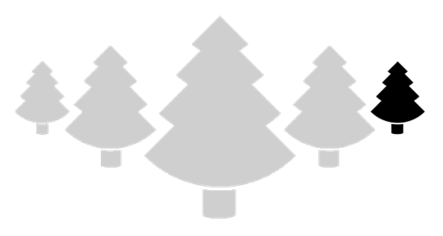
Distant associations
outside of narrow scope
nuts
cone
tree
claw
grass
tomato
pine
crab
sauce
alfredo
pot
cocktail
narrow attention
Notes:
One possibility is that attention varies spatially…
For example, the viewer is narrowly focused on one tree while ignoring the other trees, which could encourage their conceptual space to narrow so that they are focusing on close associations, while ignoring distant ones.

Slide 9
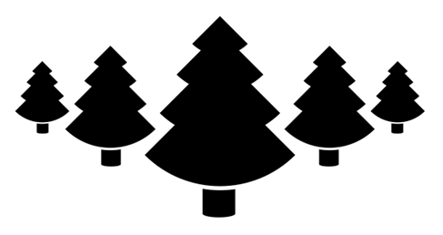
apple
nuts
cone
tree
claw
grass
tomato
pine
crab
sauce
alfredo
pot
cocktail
broad attention
Notes:
Conversely, the viewer could have a broader focus of attention and see the whole forest, which encourages their conceptual space to broaden and allows them to gain access to conceptually distant associations.

Slide 10
Distant (weak)
associations ignored
nuts
cone
tomato
claw
grass
tree
square
telephone
club
pine
crab
sauce
alfredo
pot
cocktail
selective attention
Notes:
Another possibility hinges on the selectivity of attention.
For example, a visual task could encourage the viewer to selectively attend to one tree while ignoring the others. This could encourage more selective conceptual processing, so that they focus more on dominant associations and have decreased ability to access weak associations.

Slide 11
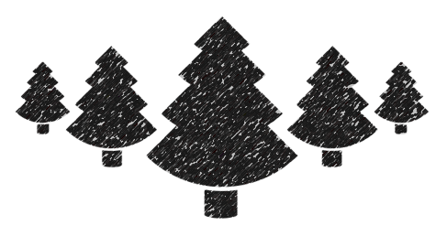
apple
nuts
snow
needle
cone
tomato
claw
king
grass
béarnaise
tree
pine
crab
sauce
alfredo
pot
cocktail
less selective attention
Notes:
Conversely, if a visual task encourages less selective visual processing, it may also encourage less selective conceptual processing, decreasing their focus on dominant but incorrect associations and increasing the strength of distantly related associations.

Slide 12
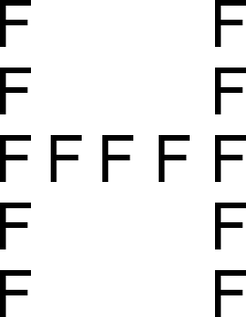
H
Notes:
In two experiments, we tested both spatial and selectivity possibilities with hierarchical letter stimuli, in which a global letter –the big H– is made of local letters –the small F’s.
You can imagine people focus on the levels in two ways: either by how they allocate attention spatially, or by how they select some information over other information.

Slide 13
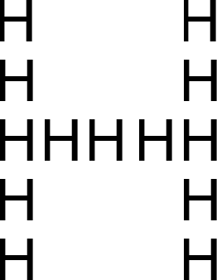
Local-global letter task
(Whole block – 160 trials)
Ready?
1 second
2 seconds
Local task – Is small letter H or S? (Yes/No)
Global task – Is big letter H or S? (Yes/No)
Notes:
In our letter task, participants see a fixation for 1 second, then they see a hierarchical letter and are asked to make a yes/no judgment depending on the condition they were assigned:
In the local condition, participants were asked to determine whether the small letter was an H or S.
In the global condition, participants were asked whether the big letter was an H or S.

Slide 14
Compound Remote Associates (CRA) problems (50 trials per set)
pine
crab
sauce
+
1 second
12 seconds
spacebar
Notes:
Before and after the letter task, participants attempt to solve 50 CRA problems.
First, they see a fixation cross for one second, then they have 12 seconds to come up with a solution word that can form a compound with each of the three problem words.
When they arrive at a solution, they hit the spacebar and verbally provide the solution, which was scored by the experimenter.

Slide 15
Compound Remote Associates (CRA) problems
Insight or Analysis?
Notes:
Then, they are asked whether they solved the problem with insight or with analysis, which we used to measure changes in problem solving.

Slide 16

Distant associations
outside of narrow scope
or ignored (apple)
pine
crab
sauce
tree
selective or narrow
attention
Analysis
Notes:
We expected participants who performed the local task would increase analytic solving regardless of interpretation because both narrowed spatial attention and increased selectivity should increase focus on dominant associations at the expense of more remote ones.

Slide 17
Local letter task did not reliably induce more analytic solving
† marginal, p=.08
Number of CRAs solved correctly
Experiment #
Notes:
We found a pattern of increased analytic solving after the local task in both experiments, but the effect was marginal, not statistically reliable.
Also, we should note that after experiment 1, we counterbalanced the CRA problem sets to account for a set effect, and had participants perform another block of the letter task during the final set of problems.

Slide 18
apple
nuts
cone
tree
claw
grass
tomato
pine
crab
sauce
alfredo
pot
cocktail
H
broad attention
Insight
Notes:
The two potential mechanisms make contrasting predictions for the GLOBAL TASK:
If people respond to global targets by spatially broadening attention, then conceptual attention should also become spatially broadened, making remote associates more accessible and leading to more insight solutions.

Slide 19
apple
nuts
cone
tree
claw
(more selective conceptual attention,
remote associates less accessible)
grass
tomato
pine
crab
sauce
alfredo
pot
cocktail
H
more selective attention
Analysis
Notes:
In contrast, if people need to inhibit the local stimuli to select the global which demands more selective attention, this should increase selectivity of attention conceptually, making remote associates less accessible and leading to more analytic solutions.

Slide 20
Global letter task induced more analytic solving
*
†
*
Number of CRAs solved correctly
* p < .05
† marginal, p=.08
Experiment #
Notes:
In fact, this was the exact pattern we found: in both experiments, participants reliably increased analytic solving after the global task.
So, it seems selectivity is the important feature here.
But, why did focusing on global letters increase analytic solving even more than focusing on local letters?

Slide 21
-
Incongruent latencies
Congruent latencies
congruency effect
(index of selective attention)
Notes:
One way to approach this question is to look at congruency effects, which is how we indexed selective attention. We calculated them by subtracting the latencies of congruent trials from incongruent trials.

Slide 22
Not much conflict, small latencies
Not much conflict, small latencies
-
incongruent
congruent
small congruency effect
(Local task - Is small letter H or S?)
Notes:
For the local task, there should not be much conflict from the global level so we should expect a small congruency effect.

Slide 23
More conflict, big latencies
Not much conflict, small latencies
-
incongruent
congruent
larger congruency effect
(Global task - Is big letter H or S?)
Notes:
In comparison, it is harder to select the global letter without ignoring the local elements, so incongruent trials should be harder and take longer than congruent trials, which should give us a larger congruency effect.

Slide 24
Congruency Effects (from 3 experiments)
Notes:
In these two experiments, global task participants showed reliably larger congruency effects and a third experiment (in a different context) showed the same effect. Thus, the global task, which had bigger congruency effects indicating a greater demand for selective attention, induced more analytic solving.

Slide 25
Individual differences in selectivity and problem solving
Notes:
Finally, we also looked at individual differences in selectivity in the letter task, and how these relate to insight and analytic problem solving in CRAs…

Slide 26
Larger congruency effects are positively correlated with number of verbal problems solved with insight.
Congruency effect (ms)
r = .22,
p = .05
Insight solving (z-scored)
Notes:
We found that a larger congruency effect, or less selective attention, is positively correlated with number of verbal problems solved with insight.

Slide 27
Smaller congruency effects are negatively correlated with number of verbal problems solved with analysis.
Congruency effect (z-scored)
r = -.16,
p = .05
Analytic solving (z-scored)
Notes:
Conversely, a smaller congruency effect, or more selective attention, is negatively correlated with number of verbal problems solved with analysis.

Slide 28
Summary
H
more selective attention
Analysis
Notes:
To summarize, our global task, which asked participants to make judgments at the global level, induces selective attention and analytic solving.
And, the degree of selectivity of attention is relates to differences in insight/analytic solving across individuals.

