Slide 1
Ionic Framework
Team Member:
Liman Zhou
Jiaqian Li
Josh Lebreton
Yuchen Jia

Slide 2




Ionic Framework
Open Source
Cross-platform
Web
Source code
Android
Javascript
CSS
HTML
Apple
Hybrid Development

Slide 3
Ionic Framework
the frontend UX and UI interaction of an app

Slide 4




Angular has always been at the center of what makes Ionic great. While the core components have been written to work as a standalone Web Component library, the @ionic/angular package makes integration with the Angular ecosystem a breeze. @ionic/angular includes all the functionality that Angular developers would expect coming from Ionic 2/3, and integrates with core Angular libraries, like the Angular router.
Ionic Framework
Angular
React
Vue

Slide 5
Ionic Framework
Ionic now has official support for the popular React library. Ionic React lets React developers use their existing web skills to build apps that target iOS, Android, and the web. With @ionic/react, you can use all the core Ionic components, but in a way that feels like using native React components.
Angular
React
Vue

Slide 6
Ionic Framework
Ionic now has official support for the popular Vue 3 library. Ionic Vue lets Vue developers use their existing web skills to build apps that target iOS, Android, and the web. With @ionic/vue, you can use all the core Ionic components, but in a way that feels like using native Vue components.
Angular
React
Vue

Slide 7
Discussion
Advantages of Using Ionic
Faster development time
Code reusability
Wide community support

Slide 8
Installation

Slide 9
Prerequisites
Build-in Terminal app
Code Editor
Node.js & npm
Git
Angular CLI
A basic understanding of Angular and TypeScript

Slide 10
Install Ionic
Ionic provides a command-line interface tool to help you build Ionic apps. Install the CLI with npm:
npm install -g @ionic/cli

Slide 11
Ionic CLI
The Ionic Command Line Interface (CLI) is a powerful tool used for developing, building, and managing Ionic applications.
The Ionic CLI provides developers with a command-line interface to streamline various development tasks. Here are some essential commands:
1. ionic start: This command initializes a new Ionic project by creating a base template with the selected starter app. You can specify the project name and template to use, such as blank, tabs, sidemenu, etc:
ionic start <project_name> <template>

Slide 12
Ionic CLI
2. ionic generate: The generate command helps create different parts of your app, such as pages, components, services, directives, and more:
ionic generate page <page_name>
For instance, ionic generate page MyPage generates a new page named "MyPage.”

Slide 13
Ionic CLI
3. ionic serve: This command launches a local development server, allowing you to run your Ionic app in a web browser during development. Any changes made to the code will automatically reload the application in the browser.
4. ionic build: This command compiles the Ionic app into a distributable format for the specified platform, such as Android, iOS, or the web.
5. ionic capacitor add: This command adds a native iOS or Android project using Capacitor

Slide 14
UI with Ionic Components
https://ionicframework.com/docs/components

Slide 15
Theming
Ionic Framework is built to be a blank slate that can easily be customized and modified to fit a brand, while still following the standards of the different platforms. Theming Ionic apps is now easier than ever. Because the framework is built with CSS, it comes with pre-baked default styles which are extremely easy to change and modify.
https://ionicframework.com/docs/theming/basics

Slide 16
Codes Demo

Slide 17
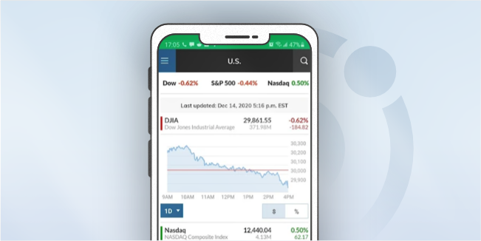
Examples of Ionic Apps
https://mdevelopers.com/blog/14-best-ionic-apps-of-2022
This is a free Ionic app available for Android and iOS. MarketWatch helps you discover the most recent business news, analysis, and stock market data.
The Director of Product at market Watch Brian Aguilar said "We picked Ionic because of how heavily it leans on existing technologies that we are familiar with and use regularly, but we wanted something that also didn’t compromise on the app experience. The fact that the framework is so performant only reinforced our decision. We’re incredibly pleased with the outcome and think Ionic has made our app stronger.”

Slide 18
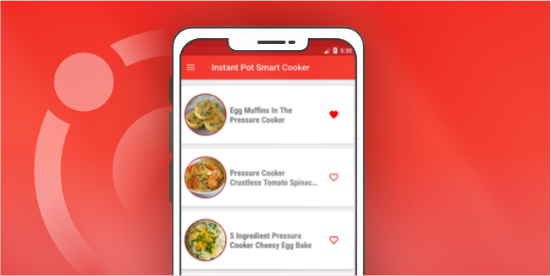
Examples of Ionic Apps
https://mdevelopers.com/blog/14-best-ionic-apps-of-2022
The InstantPot Ionic app makes it simple to find recipes, bookmark favorites, take notes, and even create grocery lists so that you may get down to business with cooking your meals.
This application made with the Ionic framework is rated so well for its design. The mobile app looks nice but is also readable and easy to use, and the combination of these features is almost always a recipe for success. This is one of the best free mobile applications available on Android and iOS devices and it holds the #32 place in Food & Drinks in the app store.

Slide 19

Conclusion
Define Ionic as a popular open-source UI toolkit for building cross-platform mobile applications.
Its focus on using web technologies like HTML, CSS, and JavaScript.
Highlight the main features of Ionic, such as:
Pre-built UI components
Cross-platform compatibility
Theming and customization options

Slide 20
Q & A

Slide 21
Let’s Build Our Fist Ionic Application!

Slide 22
THE END
THANKS

