Slide 1


Smart India Hackathon 2024
• Problem Statement ID: SIH1591 / PS26245
• PS Title: AI-Powered Edge Video Analytics & Governance
• Theme: Smart Automation / Governance & Skilling
• PS Category: Software
• Team ID: [Team ID]
• Team Name: Drishti Innovators / HackSolvers
Drishti-Skilling
~ Privacy-Preserving Edge AI Governance for Vocational Centres

Slide 2
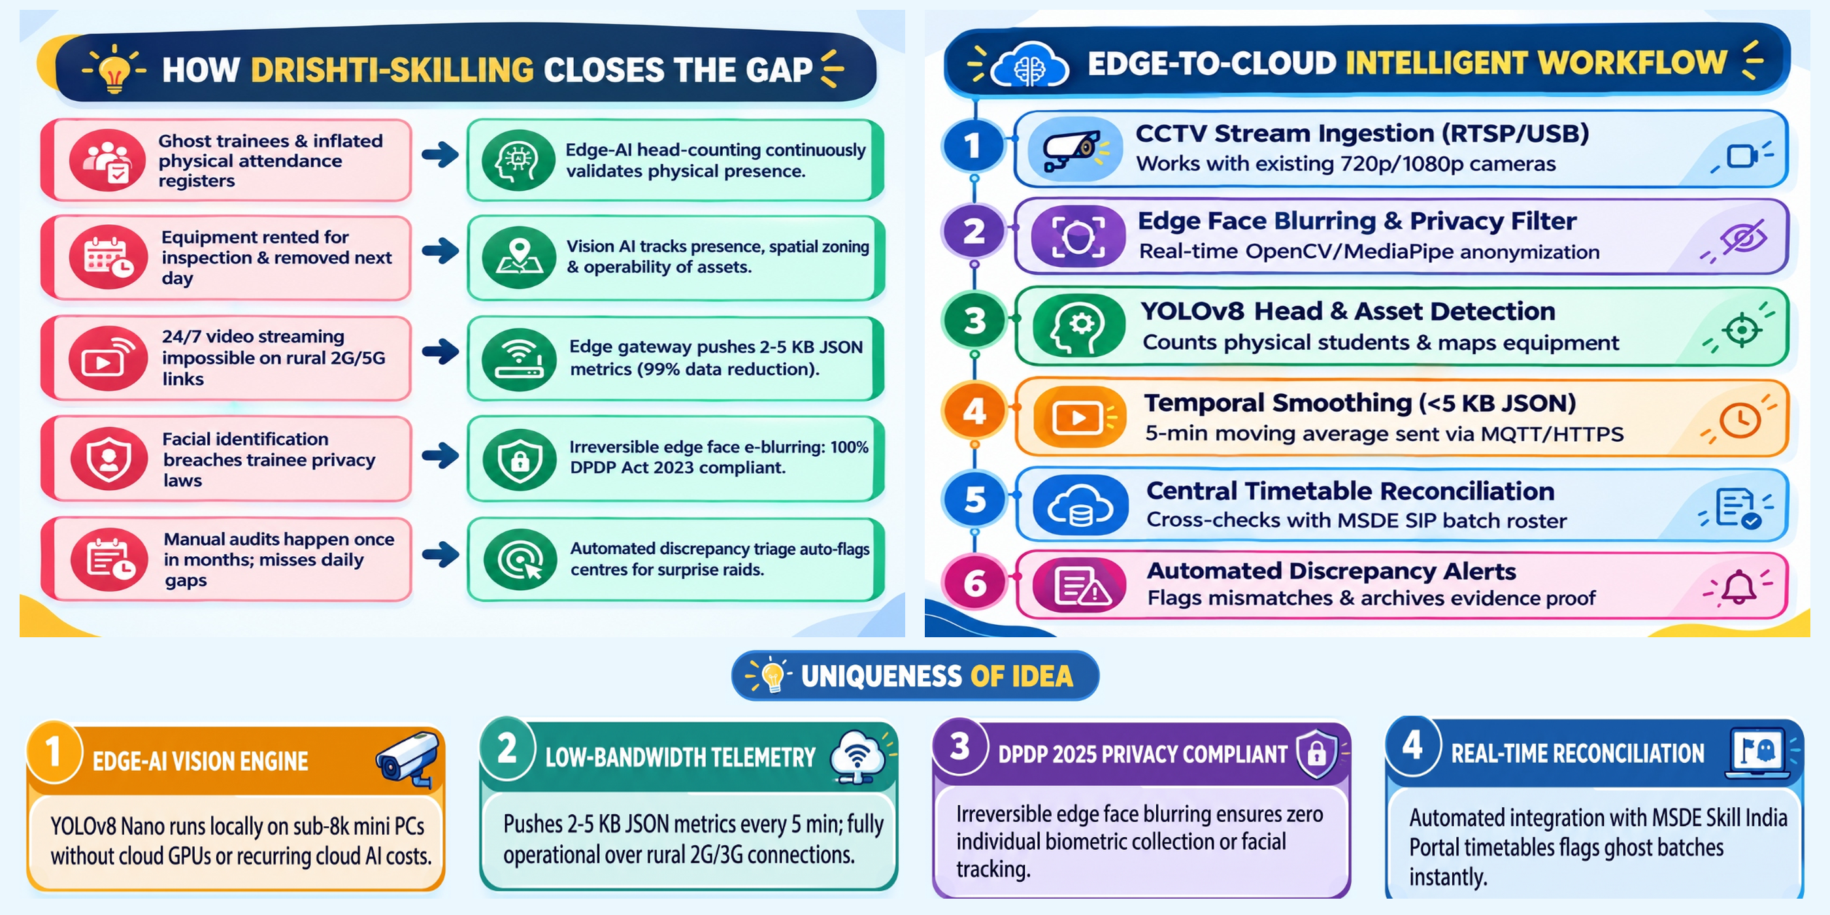
(DS)
DRISHTI-SKILLING
Privacy-Preserving Edge AI Governance for Vocational Centres
2

Slide 3
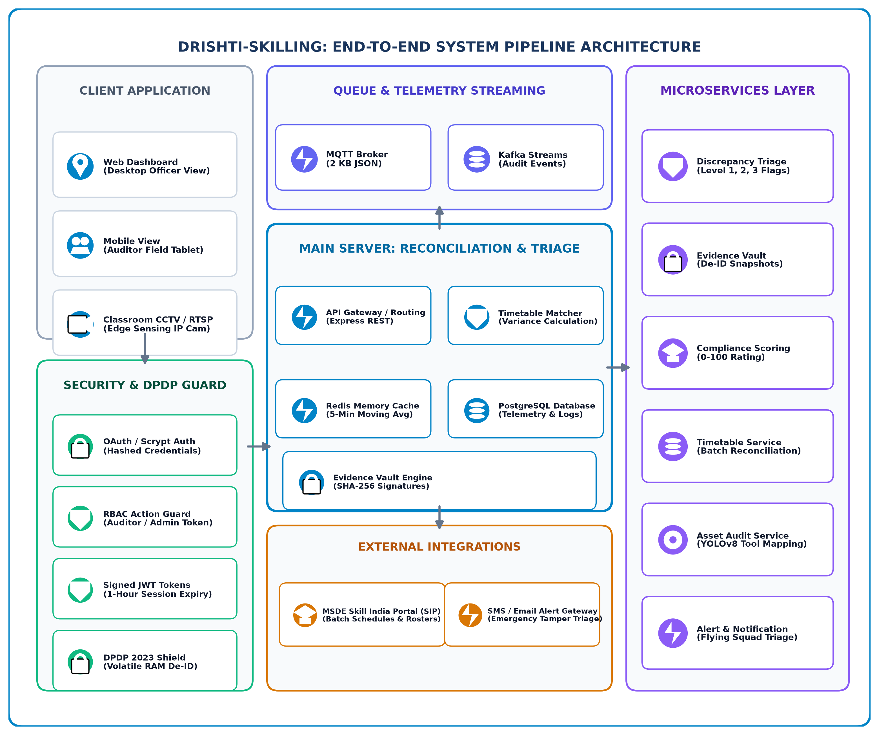
(DS)
Technical Approach
Edge AI & Vision
• BlazeFace 50 FPS De-ID
• YOLOv8-Nano Head Count
• COCO Spatial Asset AI
Backend & API
• Node.js & Express REST
• FastAPI / Python Edge
• MQTT Telemetry Broker
Frontend & GIS
• HTML5 & TailwindCSS
• Leaflet.js GIS Mapping
• Chart.js Live Telemetry
Security & DB
• DPDP Act 2023 RAM Shield
• Scrypt Auth & Signed JWT
• SQLite & PostgreSQL
Methodology and process for implementation
➔ Core Architecture:
● Edge Gateway: RTSP stream capture from existing classroom/lab CCTV.
● Volatile RAM De-ID: BlazeFace hardware downscaled inference (<12ms) with zero raw face storage.
● YOLO Headcount & Asset Check: Temporal 5-minute rolling average to suppress momentary false flags.
➔ Integration & Security:
● Encrypted Telemetry: Transmits 2-5 KB JSON packets to cloud via MQTT/HTTPS.
● Automated SIP Reconciliation: Live cross-check against Skill India Portal batch roster.
● Security & Cryptography: Scrypt password hashing, JWT token authorization, and SHA-256 evidence signing.
3

Slide 4
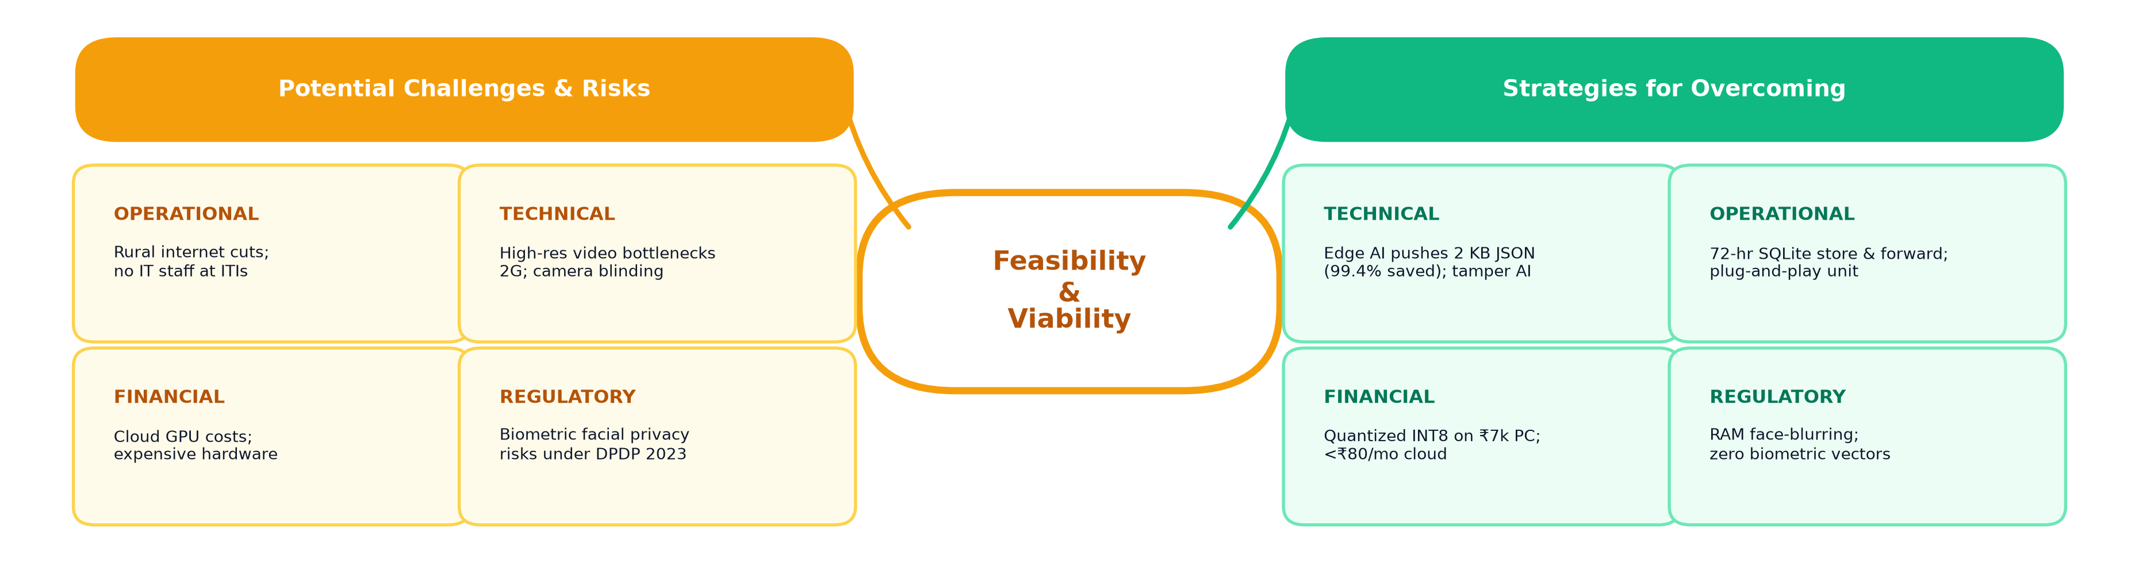
(DS)
Feasibility & Viability
TECHNICAL FEASIBILITY
• Reuses standard RTSP CCTV / DVRs.
• INT8 YOLOv8 runs 25+ FPS locally.
• BlazeFace 50 FPS de-identification.
• Working MVP deployed on Vercel.
MARKET & SCALE FEASIBILITY
• Applies to 15,000+ national centres.
• Extensible to ITIs, PMKVY, DGT, polytechnics.
• Dockerized OTA automated deployment.
• 10-minute web setup wizard.
FINANCIAL FEASIBILITY
• Low CapEx: ~₹6,500 edge unit per centre.
• OpEx <₹80/mo (replaces ₹1,800 streaming).
• Saves ₹100+ Cr in ghost stipend fraud.
• Cuts physical audit travel by 75%.
OPERATIONAL & REGULATORY
• 100% compliant with DPDP Act 2023.
• Zero biometric or Aadhaar storage.
• Ensures rural youth get real trade skills.
• Accelerates payouts for ethical partners.
Interactive System Prototype: https://drishti-skilling.vercel.app/
4

Slide 5
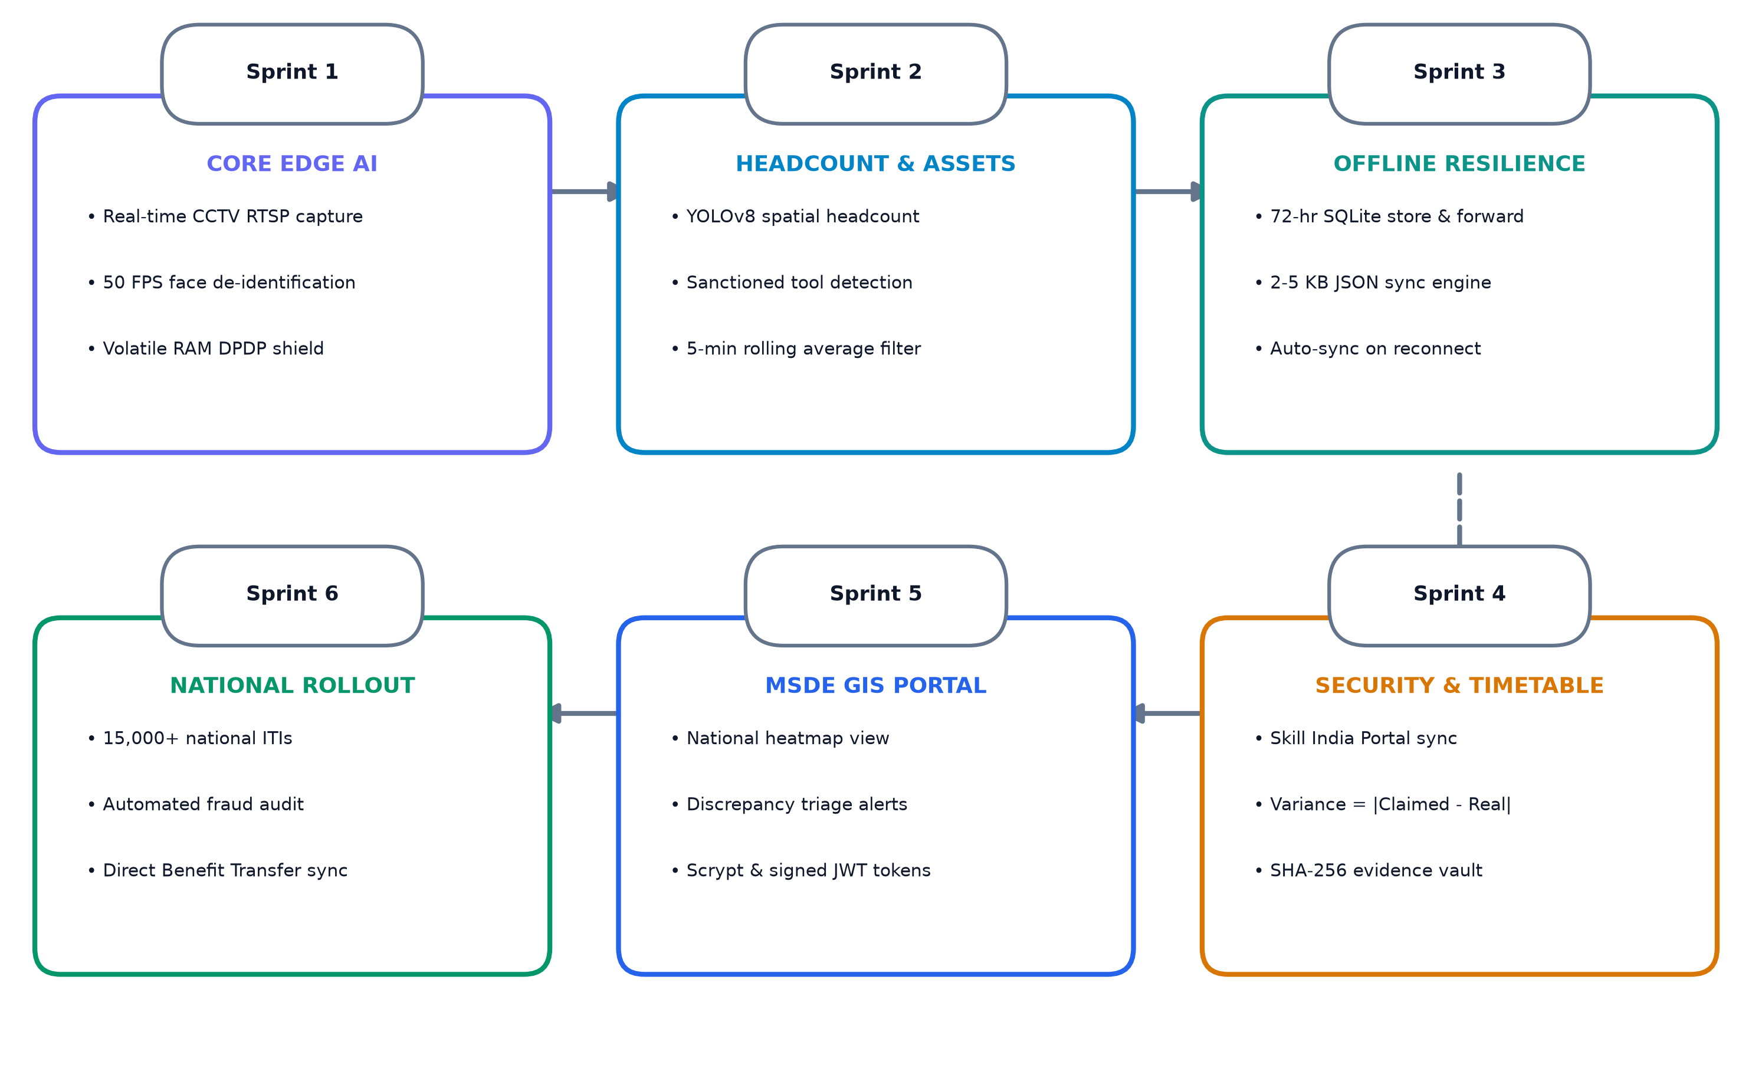
(DS)
Impact and Benefits
🌍 Potential Impact & Benefits of Solution
💡 Roadmap & Future Goals (Deployment Sprints)
01
Plugs Ghost Trainee Leakages
Stops ₹100+ Crores in fraudulent stipend claims; halts illegal payouts automatically.
02
Guarantees Real Youth Skills
Enforces mandatory physical trainer presence & hands-on equipment practice for trainees.
03
99.4% Rural Bandwidth Reduction
Operates smoothly on 2G/3G links with 2-5 KB JSON metrics; saves millions in streaming bills.
04
100% DPDP Act 2023 Compliance
Volatile RAM face-blurring guarantees zero citizen facial biometrics stored or leaked.
05
75% Audit Travel Cost Reduction
Objective risk triage directs flying squads only to red-flagged hotspot centres.
06
Faster Payouts for Ethical Centres
Automated compliance index clears verified training centres for rapid subsidy disbursement.
5

Slide 6
(DS)
Research and References
Details / Links of the reference and research work
1. Comptroller and Auditor General of India (CAG): Performance Audit on National Skill Development Mission (Report No. 10 of 2018), documenting 25-35% variance between reported trainee rosters and physical classroom occupancy in unmonitored centres.
2. Ministry of Skill Development and Entrepreneurship (MSDE): Guidelines for Empanelment & Continuous Monitoring of Training Centres (PMKVY 4.0 / DGT Norms), specifying mandatory trainer-trainee ratios, equipment checklists, and biometric audit requirements.
3. Digital Personal Data Protection Act, 2023 (DPDP Act): Act No. 22 of 2023, Gazette of India, Section 6 & 8 (Data Minimization & Purpose Limitation Principles), mandating edge-level de-identification and prohibiting continuous storage of raw facial biometrics.
4. Ultralytics & Google Research (Edge Vision Benchmarks): YOLOv8-Nano and BlazeFace Real-Time Performance on Resource-Constrained Embedded Devices (Edge TPUs and Intel N100 Mini-PCs), demonstrating 25-50 FPS throughput at sub-15W power envelope.
5. Ministry of Electronics and Information Technology (MeitY): IoT & Edge AI Architectural Guidelines for Public Sector Service Delivery, emphasizing local compute, store-and-forward telemetry, and cryptographic verification of audit records.
6. National Skill Development Corporation (NSDC): Standard Operating Procedures for Skill India Digital Hub (SIDH) Batch Accreditation & Verification, detailing API interfaces for third-party automated discrepancy reporting.
7. Drishti-Skilling Production Platform & Verifiable Codebase: Live Web Platform: https://drishti-skilling.vercel.app/ | Architecture & Audit Test Suite: https://github.com/aetherpixels/drishti-skilling (17/17 Security & RBAC automated audit tests passing).
6

