Slide 1


Composition and Inheritance in React
By Calvin Kwong

Slide 2
Composition and Inheritance in JavaScript

Slide 3
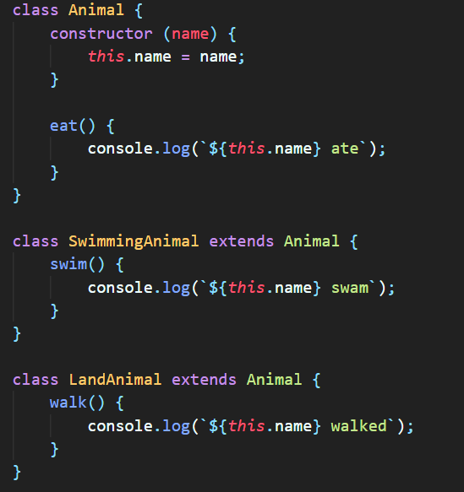
Inheritance in JS

Slide 4
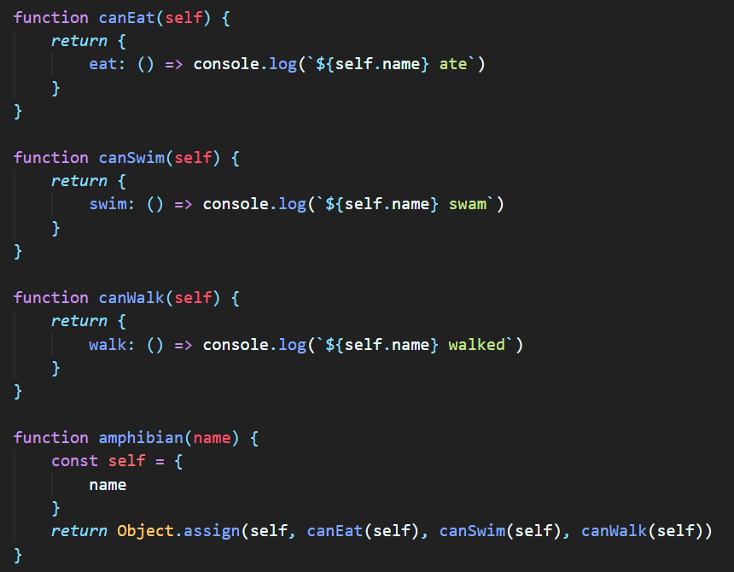
Composition in JS

Slide 5
Composition and Inheritance in React

Slide 6
Purposes
Reuse code
Containment: components don’t know what their children will be ahead of time
Sidebar or dialog box
Specialization: component is a special case of another

Slide 7
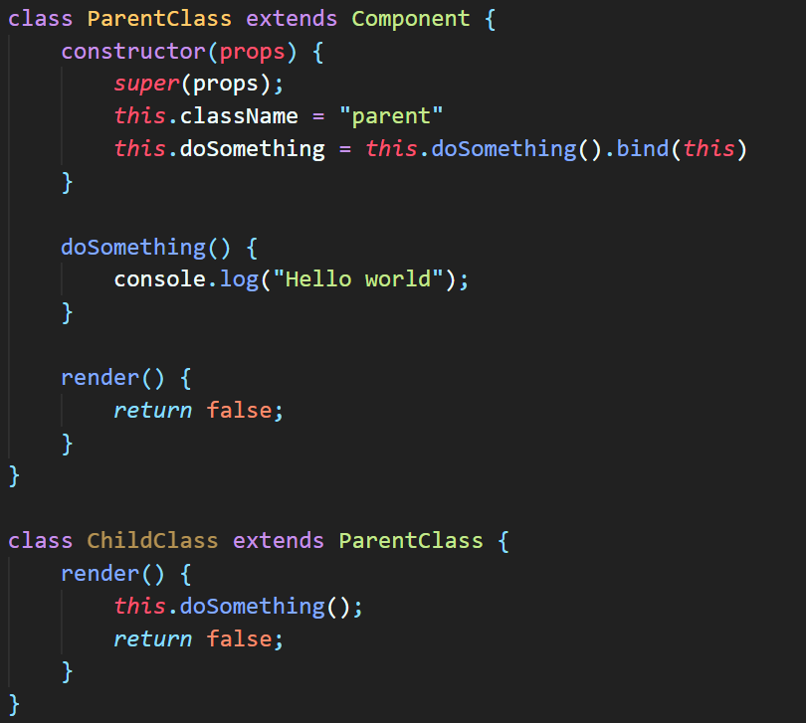
Inheritance in React

Slide 8
React has a powerful composition model, and we recommend using composition instead of inheritance to reuse code between components.
https://reactjs.org/docs/composition-vs-inheritance.html
In general, composition is preferable to inheritance.

Slide 9
Why composition?
Avoids nesting too many components
Ability to use props to pass in arguments
<Example date={Date()}/>
“Everything as a component”

Slide 10
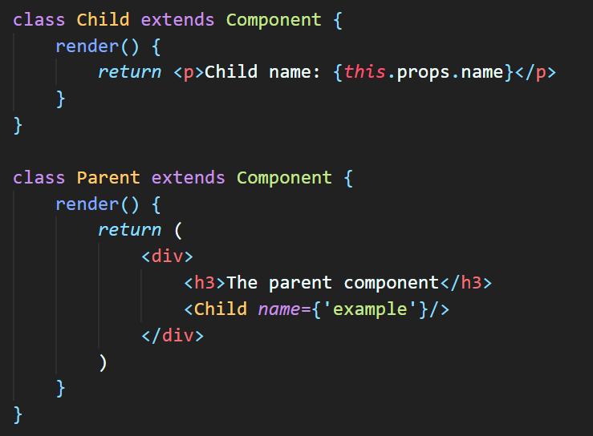
Composition in React

Slide 11


Additional Resources
https://github.com/aethyris/CUS1172-TechPresentation
https://reactjs.org/docs/composition-vs-inheritance.html
https://formidable.com/blog/2021/react-composition/
https://medium.com/leanjs/react-is-all-about-composition-f9f49dec183c

