Slide 1
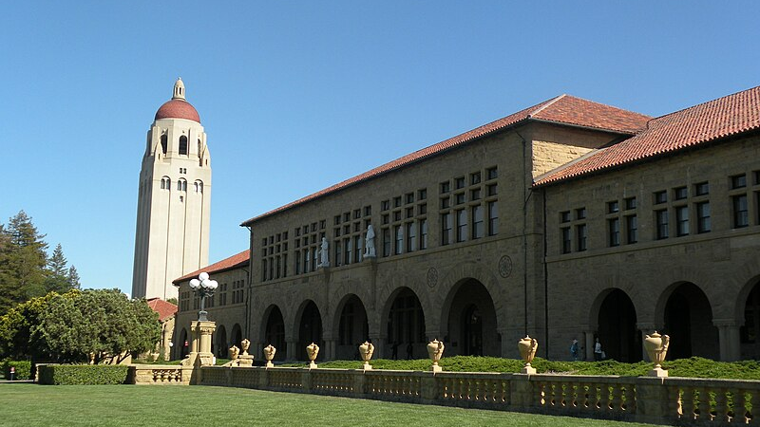
University Admission &
Enrollment System
C++ Console Application | Eligibility • Program Selection • Merit • Aid
ICT Project Presentation
Notes:
[Sources] - https://commons.wikimedia.org/wiki/File:Stanford_University_campus_-_Hoover_Tower_view_2014-05-19.JPG (background image; CC BY-SA 4.0)

Slide 2
Introduction
Problem → Solution
Why automate admissions?
Stage 1
Manual screening is slow and inconsistent
Multiple programs require different rules and thresholds
Students need clear outcomes: selection, merit category, aid, hostel
A rule-based system improves transparency and reduces errors
Eligibility
Stage 2
Selection
Outputs
Merit + Aid

Slide 3
Project Objectives
What the program delivers
Goals
Eligibility Check
Program Selection
Age & Intermediate % screening (Stage 1).
Apply rules for CS, Engineering, BBA, and Arts.
Merit & Categories
Fee Decisions
Compute merit = (Inter + Test) / 2 and assign category.
Merit scholarship, need-based aid, or normal fee.

Slide 4



System Overview
High-level flow
Inputs
Processing
Outputs
Age
Matric %
Inter %
Entry test %
Stream
Non-local?
Income
Program
Stage 1 eligibility
Dept suggestion
Program rules
Merit calculation
Aid/fee rules
Hostel decision
Selection result
Merit category
Scholarship / aid
Hostel status
Document checklist
Notes:
[Sources] - https://commons.wikimedia.org/wiki/File:College_of_Engineering_Building_II,_North_Carolina_State_University_(2013).jpg (background image; CC BY-SA 3.0)

Slide 5
User Inputs & Validation
What the system asks for
Collected from applicant:
Validation & early exits
Age
Matric %, Intermediate %, Entry test %
Stream (Pre-Medical, Pre-Eng, ICS, Arts, Commerce)
Non-local status (hostel eligibility)
Monthly family income (need-based aid)
Applied program (CS, Engineering, BBA, Arts)
Age must be ≥ 17
Intermediate must be ≥ 50% (Stage 1)
Program choice must be 1–4
Engineering requires Pre-Engineering stream
Design note
The code reads Matric %, but the current merit formula uses only Intermediate + Test.

Slide 6
Stage 1: Basic Eligibility
Fast screening
Rules implemented:
Age ≥ 17
Inter ≥ 50%
If age is below 17, system exits with “Not Eligible”.
Intermediate must be at least 50% to proceed.
Outcome:
Stage 1 Passed → proceed to department suggestion + program selection.

Slide 7
Stream-based Department Suggestion
Guidance before selection
Mapping used in the code
Pre-Engineering (2)
CS or Engineering
ICS (3)
CS or Engineering
Commerce (5)
Business (BBA)
Arts (4)
Arts / Social Sciences
Pre-Medical (1)
Arts or Business (fallback)
Note: This is a suggestion only — final selection still follows program criteria.

Slide 8
Stage 2: Program Selection Rules
Decision logic
Computer Science
Computer Science
Engineering
Inter ≥ 60%
Test ≥ 55%
Age ≤ 23
Stream = Pre-Engineering
Inter ≥ 65%
Test ≥ 60%
Business (BBA)
Arts
Inter ≥ 55%
Test ≥ 50%
Inter ≥ 45%
Engineering has extra constraints (age + stream) before checking percentages.
Tip:

Slide 9
Threshold Comparison
Minimum requirements by program
Inter & Entry Test minimums
Arts has no test threshold in the current implementation (0 shown).

Slide 10
Merit Calculation
Category assignment
Formula
Example (for understanding)
Inter = 72%
Test = 66%
merit = (inter + test) / 2
Merit = (72 + 66) / 2 = 69%
Merit Categories
Category → Self Finance
Open Merit
≥ 80
Merit is independent of selected program
Used for list category + hostel priority
2nd Merit List
70–79.99
Self Finance
60–69.99
Not Selected
< 60

Slide 11
Fee / Scholarship Decision
Affordability logic
Decision rules (as implemented)
Merit Scholarship
Need-based Aid
Normal Fee
Merit Scholarship
Need-based Aid
Rule
Rule
Rule
Inter ≥ 85% AND Test ≥ 70%
Income ≤ 80,000 AND Merit ≥ 70%
Otherwise
Outcome
Outcome
Outcome
Highest academic support.
Financial assistance based on merit + income.
Standard fee applies.

Slide 12
Hostel & Document Checklist
Post-selection outputs
Hostel status
Required documents
If Non‑Local = Y → Hostel Eligible
If Merit ≥ 80 → Priority: High
Otherwise → Hostel Not Eligible
CNIC / B‑Form
Passport-size photographs
Matric certificate
Intermediate certificate
Entry test result
Domicile certificate
Character certificate
Why it matters
Prioritizing high-merit non-local students supports fair allocation of limited hostel seats.

Slide 13
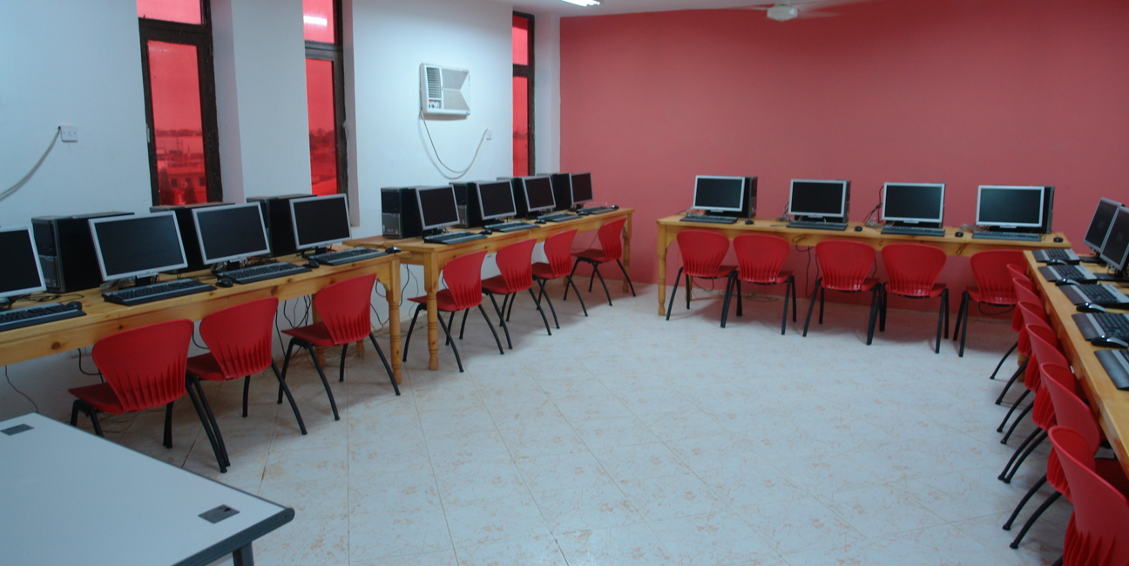
Core Working Logic
Key decision blocks
Readable snippet (simplified)
1 // Stage 1 2 if (age < 17 || inter < 50) exit(); 3 4 // Stage 2 (example: Engineering) 5 if (age > 23) reject(); 6 else if (stream != PRE_ENG) reject(); 7 else if (inter >= 65 && test >= 60) select(); 8 9 // Merit + aid 10 merit = (inter + test) / 2; 11 if (inter >= 85 && test >= 70) scholarship(); 12 else if (income <= 80000 && merit >= 70) aid();
Notes:
[Sources] - https://commons.wikimedia.org/wiki/File:Computer_lab_in_future_university.jpg (background image; CC BY 3.0)

Slide 14
Sample Scenarios
What users see
Scenario A (successful)
Scenario B (rejected)
Age 19 | Inter 72 | Test 66 | Stream: ICS | Program: CS | Non-local: Y | Income: 70,000
Age 24 | Inter 78 | Test 70 | Stream: Pre-Engineering | Program: Engineering
Stage 1: Passed
CS: Selected (72 ≥ 60 and 66 ≥ 55)
Merit: 69% → Self Finance
Fee: Normal (no scholarship/aid)
Hostel: Eligible (Non-local Y)
Stage 1: Passed
Engineering: Rejected (age must be ≤ 23)
Merit still calculated for reporting
Scholarship depends on Inter/Test thresholds
Note: Aid requires Merit ≥ 70; scenario A gets Normal Fee.

Slide 15
Conclusion
A clean rule-based admission workflow with clear outcomes
Key Achievements
Future Enhancements
Two-stage eligibility + selection
Program-specific constraints (incl. engineering stream + age)
Merit categories, aid rules, hostel decisions, and document checklist
User-friendly console outputs with clear reasons for rejection
GUI application (desktop/web) with form validation
Database integration for applicants & merit lists
Config file for thresholds (no recompilation)
Include Matric % in merit weighting if required
Generate printable admission letters / fee challans
Thank you

