Slide 1
MT104-Linear Algebra

Slide 2


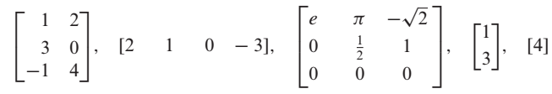
A

Slide 3
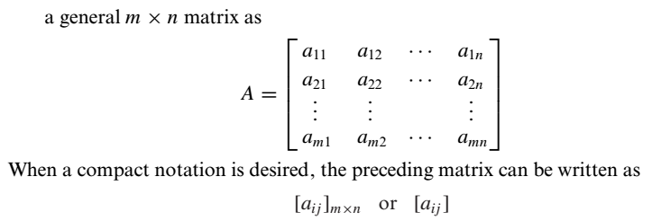


A
is

Slide 4
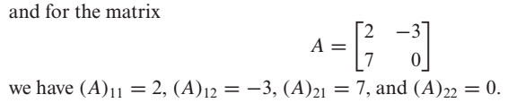

Slide 5
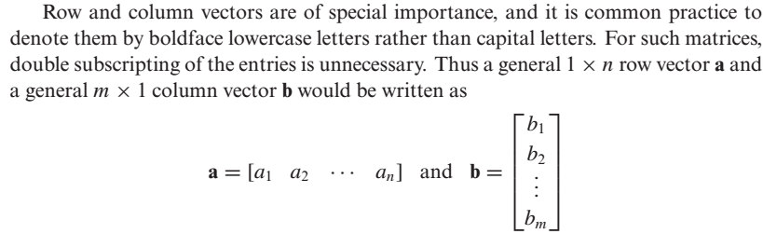
Row Vector and Column Vector

Slide 6
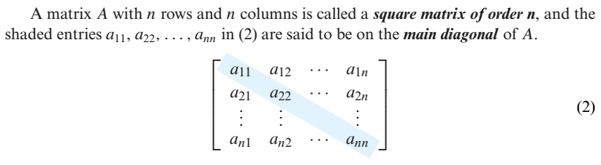
Square Matrix and Main Diagonal

Slide 7



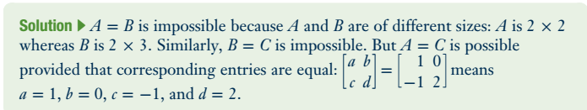
Problem

Slide 8
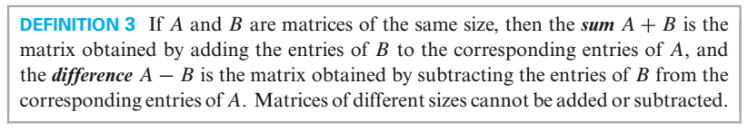
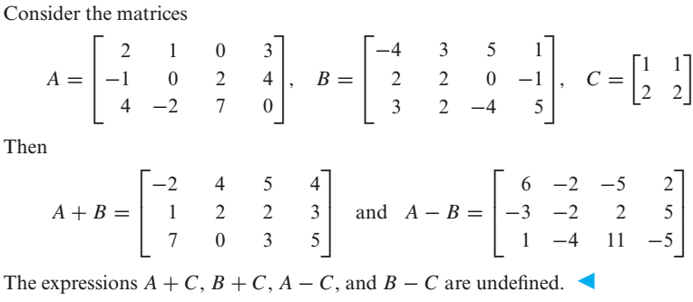

Slide 9
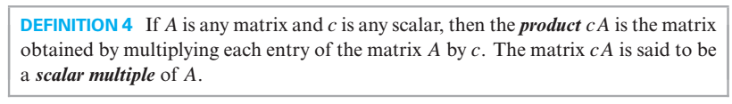
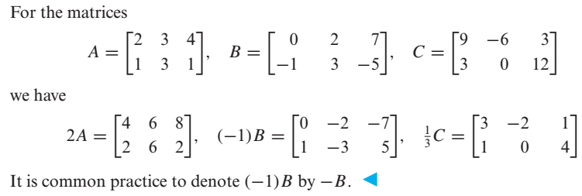
Scalar Multiples of a Matrix

Slide 10
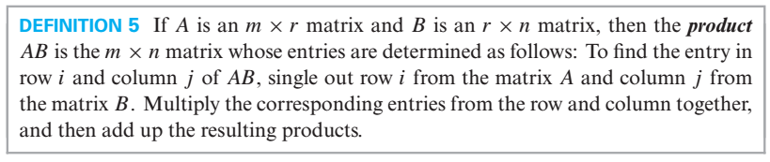
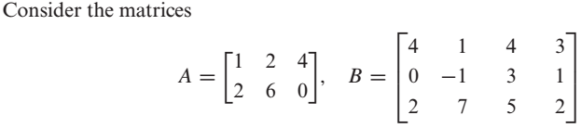
Product of Two Matrices

Slide 11
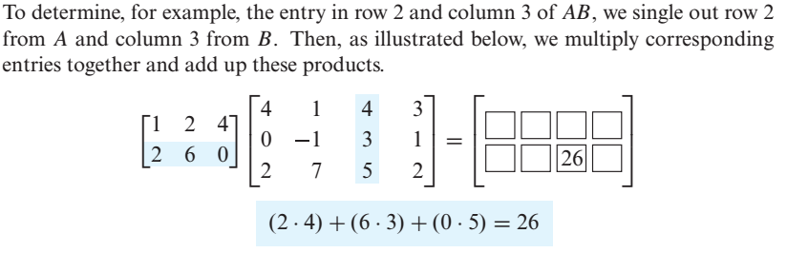
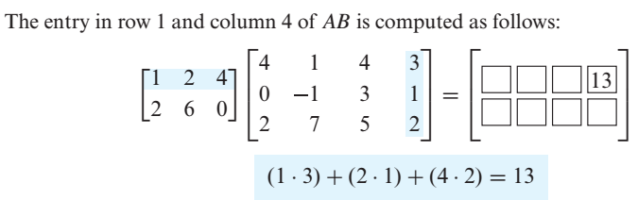

Slide 12
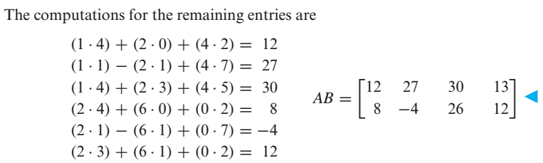

Slide 13
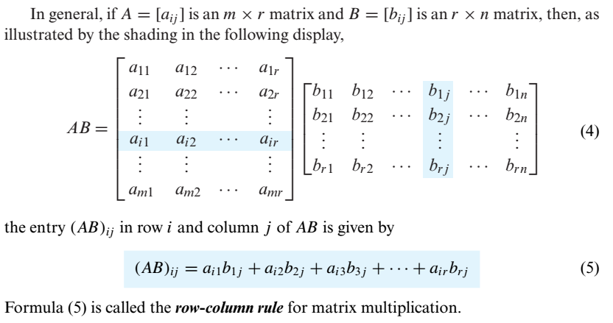

Slide 14

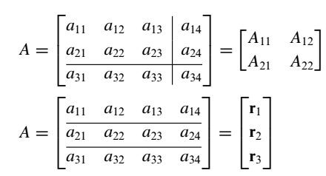
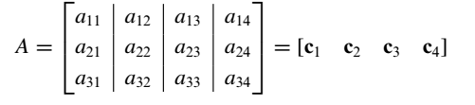

e.g

Slide 15

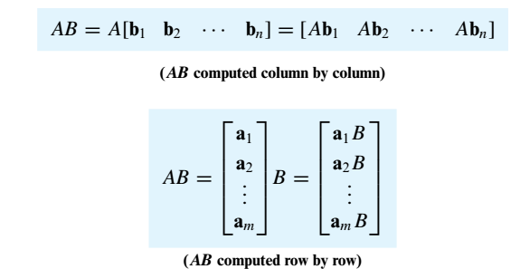

Slide 16
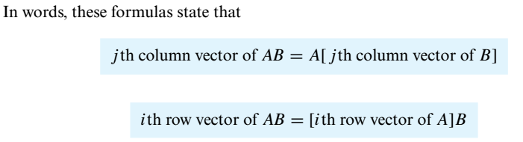


Problem

Slide 17



Slide 18
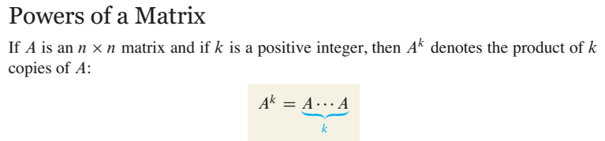
For instance , in order to find we will multiply with .

Slide 19
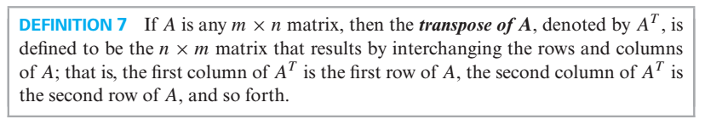
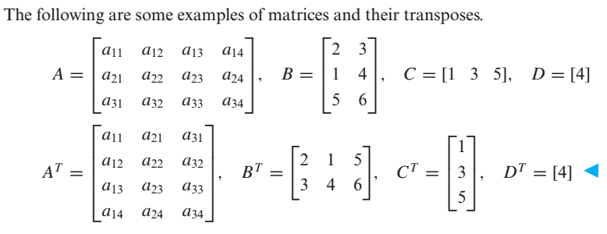
Transpose of a Matrix

Slide 20
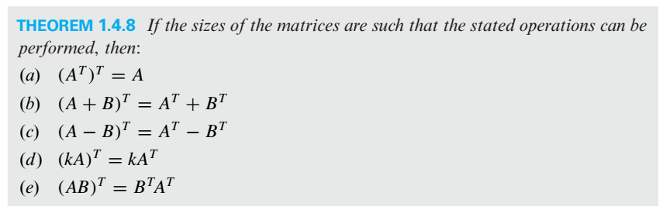
Properties of Transpose

Slide 21
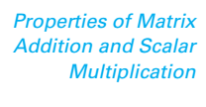
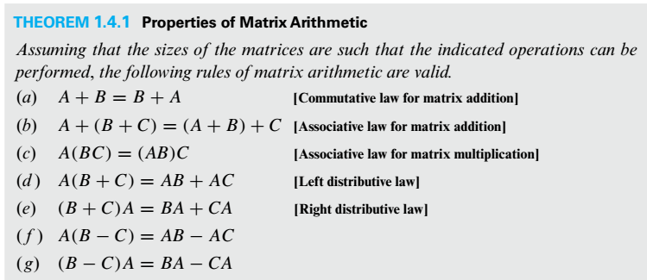

Slide 22
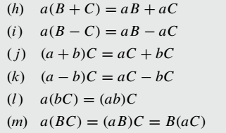

Slide 23
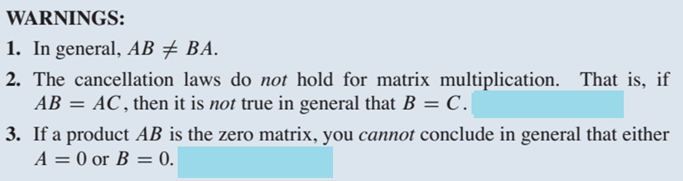
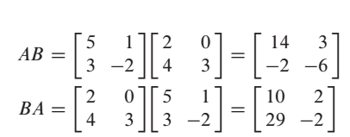


Example on Point 1

Slide 24
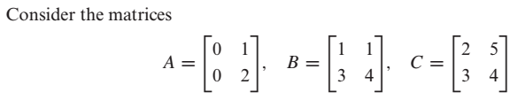

Example on Point 2
Here
But

Slide 25
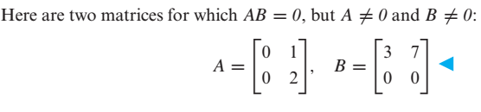
Example on Point 3

Slide 26

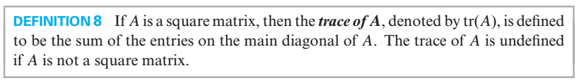
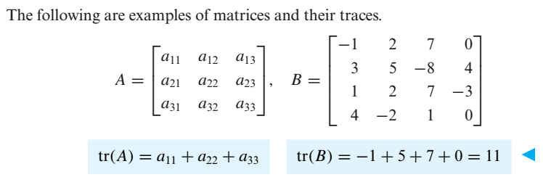

Slide 27
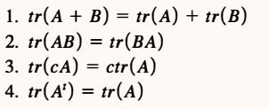

Slide 28

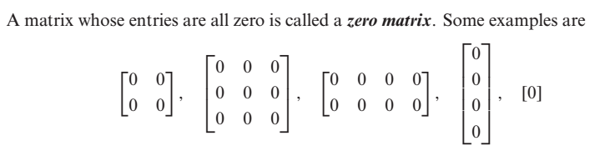

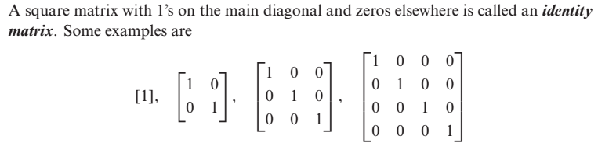

Slide 29

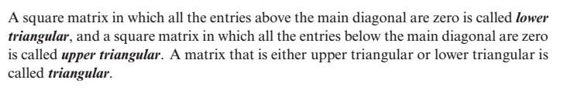
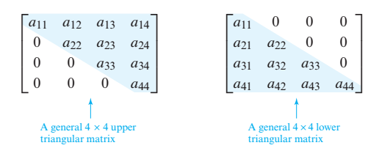

Slide 30


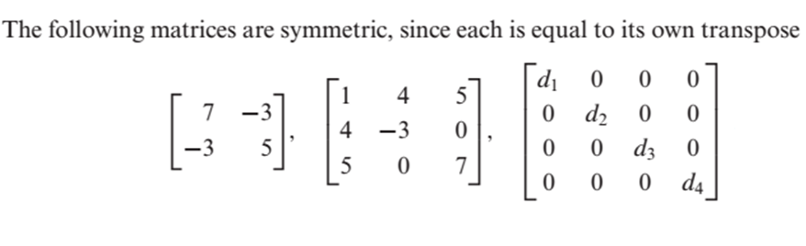

Slide 31
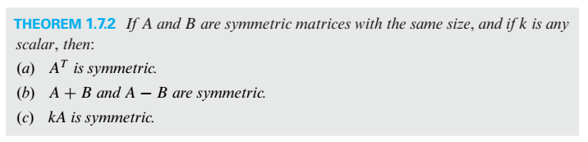

Slide 32




Equivalent Matrices
e.g and the matrix
are equivalent because we can obtain A from identity matrix by multiplying row 2 by -3
Elementary Matrix

Slide 33
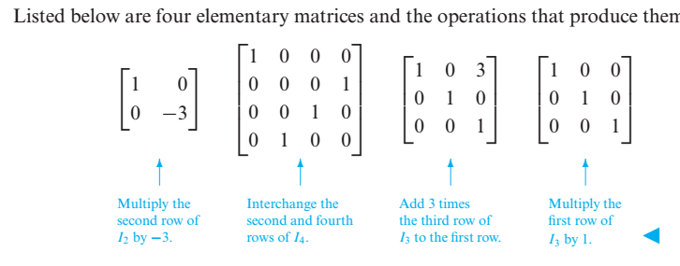

Slide 34


Determinants
For 2×2 Matrices the formula is
Let’s talk about minor and cofactor of an element with the help of which we will calculate determinants of higher order matrices.

Slide 35
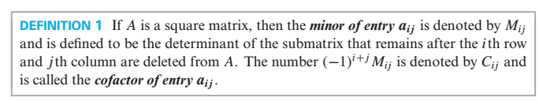
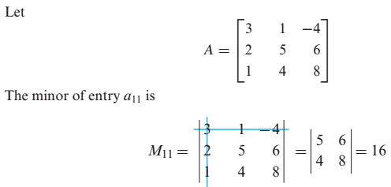


Minor & Cofactor of an element (In a Square Matrix)

Slide 36
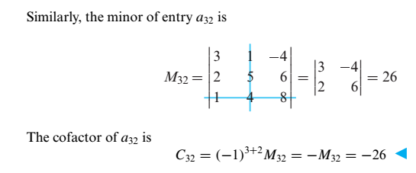

Slide 37

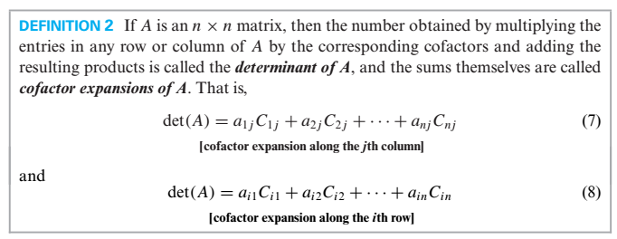

Slide 38
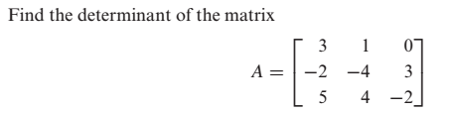

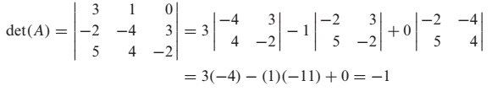
Problem
By cofactor expansion along the first Row

Slide 39
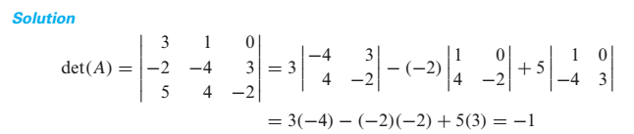
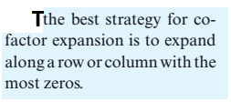
By cofactor expansion along the first coulmn

Slide 40
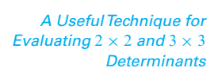


Slide 41

e. g

Slide 42



Slide 43



Slide 44



Slide 45




Slide 46




Slide 47



Slide 48



Slide 49




Slide 50



Slide 51



In general

Slide 52

Evaluating Determinants by Row Reduction

Slide 53




Slide 54




Slide 55



Slide 56



Slide 57





Slide 58



Slide 59


Slide 60




Inverse of a 2 2 Matrix

Slide 61


Slide 62





Problem
Find the inverse of the matrix
Sol
Another method for finding inverse of a matrix is illustrated in the coming slides.

Slide 63



Slide 64


Slide 65



Slide 66


Slide 67


Note

Slide 68



Slide 69





Slide 70


Slide 71





Slide 72

General Form of a Diagonal Matrix

Slide 73


Inverse of a Diagonal Matrix
Power of a Diagonal Matrix

Slide 74


Slide 75


A matrix is said to be in Echelon form if it has the following properties
Every nonzero row precedes every zero row.
In each successive nonzero row, the number of zeros before the leading entry of a row
increases row by row.

Slide 76





Slide 77


Rank of a Matrix
The number of nonzero rows in the echelon form of a matrix is called rank of the matrix.

Slide 78






Linear System
is a solution of

Slide 79


In matrix form, we can write ( ) as
where,
A is called the

Slide 80


Slide 81




Slide 82


Slide 83
Important Points about Linear Systems
There are a lot of methods for solving linear systems, some methods work in special cases while some works for every type of linear system.
If in a linear system the number of equations is equal to the number of unknowns ( i.e. if the coefficient matrix is a square matrix i.e. if m = n ) then from determinant we can comment about the number of solution(s).
Any linear system in which , and , has a unique solution. We can obtain this
unique solution by any of the following methods:
(i) Matrix Inversion Method (ii) Cramer's Rule
(iii) Gauss Elimination (iv) Gauss-Jordan Elimination
Furthermore, if the system is homogeneous then this unique solution is the trivial solution
(zero solution).

Slide 84
A homogeneous system has always a zero solution called trivial solution. Thus a homogeneous system is always consistent.
A homogeneous linear system in which , and , has infinite solutions ( i.e.
nontrivial solutions also exist).
5. In case of nonhomogeneous linear system in which and , there is possibility
that the system has
(i) No Solution (ii) Infinite Solutions
6. If in a linear system the number of equations is not equal to the number of unknowns ( i.e. if
the coefficient matrix is not a square matrix i.e. if m n ) then we can comment about the
number of solution(s) by looking into the rank of coefficient matrix, rank of augmented
matrix and number of unknowns in the system. In this case we can find the solution(s) (if
exist) by either Gauss Elimination or by Gauss-Jordan Elimination.

Slide 85


Slide 86

(Because for homogeneous linear system Rank of the coefficient matrix is always equal to Rank of the augmented Matrix and if number of equations is less than unknowns this mean that common rank < n, so by third part of fundamental theorem, system will have infinite solutions.

Slide 87


Methods for solving a linear System
(or Gauss Elimination)

Slide 88


Problem

Slide 89





Slide 90





Slide 91





Slide 92



Slide 93




Slide 94




Slide 95



Slide 96


Slide 97


Slide 98


Problem

Slide 99


If we reduced the augmented matrix to reduce echelon form we have

Slide 100


Slide 101


Slide 102


Problem

Slide 103



e.g.

Slide 104





