Slide 1
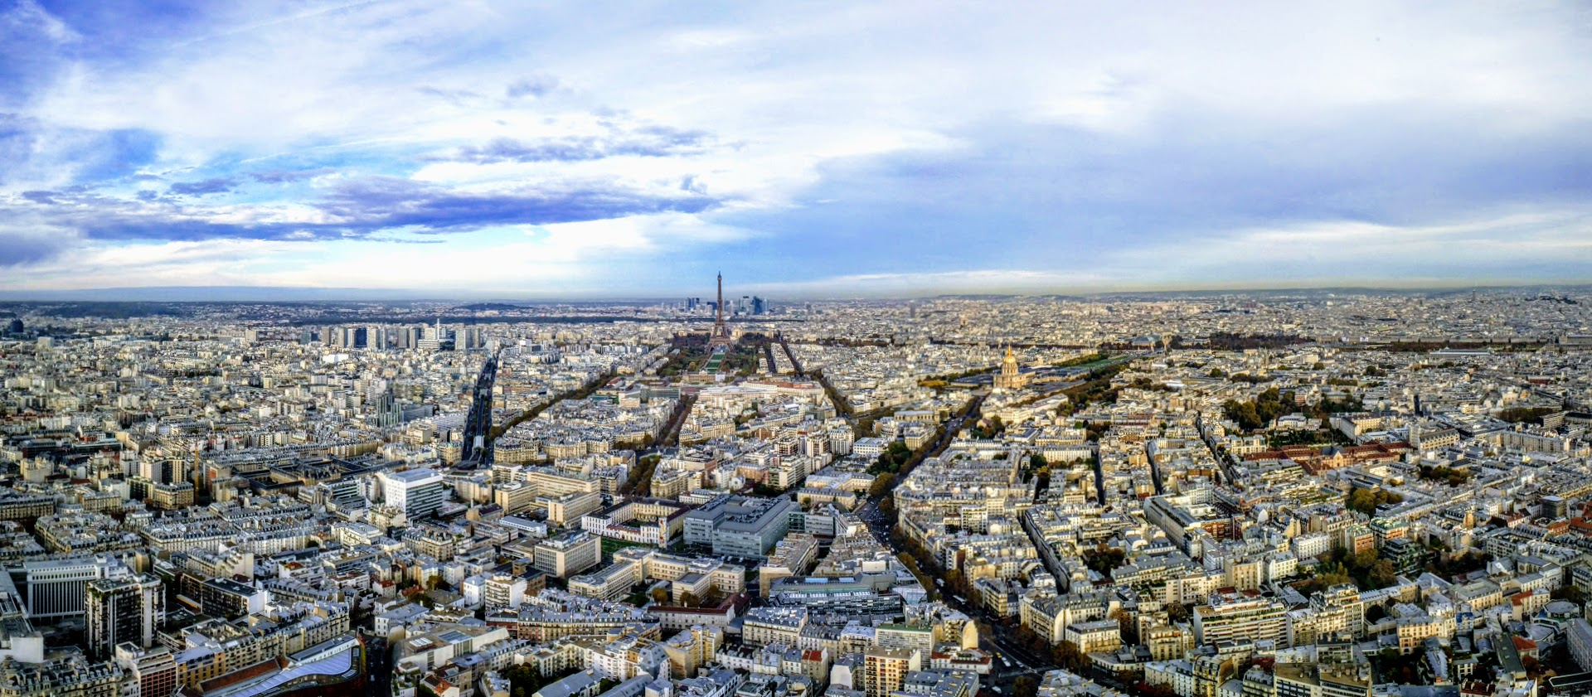
A day trip in Paris with a few must-sees
In what order should I visit the sites (to avoid large crowds)?
What interesting events are nearby?

Slide 2
Mock-up
1) Select classic attractions
2) Select interests in events
3) Additional filters
( ) Eiffel tower
( ) Arc de triomphe
( ) Louvre
( ) Jardin de Tuileries
( ) Le Marais
( ) Sacre-coeur
( ) Musee d’Orsay
( ) Musee d’Orangerie
...
( ) dance
( ) workshops
( ) classical
( ) jazz
( ) hip-hop
( ) guided tours
( ) fine art
( ) sports
( ) contemporary art
( ) free admission
( ) no reservation
let the algorithm
figure out based on
selections in 1)
extracted from lists of
popular destinations

Slide 3
Data
MVP
Que faire a Paris (list of upcoming events) → .json
TripAdvisor (attractions, descriptions, locations) → beautifulsoup
Popular times
Google Maps hours, and popular time → api
Transit suggestions
RATP station locations (locations of metro stations) → .json
Metro air quality prediction
Metro air quality data (for forecast) → .json (8 years, 50k+ entries, 3 locations)
(This may be its own project, considering constructions, weather, passengers, etc.)

