Slide 1
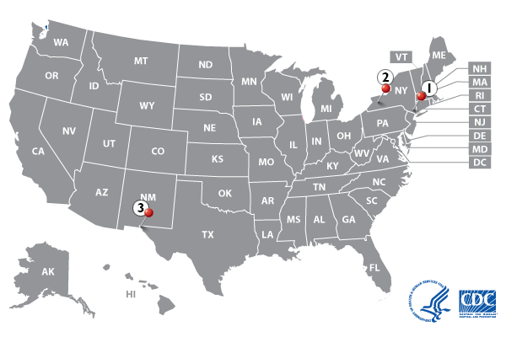
Problem
Measles is extremely contagious and can be very serious
(110,000 deaths in 2017). Most outbreaks are linked to international travels.
People in what areas are subject to higher risks but may not be aware?
End users: government, hospitals, schools, general public

Slide 2
Mock-up
Location in the US
An interactive map with risk index
Risk index =
Passenger traffic from epidemic places
/ general public awareness

Slide 3
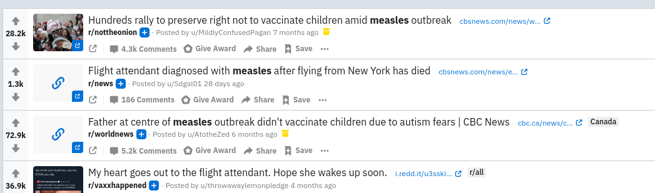
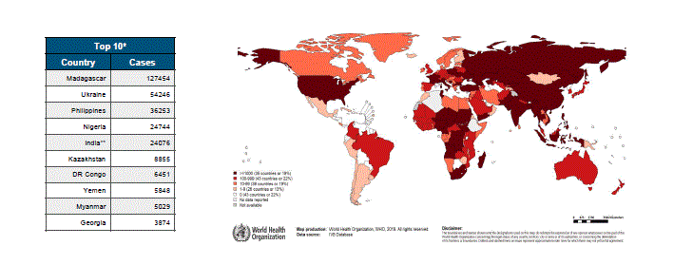
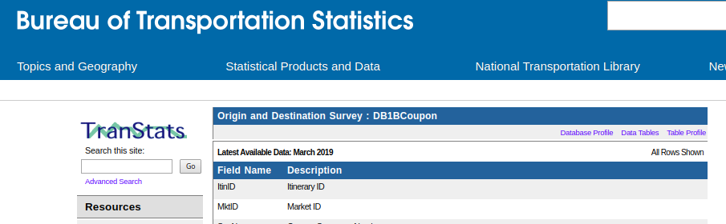
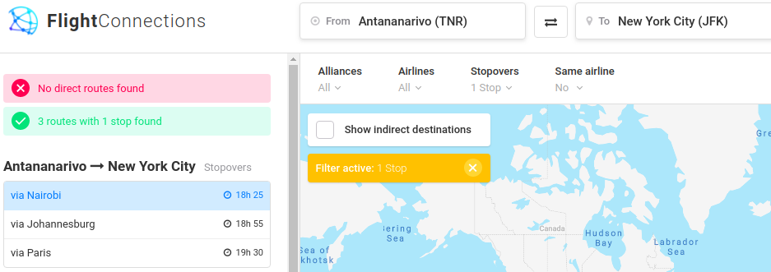
Data graph/visualization
Twitter/reddit posts + passenger itinerary + epidemic map + airline routes

Slide 4
Algorithm
Transmission
Input a city (destination)
Search through (direct/connecting) incoming airline traffic
Weight each origin by 1) level of epidemic 2) number of transfers
Awareness
Extract tweets and locations
Normalize by population
Calculate awareness index

Slide 5
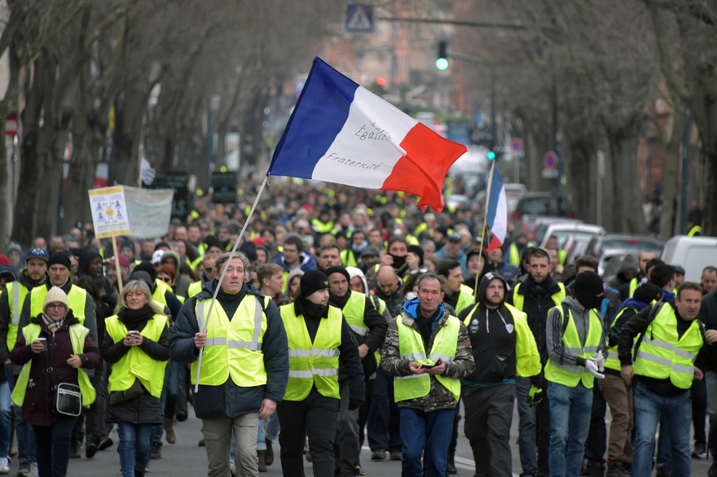
Problem
Paris is infamous for transportation disruptions due to strikes/protests. What is the likelihood of those for a means of transportation in a certain time?
Users: tourists / local authorities

Slide 6
Mock-up
Times of the year (date)
Means of transportation
XX % chance of strikes at YYY locations

Slide 7
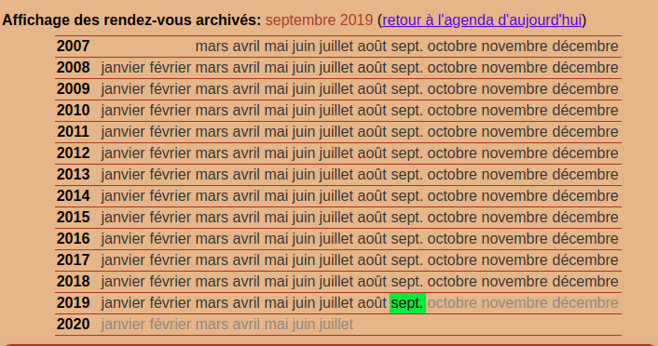
Data graph/visualization
Strike/protest history
+ Twitters of Paris airport and transport operators (disruptions due to strikes)
+ NOAA (weather)
+ election schedules (politics)
+ news (major events)
+ calendar (holidays), etc.

Slide 8
Algorithm
Input
Output

