Slide 1
Hadoop+Spark Geospatial Calculation
Group 2
Audrey Wong | Lei Chen | Yihan Lu
Boxin Du | Rongyu Lin

Slide 2
Geometry Functions
Geometry Union (Lei)
Geometry Convex Hull (Audrey)
Geometry Farthest Pair (Yihan)
Geometry Closest Pair (Boxin)
Spatial Range Query (Rongyu)
Spatial Join Query (Rongyu)
Spatial Aggregation Application (Lei)

Slide 3
Hardware Setup
Laptop1 (Windows)
VM1(Ubuntu)
HDFS Namenode / HDFS Datanode / Spark Master
Wireless LAN
Laptop3 (Windows)
VM3(Ubuntu)
HDFS Datanode / Spark Worker2
Laptop2 (Windows)
VM4(Ubuntu)
Spark Worker4
VM2(Ubuntu)
HDFS Datanode / Spark Worker2
VM5(Ubuntu)
Spark Worker5

Slide 4
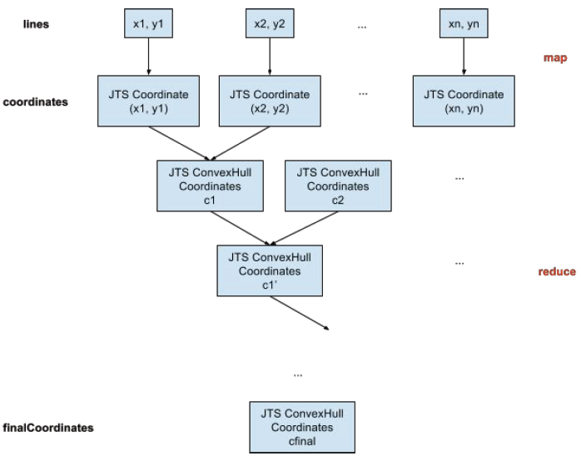
Geometry Convex Hull
Data flow

Slide 5
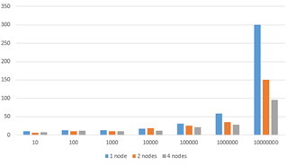
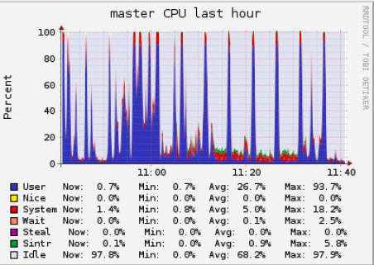
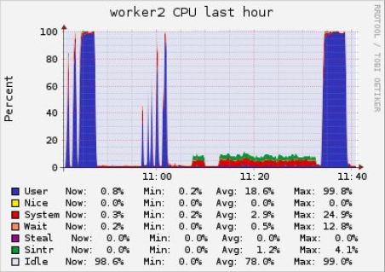
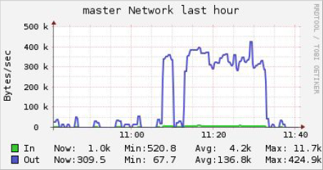
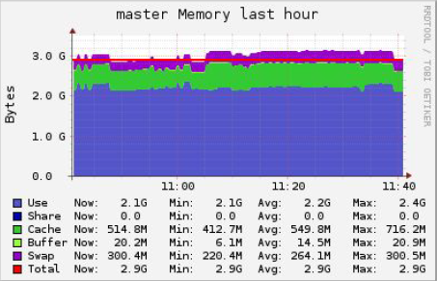
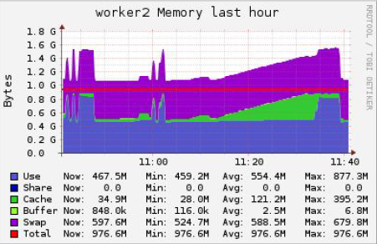
Geometry Convex Hull
Metrics

Slide 6
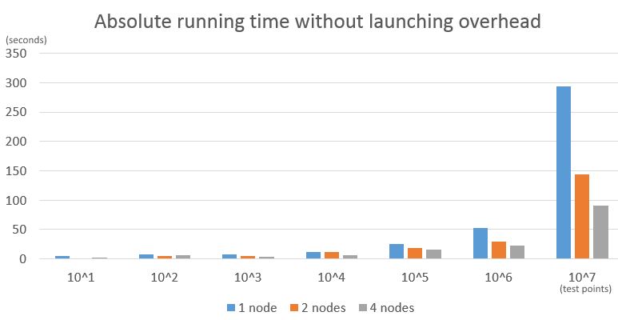
Geometry Convex Hull
Scalability: Scale-out.

Slide 7
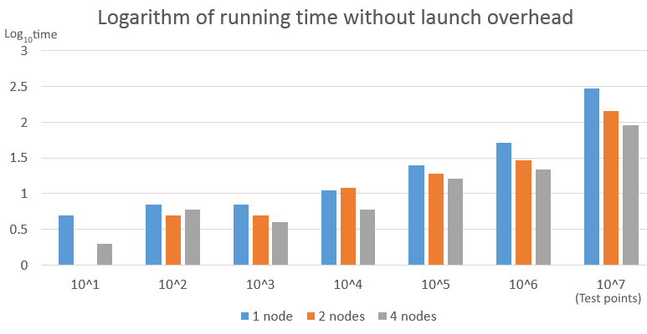
Geometry Convex Hull
Scalability: Increasing test data size.

Slide 8
Conslusion
The functions were implemented with good scalability.
One observation was that when we increased the number of worker nodes from 2 to 4, the running time of functions SpatialJoin and SpatialAggregation increased rather than decreased (E.g. SpatialAggregation went from 258 sec to 348 sec on test data of size 10^5). We checked the network metrics and inferred that the reason might be a significant raise of across nodes communication overhead.
Future work includes applying the spatial range dividing technique to other functions besides SpatialAggregation. Also we may implement and test different dividing strategies.

