Slide 1


Sightseeing Weekend
SwedenC++, 26 September 2019
github.com/aexg
www.linkedin.com/in/alexandre-gordeev

Slide 2
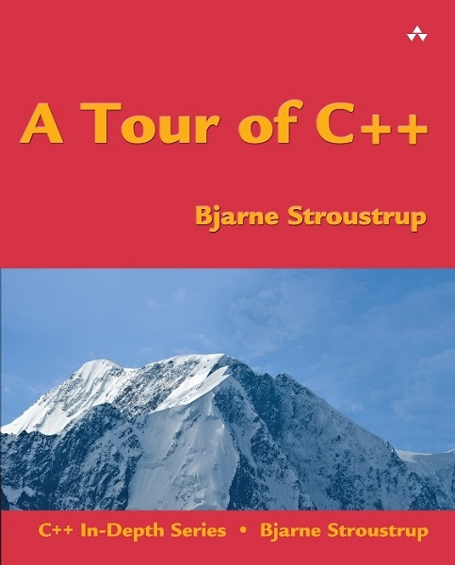

Slide 3
Who shall read it?
"Aimed at people who can program, but might have a 1990s view of C++" (www.stroustrup.com)
Experts in other languages looking to improve run-time performance
C++ amateurs

Slide 4
Key Takeaway : Templates
Watch: www.youtube.com/watch?v=XV1lXtB3sqg
Read: jguegant.github.io/blogs/tech/meta-crush-saga.html
Play: github.com/Jiwan/meta_crush_saga

