Slide 1
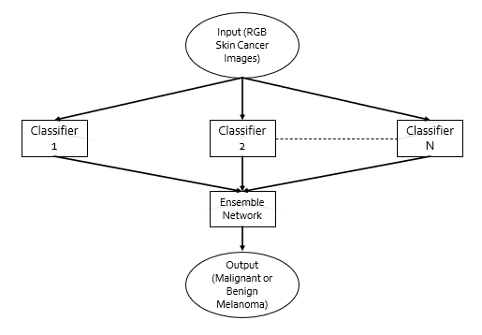
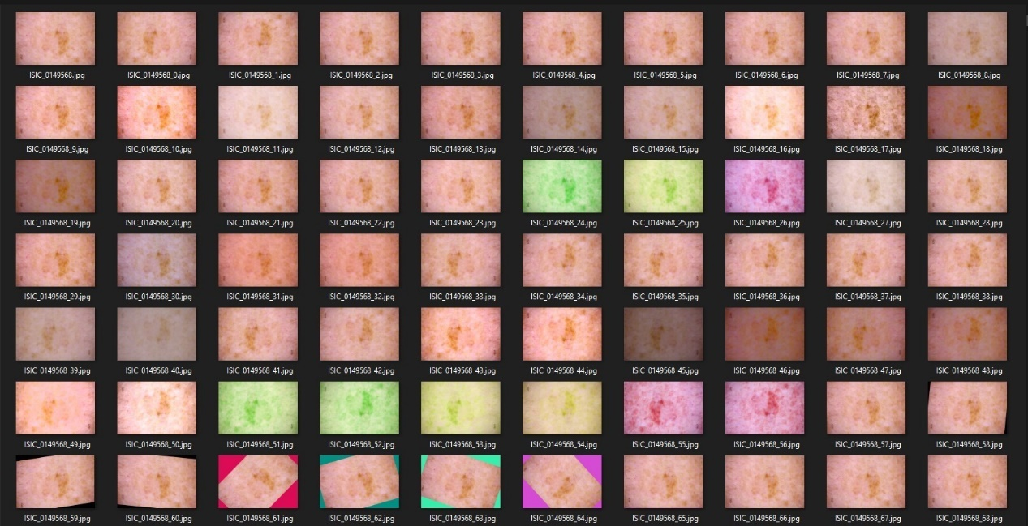

Melanoma Skin Cancer Diagnosis Using Machine Learning
Dr. Shahzad Ali Malik, Professor, ECE Department, CU Islamabad
Abstract
Skin cancer is the most dangerous form of cancers. One of the most common form of skin cancer is Melanoma. Early detection of Melanoma skin cancer is necessary for the patient because it can directly lead to the death of a person. If this cancer is detected in an early stage, then it can be cured easily. Image classification using machine learning is an effective technique to detect Melanoma using the images of lesions, it can help medical diagnostic centers in early detection of Melanoma. Machine learning techniques like Artificial neural network (ANN) are used in classification of images.
Our aim is to classify benign and malignant cancer images using multiple neural network architectures and then use an ensemble network to find the best result out of them all.
Process Flow Diagram
Why Python?
Python has syntax that allows developers to write programs with fewer lines than some other programming languages
Python can be approached in three ways: procedural, object-oriented, and functional
Python bears some resemblance to the English language, with a mathematical impact
In contrast to other programming languages, Python employs new lines to complete commands, rather than semicolons or parentheses
Aims and Scope
To distinguish between benign and malignant melanoma skin cancer.
To implement and test different neural network architectures for best results.
To be able to detect within reasonable degree of accuracy.
To try to improve on the accuracy of our model.
Advantage of Neural network
1. Store information on the entire network
Ability to work with inadequate data
Good fault tolerance
Distributed memory
Gradual corruption
Ability to train machine
Ability of parallel processing
Augmentation
Submitted by:
M. Yahya Khan FA17-ECE-027
Qasim Ashraf `FA17-ECE-032
.
Department of Electrical and Computer Engineering.
COMSATS University, Islamabad.

