Slide 1
Agentic RAG Chatbot using MCP
Multi-format Document QA with Local LLMs and Structured Agent Communication

Slide 2
Agentic Architecture with MCP
• IngestionAgent: Parses PDF, DOCX, PPTX, CSV, TXT files
• RetrievalAgent: Embeds chunks using sentence-transformers + FAISS
• LLMResponseAgent: Generates answers using HuggingFace GPT2
• Communication: Structured via Model Context Protocol (MCP)

Slide 3
System Flow
1. User uploads documents via Streamlit UI
2. IngestionAgent parses content → sends to RetrievalAgent
3. RetrievalAgent embeds + retrieves top chunks
4. LLMResponseAgent receives context via MCP → generates response
5. UI displays final answer + history

Slide 4
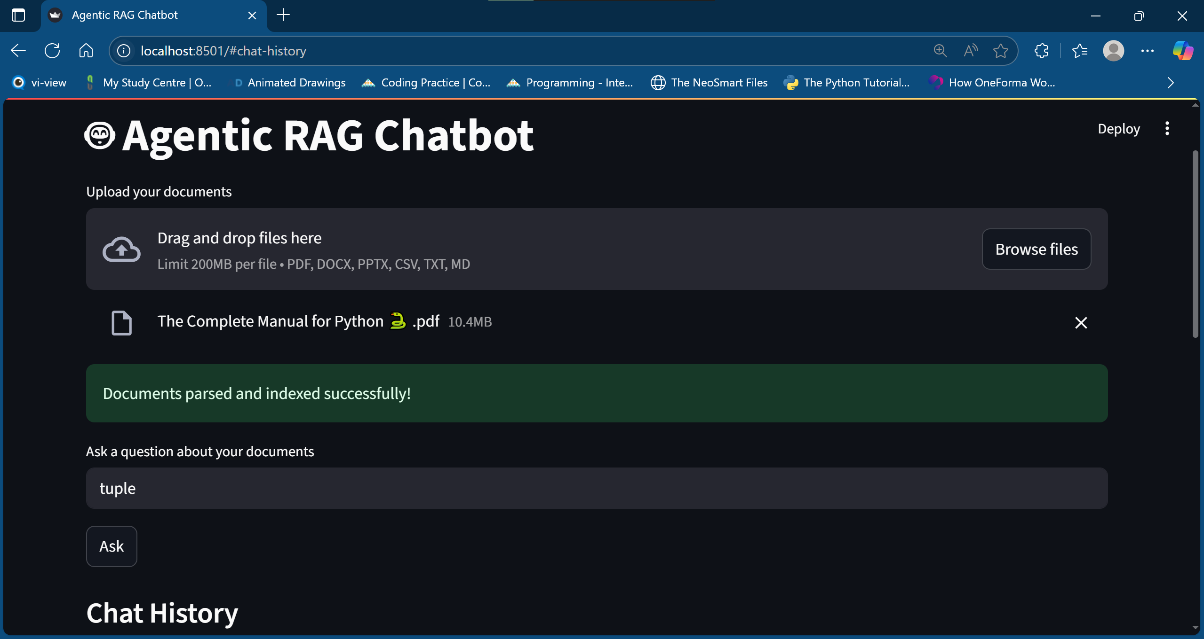
USER INTERFACE OVERVIEW

Slide 5
Tech Stack
• UI: Streamlit
• Embeddings: sentence-transformers (MiniLM)
• Vector Store: FAISS
• LLM: HuggingFace distilgpt2
• File Parsing: pdfminer, docx, pptx, pandas
• Messaging Protocol: Custom JSON (MCP)

Slide 6
Challenges & Future Scope
Challenges:
• Parsing large and noisy document formats
• Keeping LLM responses relevant with light models
Future Scope:
• Add face login or PDF summarizer agent
• Integrate OpenAI/Mistral for higher-quality answers
• Improve UI with source highlighting and chat memory

