Slide 1
Databases and
SQL

Slide 2
Introduction to Databases
A database is an organized collection of structured information or data stored electronically. It allows easy access, management, and updating of data.
Database Type | Data Model | Typical Use | Example Systems
Relational | Tables with rows and columns (structured data) | Applications with structured, related data and strong consistency (e.g., accounting systems) | MySQL, PostgreSQL, SQLite, Oracle
NoSQL | Flexible, non-tabular (documents, key-value) | Handling unstructured or semi-structured data; scalability and speed | MongoDB (document), Redis (key-value)
In-Memory | Stores data primarily in RAM for ultra-fast access | Caching, session storage, real-time analytics | Redis

Slide 3
Relational Databases (RDBMS)
Relational Databases store data in tables (relations) with rows and columns.
Each table has a primary key (unique) and can relate to other tables through foreign keys.
Examples: MySQL, PostgreSQL, SQLite, Oracle, SQL Server.

Slide 4
Key Concepts in RDBMS
- Table: Collection of rows and columns. Each entity become a table.
- Row: A single record (data) in a table.
- Column: An attribute of data.
- Primary Key: Uniquely identifies a record.
- Foreign Key: Connects tables together.
- SQL: Structured Query Language used to manage data.

Slide 5
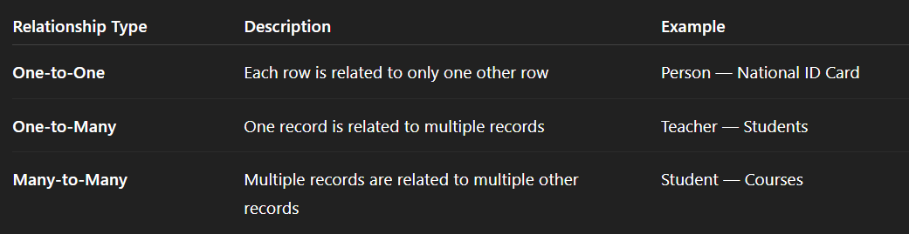
Types of Relations

Slide 6
Introduction to SQL
SQL (Structured Query Language) is the standard language for managing relational databases.
Main uses:
- Creating databases and tables
- Inserting, Updating, and Deleting records
- Querying data (Read)
- Managing permissions and transactions
CRUD stands for the four basic actions you can do with data in a database.

Slide 7
SQL Categories
1. DDL (Data Definition Language): CREATE, ALTER, DROP
2. DML (Data Manipulation Language): INSERT, UPDATE, DELETE
3. DQL (Data Query Language): SELECT
4. DCL (Data Control Language): GRANT, REVOKE
5. TCL (Transaction Control Language): COMMIT, ROLLBACK

Slide 8
Data Types in SQL
SQL supports various data types grouped into categories:
- Numeric: INTEGER, REAL, DECIMAL
- Character: CHAR, VARCHAR, TEXT
- Date/Time: DATE, TIME, DATETIME
- Boolean: TRUE/FALSE (sometimes as INTEGER)
- Binary: BLOB

Slide 9
Numeric Data Types
INTEGER: Whole numbers (-2B to 2B)
REAL / FLOAT: Decimal numbers (approximation)
DECIMAL(precision, scale): Exact decimal values
Type | Can have decimals? | Exact or Approximate? | Typical Use
INTEGER | No | Exact | IDs, counts
FLOAT / REAL | Yes | Approximate | Measurements
DECIMAL(p,s) | Yes | Exact | Money, precise values

Slide 10
Text Data Types
CHAR(n): Fixed-length text
VARCHAR(n): Variable-length text
TEXT: Long text strings
Type | Fixed or Variable Length? | Maximum Size | Typical Use
CHAR(n) | Fixed-length | Exactly n characters | Short, fixed-size codes (e.g., country codes)
VARCHAR(n) | Variable-length (up to n) | Up to n characters | Regular text with varying length (e.g., names)
TEXT | Variable-length (very large) | Up to database’s text limit (often MBs) | Long text fields (e.g., descriptions, articles)

Slide 11
Date and Time Types
DATE: '2025-11-06'
TIME: '14:30:00'
DATETIME or TIMESTAMP: '2025-11-06 14:30:00'
Type | What It Stores | Example Value | Typical Use
DATE | Only the calendar date (year, month, day) | '2025-11-06' | Birthdays, registration dates, due dates
TIME | Only the time of day (hours, minutes, seconds) | '14:30:00' | Opening hours, event times, durations
DATETIME or TIMESTAMP | Both date and time together | '2025-11-06 14:30:00' | Logging events, order timestamps, created/updated fields

Slide 12
Constraints
Constraints maintain data integrity:
PRIMARY KEY: Unique identifier
FOREIGN KEY: References another table
UNIQUE: Prevents duplicates
NOT NULL: Value must exist
CHECK: Enforces a condition

Slide 13
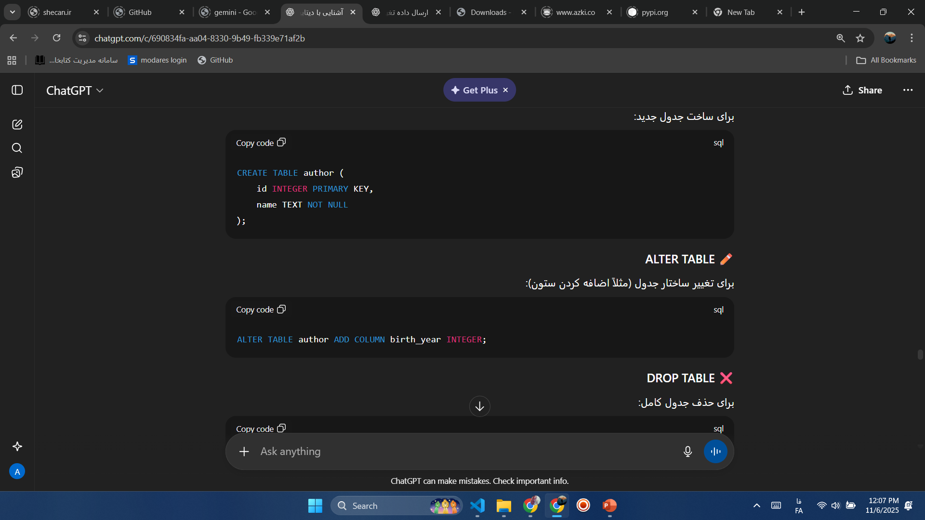
Creating Tables
This defines the structure of a table with columns and their data types.

Slide 14

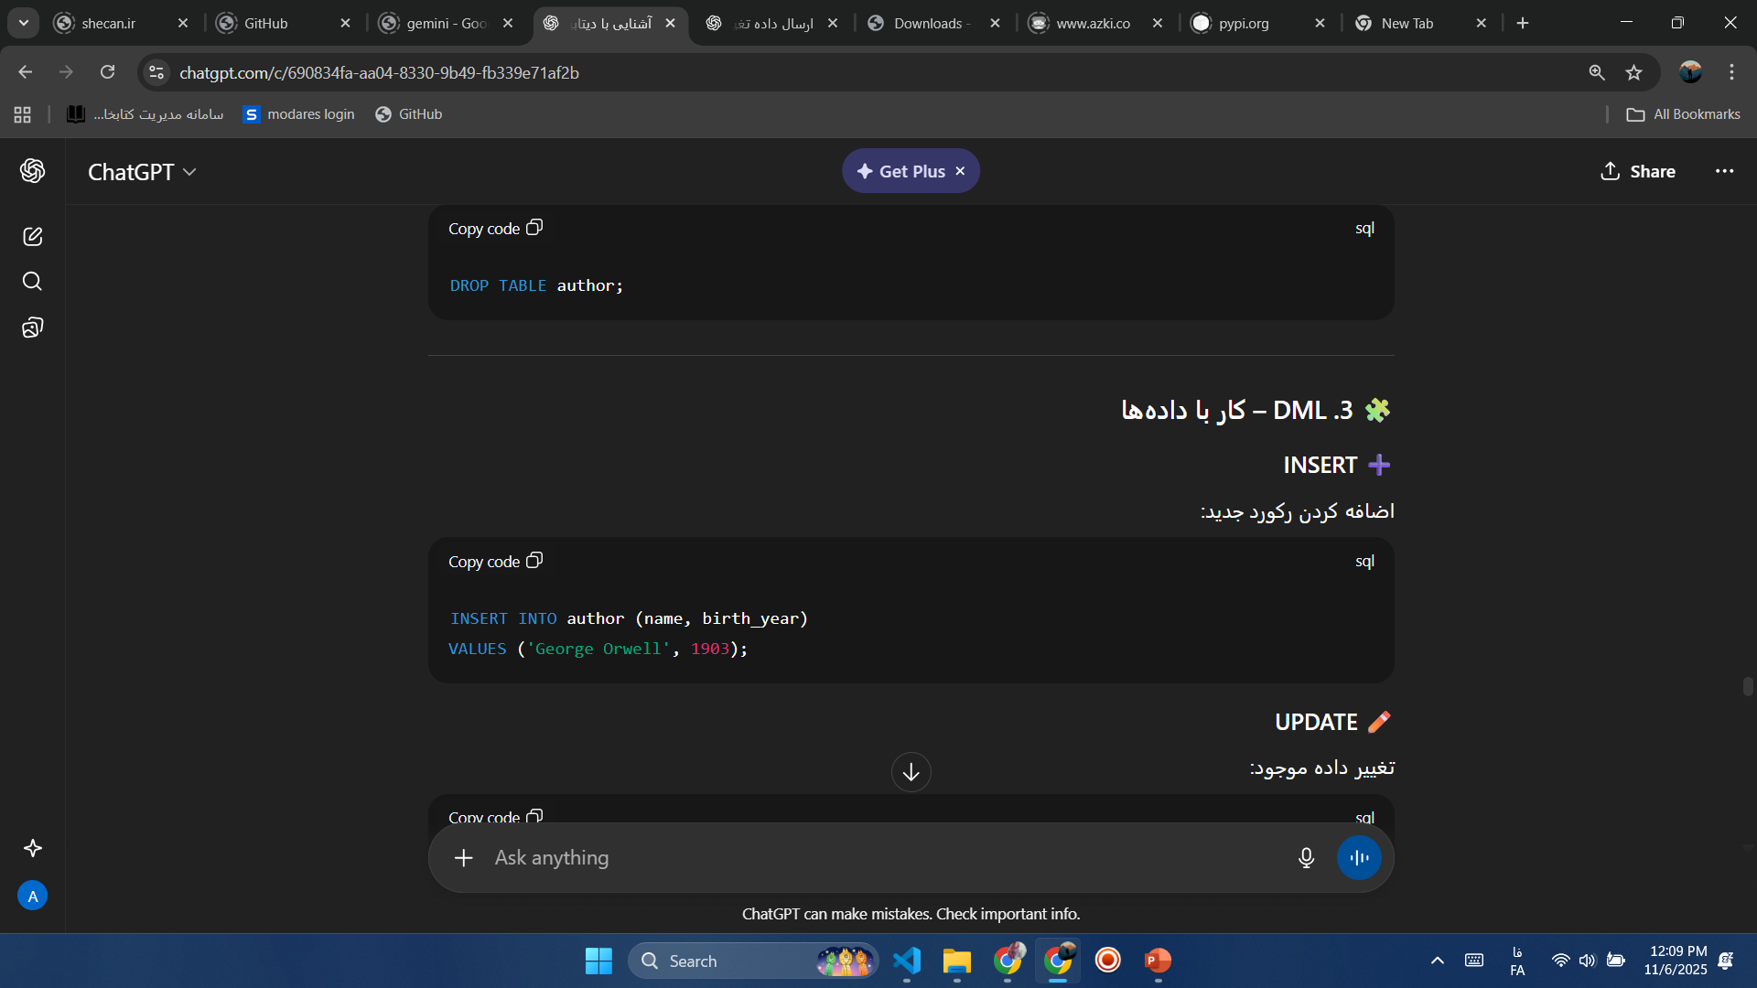
Altering and Dropping Tables

Slide 15
Inserting Data

Slide 16
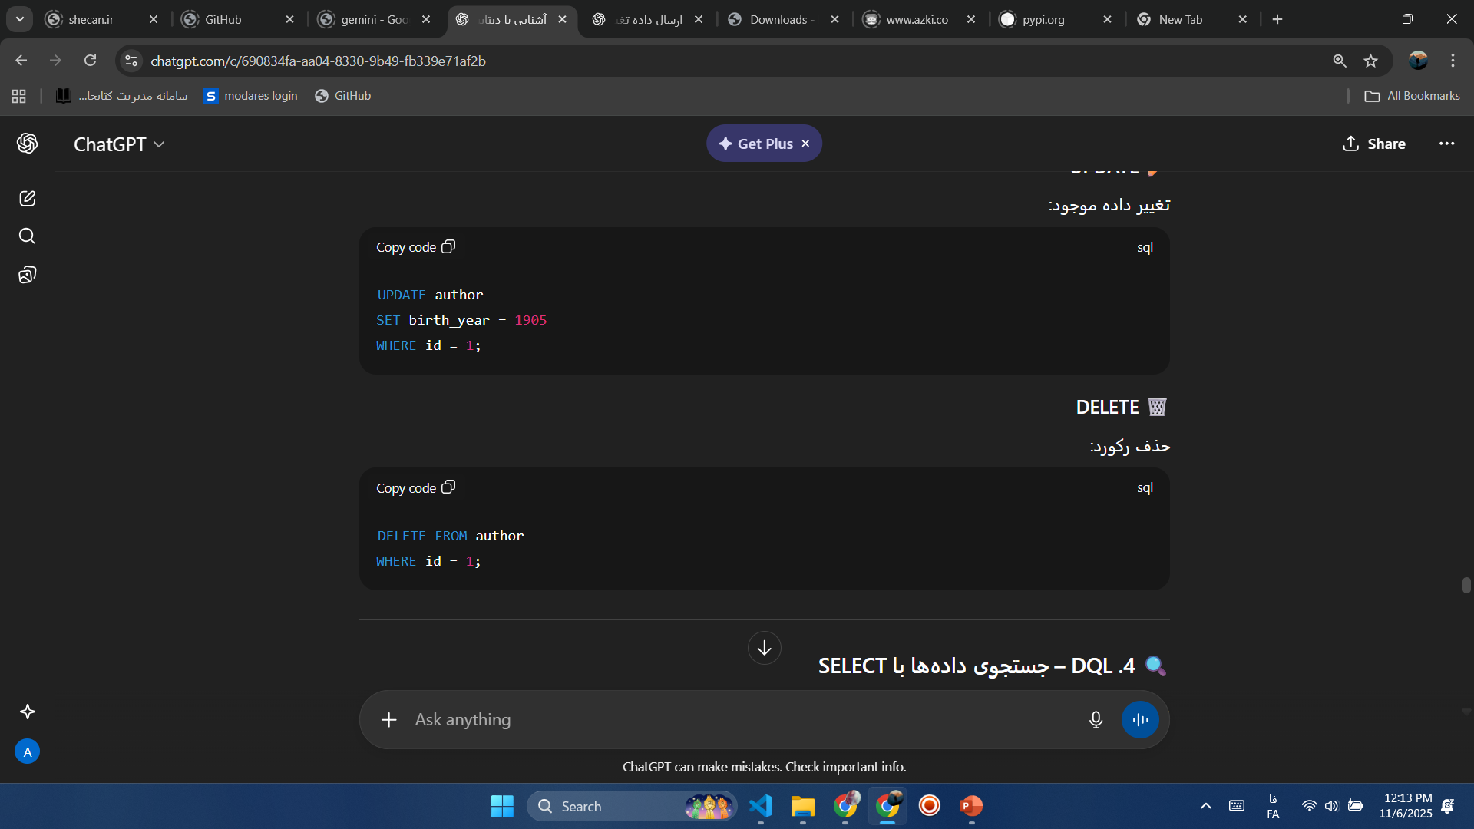
Updating and Deleting Records

Slide 17
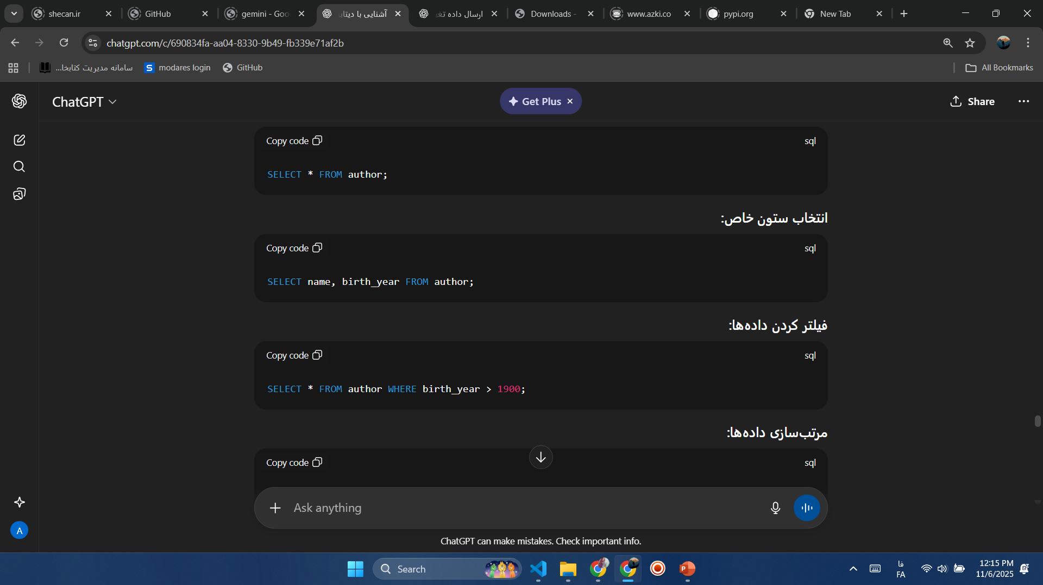
Selecting Data

Slide 18
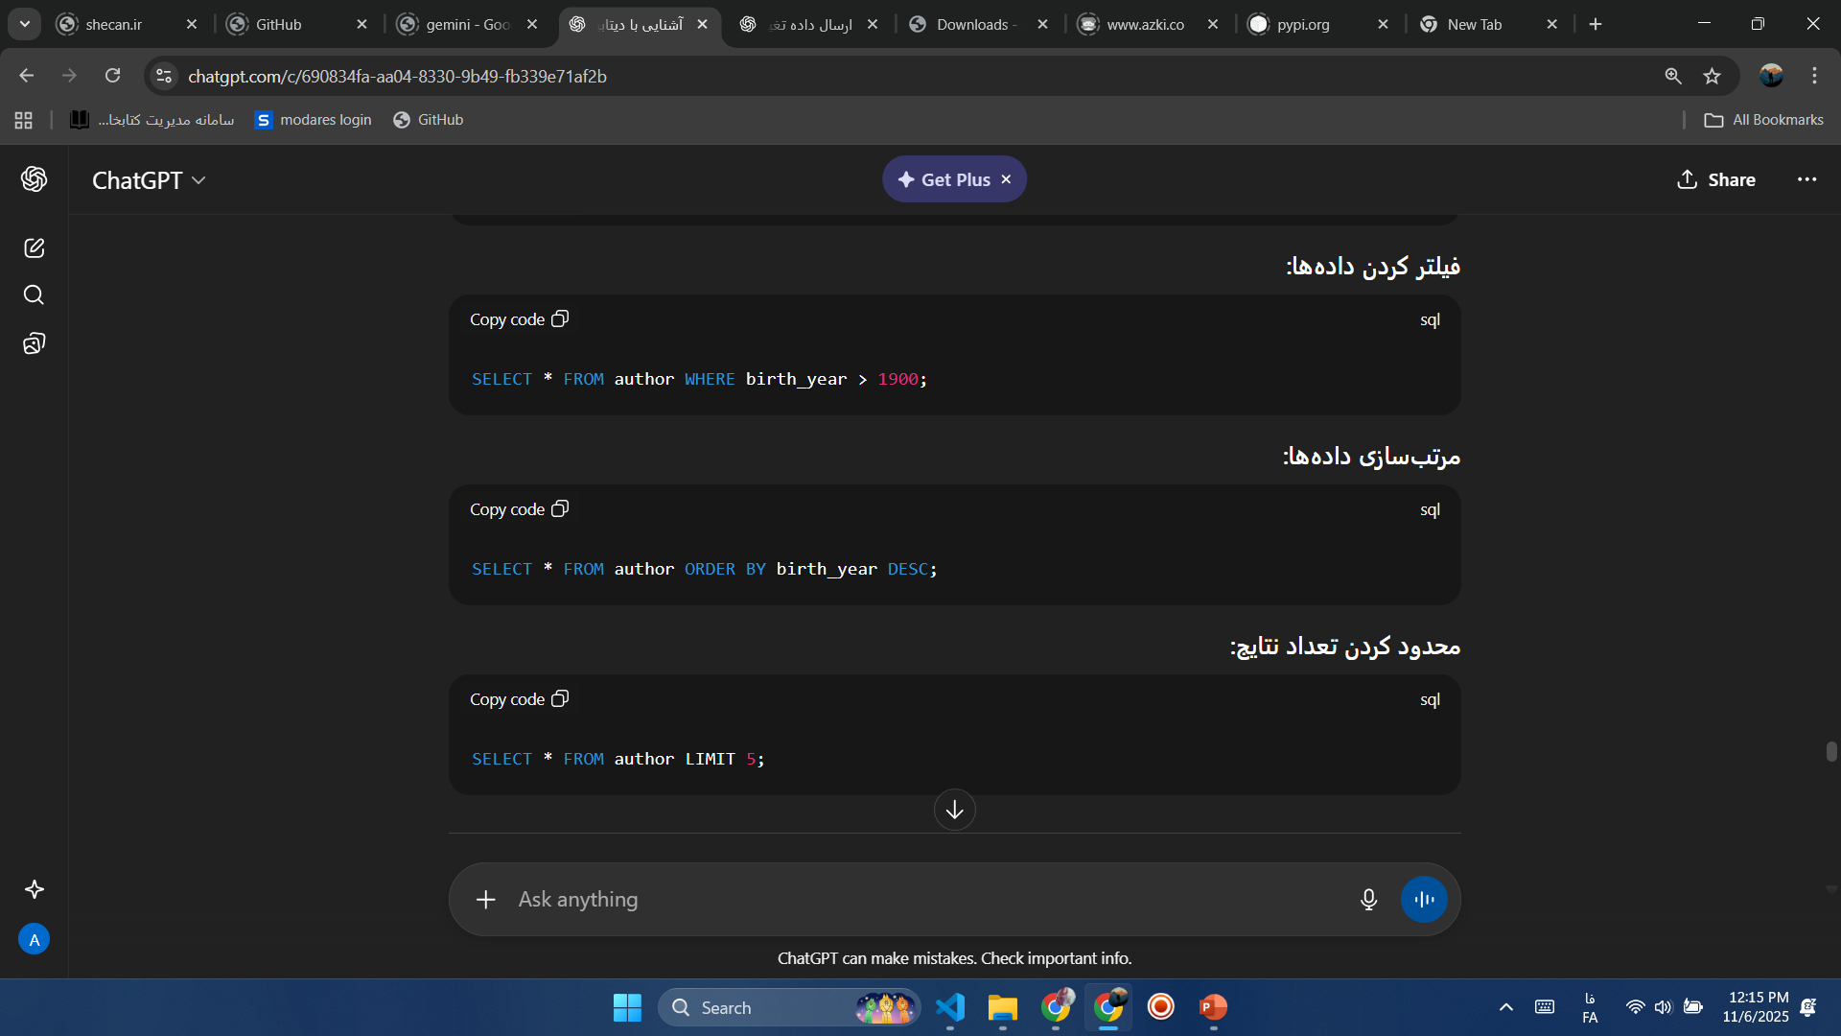
Filtering and Sorting

Slide 19
Types of Relations

Slide 20
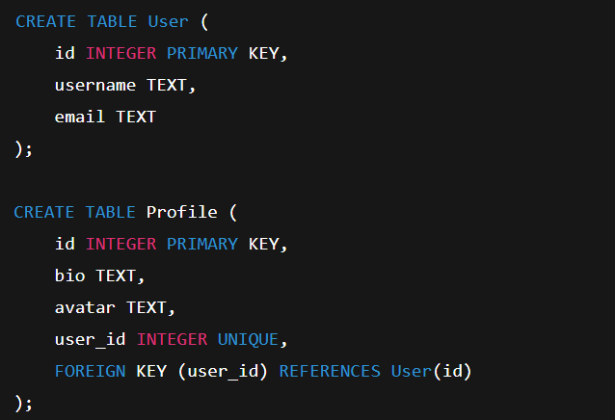
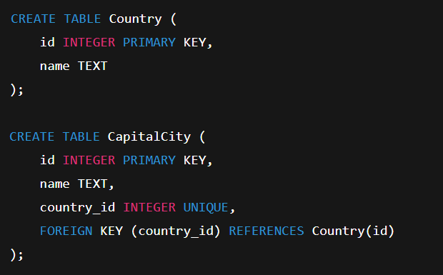
One to One Examples
User and Profile
Country and Capital

Slide 21
One to One Exercise
Create two tables in SQLite to represent a one-to-one relationship between a Person and an ID Card:
Person table:
  id → Person’s unique ID (primary key)
  name → Person’s name
  birthdate → Person’s date of birth
IDCard table:
  id → ID card record ID (primary key)
  card_number → ID card number (unique)
  issue_date → Card issue date
  person_id → ID of the person associated with this card (one-to-one relationship)

Slide 22
One to Many Examples
User and Profile
Country and Capital

Slide 23
One to Many Exercise
Create two tables in SQLite to represent a one-to-one relationship between a Person and an ID Card:
Person table:
  id → Person’s unique ID (primary key)
  name → Person’s name
  birthdate → Person’s date of birth
IDCard table:
  id → ID card record ID (primary key)
  card_number → ID card number (unique)
  issue_date → Card issue date
  person_id → ID of the person associated with this card (one-to-one relationship)

Slide 24
Many to Many Examples
User and Profile
Country and Capital

Slide 25
Many to Many Exercise
Create two tables in SQLite to represent a one-to-one relationship between a Person and an ID Card:
Person table:
  id → Person’s unique ID (primary key)
  name → Person’s name
  birthdate → Person’s date of birth
IDCard table:
  id → ID card record ID (primary key)
  card_number → ID card number (unique)
  issue_date → Card issue date
  person_id → ID of the person associated with this card (one-to-one relationship)

