Slide 1
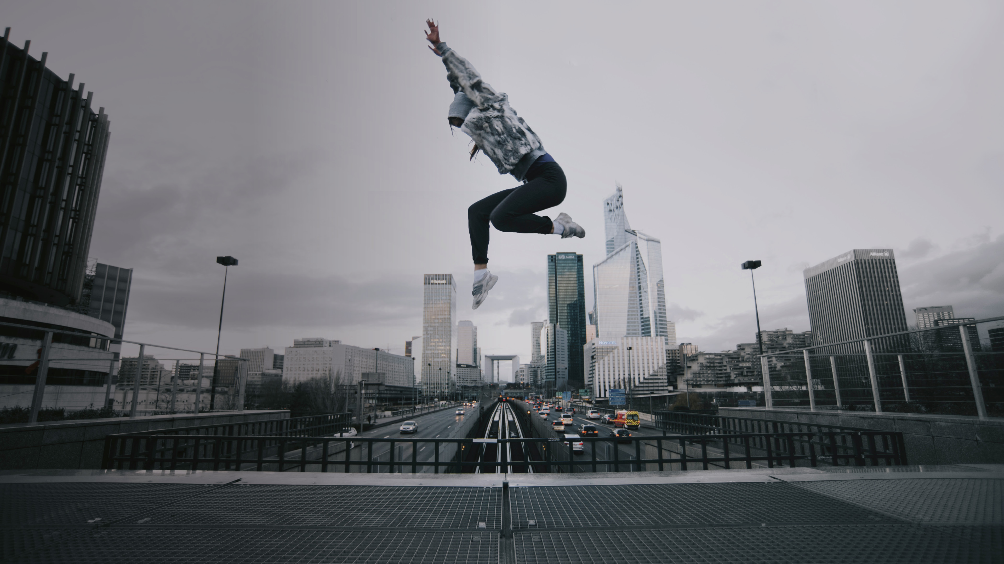
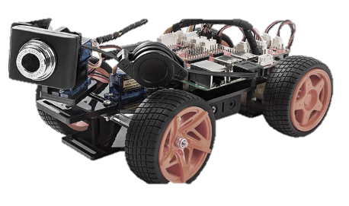
Pi car project for people

Slide 2
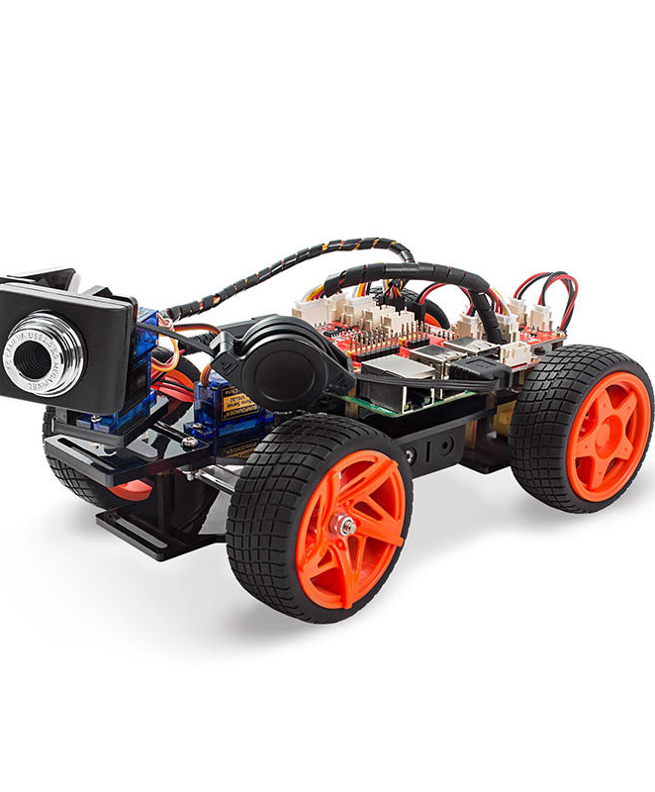
A project to learn
Some people concluded with the idea to do something with a raspberry-pi-equipped car
Abdullah
Przemyslaw
Gyokan
Mithilesh
Horace
Car has a camera, servos for the front wheels and camera, and motors to drive the rear wheels
We are trying to make a lane following algorithm. If you have any other ideas for the car or if you want to join the club, let us know!

Slide 3
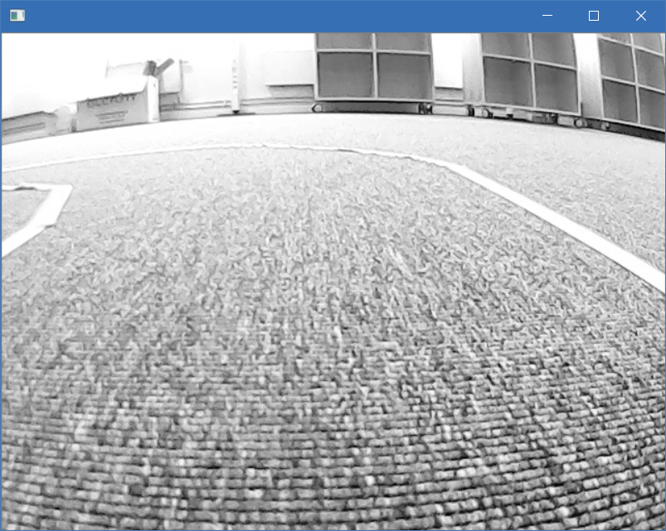
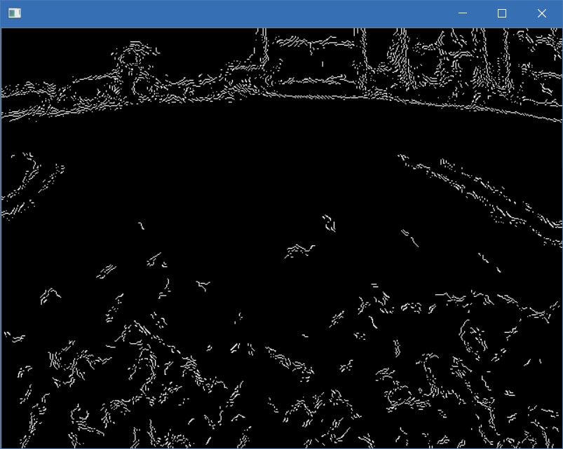
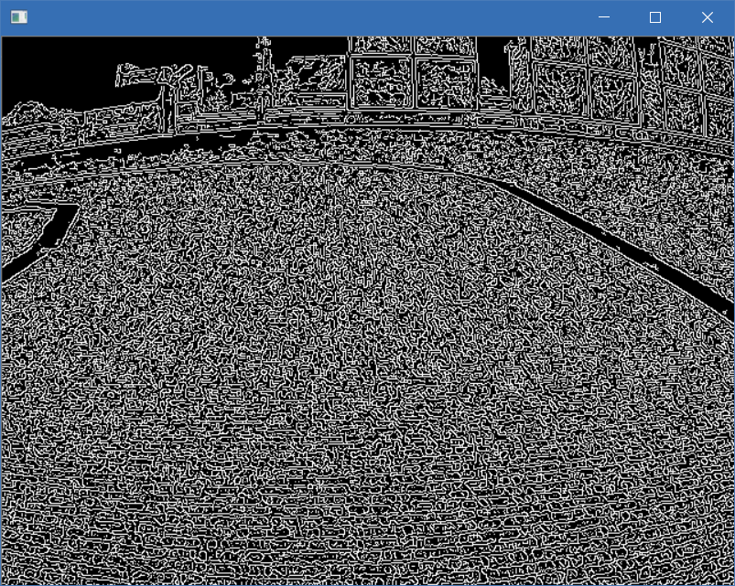

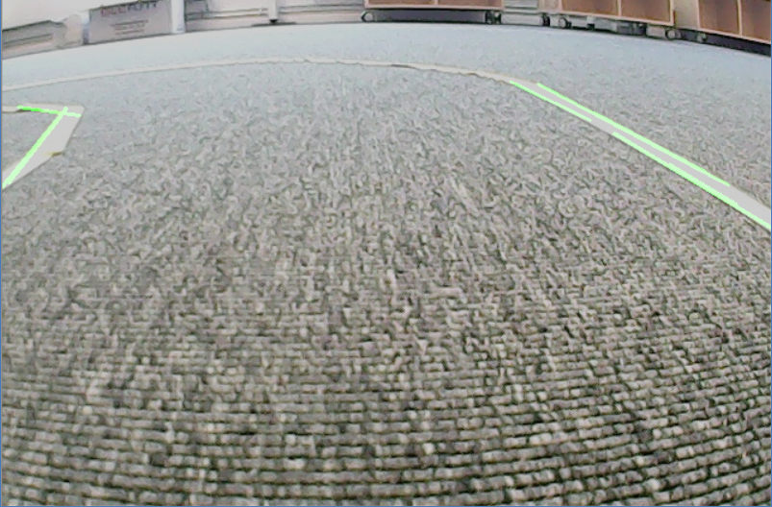
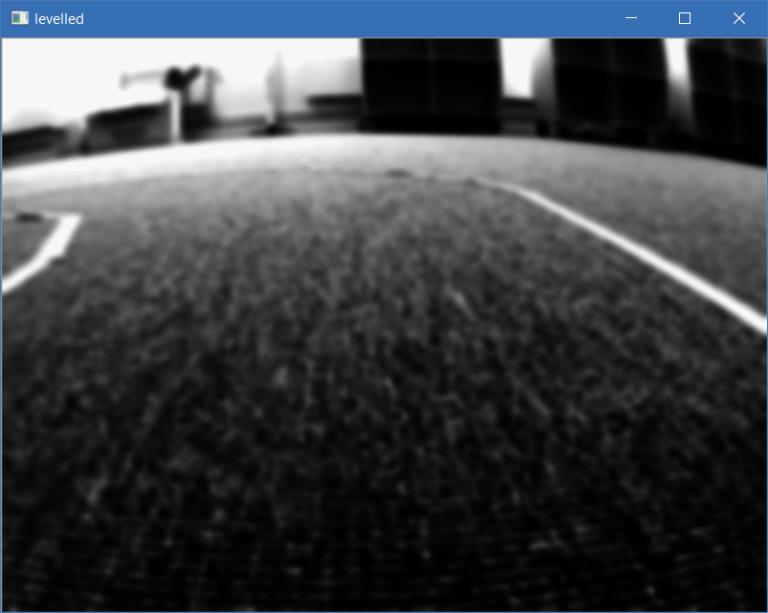
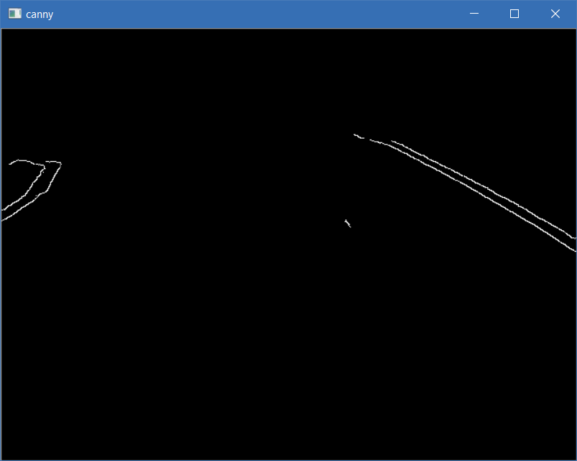
We did some lane recognition
Tried different combinations of blurring, mapping the lights and darks of the images, and played with thresholds for edge detection
Fitted straight lines onto the edges

