Slide 1





MNIST
DIGIT RECOGNITION
R. Arif Firdaus Lazuardi
Lazuardi.dp@gmail.com
github.com/ af-lazuardi
Kadek Suar Wibawa
suarwibawa@gmail.com
github.com/ kadek-suar
I Komang Tryana Mertayasa
tryanamertayasa@gmail.com
github.com/ tryanamertayasa
REPOSITORY:
github.com/af-lazuardi/bangkit-assignment5

Slide 2
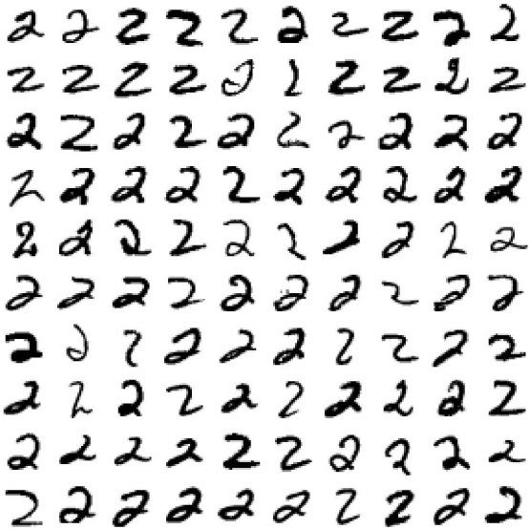
Training of the network is done by a dataset named MNIST dataset. MNIST dataset has a training set of 60,000 examples, and a test set of 10,000 examples. All the images in the dataset are of 28x28 pixels.
METADATA OF THE DATASET

Slide 3
WE WANT THE MACHINE LEARNED MODEL TO RECOGNIZE THE HAND WRITTEN DIGIT.
Ideal Outcome
Our ideal outcome is to classify the handwritten digit
Success Metrics
Our success metrics are the hand written digit that can be clasify
Our KR for the success metrics are to properly classify the handwritten digit with 95% accuracy.
Problem Description
The main of problem is to recognize the handwritten digit that have different pattern.
FRAMING

Slide 4
Failure and Success
We can recognize the handwritten digit and 95% accuracy.
We can define the failure if the recognize the handwritten digit get the value under 95% from the models.
Output
The output from our ML model will be clasify the handwritten digit
Using the output
The digit recognition can be used for OCR (optical character recognition
FRAMING

Slide 5
H0: our model have 95% or upper accuracy
H1: our model have 95% or lower accuracy
HYPOTESIS

Slide 6
The preparation that we need is to download the MNIST data set. The MNIST dataset is one of the most common datasets used for image classification and accessible from many different sources. In fact, even Tensorflow and Keras allow us to import and download the MNIST dataset directly from their API.
PREPARATION
NEEDED

Slide 7
•Downloading the MNIST Data
•Reshaping and Normalizing the Images
•Building the Convolutional Neural Network
•Compiling and Fitting the Model
•Evaluating the Model
TECHNIQUES

Slide 8
TESTING & EVALUATION
•We use architecture network as is of tensor flow tutorial: a. https://www.tensorflow.org/tutorials/quickstart/beginner
b. https://www.tensorflow.org/tutorials/quickstart/advanced

Slide 9
TESTING & EVALUATION
After some training with different epoch, we get result:
Epoch | Accuracy (%)
5 | 97.68
10 | 98.06
20 | 98.15
40 | 98.05
80 | 98.06

Slide 10
Eventhough the MNIST has “only” 60,000 training images, each 28 by 28 grayscale pixels, and is divided into 10 classes (0, 1, 2, …, 9) we can achive 98% accuracy so that we achive our success metric. With the 98% accuracy we prove the h0 hypotesis. By comparison, modern image recognition systems may be trained on more than a million full-color, high-resolution images, with far more classes. This model is very simple but have a lot of application in real life such as OCR, document scanner using photo of handwritten, etc.
RESULT AND
CONCLUSION

