Slide 1
ESSENTIALS DEMO

Slide 2

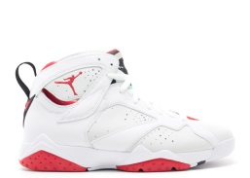
PROJECT OVERVIEW
iOS Client (Frontend)
Found
Shoe name
Email
Air Jordan 7 Retro
"hare"
Find
Send
Lowest Price: $300
Request
Status
1
2
3
Google Endpoints
Full Stack Backend
Google App Engine (API)
Google App Engine
4
Google Compute Engine (VM/Backend)
Google DataStore(DB)
Python Scripts
(Backend Code)
Google Services – i.e. Email/Http Req
(APIs)
7
5
6

Slide 3
BACKEND
Computations, Structuring, and User Interaction

Slide 4
Part 1 – DATA GATHERING
TARGET SITE: FLIGHT CLUB
GOAL: FULL SHOE LISTING

Slide 5
PART 2 - DATA ORGANIZATION
TARGET : SHOENAME, NICKNAME, PRICE, URL, IMAGE, SIZES
GOAL: NEATLY ORGANIZED AND STRUCTURED

Slide 6
FRONTEND
User interface aka where the magic happens

Slide 7
PART 3 - iOS Client
SEARCH ++ AUTO COMPLETE
INTERACTIVE SHOE DISPLAY
BEAUTIFUL / FUNCTIONAL DESIGN

