Slide 1

進捗報告 Progress report
Tomoyuki Ueda
芝浦工業大学
宮田研究室

Slide 2
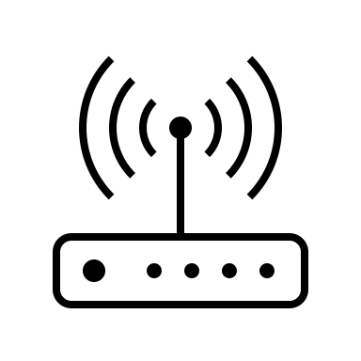


実験方法
Experimental method
トラヒック負荷ごとに検知
2.4GHz帯で実験
Iperf やデバイスを使用した負荷
Iperfなしと3MB, 5MB, 7MBの負荷
Detection with separate traffic load
Experiments in the 2.4GHz band
Load with Iperf and devices
Without Iperf and 3MB, 5MB and 7MB load
Iperfの負荷
Load using iperf
google.com
RTT取得
Get RTT
ping
Notes:
udpのパケットを送信

Slide 3
取得結果
Acquisition Result
Iperfなし・PC3台+iPhone1台に接続
Without iperf, connect with 3 PCs and an iPhone.
Buffalo→正規AP aterm→不正AP
Legitimate
Rogue

Slide 4
取得結果
Acquisition Result
3MBの負荷・PC3台+iPhone1台に接続
Load 3MB, connect with 3 PCs and an iPhone.
Buffalo→正規AP aterm→不正AP
Legitimate
Rogue

Slide 5
取得結果
Acquisition Result
5MBの負荷・PC3台+iPhone1台に接続
Load 5MB, connect with 3 PCs and an iPhone.
Buffalo→正規AP aterm→不正AP
Legitimate
Rogue

Slide 6
取得結果
Acquisition Result
7MBの負荷・PC3台+iPhone1台に接続
Load 7MB, connect with 3 PCs and an iPhone.
Buffalo→正規AP aterm→不正AP
Legitimate
Rogue

Slide 7
まとめと課題
Summary and Issues
0MB
3MB
平均、分散ともに正規＜不正
負荷が上がるにつれRTT上昇
検知プログラムの修正・適用 (途中)
 | baffalo | aterm
variance | 23.2343 | 558.655
average | 7.729097 | 20.25342
 | baffalo | aterm
variance | 115.3089 | 1533.754
average | 10.70608 | 35.24823
5MB
7MB
 | baffalo | aterm
variance | 153.7201 | 2105.33
average | 12.59797 | 42.54448
 | baffalo | aterm
variance | 502.101 | 4069.698
average | 19.08844 | 57.70722
Both mean and variance are legitimate < rogue
RTT increases as load increases
Correction and application of detection programs

