Slide 1

進捗報告 Progress report
Tomoyuki Ueda
芝浦工業大学
宮田研究室

Slide 2

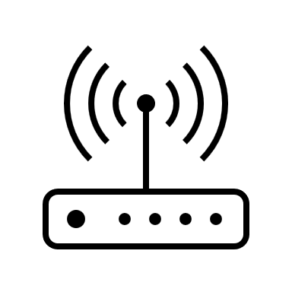

Research background & objective
Theme : Evil-Twin Attack detection
Spoof legitimate wireless LAN access points and launch various attacks against connected users.
SSID : Free-1
SSID : Free-1
Rogue AP
？
Legitimate AP
user
Improved accuracy of rogue AP detection
Notes:
My research is to detect Evil-Twin attack.
ET is ~.

Slide 3


Conventional methods & issue
RTT-based detection methods
Use RTT differences between different hop counts.
Detection by comparing the difference between the threshold and the RTT.
2-hop
Rogue AP
（evil-twin）
User
1-hop
Legal AP
Internet
RTT dispersion during congestion less considered
Notes:
This is conventional method and assumed situation.
Conventional method is using RTT diffaerences ~.
However, convention methods didn’t consider RTT dispersion ~.

Slide 4




Key idea & experimental environment
Detection with separate traffic load
Experiments in the 2.4GHz band
Without Iperf and 3MB, 5MB and 7MB load
Load using iperf
between PC1 to PC2
PC 2
Send ping
PC1 to google.com
PC 1
(To measure)
Rogue AP
Legal AP
Devices
16 IoT devices
google.com
Notes:
Next, I discuss the experimental setup in more detail.
As mentioned earlier, we conducted the experiments using Iperf between two PCs while sending pings to google.com to measure the RTT until the ping response is received.
During the experiments, the devices connected to the AP included 3 PCs, 1 smartphone, and 16 IoT devices, and the operating frequency was set to 2.4GHz.
We performed the experiments under four traffic load conditions: no Iperf load, Iperf load of 3MB, Iperf load of 5MB, and Iperf load of 7MB.
次に、実験方法について詳しい話をします。 先ほども話した通り、2つのpc間でiperfを使い、その状態でgoogle.comにpingを打ち、pingが返ってくるまでの時間をRTTとして実験をします。 この時、APに接続しているデバイスは、3つのPCと1つのスマートフォン、16個のIoT機器であり、使用している帯域は2.4GHZで行った。 また4つのトラヒックの状態は、iperfなしの状態とiperfで3MBの負荷、5MBの負荷、7MBの負荷の状態の4つである。

Slide 5
Experiment flow
Measure RTT
Get RTT
AP
Thresholds are assigned for each traffic load
User
Detect with k-means
”There is rogue AP”
RTT [ms]
Yes
No
Use CDF
Done
Data number

Slide 6
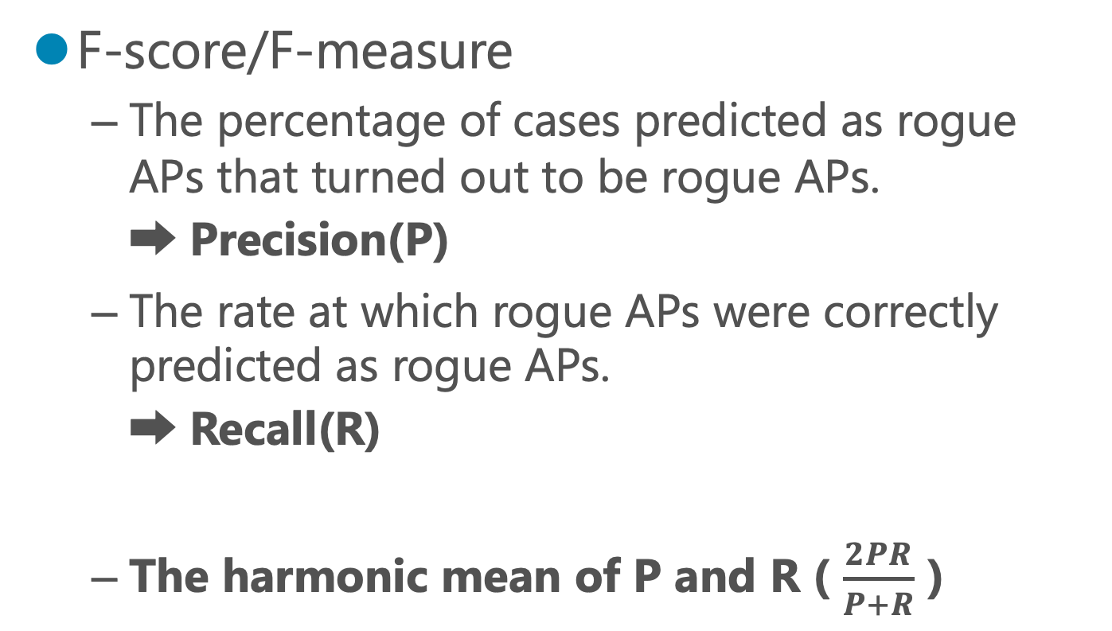
Evaluation method
F-score/F-measure
The percentage of cases predicted as rogue APs that turned out to be rogue APs.
➡ Precision(P)
The rate at which rogue APs were correctly predicted as rogue APs.
➡ Recall(R)
The harmonic mean of P and R ( $\frac{2PR}{P+R}$ )
Notes:
The evaluation is done by F-score.
F-score is The harmonic mean of P and R.
Where P is the percentage of cases predicted as rogue APs that turned out to be rogue aps and R is The rate at which rogue APs were correctly predicted as rogue APs.

Slide 7
Detection results (proposed method)
F-score : 0.92, Accuracy : 0.92
Four measurements with 300 packets per measurement
1 time used for training data, 3 times for test data
 | Not using iperf |  |  | Iperf 3MB |  |  | Iperf 5MB |  |  | Iperf 7MB
Legal | 〇 | 〇 | 〇 | 〇 | 〇 | 〇 | 〇 | 〇 | 〇 | × | 〇 | ×
Rogue | 〇 | 〇 | 〇 | 〇 | 〇 | 〇 | 〇 | 〇 | 〇 | 〇 | 〇 | 〇
Notes:
In this experiment, the number of RTT data used in one experiment was 300; four measurements were made, one of which was used as the threshold.
First, let's start with the results of the proposed method.
This resulted in an F-score of 0.92 and a percentage of accuracy of 0.92.
１回の実験で使用されたRTTデータ数は300である。4回測定し、そのうち1回を閾値に利用した。

Slide 8
Progress report
Research the Impact of the IoT
Packet loss is large with only 7MB of iperf load
Possibly already overloaded with IoT alone
Comparison in the following situations to confirm the impact
Connected to 3 PCs and 1 iphone (no IoT used)
Connect to IoT only
Connected to IoT + 3 PCs and 1 iphone
Notes:
This is why I had stopped the iperf load at 7MB
And I considered the possibility that IoT devices alone are already overloaded.

Slide 9
Result
Connected to 3 PCs and 1 iphone (no IoT used)

Slide 10
Result
Connect to IoT only

Slide 11
Result
Connected to IoT + 3 PCs and 1 iphone

Slide 12
Result
Average & Variance
Connected to 3 PCs and 1 iphone (no IoT used)
Connect to IoT only
 | average | variance
Not using iperf | 6.814815 | 17.8546
iperf 7MB | 12.27703 | 55.22055
 | average | variance
Not using iperf | 8.19 | 9.11
iperf 7MB | 14.02 | 298.65

Slide 13
Result under no IoT devices
Without packet loss, loads of up to 15 MB can be measured
Experiments with no Iperf, 7MB and 15MB
Notes:
At the limit of no packet loss, it was possible to measure loads up to about 15 MB.
Packet loss was observed above 15 MB.
Measurements were taken with no Iperf, 7MB and 15MB.

Slide 14
IoTありとなしの比較
Comparison with and without IoT
←IoT接続時 Non-iperf・7MB
←IoT非接続時
Non-iperf・7MB
When connected to IoT
 | Iperfなし | 7MB
variance | 60.27545 | 235.8639
average | 9.761745 | 15.34014
When IoT is not connected
 | Iperfなし | 7MB
average | 6.814815 | 12.27703
variance | 17.8546 | 55.22055

Slide 15
まとめと予定 Summary and plans
IoTの負荷の影響の確認ができた
IoTなしでのRTTを取得完了（今は途中）
IoTを含まないRTTを使用した検知
The impact of the IoT load could be checked.
Completed getting RTT without IoT (now on the way)
Detection using RTT without IoT.

