Slide 1

Progress report
Tomoyuki Ueda
芝浦工業大学
宮田研究室
Notes:
I'll start self introduction and the progress report now.

Slide 2


Self introduction
Name : Tomoyuki Ueda
Age : 22
Birthplace : Tokyo
Favorite, hobby : Ramen, Work out frequently
Notes:
I'll start with a self-introduction. My name is (name). I'm from Tokyo and currently 22 years old.
As for my hobbies and interests, I enjoy eating ramen and working out frequently.
I'm not very good at speaking English, but nice to meet you

Slide 3



Research Interests
Theme : Evil-Twin Attack detection
Spoof legitimate wireless LAN access points and launch various attacks against connected users.
Conventional Issues :
Detection errors under high traffic load
SSID : Free-1
SSID : Free-1
Rogue AP
？
Legitimate AP
user
Notes:
Next, I'll explain my research topic. I'm researching on detecting evil twin attacks.
Evil twin attacks are spoof legitimate wireless LAN access points and launch various attacks against connected users.
However, there was a problem that detection errors were more likely to occur when the traffic load was high.

Slide 4





Research Interests
Key idea :
Detection with separate traffic load
3 types of loads (low, medium, high)
Connect PCs, etc. for each load
ping
IoT
low
Streaming
medium
high
Notes:
Therefore, as a key idea, we propose conducting detection for each load. Specifically, we will set a threshold for each load.

Slide 5


Experimental method
Connect for each load
Per one transmission：➡︎1000
Divided into time slots and performed 5 times
➡ Conduct for all loads
AP
ping
Get RTT
Connectable range
Notes:
I measured by sending and receiving 1000 ping packets.
I performed a total of 5000 packets by dividing it into time slots and conducting it 5 times.

Slide 6
Research Interests -Result
 | Low |  |  | Medium |  |  | High
Lagetimate | 〇 | 〇 | × | 〇 | 〇 | 〇 | × | × | ×
Rougue and lagetimate | 〇 | 〇 | 〇 | 〇 | 〇 | 〇 | 〇 | 〇 | 〇
F-score → 0.82
False positives are occurring under high load.
〇 : correct, × : incorrect
Notes:
The results turned out as follows: the F-score is high at 0.82, but false positives are occurring under high load.

Slide 7
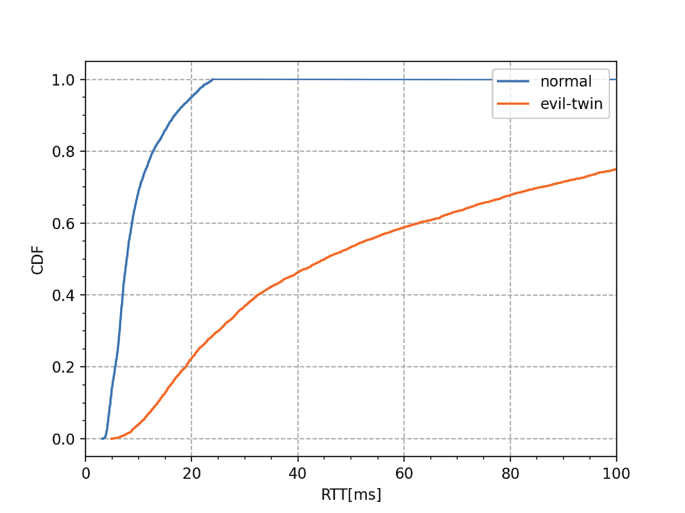
Present Progress
Additional detection using CDF
Apply only under high load.
Future plans
Determination of plans after CDF analysis.
Notes:
So, I’m currently conducting additional detection using CDF. This graph shows the CDF for normal and attack situations under high load.
I'm in the process of obtaining the confidence interval of the CDF for normal situations under high load, and comparing it with the acquired data.
As future plans, we will plan goals and objectives after conducting the CDF analysis, and proceed with new initiatives.
That concludes my presentation.

