Slide 1

Self introduction & My research description
Tomoyuki Ueda
芝浦工業大学
宮田研究室
Notes:
I'll start self introduction and my research description now.

Slide 2


Self introduction
Name : Tomoyuki Ueda
Age : 22
Birthplace : Tokyo
Favorite, hobby : Ramen, Work out frequently
Notes:
I'll start with a self-introduction. My name is (name). I'm from Tokyo and currently 22 years old.
As for my hobbies and interests, I enjoy eating ramen and working out frequently.
I'm not very good at speaking English, but nice to meet you

Slide 3



Research Interests
Theme : Evil-Twin Attack detection
Spoof legitimate wireless LAN access points and launch various attacks against connected users.
Conventional Issues :
Detection errors under high traffic load
SSID : Free-1
SSID : Free-1
Rogue AP
？
Legitimate AP
user
Notes:
Next, I'll explain my research topic. I'm researching on detecting evil twin attacks.
Evil twin attacks are spoof legitimate wireless LAN access points and launch various attacks against connected users.
However, there was a problem that detection errors were more likely to occur when the traffic load was high.

Slide 4





Research Interests
Key idea :
Detection with separate traffic load
3 types of loads (low, medium, high)
Connect PCs, etc. for each load
ping
IoT
low
Streaming
medium
high
Notes:
Therefore, as a key idea, we propose conducting detection for each load. Specifically, we will set a threshold for each load.

Slide 5
検知方法（1）
k-means法を利用
There are two groups to divide
Applies to normal/attack data that is split
Find the y-axis ratio of the coordinates of the center of gravity point
RTT [ms]
Number of packets
Notes:
The detection method is described below. The k-means method is used for detection.
This is a method that groups data into a defined number This method is applied to data divided into several groups.
The number of center-of-gravity points and the number of divided groups are two, and the ratio of the y-coordinates of the coordinates of the center-of-gravity points of these two points is calculated.

Slide 6
Detection method (2)
Calculate y-axis ratio of center of gravity point from normal data ➡ Threshold value
Only legitimate APs
The y-axis ratio calculated from the normal data
With rougue APs
The y-axis ratio calculated from the attack data
RTT [ms]
Data number
Greater than threshold
➡There is rogue AP
RTT [ms]
Data number
Notes:
This k-means method is used to determine the y-axis ratio of the coordinates of the center of gravity point to the RTT data during normal and attack.
The y-axis ratio of the coordinates of the center of gravity point, calculated from one of the normal RTT data divided into several parts, is used as the threshold value.
Then, the y-axis ratio of the coordinates of the center of gravity point during normal and attack is compared to the threshold value,
and if the value is larger than the threshold, it is determined that there is a rogue AP.

Slide 7


Experimental method
Connect for each load
Per one transmission：➡︎1000
Divided into time slots and performed 5 times
➡ Conduct for all loads
AP
ping
Get RTT
Connectable range
Notes:
Devices were connected for each load and measured by sending and receiving 1000 ping packets.
I performed a total of 5000 packets by dividing it into time slots and conducting it 5 times.

Slide 8
RTT in low traffic
Normal ＋
Attack ×
RTT [ms]
Clearly Separated
Number of packets
 | Mean | Variance | SD
normal | 6.442 | 0.162 | 0.403
evil-twin | 24.899 | 251.274 | 15.852
Notes:
I will then discuss the measurement results
In this experiment, the results exclude request time loss and outliers, so the result is less than 5,000 packets.
This low-load result shows that a clear difference is created between normal and attack times.

Slide 9
RTT in medium traffic
Normal ＋
Attack ×
RTT [ms]
overlap in part
Number of packets
 | Mean | Variance | SD
normal | 6.319 | 2.761 | 1.662
evil-twin | 20.663 | 134.464 | 11.596
Notes:
At medium loads, the RTTs will overlap between normal and attack.

Slide 10
RTT in high traffic
Normal ＋
Attack ×
RTT [ms]
overlap completely
Number of packets
 | Mean | Variance | SD
normal | 9.318 | 22.077 | 4.699
evil-twin | 69.013 | 3770.059 | 61.401
Notes:
At high loads, they are completely overlapped both during normal and attack.

Slide 11
Research Interests -Result
 | Low |  |  | Medium |  |  | High
Only Legitimate | 〇 | 〇 | × | 〇 | 〇 | 〇 | × | × | ×
With Rogue | 〇 | 〇 | 〇 | 〇 | 〇 | 〇 | 〇 | 〇 | 〇
F-score → 0.82
False positives are occurring under high load.
〇 : correct, × : incorrect
Notes:
I will then describe the detection results
The results turned out as follows: the F-score is high at 0.82, but false positives are occurring under high load.
These are the previous results

Slide 12
進捗 Progress
前回の結果に誤りがあった
K-meansのクラスタの作り方に問題
新しい結果とCDFを用いた検知
ランダムに600個抜き出したデータに適用
1つの負荷で10回行った
各負荷でCDFを用いた追加検知の実行
There was an error in the previous results.
Problem with the way K-means clusters are created.
New results and detection using CDF
Applied to 600 randomly extracted data.
I did 20 times with one load.
Perform additional detection with CDF on each load.

Slide 13
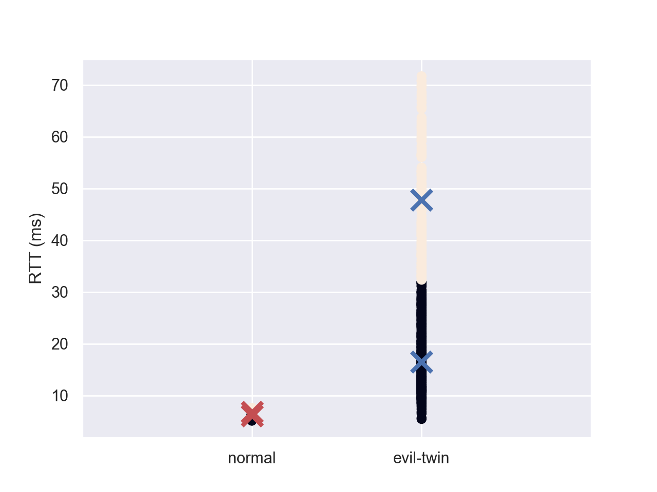
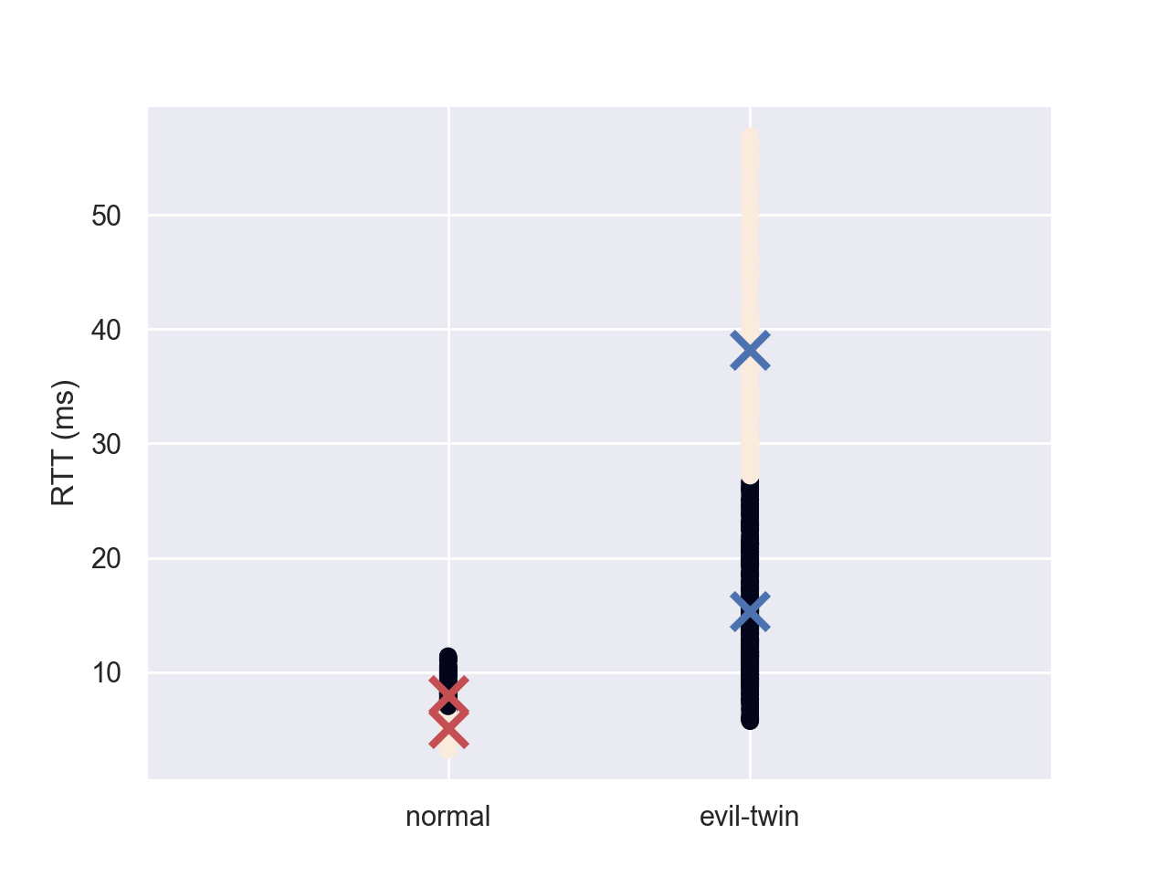
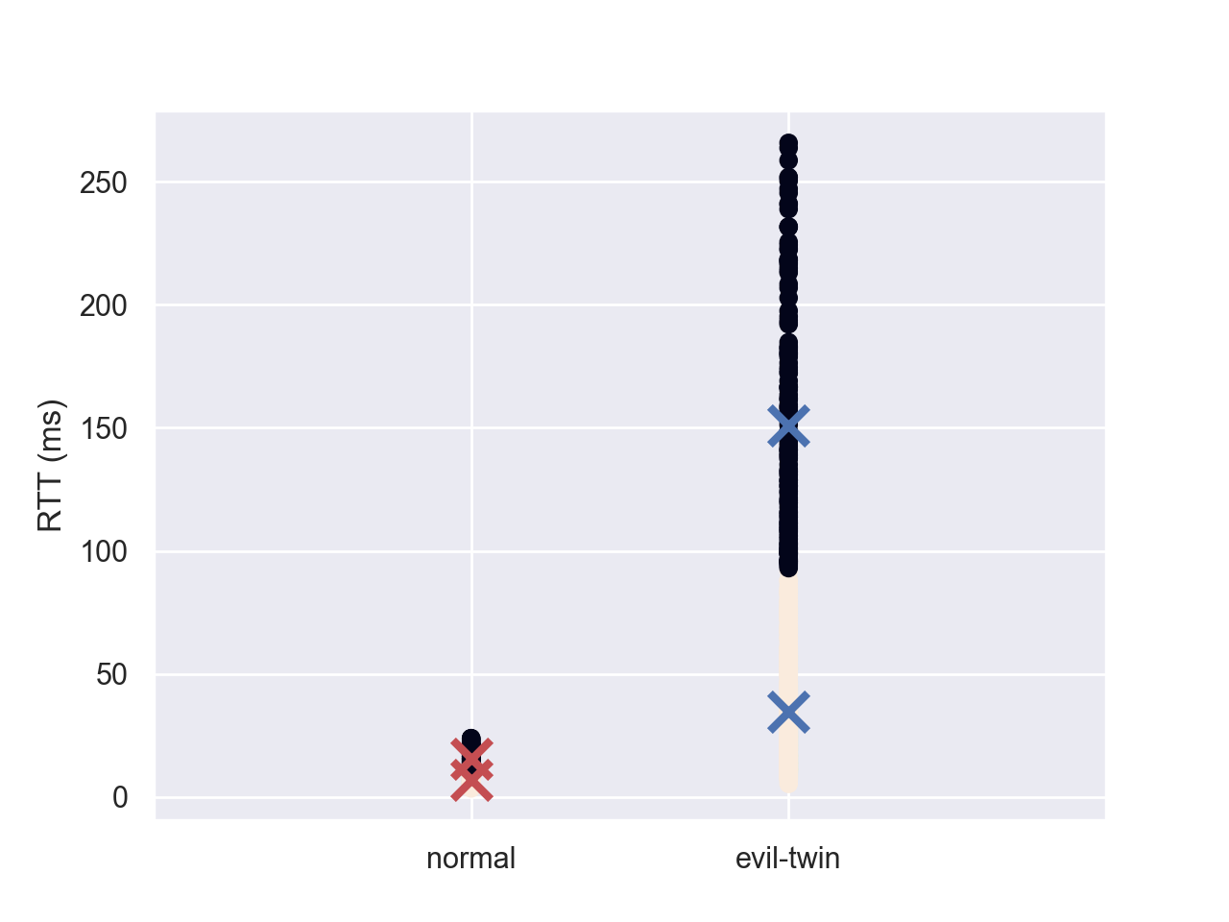
クラスタリング結果 Clustering results
通常時（左）と攻撃時（右）の クラスタリング結果
×はクラスタ中心点
Clustering results for normal (left) and attack (right)
× is the cluster center point
低負荷
Low traffic
中負荷
Medium traffic
高負荷
High traffic

Slide 14
新たな結果 New detection results
For fixed thresholds ( F-score : 0.98, Accuracy : 0.97)
提案手法 (F値 : 0.98, 正解率 : 0.97)
閾値固定の場合 (F値 : 0.57, 正解率 : 0.67)
 | 低 Low |  |  |  |  | 中 Medium |  |  |  |  | 高 High
正規AP | 〇 | 〇 | 〇 | 〇 | 〇 | 〇 | 〇 | 〇 | × | 〇 | 〇 | 〇 | 〇 | 〇 | 〇
不正AP | 〇 | 〇 | 〇 | 〇 | 〇 | 〇 | 〇 | 〇 | 〇 | 〇 | 〇 | 〇 | 〇 | 〇 | 〇
Legitimate
Rogue
For fixed thresholds ( F-score : 0.57, Accuracy : 0.67)
 | 低 Low |  |  |  |  | 中 Medium |  |  |  |  | 高 High
正規AP | 〇 | 〇 | 〇 | 〇 | 〇 | × | × | × | × | × | × | × | × | × | ×
不正AP | 〇 | 〇 | 〇 | 〇 | 〇 | 〇 | 〇 | 〇 | 〇 | 〇 | 〇 | 〇 | 〇 | 〇 | 〇
Legitimate
Rogue
Notes:
固定の閾値は、各負荷で測定したRTTの中から算出した。
Fixed thresholds were calculated from the RTTs measured at each load.

Slide 15
課題と予定 Challenges and plans
Amgadと協力し、本物のAPを使用した 実機での実験を検討
ラズベリーパイは不正APに適さない
トラヒックレートを数値で表現可能
データ数を前回より多く取得予定
中負荷における誤検知の原因調査
Working with Amgad to consider experimenting with actual equipment using real Aps.
Raspberry Pi is not suitable for rogue AP
Traffic rate can be expressed numerically
More data will be acquired than last time
Investigation of causes of false positives in medium loads

Slide 16
Background and Objectives of the Study
Increased in access points (APs) in wireless LANs due to the Corona Disaster
Increased damage due to unauthorized APs ➡ Evil Twin Attack
[S. Kitisriworapan +, EURASIP Journal on Wireless Communications and Networking, 2020]
[K. C. Patel+, INDIACom, 2022]
Improved accuracy of rogue AP detection
Notes:
近年、Free-WiFiなどの無線LANにおけるアクセスポイント、通称APが増えている。また、コロナ禍になってからリモートによる授業や仕事が増え、カフェやレストランでもリモートワークを行う人が増えている。そのためAPはさらに増加していくことが予想される。
しかし、それと同時に不正APと呼ばれる攻撃も増加している。例えばevil-twin attack。
そのため、不正APの検知の精度の向上が求められています。

Slide 17

Detection mechanism using RTT
Detection method using RTT
Using difference 1-hop and 2-hop
Compare threshold and RTT
2-hop
Rogue AP
（evil-twin）
ユーザ
1-hop
Legitimate AP
Internet
Notes:
近くに同じ名前の2つのAPがあったとき、双方に接続して測定したRTTと閾値を比較

Slide 18
Conventional Methods and Issues
RTT-based methods
Less consideration of RTT dispersion during traffic congestion
Detection accuracy improved when considering it.
Method using MCS (transmission rate)
MCS : Indexes containing set values for modulation, encoding, etc.
Obtaining MCS is not easy.
[Kitisriworapan+，J Wireless Com Network 2020，2020]
Evil-Twin detection considering traffic load
Notes:
トラヒックが混雑していないときに注目した研究が多く、混雑しているときのRTTの予測までは行えていないものが多い。
そこで、本実験の目的として、トラヒック負荷別にRTTを実際に計測しました。

Slide 19
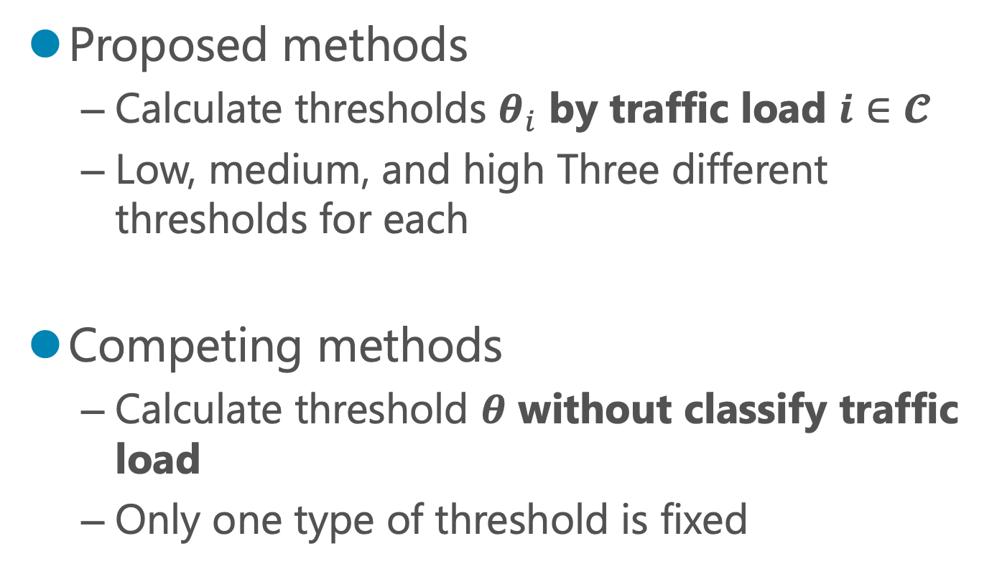
Proposed and competing methods
Proposed methods
Calculate thresholds $θ_{i}$ by traffic load $i∈𝓒$
Low, medium, and high Three different thresholds for each
Competing methods
Calculate threshold $θ$ without classify traffic load
Only one type of threshold is fixed

Slide 20

実験方法
接続する台数を$N_{i}, i∈𝓒$
1回の送信：1000個
時間帯を分けて5回
➡すべての負荷で行う
tcpdump
ping送信
正規AP
不正AP
RTT取得
Notes:
不正APの場合はtcpdumpと呼ばれる、ネットワークを流れるパケットデータを捕縛して内容を表示することができるツールを用いて、
evil-twin攻撃の再現を行う。

Slide 21
Existing method
Classification of existing methods
Fingerprinting (Administrator's Side)
➡stable accuracy, high cost, complex
[Qiaolin Pu+, IEEE Transactions on Vehicular Technology, 2021]
RTT : round-trip time (User Side)
➡ low cost, not complex, environmentally sensitive
[S. Kitisriworapan +, EURASIP Journal on Wireless Communications and Networking, 2020]

Slide 22
Existing method
Classification of existing methods
Fingerprinting (Administrator's Side)
➡stable accuracy, high cost, complex
[Qiaolin Pu+, IEEE Transactions on Vehicular Technology, 2021]
RTT : round-trip time (User Side)
➡ low cost, not complex, environmentally sensitive
[S. Kitisriworapan +, EURASIP Journal on Wireless Communications and Networking, 2020]

Slide 23
Measurement Results Summary
トラヒック負荷が増えるにつれての分散
通常時：低→中→高に大きく
攻撃時：中→低→高に大きく
負荷ごとに閾値を比較
1つの負荷で3回行う
通常時と攻撃時に行う
低
中
高
Notes:
トラヒック～
しかし、平均、分散、標準偏差すべてにおいて、通常時よりも攻撃時のほうが大きくなっていることがわかります。

Slide 24
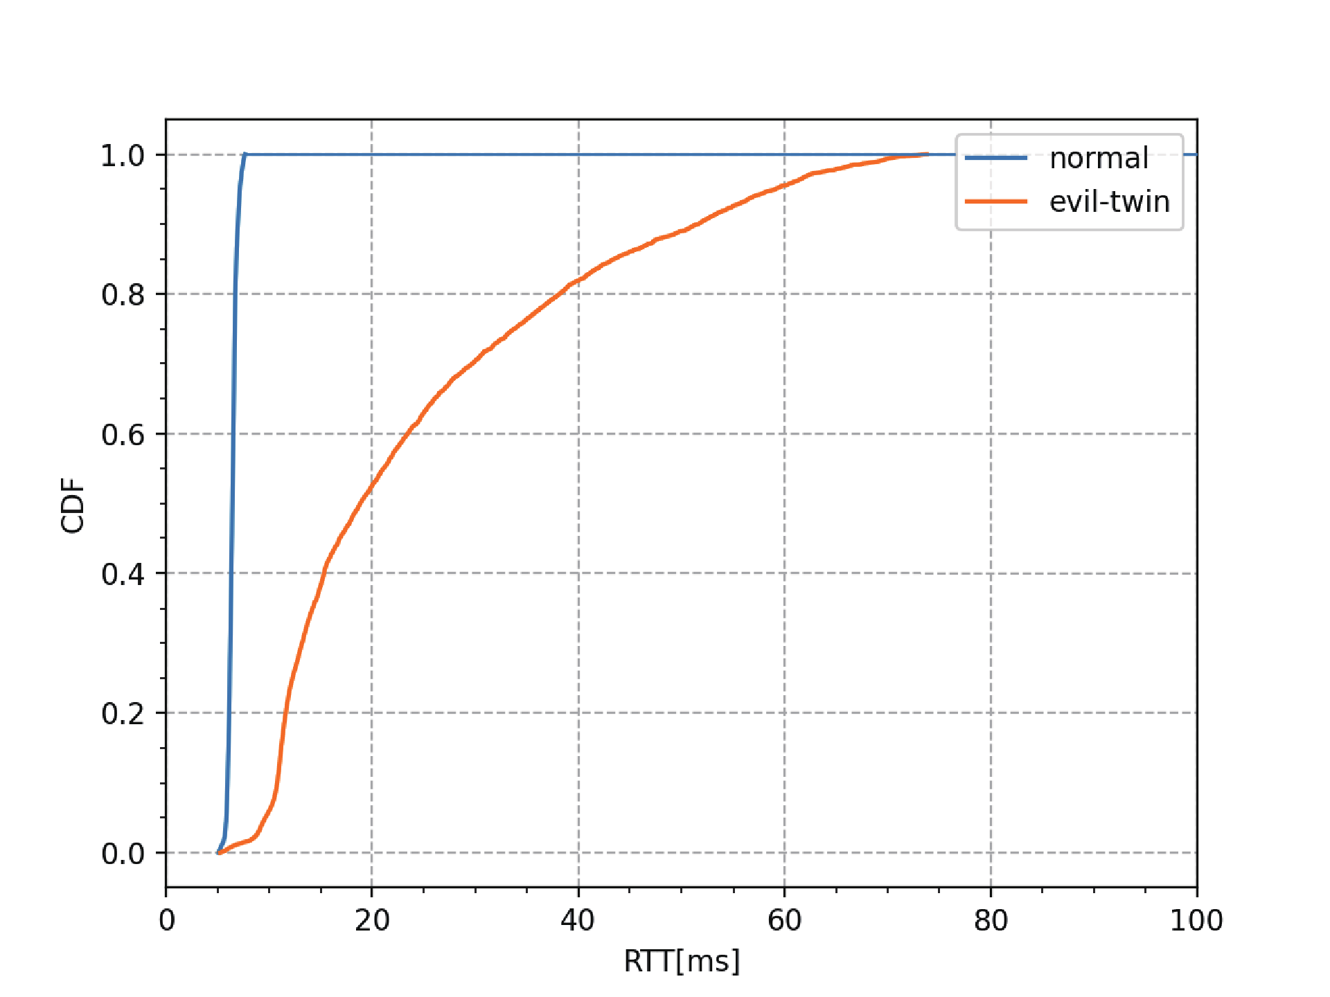
低負荷時のCDF
ー 通常時
ー 攻撃時
・通常時はほぼ0msに固まっている
・攻撃時は既に横幅が広い

Slide 25
中負荷時のCDF
ー 通常時
ー 攻撃時
角が少し丸くなる
・通常時も攻撃時もあまり変わらない
・通常時のCDFの角が丸くなっている
Notes:
角が丸くなっている→幅が少し広がった
中負荷時の攻撃時のRTTの分散は最も小さいため、少しむしろ幅が狭くなった

Slide 26
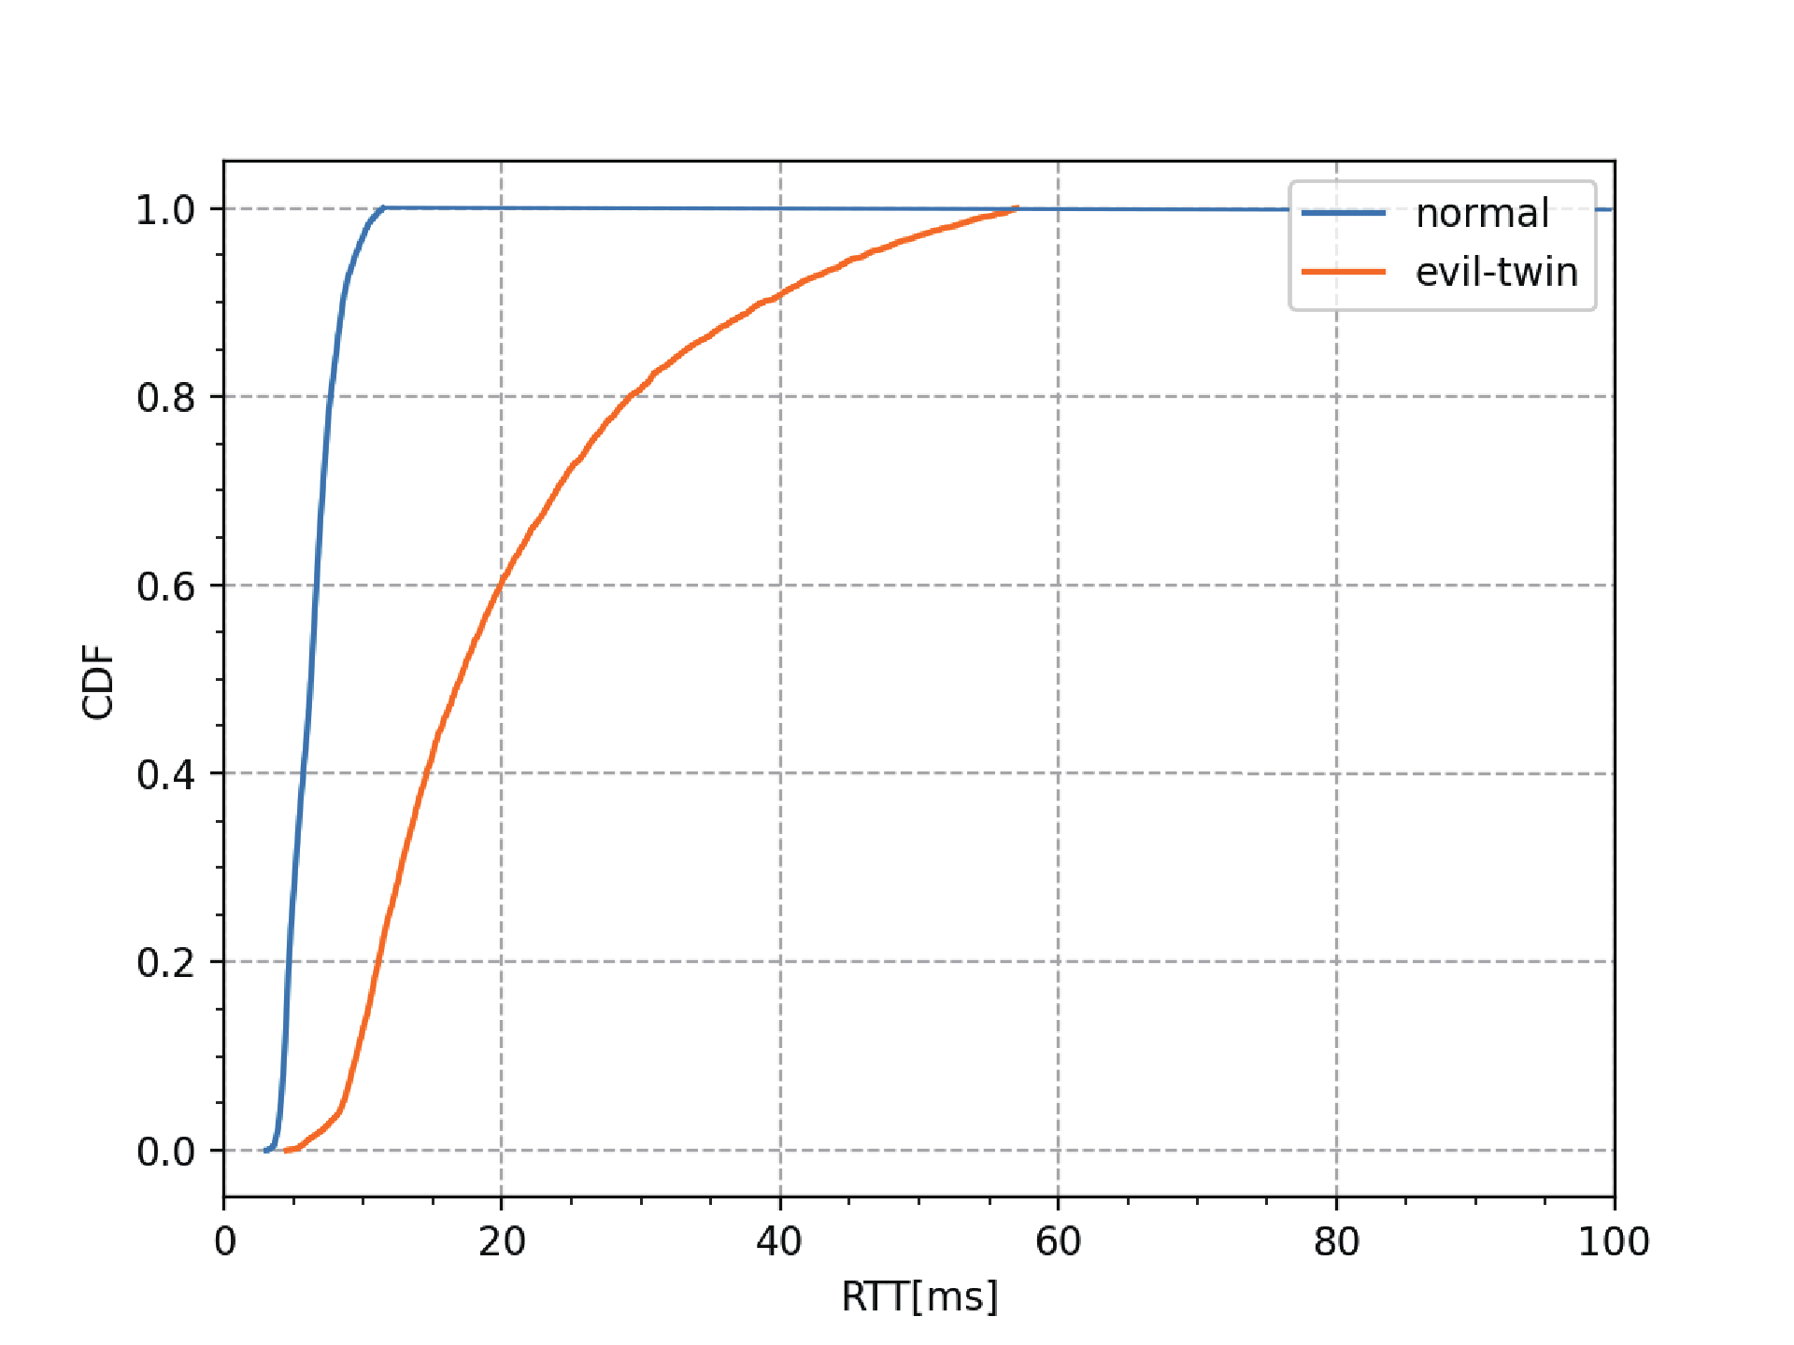
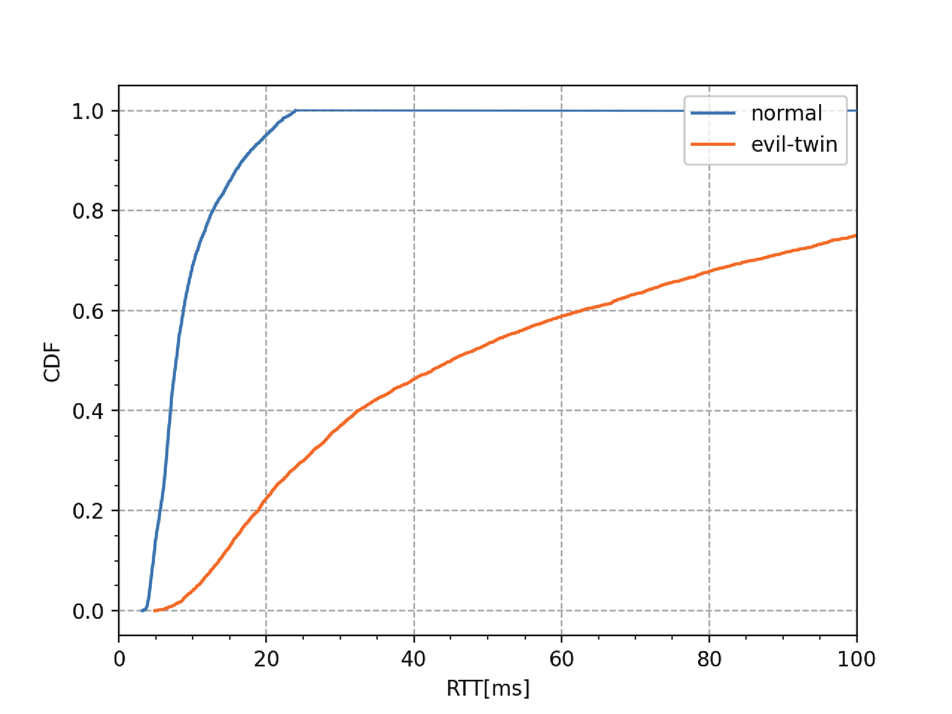
CDFの結果
通常時のCDFは大差がない
攻撃時のRTTは高負荷時では大きく変わる
CDFを用いた検知も可能
Notes:
一定の信頼区間を設けて、計測したデータの平均などと比較することにより、検知精度の向上が見込まれる
ただ不正APがラズパイなのでまだ信憑性には欠けるかも？

