Slide 1

Data Visualization
Tools for Energy Analysis
Evaluation report on tools for analyzing peak usage and energy inefficiencies.

Slide 2





Meet the Cooper Incorporated
Chibuike Okoroama
Prescila Mora
Mohamed Afthab
Venkata Manish

Slide 3

Introduction to Data Visualization
1
Objective
Compare tools for identifying energy inefficiencies and peak usage.
2
Criteria
Large datasets, real-time data, visualization adaptability, integration ease.

Slide 4

Evaluated Data Visualization Tools
Tableau
Advanced visualization for time- based energy data.
Power BI
Microsoft integration for energy trend analysis.
Google Data Studio
Cost-effective option for basic visualization needs.
Qlik Sense
Associative modeling for uncovering hidden insights.
Domo
Real-time analytics with IoT integration.
Looker
Customizable data modeling with

Slide 5

Tableau Features & Advantages
Time-series Data
Efficient handling for trend monitoring.
Integration
Connects with IoT devices and smart meters.
Customization
Precise trend and anomaly identification.

Slide 6
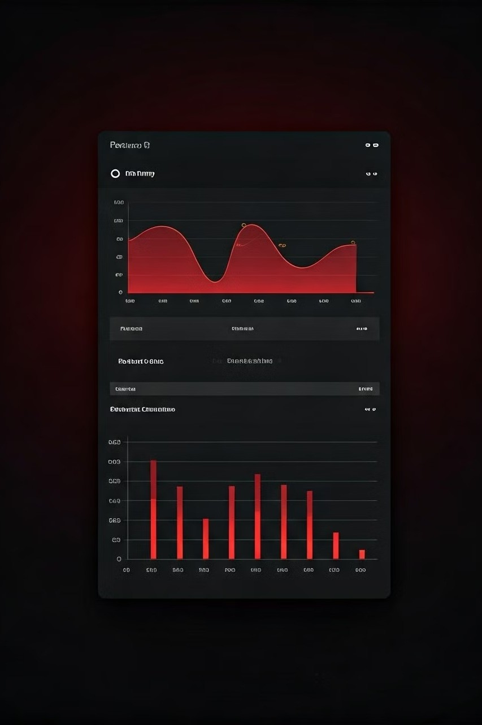
Power BI Features & Advantages
Microsoft Integration
1
Seamless connection with SQL Server and Azure.
Real-time Streaming
Ongoing monitoring of energy data.
2
User-friendly
Suitable for teams with varying skill levels.
3

Slide 7

Google Data Studio Features & Limitations
Cost-effective | Basic visualization needs
Strong integration | Google Sheets and BigQuery
Limitations | Not for large datasets or complex analytics

Slide 8

Qlik Sense Features & Advantages
Associative Model
Reveals hidden connections in energy data.
AI-powered Insights
Scalable data handling for complex analysis.
Large Datasets
Suited for businesses with complex energy data.

Slide 9
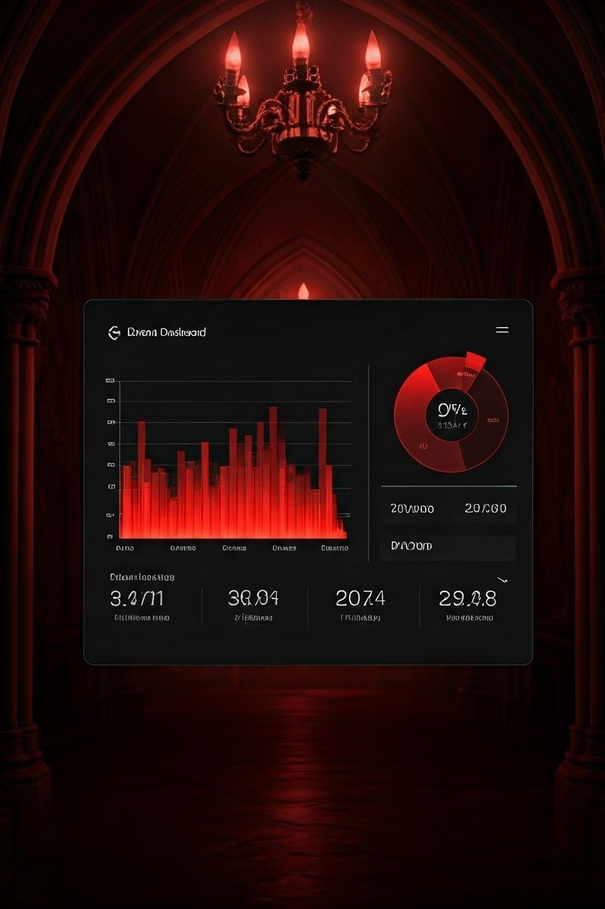
Domo: Real-Time Analytics and IoT Integration
1
Real-time Streaming
Proactive energy monitoring capabilities.
2
IoT Integration
Connects with various data sources and devices.
3
Customizable Dashboards
Tailored for peak usage insights.

Slide 10

Looker: Advanced Data Modeling with LookML
1
LookML
Develop complex, customized energy data models.
2
Cloud Integration
Works with Google Cloud and BigQuery.
Technical Focus
Ideal for companies with data modeling expertise.
3

Slide 11

Comparison of Tools: Pros and Cons
Tableau | Advanced visuals, high costs
Power BI | User-friendly, limited complex graphs
Google Data Studio | Simple, lacks advanced analytics
Qlik Sense | Scalable AI insights, requires training
Domo | Real-time analytics, costly subscriptions
Looker | Advanced modeling, requires technical skill

Slide 12

Key Benefits of Tableau
Trend Monitoring
Identifies attendance patterns, optimizes resource allocation.
Data Integration
Consolidates multiple sources into single dashboard.
Custom Visualization
Tailors detailed visuals to key performance indicators.
Scalability
Support Future needs, including predictive analytics

Slide 13

Conclusion: Tableau as Optimal Choice
1
Comprehensive Solution
Meets current and future data analysis needs.
2
High-Level Customization
Tailors visualizations to Toronto FC's specific requirements.
3
Seamless Integration
Incorporates diverse data sources for holistic insights.
4
Future-Proof Investment
Scales with club's growing analytical demands.

Slide 14

Thank You
We appreciate your time and attention throughout this presentation. Tableau's comprehensive data analysis capabilities make it the optimal choice to support Toronto FC's growing analytical needs.

