Slide 1

TORONTO FC CLOUD STORAGE SELECTION
COOPER INCORPORATED
WIL PROJECT WK 6

Slide 2





TEAM
Chibuike Okoroama
Prescila Mora
Mohamed Afhab
Venkata Manish

Slide 3

CLIENT
KEY INFO
Name: Toronto FC (Football club)
Stadium: BMO Field, Fan Base: “Red Boys”
Field Capacity: 30,000 seats
TROPHIES
MLS & Shield winners: 2017 champions
Canadian Championship winners: 7 times

Slide 4
OUR OBEJCTIVE
“Is to evaluate and compare different cloud-based data storage options capable of handling massive amount of training and match effectively then recommend the best among all”.

Slide 5
AGENDA
PROJECT RECAP
01
CLIENT INTRODUCTION
02
TYPES OF CLOUD-BASED STORAGE
03
COMPARISON
04
RECOMMENDATION
05
CONCLUSION
06
REFERENCES
07

Slide 6
CLIENT RECAP
Recommend Sprout Social platform for social media analysis that increased ROI
Use AI to Simulate and Visualize fans games attendance
Use recommended algorithm to derive insights from attendance data
Create Model that enhances game day experiences.

Slide 7

INTRODUCTION AND BENEFITS

Slide 8
INTRODUCTION
Cloud-based storage
-is a service that will enable Toronto FC to store their huge volume of generated data.
-makes it easier for them to store their training sessions and match data in easily accessible platform.
Purpose
-is to provide the flexibility and efficient way to manage and access their data from anywhere.

Slide 9
CLOUD BENEFITS
Scalability: adjust storage capacity based on demand.
Accessibility: access stored data from anywhere via internet.
Cost-benefit: charge as per demand basis.
Redundancy: protection against data loss

Slide 10
CLOUD-BASED STORAGE TYPES

Slide 11

Free Tier: 5gb standard storage for 12 months only.
Subscription: As per demand model.
Scalability: handle petabyte-scale of any data.
Durability: highly redundant platform. 99.999% durable & stored across multiple regions
Security: encrypted and robust access management.
Integrations: Integrates easily with other AWS tools.
Use case: good solution for Toronto FC data team dealing with huge amount of data like training videos, performance metrics and AI/ML models.

Slide 12
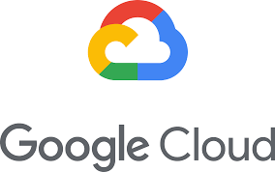
Free Tier: Google cloud offer 5gb standard storage for 12 months & ability to test small data sample before scaling.
Subscription: As per demand model on Google cloud.
Scalability: handle petabyte-scale of any data of structured & unstructured data
Durability: highly redundant platform. 99.999% durable & stored across multiple regions
Security: encrypted and robust access management.
Integrations: Integrates easily with google BigQuery & tesnorFlow for large data processing on ML & AI projects
Use case: ideal solution for Toronto FC data team that is already working within the Google ecosystem.

Slide 13
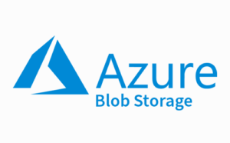
Free Tier: 5gb standard storage for 12 months & ability to test small data sample before scaling.
Subscription: tiered based pricing on access patterns (Hot, Cool & Archive storage).
Scalability: handle massive dataset while offering high availability & redundancy across multiple geographies.
Durability: highly redundant platform & stored across multiple regions to ensure data availability
Security: encrypted at rest, in transit & advanced role-based access control
Integrations: Integrates easily with Azure machine learning services, AI tools, advanced analytics platforms making easier to analyze match and training data.
Use case: suitable for organizations that is already using Microsoft cloud infrastructure or those looking for strong data governance and AI capabilities.

Slide 14
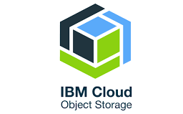
Free Tier: 25gb per month storage for free for the first 12 months, better than others.
Subscription: pricing is based on usage with an emphasis on flexibility on both cost and storage .
Scalability: highly scalable and can handle data generated from AI, machine learning & IoT applications.
Durability: offers enterprise-grade durability using “erasure coding” & geo-replication to ensure safety.
Security: multi-layered security features, including encryption at rest and in transit combined with IBM compliance range of data protection.
Integrations: Integrates well with IBM Watson which provides AI & machine learning & can be used with IBM big data solutions.
Use case: IBM Cloud is a great choice for organizations that are heavily invested in AI & need advanced insights into their data, making it ideal for sports analytics.

Slide 15
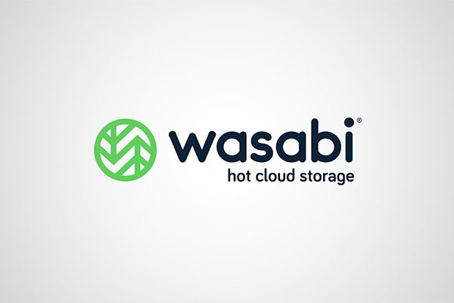
Free Tier: Wasabi does not offer a free tier but has highly competitive, flat-rate pricing.
Subscription: $5.99 per TB per month with no egress fees, which is cost savings for Toronto FC dealing with large amounts of data.
Scalability: designed for rapid scalability, making it ideal for organizations looking to store vast amounts of data without breaking the bank.
Durability: Wasabi provides same reliable as major players as AWS and Google.
Security: Wasabi offers built-in data immutability (making files unchangeable once stored), strong encryption, and access controls.
Integrations: While it lacks proprietary AI and ML tools, Wasabi integrates with many third-party analytics and backup tools, offering flexibility.
Use case: Best for organizations needing a cost-effective, scalable storage solution without worrying about additional costs for retrieving data (egress fees).

Slide 16
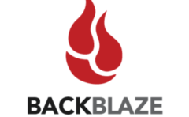
Free Tier: BackBlaze B2 offers 10GB of free storage, giving users a chance to test the platform without upfront costs.
Subscription: It’s one of the cheapest options at just $0.005 per GB per month for storage and $0.01 per GB for downloads.
Scalability: BackBlaze B2 known for its ability to scale up easily, making it a great option for storing backups, archives, and even live datasets.
Durability: BackBlaze B2 provides same reliable as major players as AWS and Google.
Security: It includes file encryption, two-factor authentication, and other security features, ensuring your data is protected.
Integrations: BackBlaze B2 integrates with a wide range of tools and platforms, including file-sharing, backup software, and media management tools.
Use case: Ideal for organizations needing low-cost, secure, and scalable storage for large datasets, particularly those focused on archival data.

Slide 17
CLOUD-BASED STORAGE COMPARISONS

Slide 18
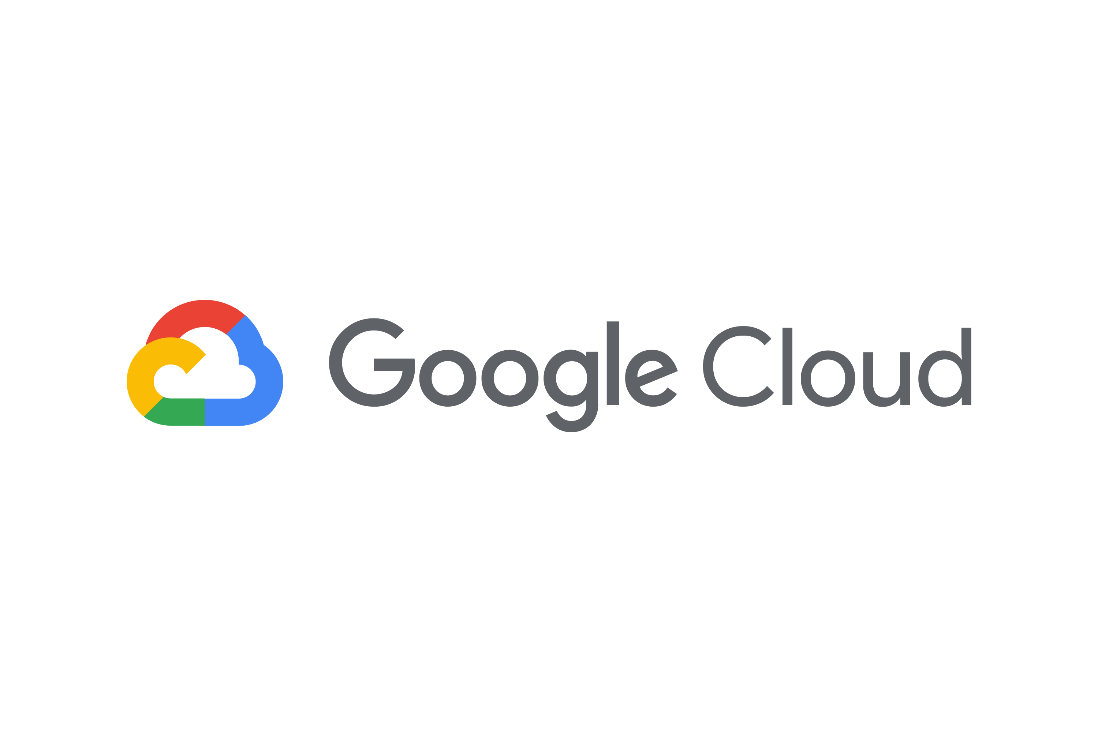

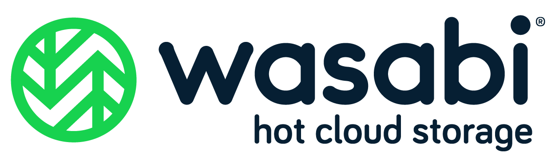

SERVICE | SCALABILITY | PERFROMANCE | EASE OF INTEGRATION
 | Unlimited scalability, auto-scaling. | High performance, low latency, great for real-time access. | Strong integration with AWS analytics tools (Athena, Redshift, Lambda)
 | High scalability, supports millions of transactions per second | Fast access times, cost-optimized storage classes. | Excellent integration with BigQuery, TensorFlow, and third-party analytics
 | Highly scalable with different storage tiers | Low-latency, supports concurrent access. | Integrates well with Azure Synapse, Power BI, and Databricks
 | Exabyte-level scalability, geo-redundant storage | High throughput, low latency, optimized for AI workloads. | Seamless integration with IBM Watson and big data tools like Hadoop and Spark
 | Scalable with flat-rate pricing, best for budget-conscious organizations | Fast, low-latency, no egress fees, ideal for hot data. | Third-party tool integration, lacks native AI/ML tools
 | Scalable, focused on archival and backup use cases | Reliable performance, better for long-term storage than real-time applications. | Basic third-party integrations, lacks native support for advanced analytics

Slide 19
SUMMARY
AWS S3 and Google Cloud Storage stand out for organizations needing maximum scalability, low-latency performance, and seamless integration with advanced analytics tools.
Azure Blob Storage is also a good choice for teams already invested in the Microsoft ecosystem, offering high performance and excellent integration with data analytics tools like Power BI and Azure, Synapse.
Wasabi and Backblaze offer cost-effective alternatives for organizations prioritizing scalable, reliable storage without the need for advanced analytics tools or performance optimization.

Slide 20
CLOUD-BASED STORAGE RECOMMENDATION

Slide 21
RECOMMENDATION
AWS S3 is the ideal solution for Toronto FC’s data storage needs due to its ability to handle vast amounts of data with unlimited scalability and high performance, ensuring fast, real-time access to Toronto FC datasets.
It integrates seamlessly with AWS tools like Amazon Athena and AWS Lambda, and third party like Apache spark, Hadoop, Power BI, SDK, API etc.
AWS S3 provides Toronto FC with the scalability, efficiency, and security needed to support data-driven performance and enhance operations on its flexible storage offer.

Slide 22
CONCLUSION
AWS S3 offers scalability, high performance, and seamless integration with advanced analytics tools, ensuring that Toronto FC can store, access, and analyze vast amounts of data in real time.
Its cost-effective storage tiers and industry-leading security make it the best solution for managing sensitive data while optimizing performance.
With AWS S3, Toronto FC is equipped to harness data-driven insights, thereby enhancing both operational efficiency and player performance.

Slide 23
REFERENCES
https://aws.amazon.com/s3/
https://azure.microsoft.com/en-us/services/storage/blobs/
https://cloud.google.com/storage
https://www.backblaze.com/b2/cloud-storage.html
https://wasabi.com/cloud-storage/
https://www.ibm.com/cloud/object-storage

