Slide 1
Philipps University of Marburg Course: Big Data Systems Instructor: Prof. Dr. Thorsten Papenbrock Submitted by: Mohammed Afaan Sajjad Hussain Shaikh (3844933) Ram Binay Gupta (3848283) Feb 1th, 2025 https://github.com/afaan123/Big_data_systems/tree/main/ddm-spark

Slide 2
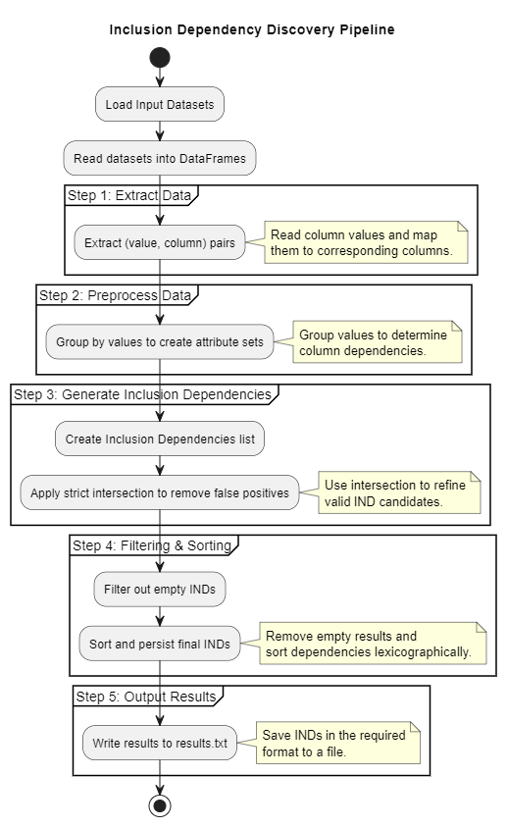

Slide 3
Steps
1. Read datasets into DataFrames
2. Extract (value, column) pairs
3. Group values to create attribute sets
4. Generate potential IND candidates
5. Apply strict intersection filtering
6. Sort and write results to a file

Slide 4
Results & Conclusion
Successfully discovered Inclusion Dependencies
Ensured correct lexicographical ordering
Results written to results.txt

