Slide 1

Estrogen receptor (ER) status prediction from the MRI image features

Slide 2
Objectives
Detection
Diagnosis
Treatment
Detection
Diagnosis
Treatment
sensing
Classification
effector action
data analysis
judgment

Slide 3
Datasets
Retrospective Study:
Patients : 992 in total (test : 305)
Images Size (GB) : 368.4
Number of Images : 773,126
Number of Series : 5,034
Modality: Breast MRI

Slide 4
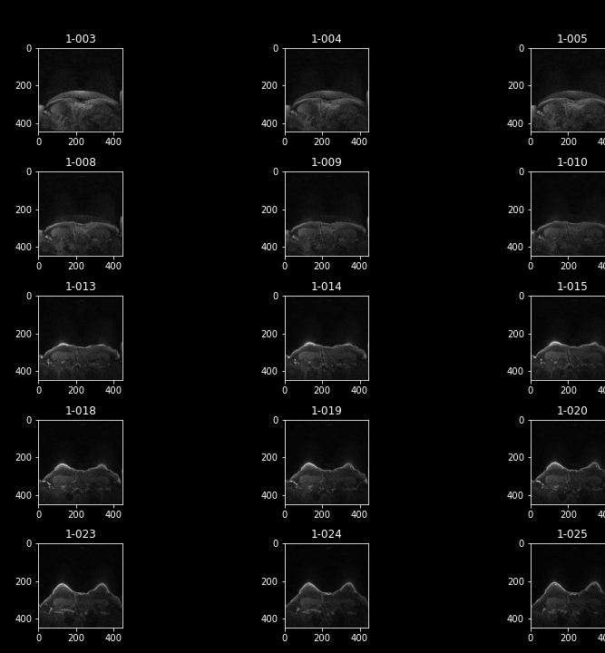






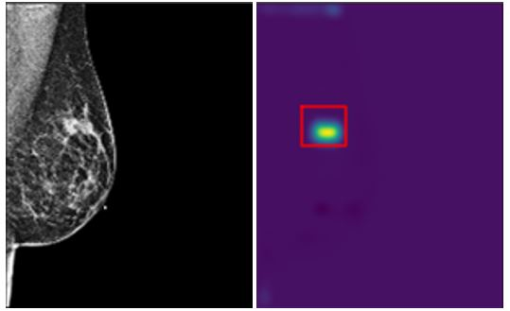





Demographic , Clinical, Pathology, Genomic, Treatment, Outcomes, AND other data
Clinical and Other Features (XLSX, 582 kB)
Pre-operative dynamic contrast enhanced (DCE)-MRI
Images (DICOM, 368.4 GB)
Annotations on the DCE-MRI images by radiologists
File Path mapping tables (XLSX, 49.6 MB)
Imaging features from DCE-MRI with Software tools
Imaging features (XLSX, 6.44 MB)

Slide 5
ANALYSIS

Slide 6
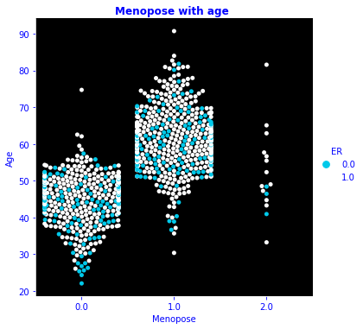
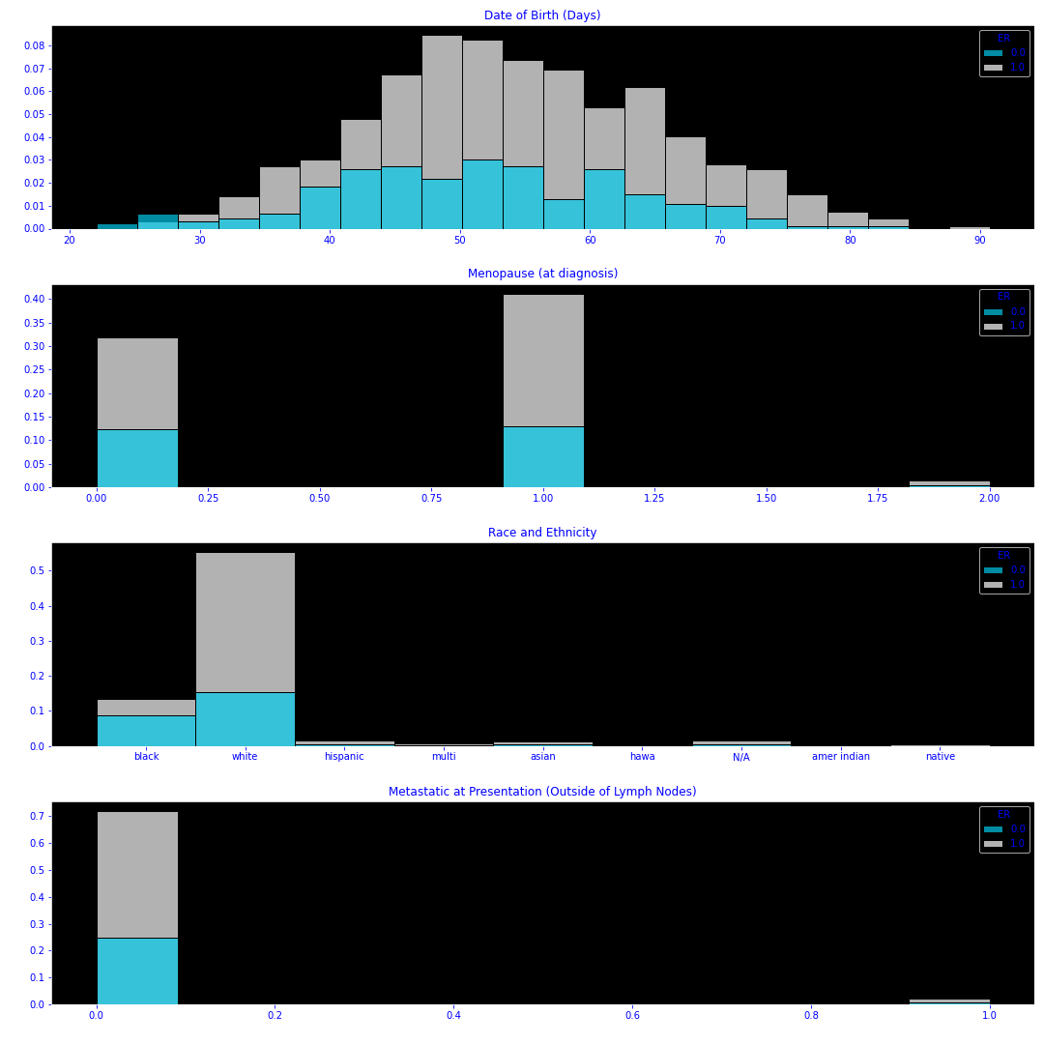
Demographics
White women are more likely to be diagnosed with subtype tumor ER, whereas 80% of black women are safe from this subtype
Distribution of age is nearly normal and we can’t deduce any impact so far on the classification
At monopose, starting from 55 years old, the risk of developing ER tumor subtype is higher

Slide 7
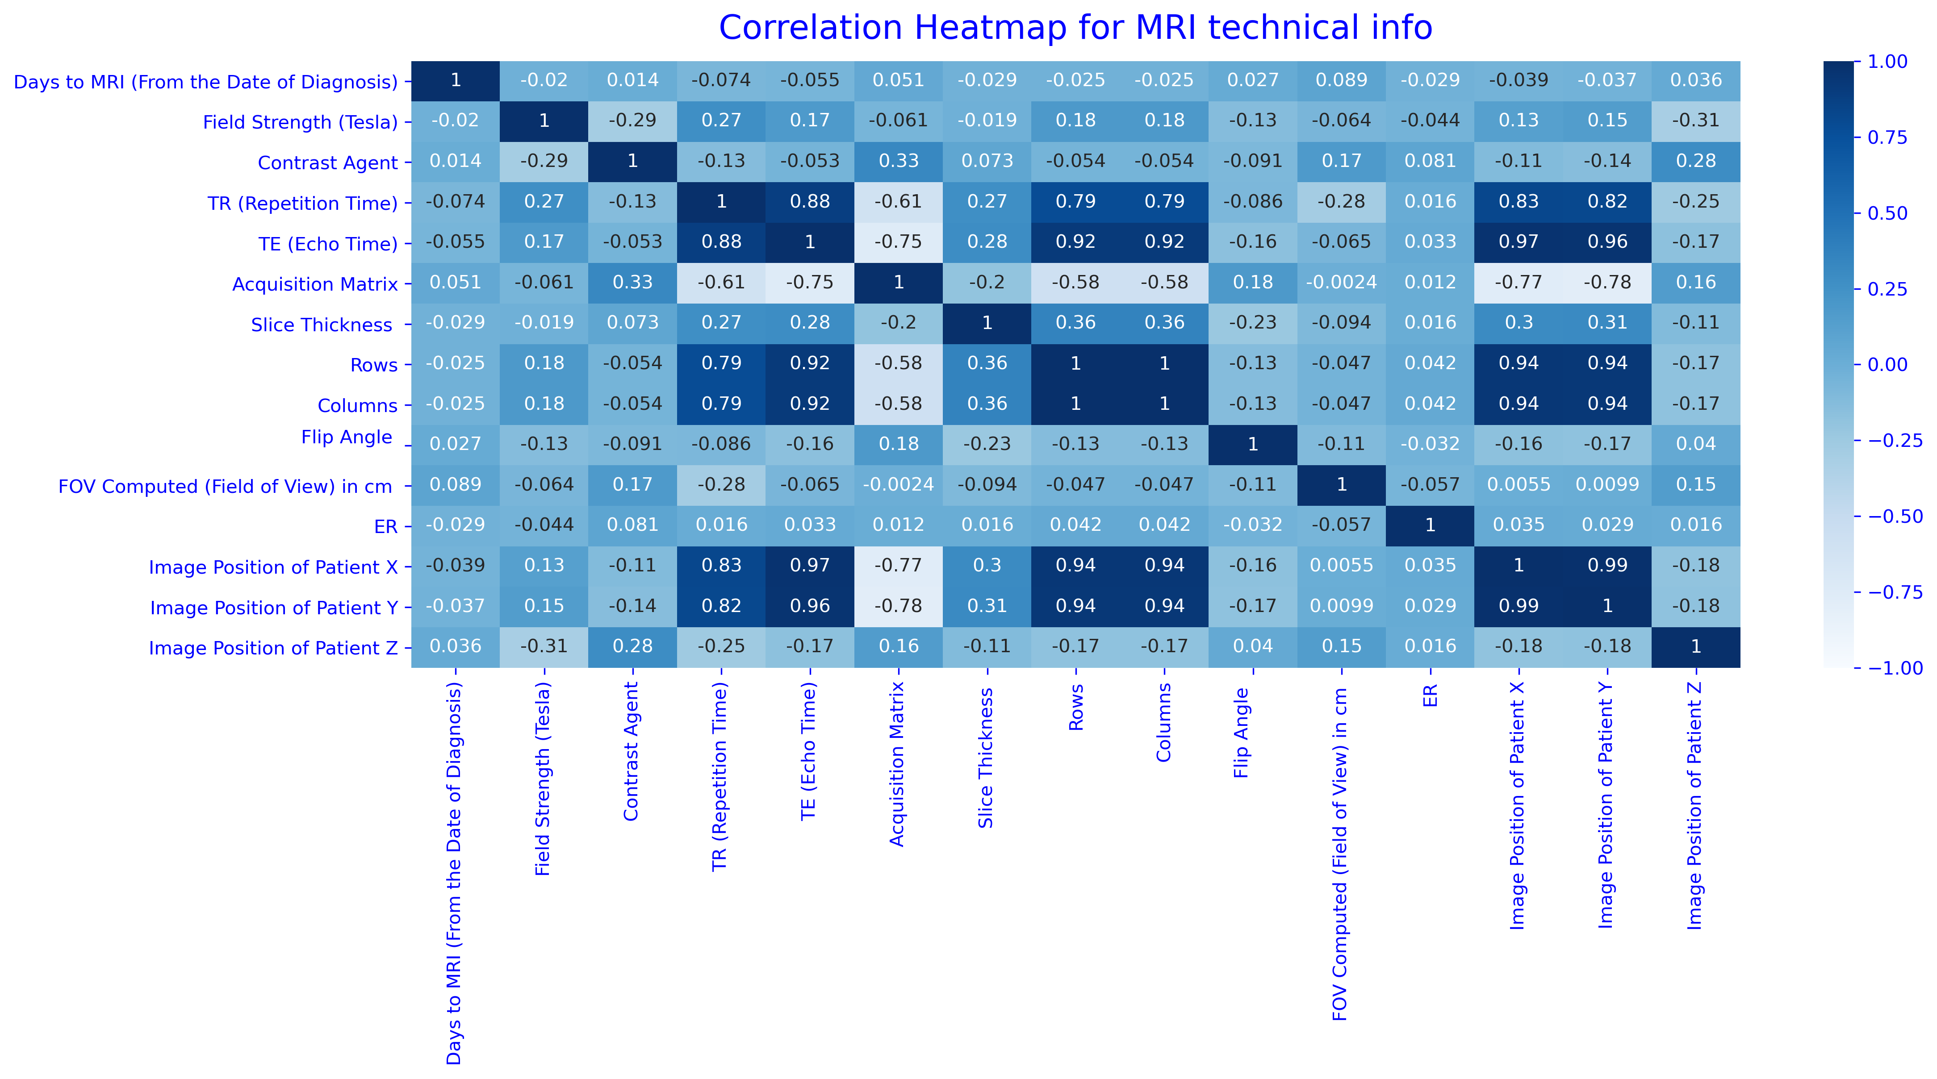
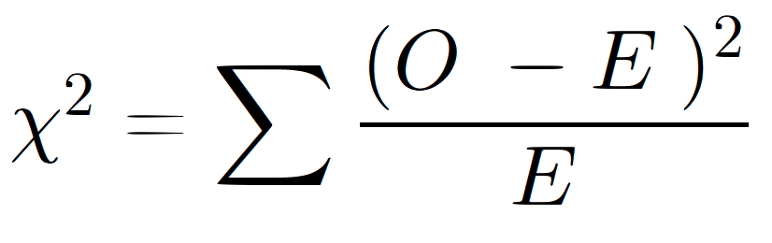

The Chi-square test
MRI technical information
feature | result
Manufacturer | Accept NULL HYPOTHESIS
Manufacturer Model Name | Accept NULL HYPOTHESIS
Scan Options | Accept NULL HYPOTHESIS
Patient Position During MRI | Accept NULL HYPOTHESIS
Doe the scan MRI technical setup such as: Manufacturer, Manufacturer model name, Scan options..impat the detection of the subtype of tumor ER
Some columns have more than 10% of the records missing, so we remove them first after checking their correlation with the target
Null hypothesis:
“colY and colX are
independent”

Slide 8
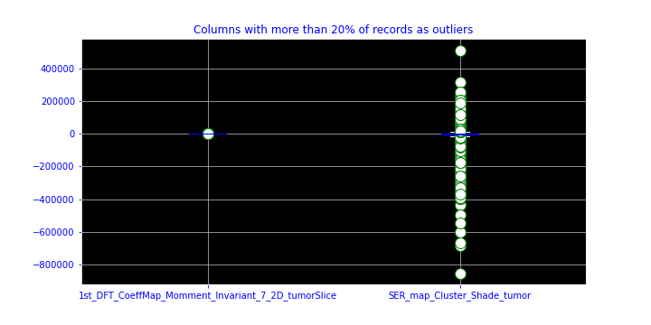
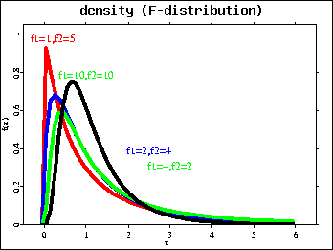
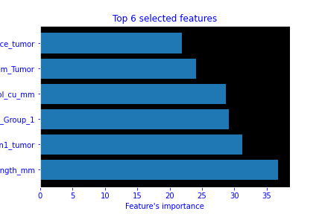
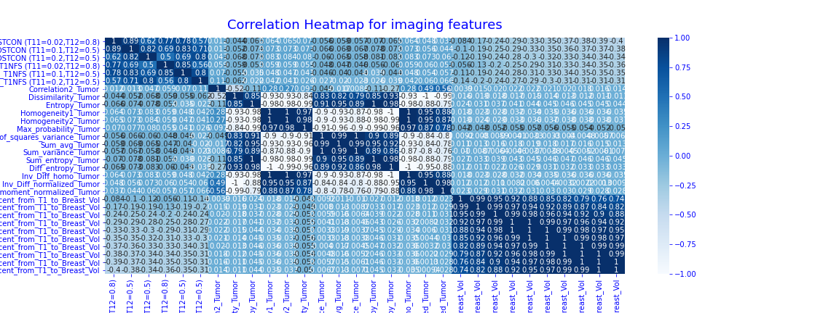
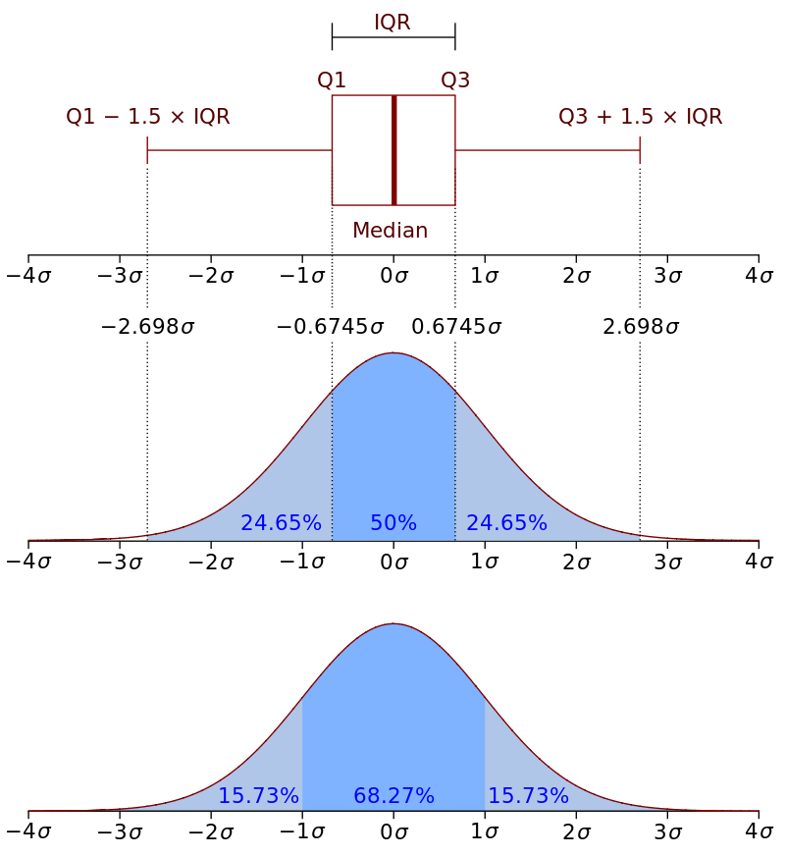
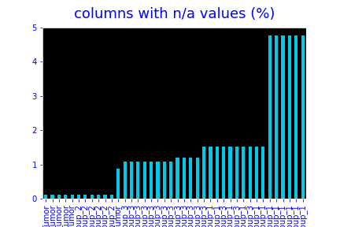


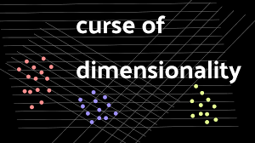
Outliers detection and handling
ANOVA( Analysis of Variance)
296 features
118 features
Image features
2 features
Feature Source: 529 imaging features from the tumor and automatically segmented FGT using the
T1- fat saturated sequence
T1-non fat saturated first post-contrast sequence both pre-processed
Fill in missing values with median on training
All columns with nan values have less that 5% of non existing values, and most of them are groups features

Slide 9
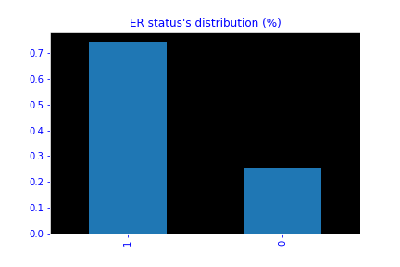
Classification

Slide 10
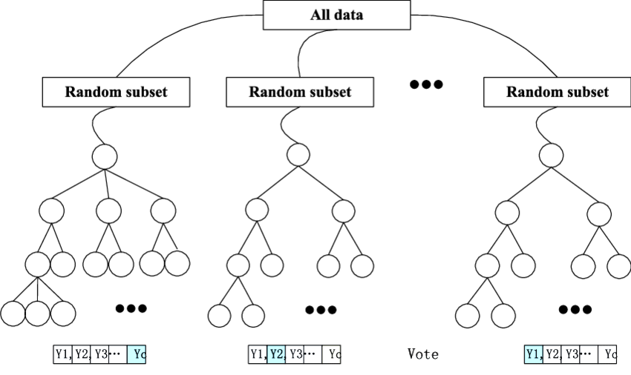


The target (ER status) is imbalanced since we have 75% of the data is positive (subtype tumor detected), plus we still suffer from the curse of dimensionality (115 features left /922 patients)
BEST HYPERPARAMETERS
Baseline model: Random forest
It reduces overfitting in decision trees
helps to improve the accuracy
works well with both categorical and continuous values
Automates missing values present in the data
Normalizing of data is not required as it uses a rule-based approach.
Uses subset of the features. This minimizes the space that each tree is optimizing over and can help combat the problem of the curse of dimensionality.
It requires much computational power as well as resources as it builds numerous trees to combine their outputs.
It also requires much time for training as it combines a lot of decision trees to determine the class

Slide 11

The target (ER status) is imbalanced since we have 75% of the data is positive (subtype tumor detected), plus we still suffer from the curse of dimensionality (115 features left /922 patients)
BEST HYPERPARAMETERS
Other models: XGBOOST/CATBOOST
It XGBoost is a good option for unbalanced datasets but we cannot trust random forest in these types of cases.
XGBoost always gives more importance to functional space when reducing the cost of a model while Random Forest tries to give more preferences to hyperparameters to optimize the model.
Random forests are easier to tune than Boosting algorithms.
Random forests will not overfit almost certainly if the data is neatly pre-processed and cleaned unless similar samples are repeatedly given to the majority of trees.

Slide 12

Evaluation

Slide 13
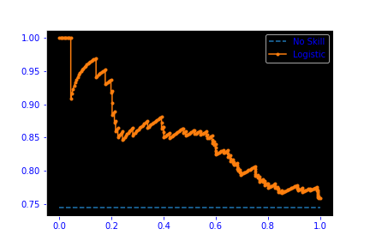
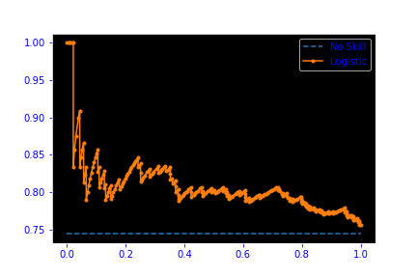


auc=0.852
auc=0.807
Performances
precision recall f1-score support
0 0.37 0.37 0.37 78
1 0.78 0.78 0.78 227
accuracy 0.68 305
macro avg 0.58 0.58 0.58 305
weighted avg 0.68 0.68 0.68 305
GRIDsearch on RF and 300 fits : 7m 50s
Classification reports
In the light of of critical medical data ( ER status determines the right diagnosis) , detection of the positive class is what matters the most (unless it’s a multiclassification). Usually, the positive class is the minor class which is not the case , so we can use as a metric Precision-Recall curves should be used
.

Slide 14
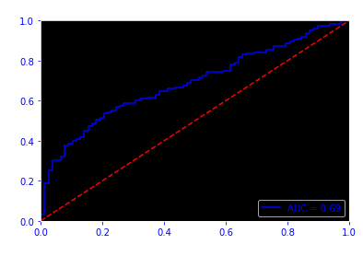
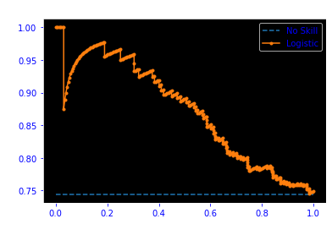
auc=0.69
Performances
precision recall f1-score support
0.0 0.36 0.64 0.47 78
1.0 0.83 0.62 0.71 227
accuracy 0.62 305
macro avg 0.60 0.63 0.59 305
weighted avg 0.71 0.62 0.65 305
GRIDsearch on XgBOOST : 16s
Classification reports
In the light of of critical medical data ( ER status determines the right diagnosis) , detection of the positive class is what matters the most (unless it’s a multiclassification). Usually, the positive class is the minor class which is not the case , so we can use as a metric Precision-Recall curves should be used
.

Slide 15
DIMENSION REDUCTION (PCA) and OVERSAMPLING

Slide 16
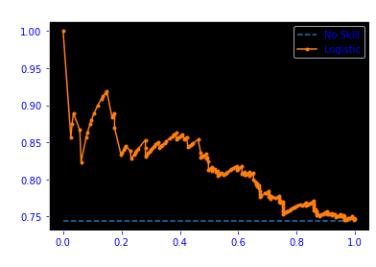
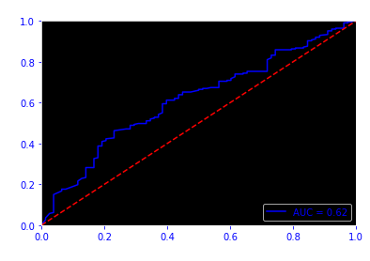
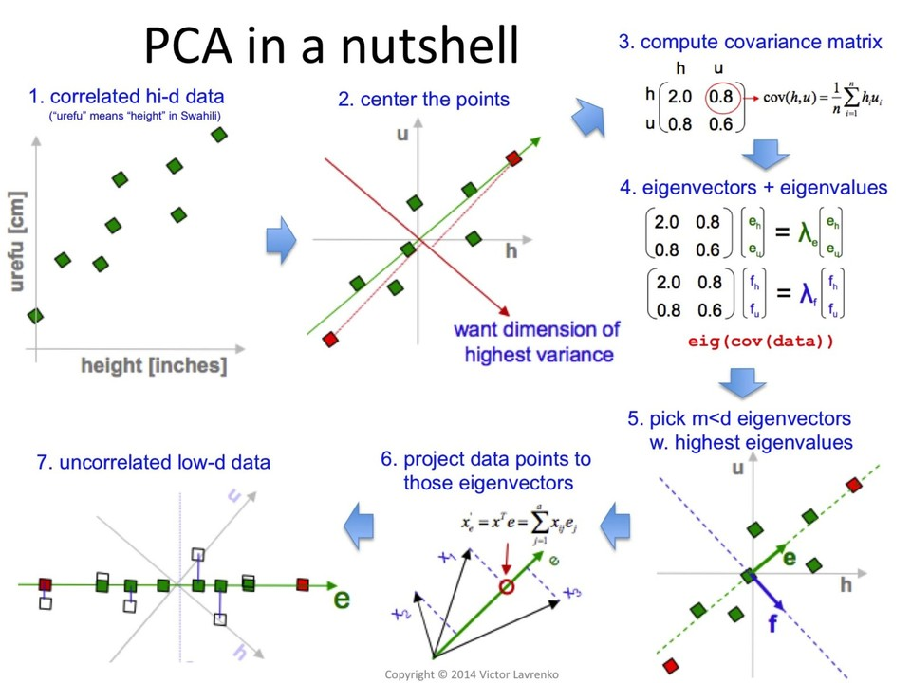


Principal component analysis (PCA)
auc=0.820
auc=0.62
precision recall f1-score support
0.0 0.34 0.50 0.40 78
1.0 0.79 0.67 0.72 227
accuracy 0.62 305
macro avg 0.57 0.58 0.56 305
weighted avg 0.68 0.62 0.64 305

Slide 17
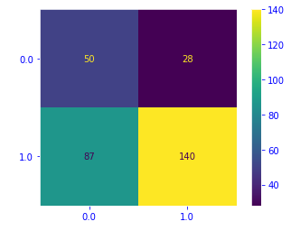
Oversampling: SMOTE
auc=0.87
auc=0.69
Synthetic Minority Over-sampling Technique (Chawla).
Creates new data points from the minority class.
Operates in the feature space.
synthetic point
a nearest neighbor
sample point

Slide 18
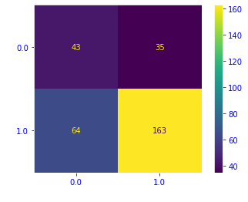
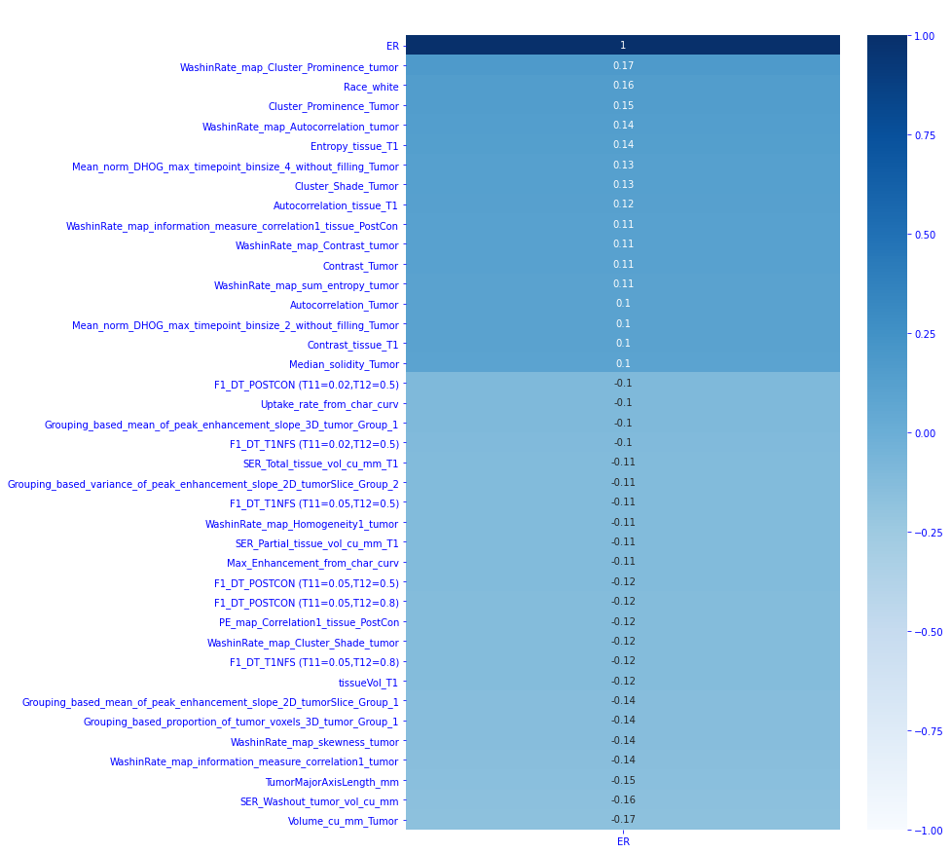
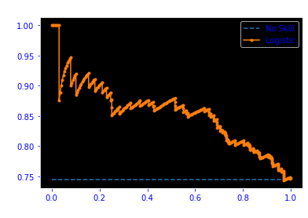

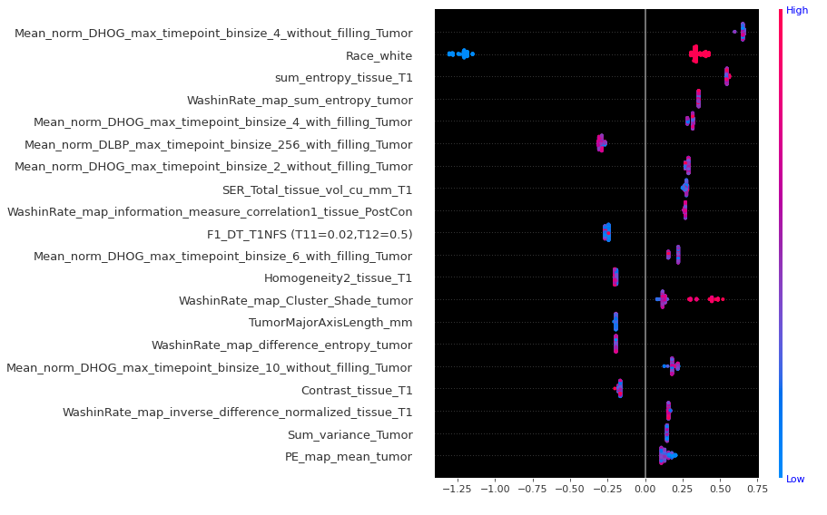
auc=0.854
Images features + Clinical features
SHAP values : Features importance
We notice a high correlation between race and ER status. However, the model select only image features as important in the classification decision

