Slide 1
Green’s Function Optimization (GFO)
GEOS-MITgcm v11.7.0
C90-LLC90-LM91

Slide 2
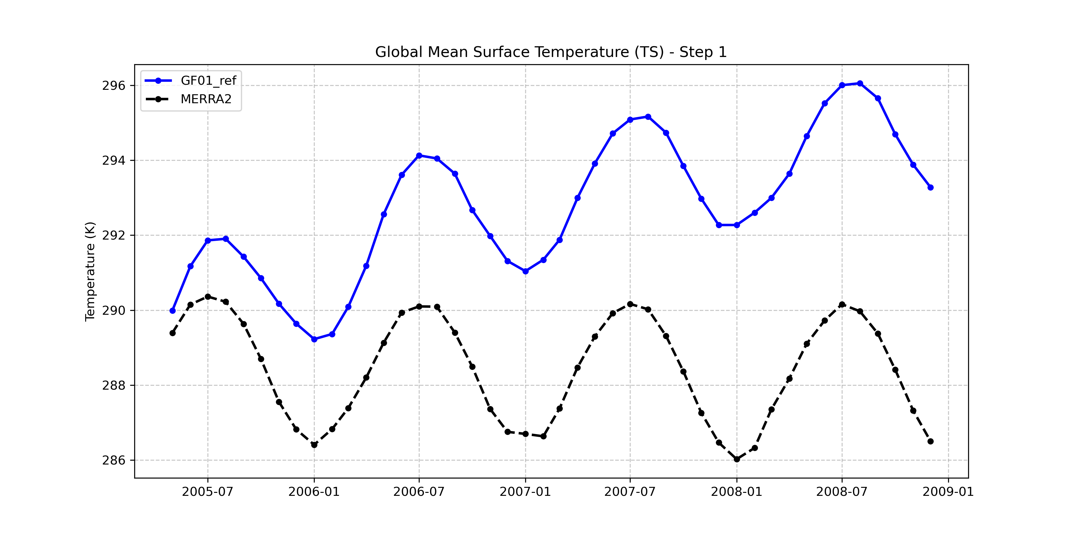
Global Mean TS

Slide 3
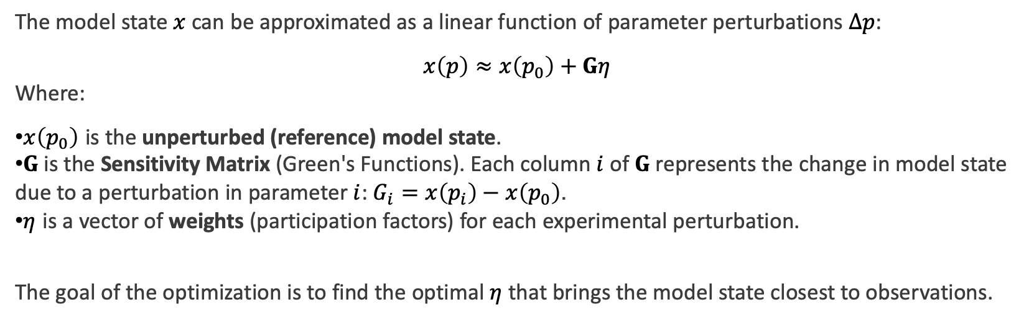
GFO
The model state $x$ can be approximated as a linear function of parameter perturbations $Δp$:
$$x\left(p\right)≈x\left(p_{0}\right)+Gη$$
Where:
$x\left(p_{0}\right)$ is the unperturbed (reference) model state.
$G$ is the Sensitivity Matrix (Green's Functions). Each column $i$ of $G$ represents the change in model state due to a perturbation in parameter $i$: $G_{i}=x\left(p_{i}\right)−x\left(p_{0}\right)$.
$η$ is a vector of weights (participation factors) for each experimental perturbation.
The goal of the optimization is to find the optimal $η$ that brings the model state closest to observations.

Slide 4
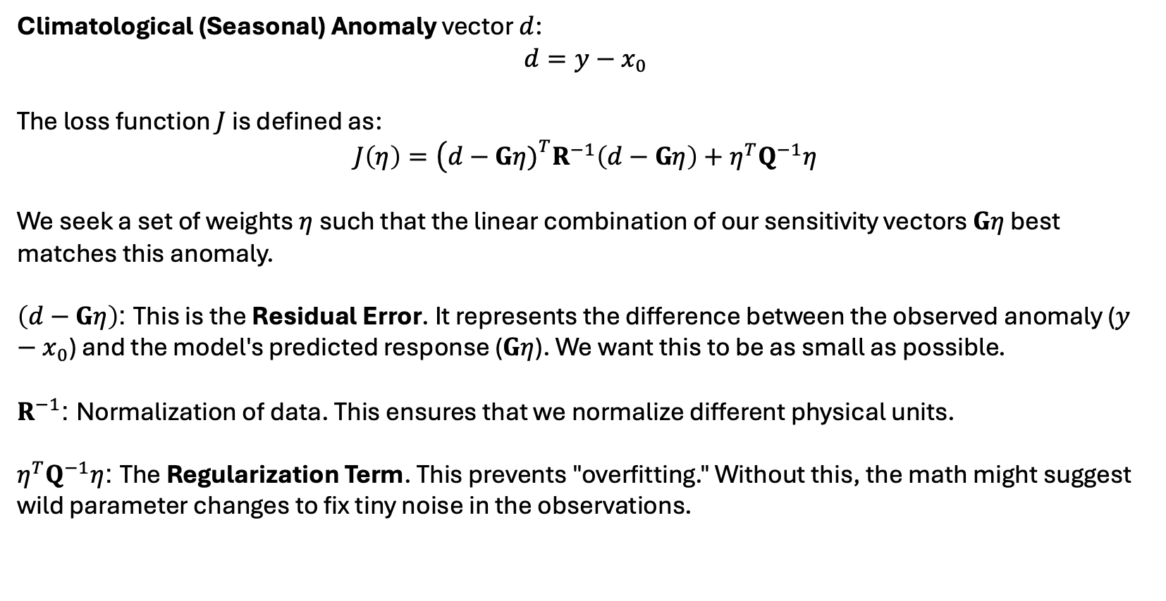
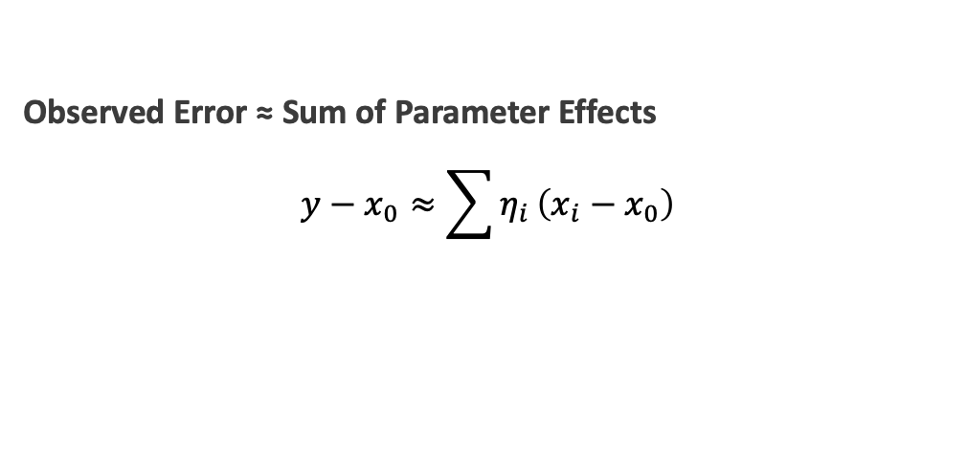
GFO
Observations ($y$) and the Reference Run ($x_{0})$
Climatological (Seasonal) Anomaly vector $d$:
$$d=y−x_{0}$$
The loss function $J$ is defined as:
$$J\left(η\right)=\left(d−Gη{\left.)\right.}^{T}R^{−1}\left(d−Gη\right)+η^{T}Q^{−1}η\right.$$
We seek a set of weights $η$ such that the linear combination of our sensitivity vectors $Gη$ best matches this anomaly.
$\left(d−Gη\right)$: This is the Residual Error. It represents the difference between the observed anomaly ($y−x_{0}$) and the model's predicted response ($Gη$). We want this to be as small as possible.
$R^{−1}$: Normalization of data. This ensures that we normalize different physical units.
$η^{T}Q^{−1}η$: The Regularization Term. This prevents "overfitting." Without this, the math might suggest wild parameter changes to fix tiny noise in the observations.
Observed Error ≈ Sum of Parameter Effects
$$y−x_{0}≈\sum{η_{i}}\left(x_{i}−x_{0}\right)$$

Slide 5
Target Variables
Variable | Dataset | Years | variables
Sea ice fraction | MERRA-2 | 2009-2018 | FRSEAICE (GEOS)
Net surface shortwave radiation | CERES | 2009-2018 | Surface_net_downward_shortwave_flux (SWGNET) (GEOS)
Net surface longwave radiation | CERES | 2009-2018 | Surface_absorbed_longwave_radiation (LWGNET) (GEOS) SFCEM-LWS
U200/T300/H500 | MERRA-2 | 2009-2018 | GEOS
T2M | HadCRUT4 2m | 2009-2018 | T2m (GEOS)
Sea surface temperature | ECCO | 2009-2018 | THETA (MITgcm)
Sea surface salinity | ECCO | 2009-2018 | SSS (MITgcm)
THETA at 300m | ECCO | 2009-2018 | THETA (MITgcm)
Salt at 300m | ECCO | 2009-2018 | SSS (MITgcm)

Slide 6
Parameters
exp_name | parameter | Reference | Perturbed
GF02_TURN | TURNRHCRIT | 726 | 850
GF03_ENTR | ENTR_DP | 0.0001 | 0.0004
GF04_WBF | WBFFACTOR | 0.091 | 0.3
GF05_DCS | DCS | 0.00029 | 0.00025
GF06_DUST | FDROP_DUST | 0.5 | 0.1
GF07_DCNV | DROPSZCNV | 2.5e-5 | 5e-5
GF08_FSOOT | FDROP_SOOT | 0.05 | 0.09
GF09_MINCN | MINCDNC | 52 | 25
GF10_TBRAD | TURB_BETA_RAD | 0.2 | 0.3
GF11_TRBKH | TURB_KHRADFAC | 0.85 | 0.5
GF12_MINRH | MINRHCRIT | 0.89 | 0.8
GF13_QRC | QRC_CRIT | 0.0002 | 0.0004
GF14_RKM | RKM | 8 | 12
GF15_AUT | AUT_SCALE | 1.7 | 0.5
GF16_UIS | UISCALE | 1 | 0.75
GF17_CAHMAX | CICE_AH_MAX | 0.3 | 0.2
GF18_ALBICEV | ALBICEV | 0.78 | 0.73
GF19_BMDL | VSLfactor | 1 | 0.8
GF20_CH1 | Charnok1 | 2.03e-06 | 2.842e-06
GF21_CH2 | Charnok2 | 0.00215 | 0.00315
GF22_CQF | CQfactor | 1 | 0.5

Slide 7
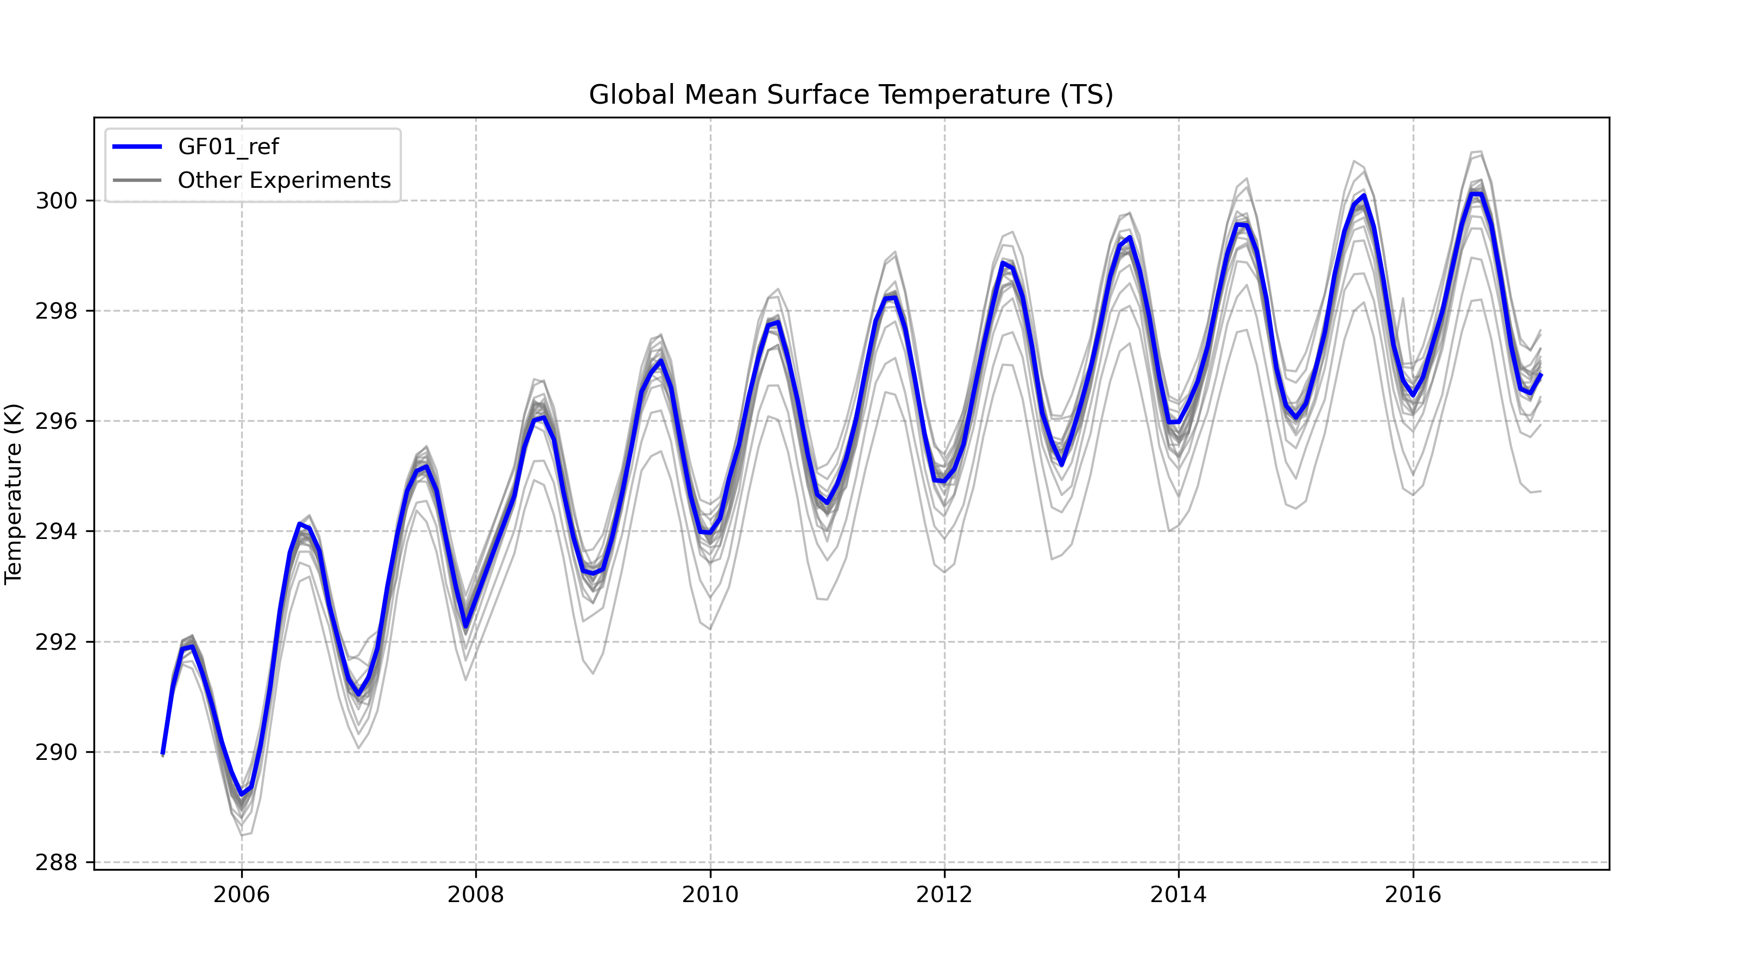

Slide 8
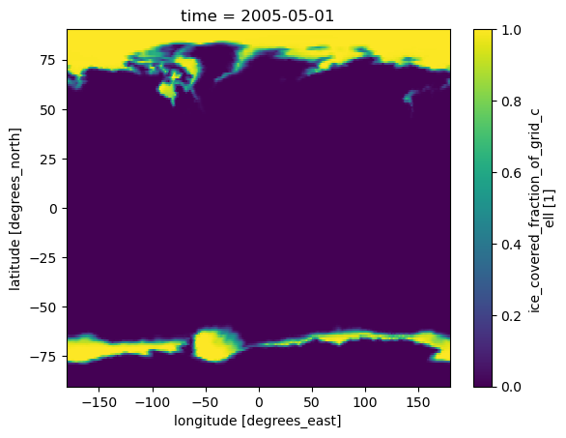
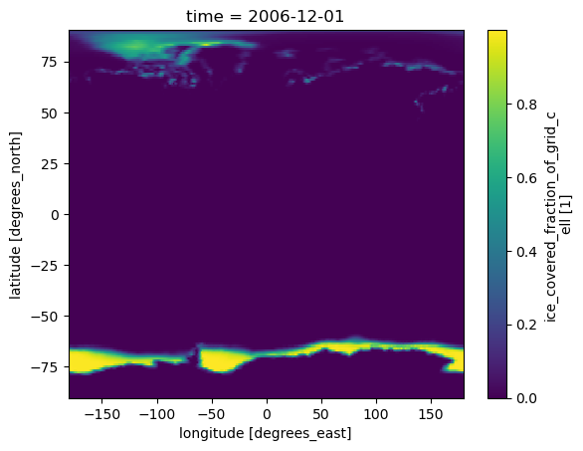
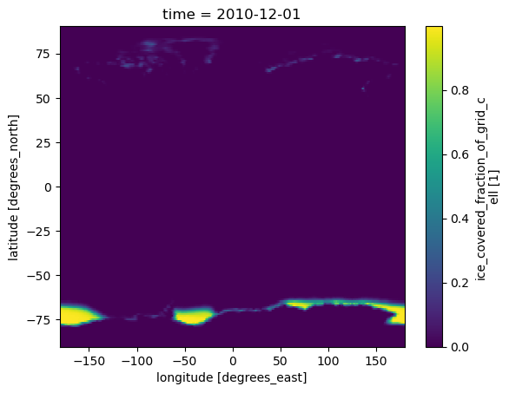
FRSEAICE

Slide 9
OptimizedParameters
exp_name | parameter | Reference | Perturbed | Optimized (% Change)
GF03_ENTR | ENTR_DP | 0.0001 | 0.0004 | 0.0003775 (+277.54%)
GF04_WBF | WBFFACTOR | 0.091 | 0.3 | 0.232 (+154.92%)
GF14_RKM | RKM | 8 | 12 | 15.28 (+90.96%)
GF15_AUT | AUT_SCALE | 1.7 | 0.5 | 0.2404 (-85.86%)
GF13_QRC | QRC_CRIT | 0.0002 | 0.0004 | 4.669e-05 (-76.65%)
GF09_MINCN | MINCDNC | 52 | 25 | 66.03 (+26.98%)
GF07_DCNV | DROPSZCNV | 2.5e-5 | 5e-5 | 1.893e-05 (-24.28%)
GF16_UIS | UISCALE | 1 | 0.75 | 1.229 (+22.86%)
GF19_BMDL | VSLfactor | 1 | 0.8 | 1.186 (+18.57%)
GF06_DUST | FDROP_DUST | 0.5 | 0.1 | 0.5886 (+17.73%)
GF20_CH1 | Charnok1 | 2.03e-06 | 2.842e-06 | 1.775e-06 (-12.58%)
GF22_CQF | CQfactor | 1 | 0.5 | 0.8877 (-11.23%)
GF21_CH2 | Charnok2 | 0.00215 | 0.00315 | 0.002309 (+7.39%)
GF11_TRBKH | TURB_KHRADFAC | 0.85 | 0.5 | 0.8188 (-3.68%)
GF12_MINRH | MINRHCRIT | 0.89 | 0.8 | 0.8597 (-3.40%)
GF05_DCS | DCS | 0.00029 | 0.00025 | 0.0002971 (+2.44%)
GF08_FSOOT | FDROP_SOOT | 0.05 | 0.09 | 0.04942 (-1.15%)
GF02_TURN | TURNRHCRIT | 726 | 850 | 734.3 (+1.15%)
GF10_TBRAD | TURB_BETA_RAD | 0.2 | 0.3 | 0.2015 (+0.74%)
GF18_ALBICEV | ALBICEV | 0.78 | 0.73 | 0.7759 (-0.52%)
GF17_CAHMAX | CICE_AH_MAX | 0.3 | 0.2 | 0.2987 (-0.42%)

Slide 10
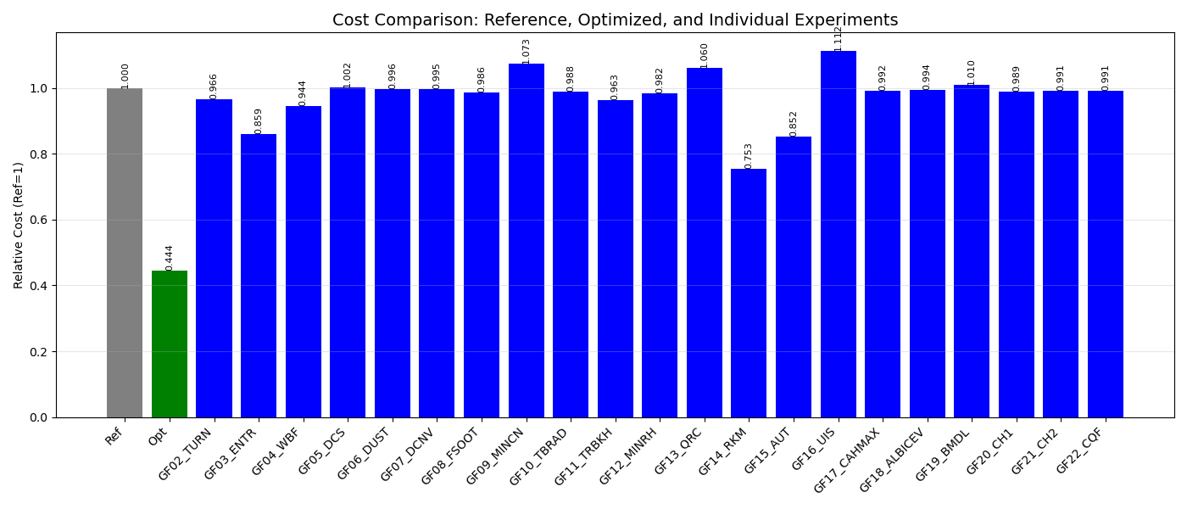

Slide 11
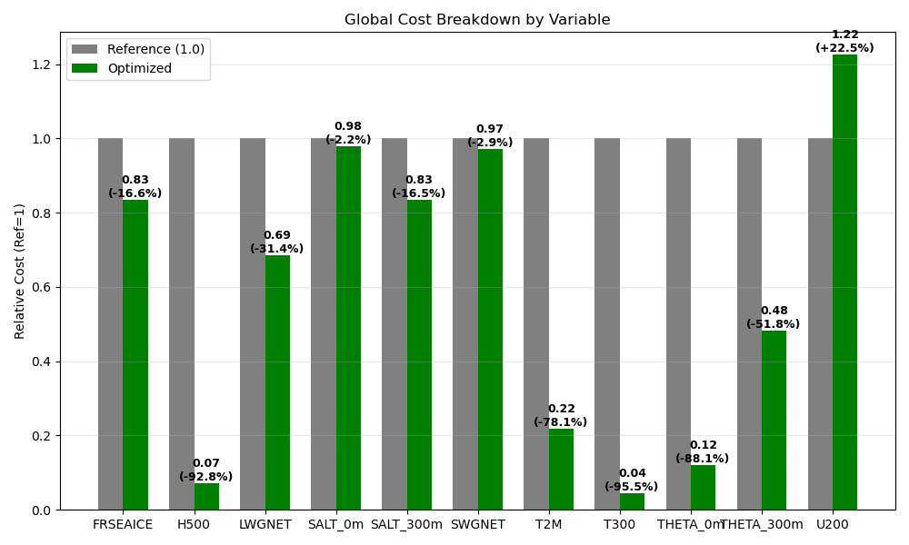

Slide 12
Global mean TS

Slide 13
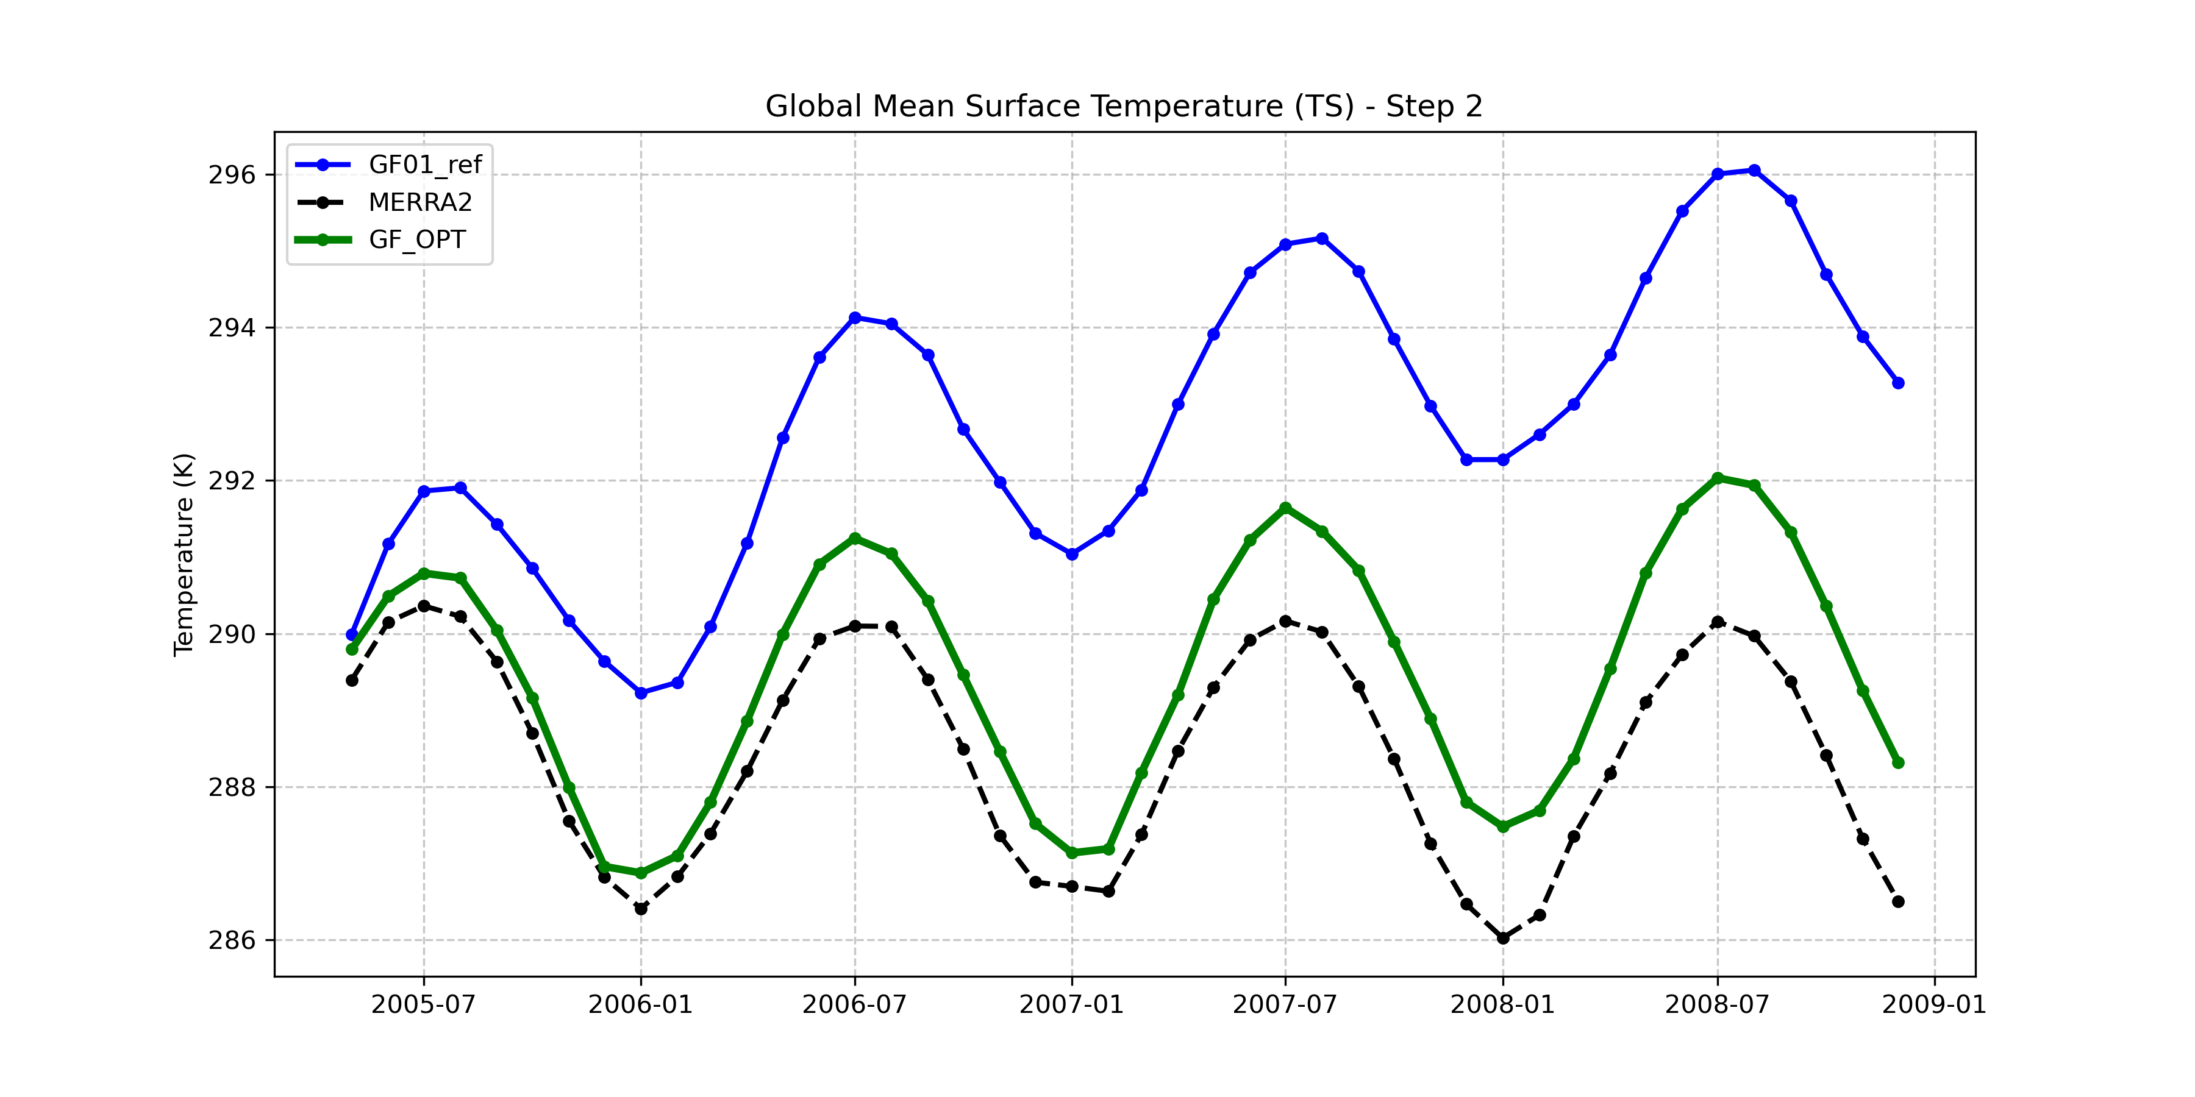
Global mean TS

Slide 14
Global mean TS

Slide 15
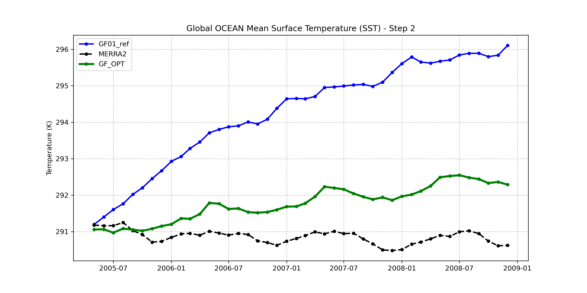
Global mean SST

Slide 16
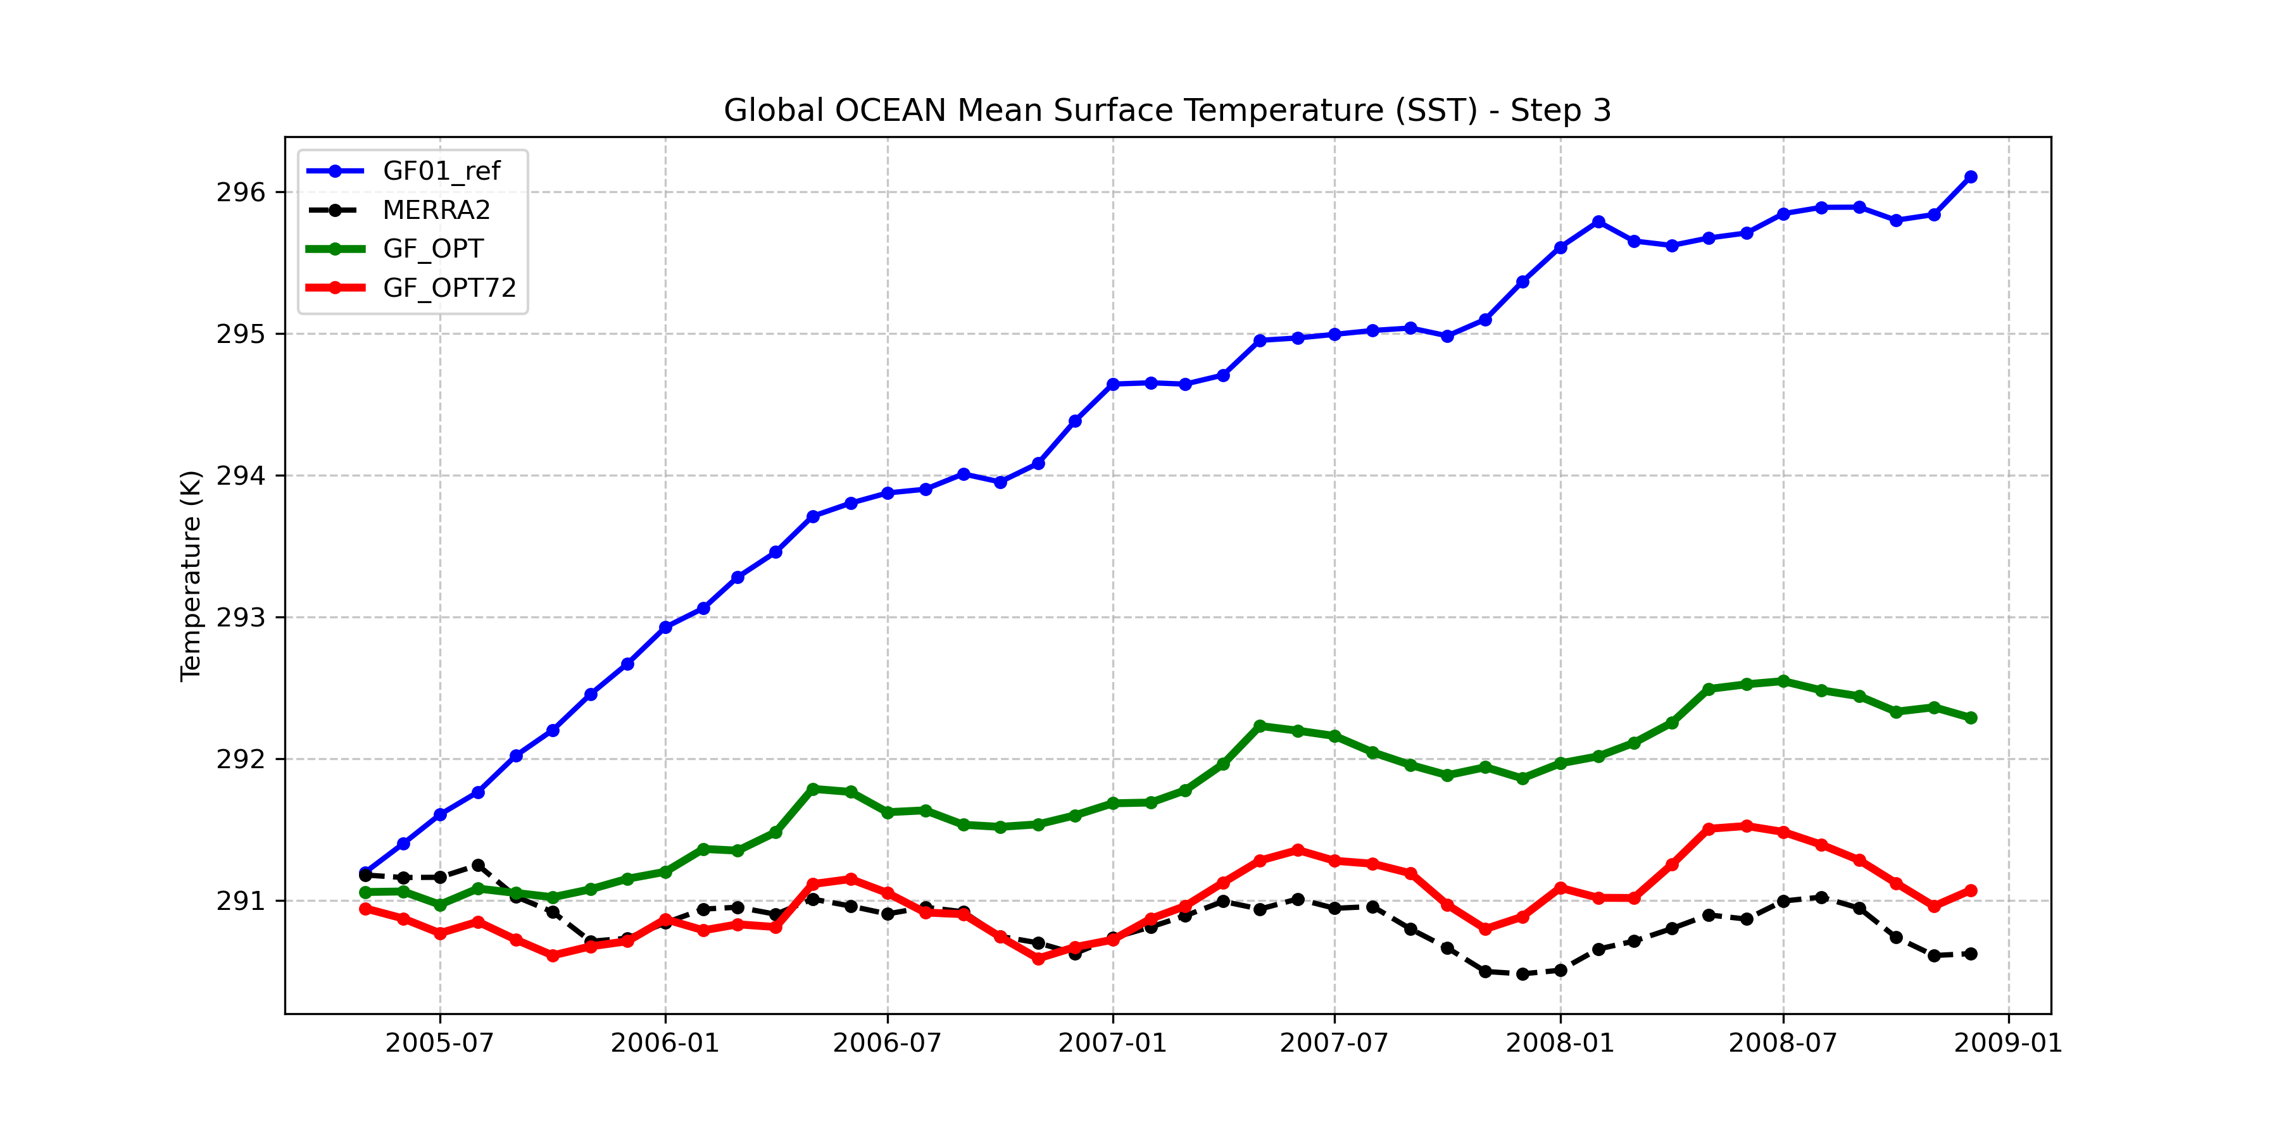
Global mean SST

Slide 17
Hardcoded Shallow
if (JASON_UW) then
call MAPL_GetResource(MAPL, SHLWPARAMS%WINDSRCAVG, 'WINDSRCAVG:' ,DEFAULT=0, RC=STATUS) ; VERIFY_(STATUS)
call MAPL_GetResource(MAPL, SHLWPARAMS%MIXSCALE, 'MIXSCALE:' ,DEFAULT=0.0, RC=STATUS) ; VERIFY_(STATUS)
call MAPL_GetResource(MAPL, SHLWPARAMS%CRIQC, 'CRIQC:' ,DEFAULT=1.0e-3, RC=STATUS) ; VERIFY_(STATUS)
call MAPL_GetResource(MAPL, SHLWPARAMS%THLSRC_FAC, 'THLSRC_FAC:' ,DEFAULT= 0.0, RC=STATUS) ; VERIFY_(STATUS)
else
call MAPL_GetResource(MAPL, SHLWPARAMS%WINDSRCAVG, 'WINDSRCAVG:' ,DEFAULT=1, RC=STATUS) ; VERIFY_(STATUS)
call MAPL_GetResource(MAPL, SHLWPARAMS%MIXSCALE, 'MIXSCALE:' ,DEFAULT=3000.0, RC=STATUS) ; VERIFY_(STATUS)
call MAPL_GetResource(MAPL, SHLWPARAMS%CRIQC, 'CRIQC:' ,DEFAULT=0.9e-3, RC=STATUS) ; VERIFY_(STATUS)
call MAPL_GetResource(MAPL, SHLWPARAMS%THLSRC_FAC, 'THLSRC_FAC:' ,DEFAULT= 1.0, RC=STATUS) ; VERIFY_(STATUS)
endif
if (JASON_UW) then
call MAPL_GetResource(MAPL, SHLWPARAMS%FRC_RASN, 'FRC_RASN:' ,DEFAULT= 0.0, RC=STATUS) ; VERIFY_(STATUS)
call MAPL_GetResource(MAPL, SHLWPARAMS%RKM, 'RKM:' ,DEFAULT= 12.0, RC=STATUS) ; VERIFY_(STATUS)
call MAPL_GetResource(MAPL, SHLWPARAMS%RPEN, 'RPEN:' ,DEFAULT= 3.0, RC=STATUS) ; VERIFY_(STATUS)
call MAPL_GetResource(MAPL, SCLM_SHALLOW, 'SCLM_SHALLOW:' ,DEFAULT= 1.0, RC=STATUS) ; VERIFY_(STATUS)
else
call MAPL_GetResource(MAPL, SHLWPARAMS%FRC_RASN, 'FRC_RASN:' ,DEFAULT= 1.0, RC=STATUS) ; VERIFY_(STATUS)
call MAPL_GetResource(MAPL, SHLWPARAMS%RKM, 'RKM:' ,DEFAULT= 8.0, RC=STATUS) ; VERIFY_(STATUS)
call MAPL_GetResource(MAPL, SHLWPARAMS%RPEN, 'RPEN:' ,DEFAULT= 3.0, RC=STATUS) ; VERIFY_(STATUS)
call MAPL_GetResource(MAPL, SCLM_SHALLOW, 'SCLM_SHALLOW:' ,DEFAULT= 1.0, RC=STATUS) ; VERIFY_(STATUS)
endif
GEOS_UW_InterfaceMod.F90
if (LM==72) then
call MAPL_GetResource(MAPL, JASON_UW, 'JASON_UW:',default= .TRUE. , RC=STATUS)
else
call MAPL_GetResource(MAPL, JASON_UW, 'JASON_UW:',default= .FALSE., RC=STATUS)
endif

Slide 18
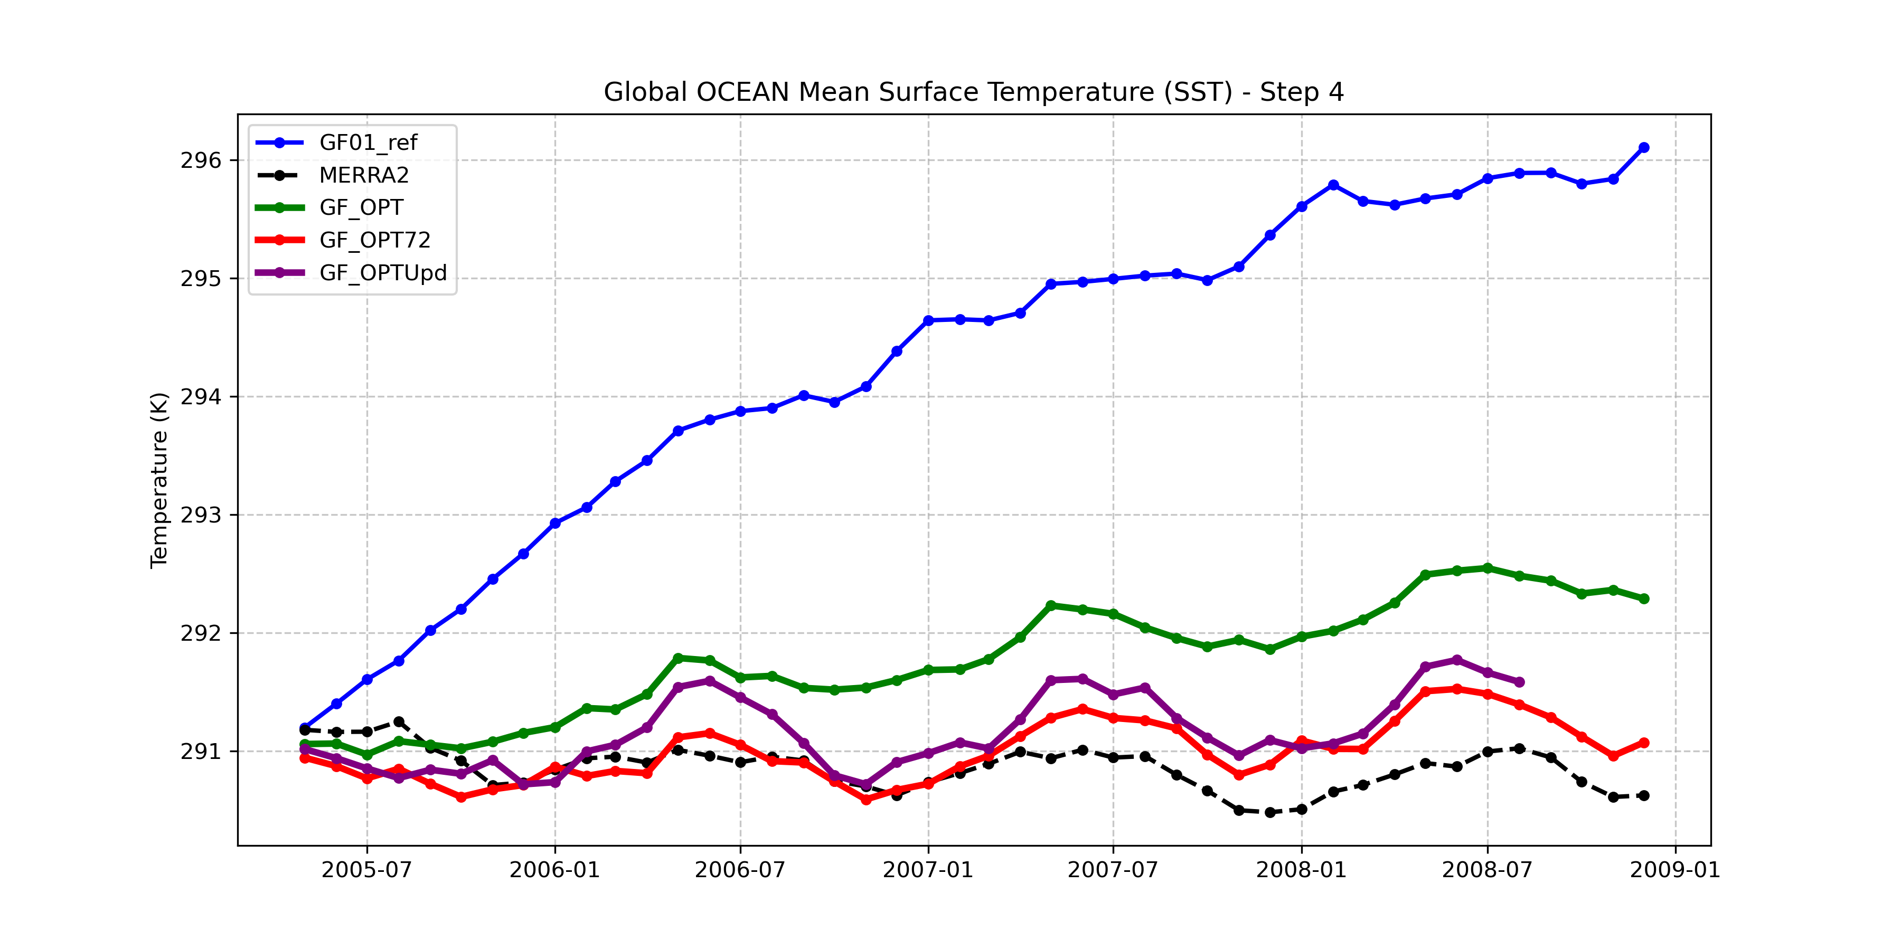
Global mean SST

Slide 19
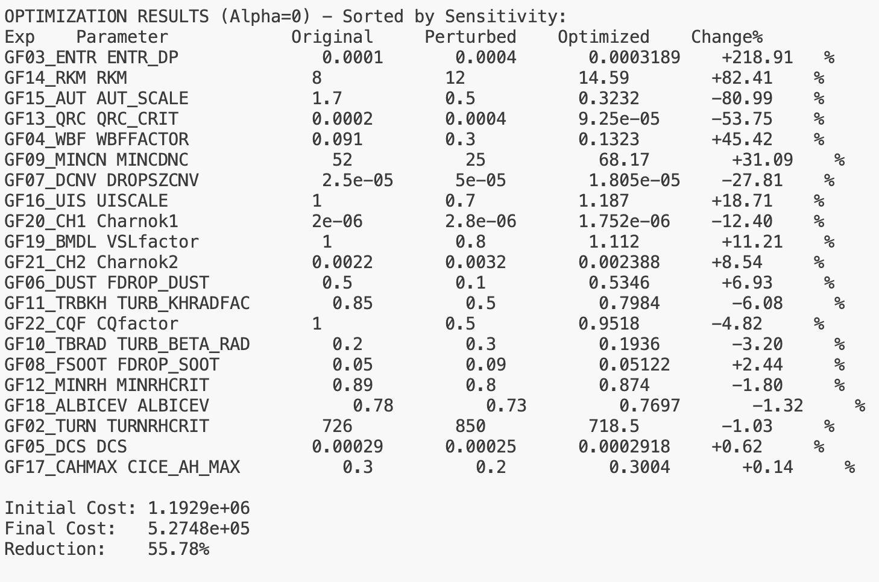
Weighted
var_weights = {
'FRSEAICE': 1.0,
'H500': 0,
'LWGNET': 1.0,
'SWGNET': 1.0,
'SALT_300m': 0.8,
'THETA_300m': 0.8,
'THETA_0m': 10,
'SALT_0m': 0.8,
'T2M': 1.2,
'T300': 2,
'U200’: 7
}

Slide 20


Slide 21
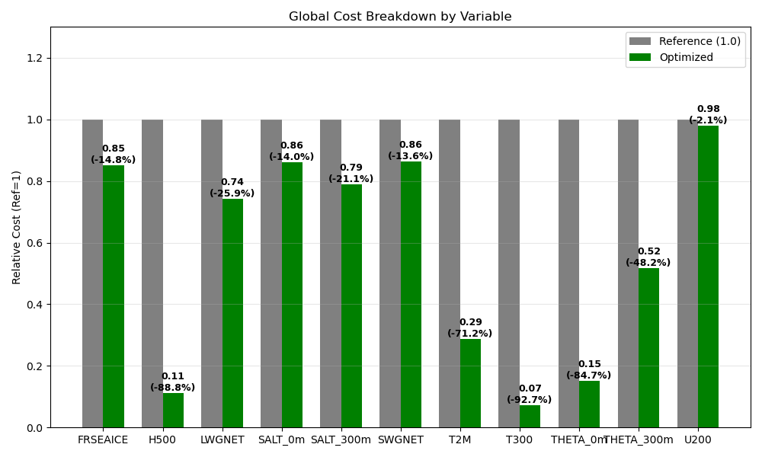
var_weights = {
'FRSEAICE': 1.0,
'H500': 0,
'LWGNET': 1.0,
'SWGNET': 1.0,
'SALT_300m': 0.8,
'THETA_300m': 0.8,
'THETA_0m': 10,
'SALT_0m': 0.8,
'T2M': 1.2,
'T300': 2,
'U200’: 7
}

