Slide 1

Web Development with Python/Django Django Forms
Dr. Abdelhameed Ibrahim
Assoc. Prof. of Computer Engineering

Slide 2
Learning Objectives
To achieve this, then, you must learn
Using Django Forms
Connect the form in the template
2

Slide 3
Forms
First, create a forms.py file inside the application!
Create a form from a pre-existing model, use forms.ModelForm
Meta class provides information connecting the model to the form.
3

Slide 4
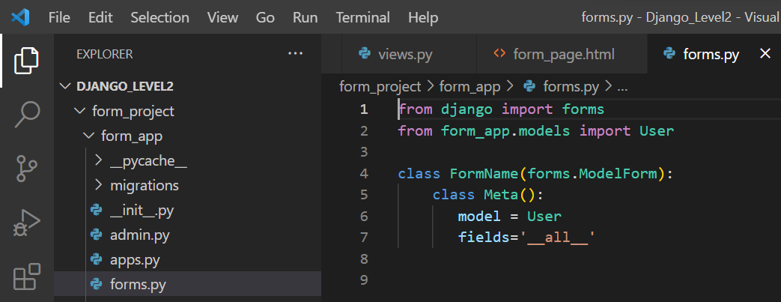
Forms
4

Slide 5
Learning Objectives
To achieve this, then, you must learn
Using Django Forms
Connect the form in the template
5

Slide 6
Forms
Now we need to show form created inside the application’s forms.py file by using a view!
Inside our views.py file we need to import the forms
from .forms import FormName
6

Slide 7
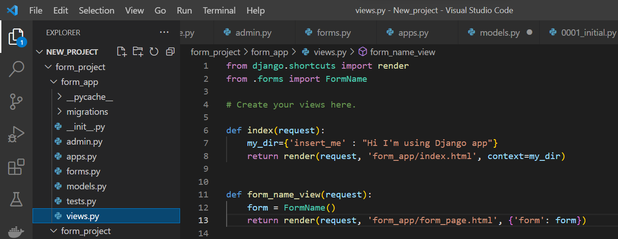
Forms, update views
7

Slide 8
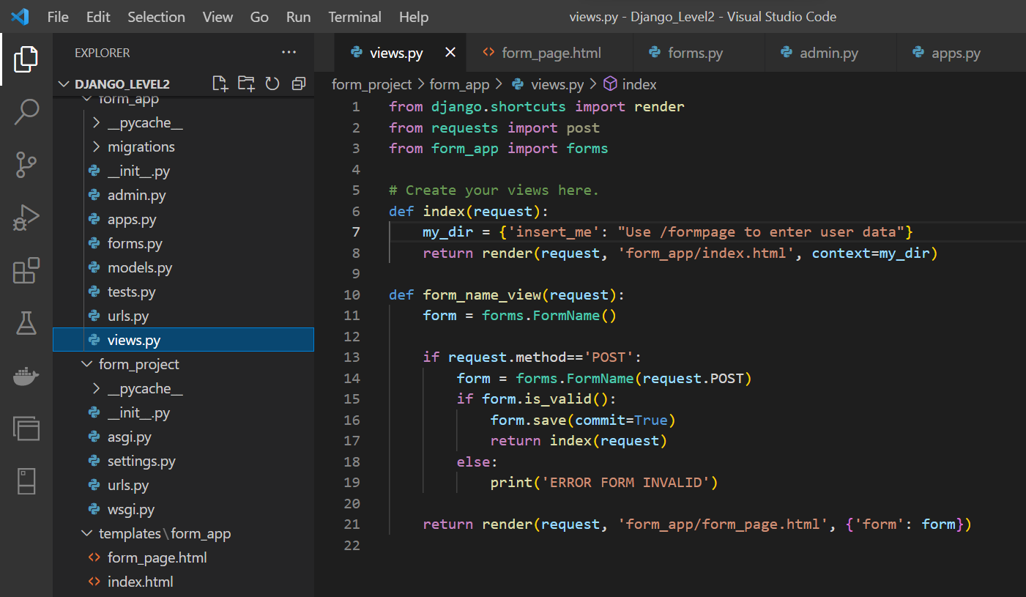

Slide 9
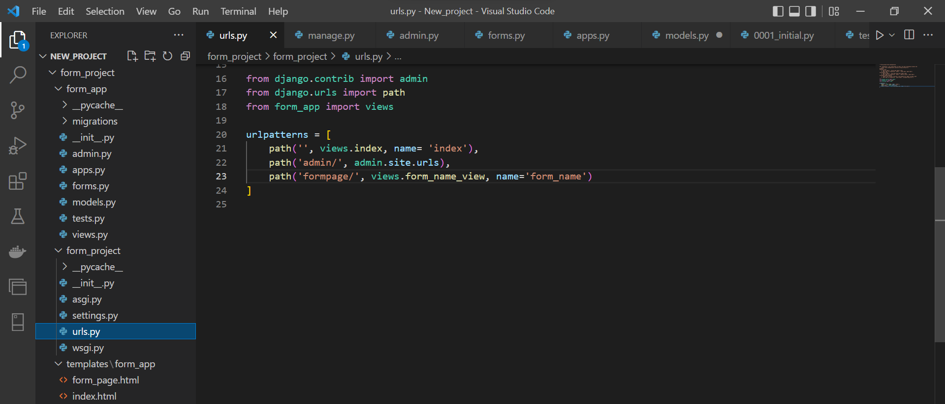
Forms, update urls

Slide 10
Forms
There are several ways you can “inject” the form using template tagging.
You can just pass in the key from the context dictionary:
{{ form }} or {{ form.as_p }}
10

Slide 11
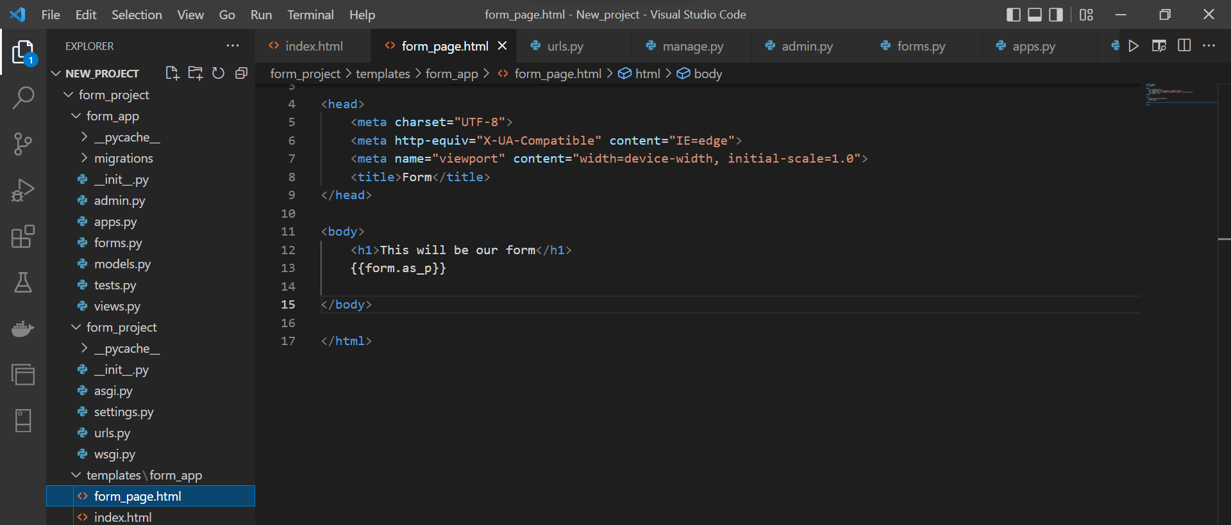
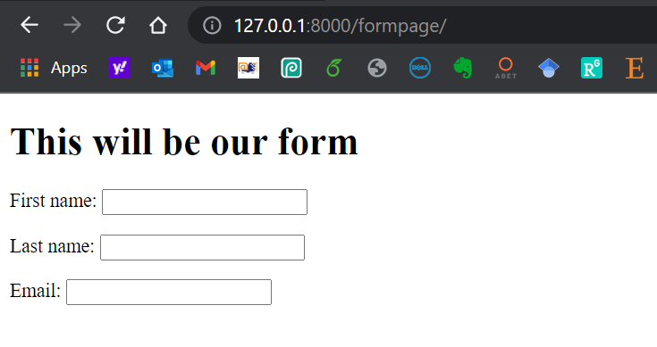
Forms

Slide 12



Thanks
Dr. Abdelhameed Fawzy

