Slide 1

Web Development with Python/Django Accepting User Input and connect it to the database
Dr. Abdelhameed Ibrahim
Assoc. Prof. of Computer Engineering

Slide 2
Forms and Models
Adding form and button to the html file
Using Bootstrap to improve the shape of the website
2

Slide 3
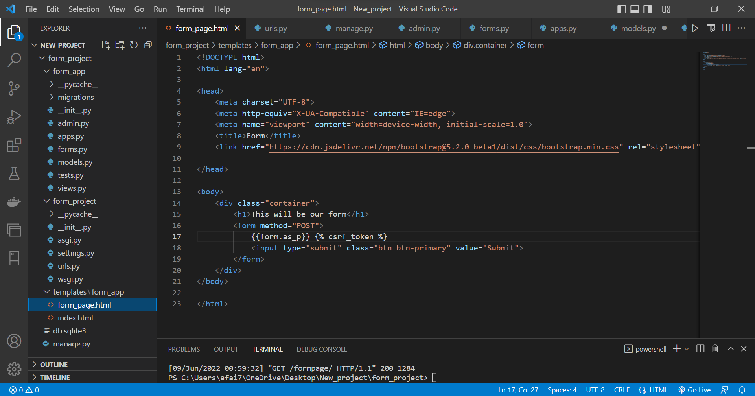

Slide 4
Forms and Models
Update views by this to save data
if request.method=='POST':
form = FormName(request.POST)
if form.is_valid():
form.save(commit=True)
return index(request)
else:
print('ERROR FORM INVALID')
4

Slide 5
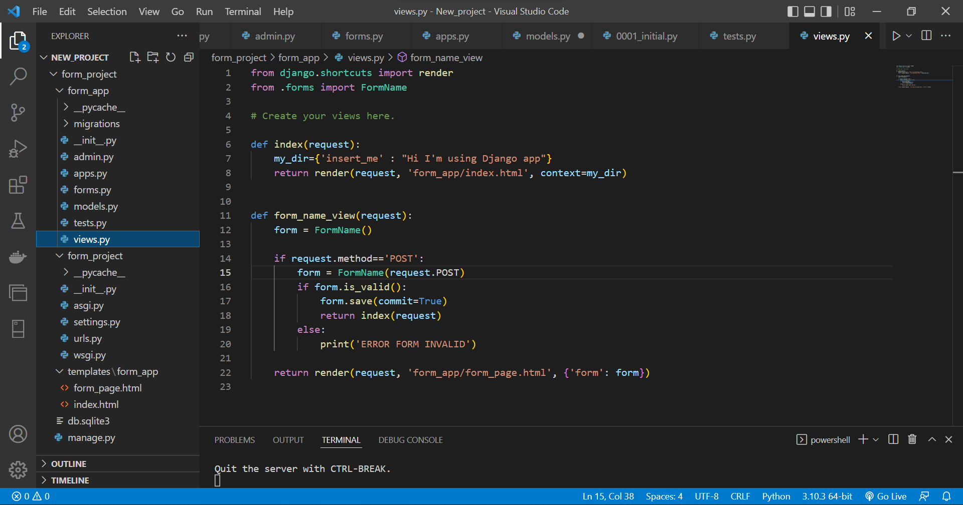

Slide 6
Model Forms - Run
6

Slide 7
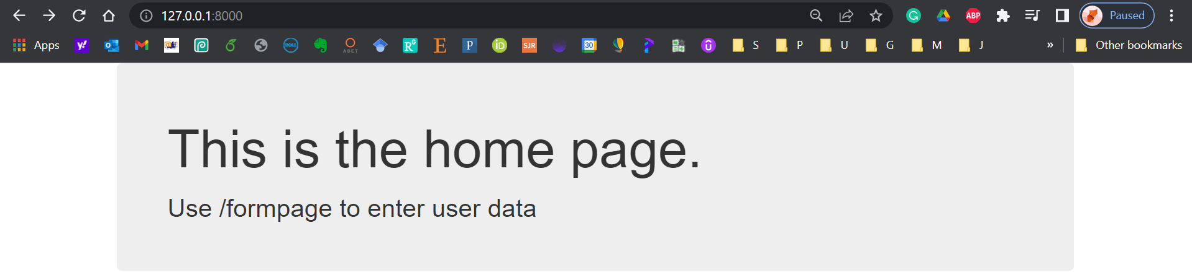
Home Page
7

Slide 8
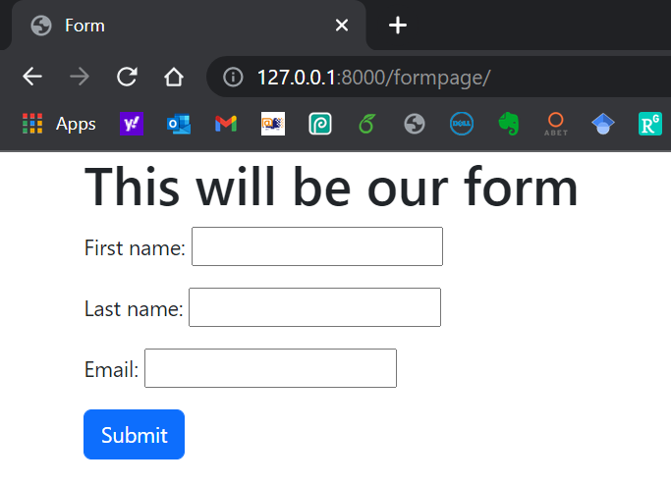
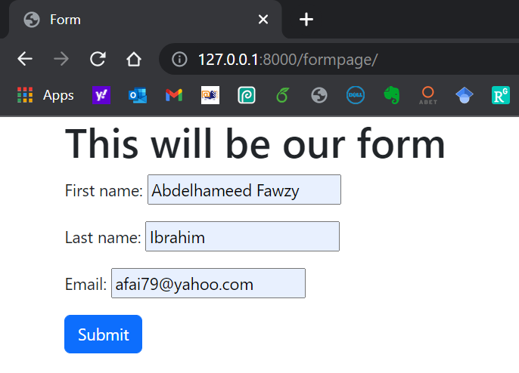
Form Page
8

Slide 9
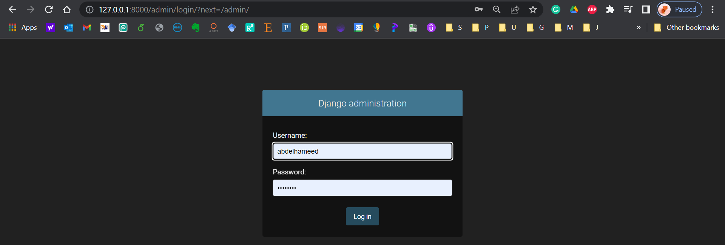
Django Admin
9

Slide 10
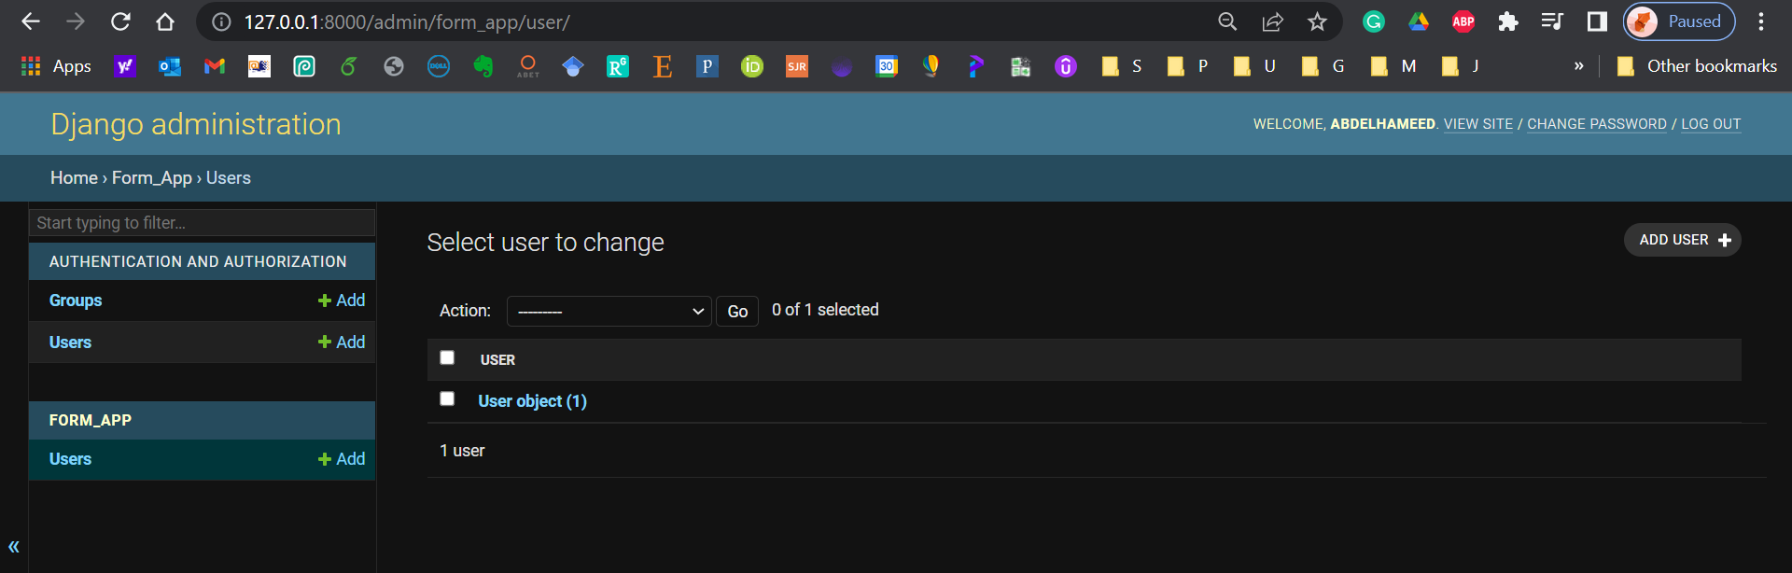
Django Admin
10

Slide 11
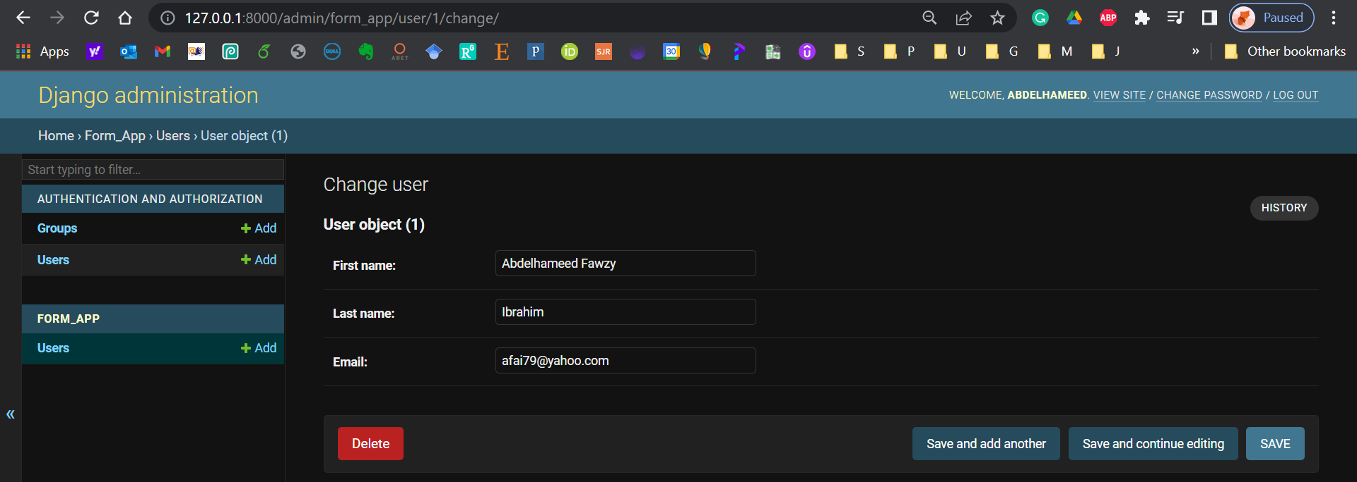
Django Admin
11

Slide 12
Django – Challenge 2
Model Forms
12

Slide 13
Challenge 2
Complete the following task:
Develop a Django web form that enables the user to insert data (username, password) into the database using a form (login).
13

Slide 14



Thanks
Dr. Abdelhameed Fawzy

