Slide 1

Web Development with Python/Django More classes for database
Dr. Abdelhameed Ibrahim
Assoc. Prof. of Computer Engineering

Slide 2
More classes for database
To display an object in the Django admin site and as the value inserted into a template when it displays an object.
https://docs.djangoproject.com/en/4.1/ref/models/instances/
class Topic(models.Model):
top_name = models.CharField(max_length=264, unique=True)
def __str__(self):
return self. top_name
class Webpage(models.Model):
category = models.ForeignKey(Topic)
name = models.CharField(max_length=264)
url = models.URLField()
def __str__(self):
return self.name
2

Slide 3
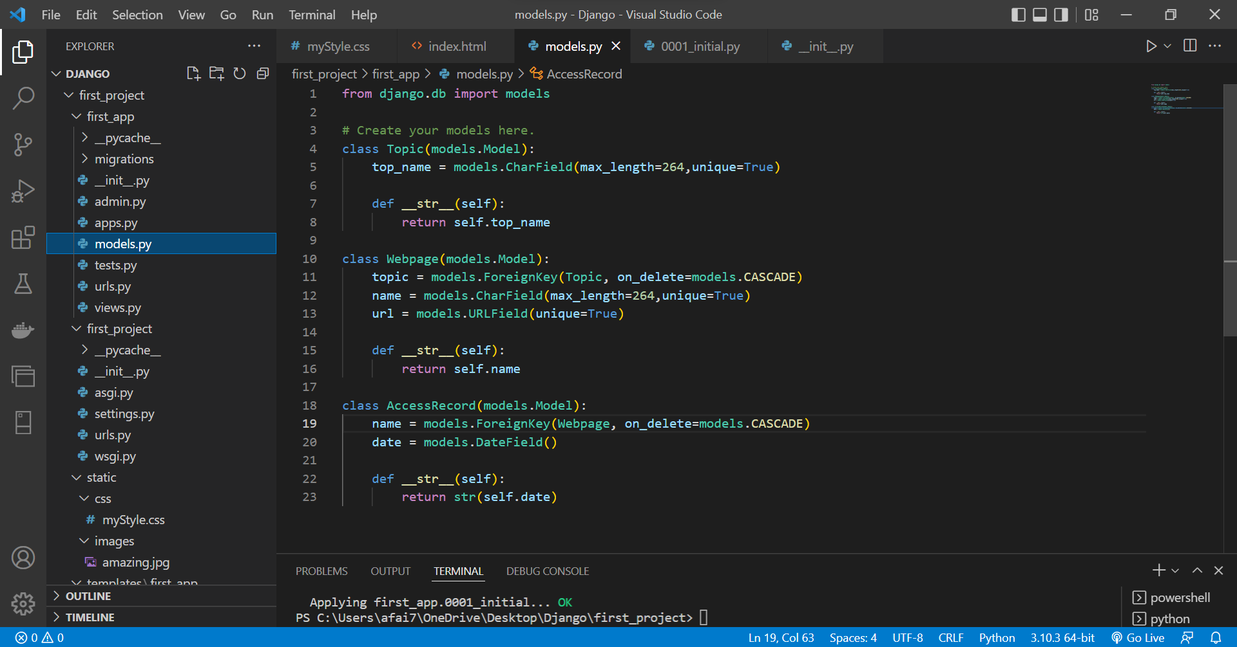
3

Slide 4
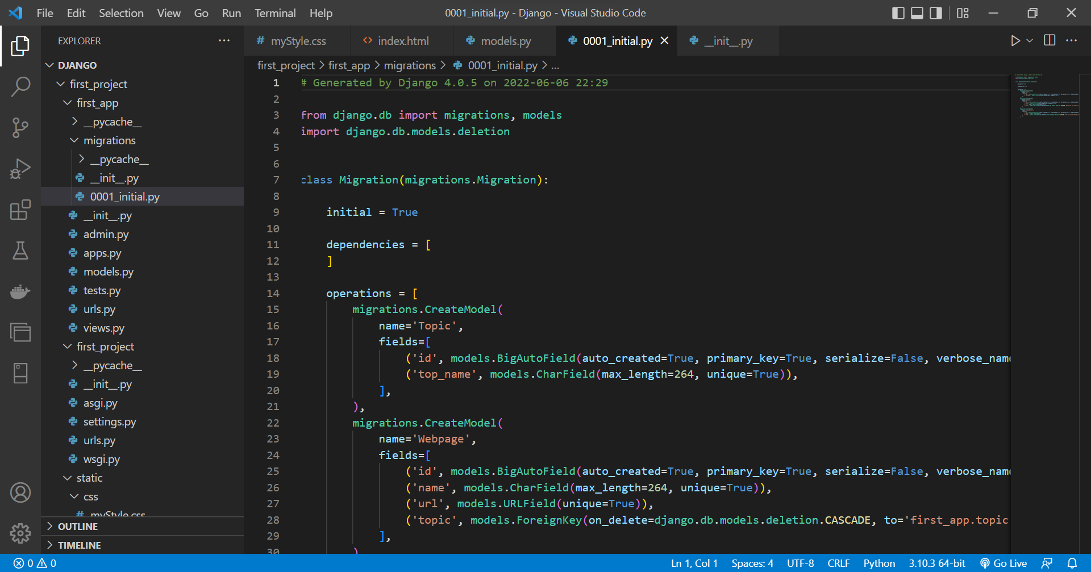
4

Slide 5
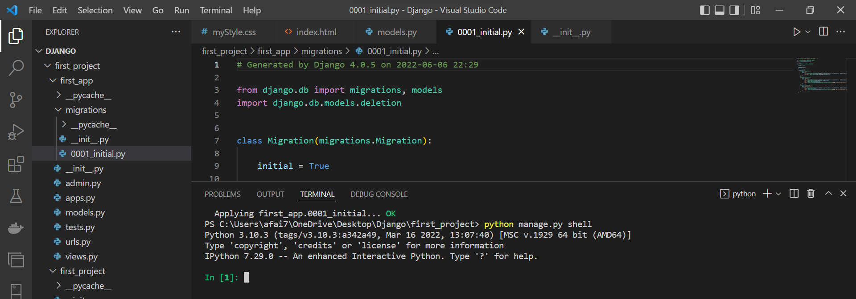
Run test data
5

Slide 6
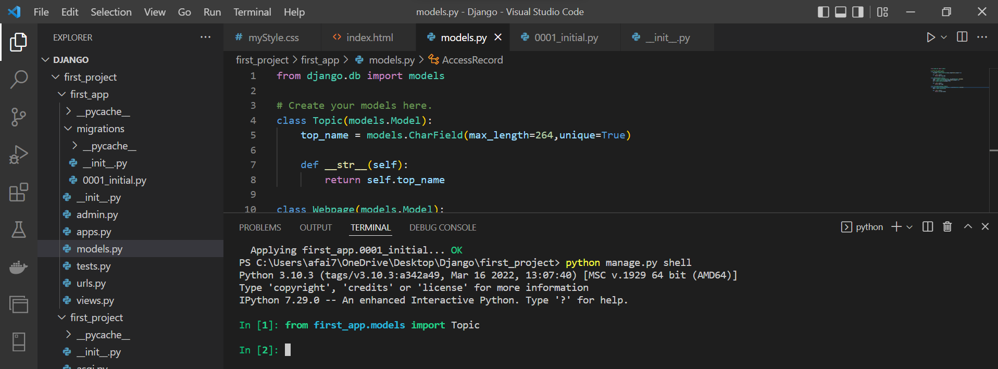
Insert data
6

Slide 7
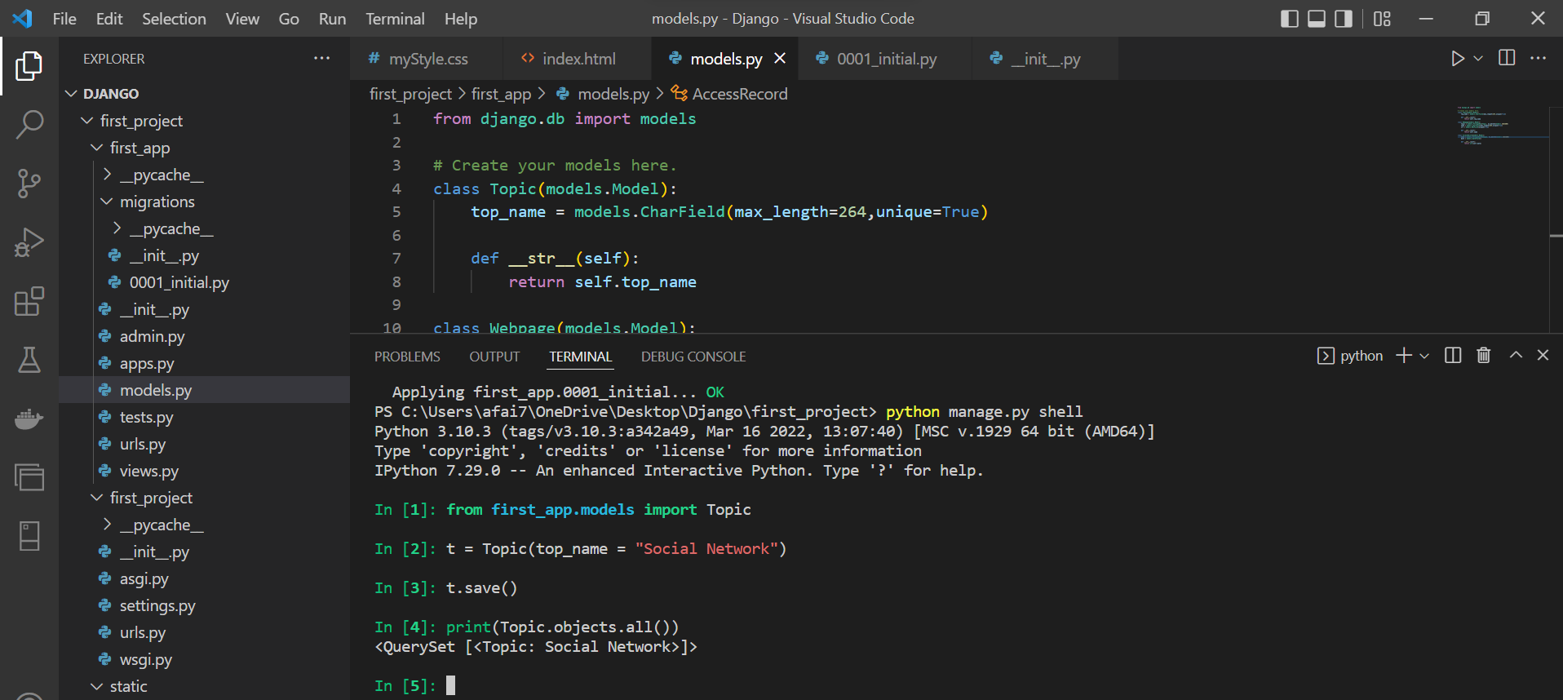
Insert data
7

Slide 8
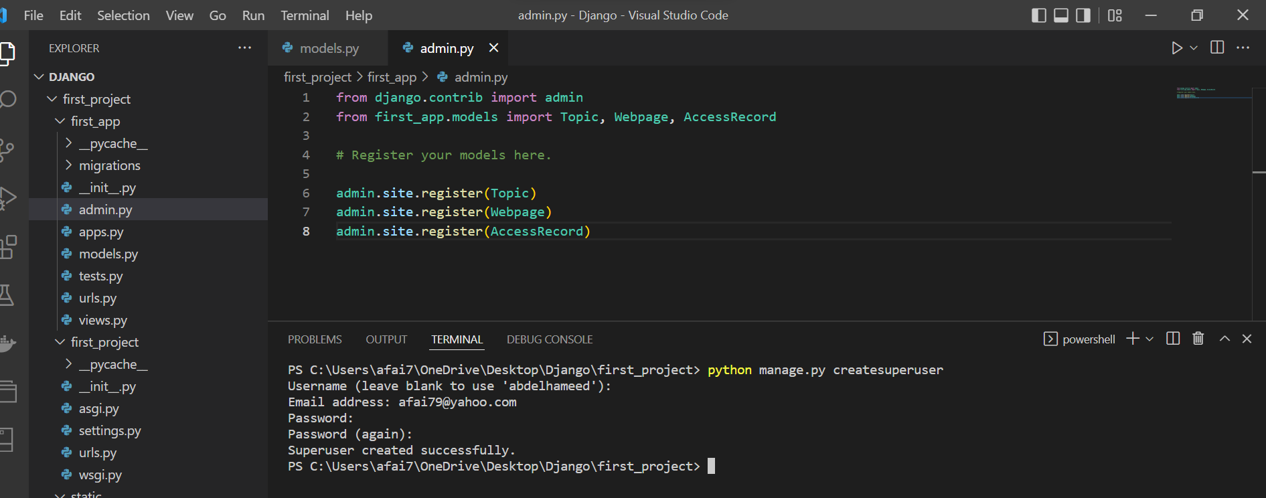
To use admin and createsuperuser
8

Slide 9
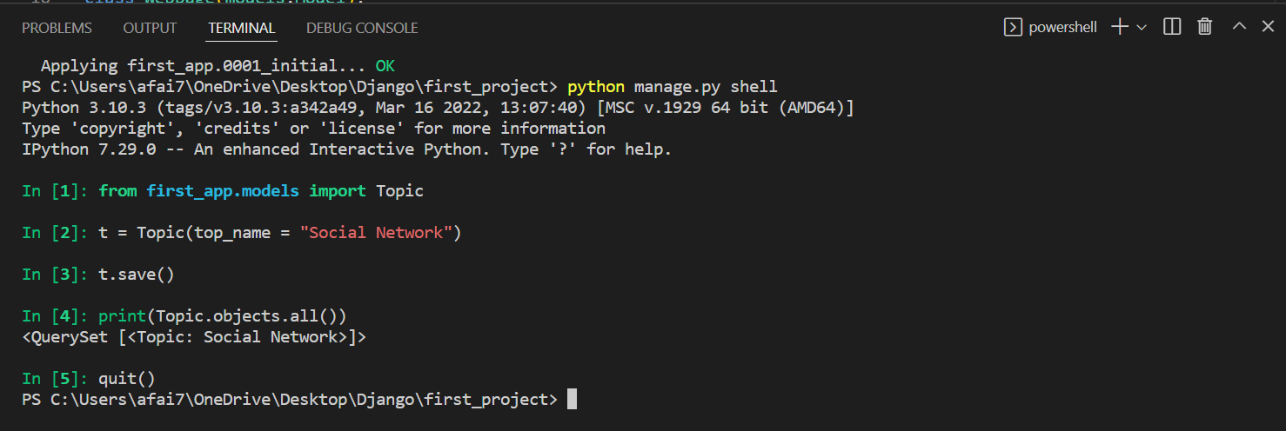
quit()
9

Slide 10
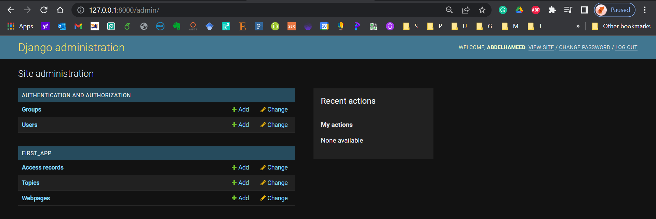
To use admin and createsuperuser
10

Slide 11
Django – Challenge 3
11

Slide 12
Challenge 3
Develop a Django web form that Creating Book store Database
12

Slide 13
Books App {
- List books with their information
- Search for a book
- Author Profile}
Books {Id, Title, Abstract, ISBN, Author, Shelf}
Db Entities {
Books (Id, Title, Abstract, ISBN, Author, Shelf)
Authors (Id, Name, Email)
Shelves (Id, Name)
}
13

Slide 14



Thanks
Dr. Abdelhameed Fawzy

