Slide 1

Web Development with Python/Django
Dr. Abdelhameed Ibrahim
Assoc. Prof. of Computer Engineering

Slide 2

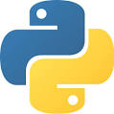

Learning Objectives
First, you will learn
Using Django web application
Creating a virtual environment (Anaconda)
Setting up Projects and Applications
Using simple Templates and tags
Creating Views and Mapping URLs
2

Slide 3
Learning Objectives
Then, you will learn
Creating a model
Using the Admin interface
Using Django Forms
Connect the form in the template
Accepting User Input and connect it to the database
3

Slide 4
Learning Objectives
Getting Started with Python in VS Code
https://code.visualstudio.com/
https://marketplace.visualstudio.com/VSCode
https://www.python.org/
https://www.anaconda.com/products/individual
4

Slide 5
Python
Getting Started with Python in VS Code
Install Visual Studio Code and the Python Extension
Verify the Python installation
py -3 --version
5

Slide 6
Python
Start VS Code in a project folder
Select a Python interpreter (Ctrl+Shift+P)
Create a Python source code file and Run
msg = "Hello World"
print(msg)
6

Slide 7
Python
Install and use packages
import matplotlib.pyplot as plt
import numpy as np
x = np.linspace(0, 20, 100)
plt.plot(x, np.sin(x))
plt.show()
7

Slide 8
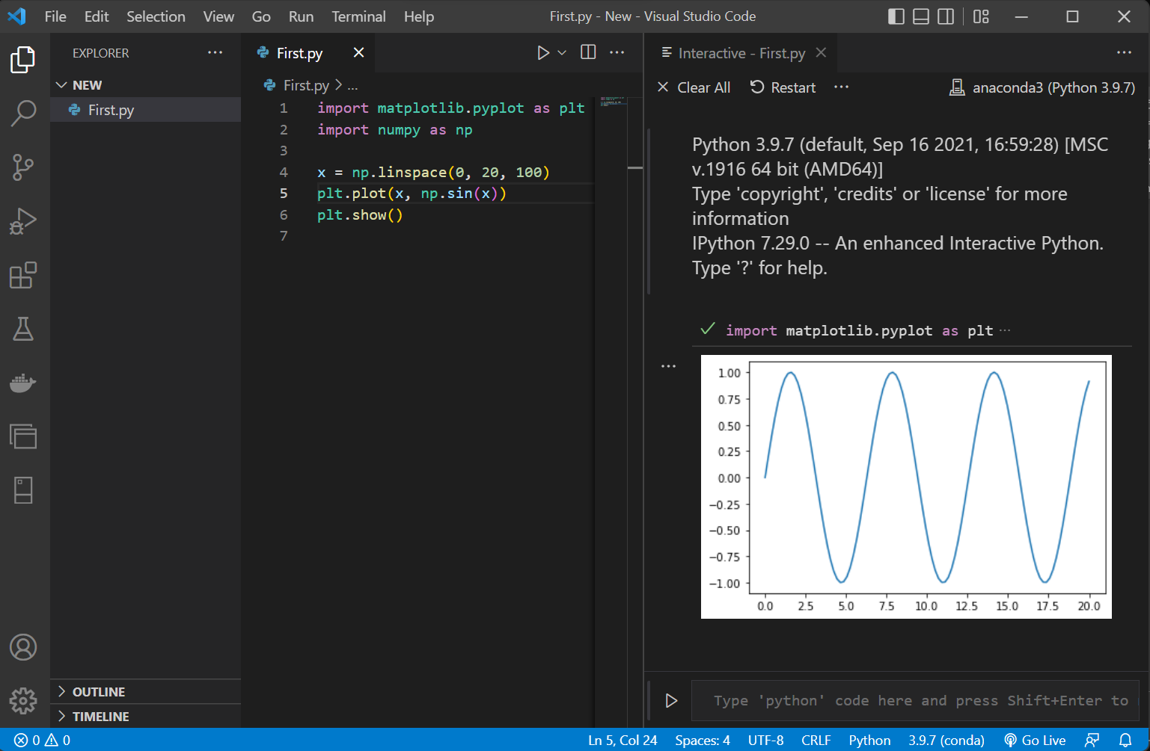

Slide 9
Learning Objectives
First, you will learn
Using Django web application
Creating a virtual environment (Anaconda)
Setting up Projects and Applications
9

Slide 10
Django
Django is an open-source and free web framework.
Django is server-side technology.
Many websites utilize it, including Instagram, BitBucket, the Washington Times, and Mozilla, among others!
10

Slide 11
Learning Objectives
First, you will learn
Using Django web application
Creating a virtual environment (Anaconda)
Setting up Projects and Applications
11

Slide 12
Virtual environment
Anaconda makes this simple for us!
Virtual environment with conda, use this:
conda create --name myEnv Django
Here, we constructed a "myEnv" environment using a recent version of Django.
12

Slide 13
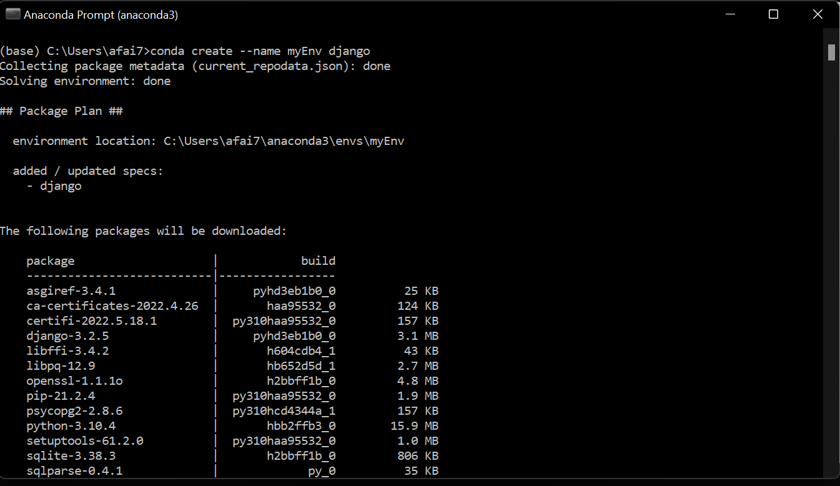
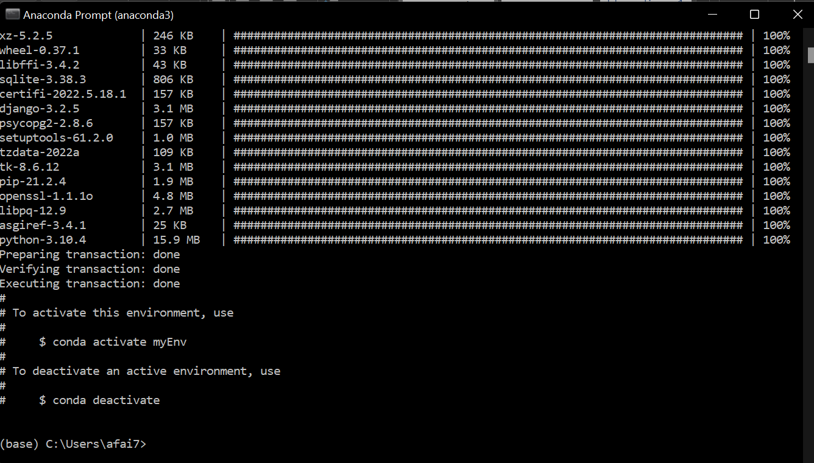
13

Slide 14
Virtual environment
Now, activate the environment:
conda activate myEnv
You can deactivate the environment.
conda deactivate
You can environment information.
conda info --envs
14

Slide 15
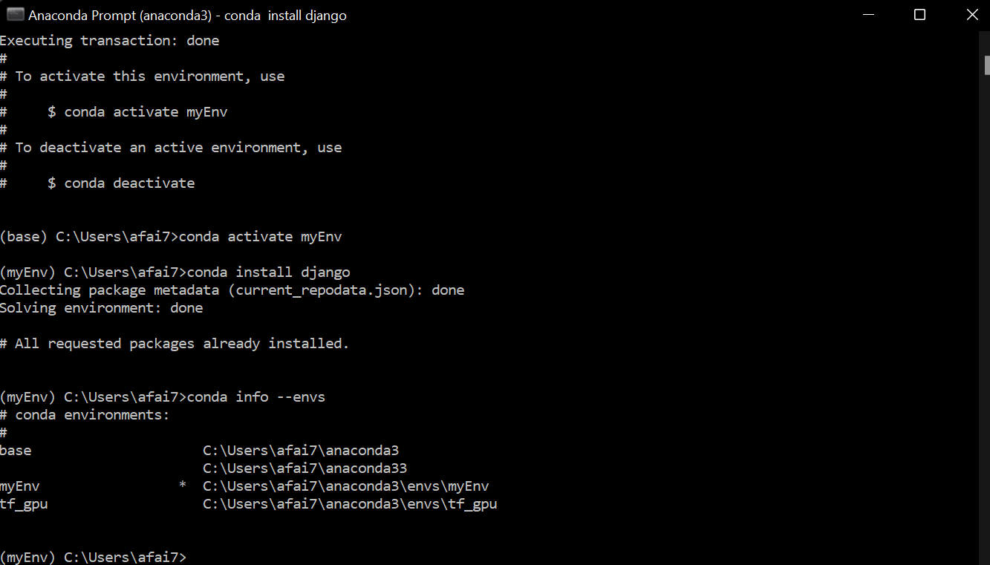
15

Slide 16
Learning Objectives
First, you will learn
Using Django web application
Creating a virtual environment (Anaconda)
Setting up Projects and Applications
16

Slide 17
Django project
When you install Django, it installed a command line tool called:
django-admin
Let’s create our first project. Type:
django-admin startproject first_project
17

Slide 18
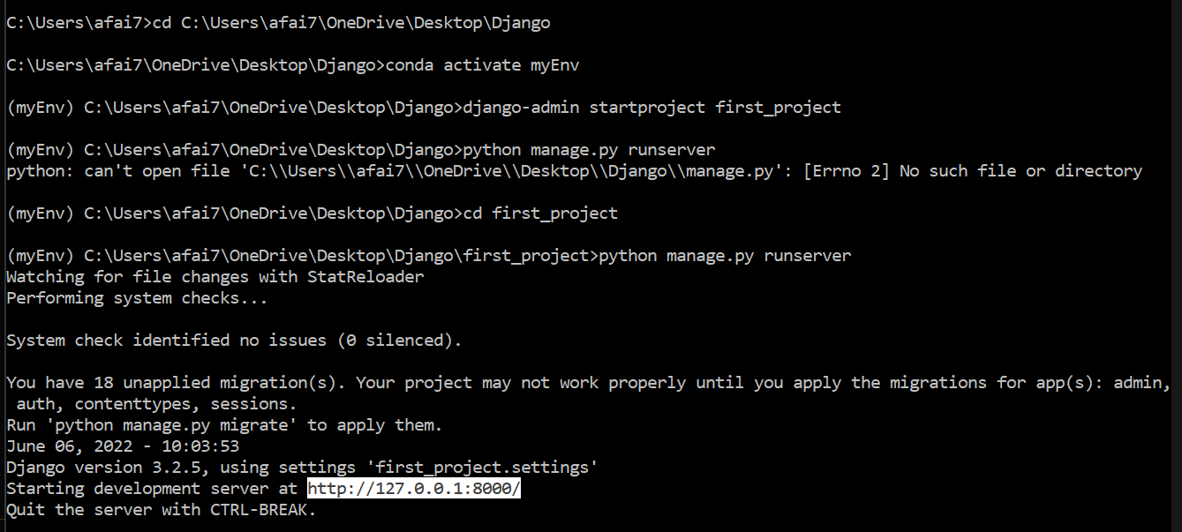
Django project

Slide 19
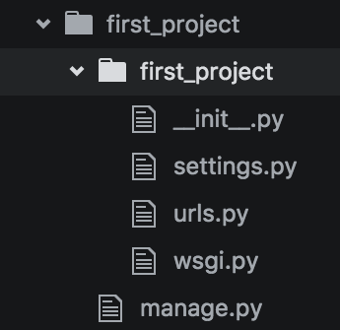
Django project
You will then receive something like this:
19

Slide 20
Django project
Let’s explain what is going on here!
20

Slide 21
Django project
__init__.py
This is a blank Python script that due to its special name let’s Python know that this directory can be treated as a package
21

Slide 22
Django project
settings.py
This is where you will store all your project settings
22

Slide 23
Django project
urls.py
This is a Python script that will store all the URL patterns for your project. Basically the different pages of your web application.
23

Slide 24
Django project
wsgi.py
This is a Python script that acts as the Web Server Gateway Interface. It will later on help us deploy our web app to production
24

Slide 25
Django project
manage.py
This is a Python script that we will use a lot. It will be associates with many commands as we build our web app!
25

Slide 26
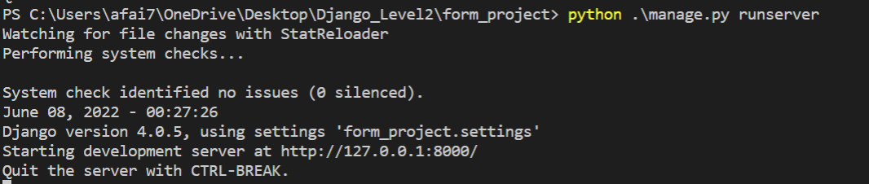
Django project
Let’s use manage.py now:
python manage.py runserver
26

Slide 27
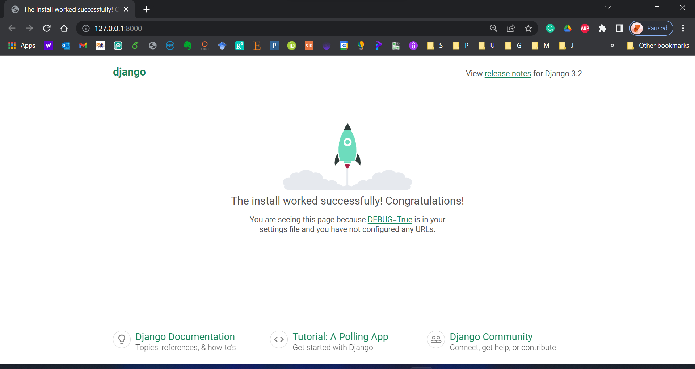
27

Slide 28
Django Application
Plug Django applications into other Django projects and reuse them! (Or use the applications of others)
Create a simple application by using:
python manage.py startapp first_app
28

Slide 29
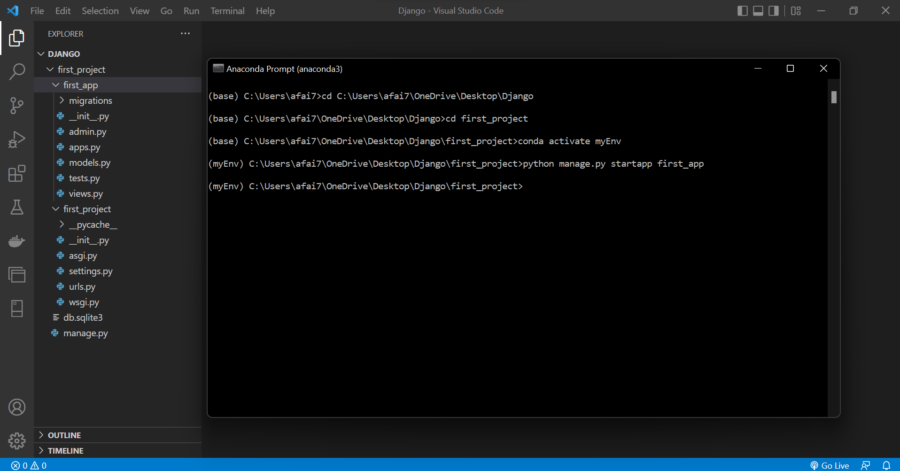
29

Slide 30
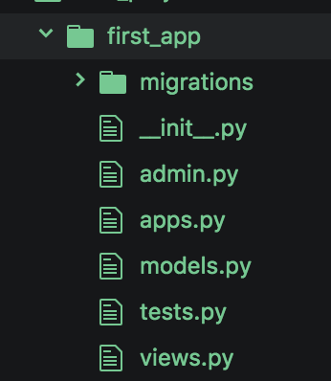
Django Application
Let’s quickly discuss all of these files!
30

Slide 31
Django Application
__init__.py
This is a blank Python script that due to its special name let’s Python know that this directory can be treated as a package
31

Slide 32
Django Application
admin.py
You can register your models here which Django will then use them with Django’s admin interface.
32

Slide 33
Django Application
apps.py
Here you can place application specific configurations
33

Slide 34
Django Application
models.py
Here you store the application’s data models
34

Slide 35
Django Application
tests.py
Here you can store test functions to test your code
35

Slide 36
Django Application
views.py
This is where you have functions that handle requests and return responses
36

Slide 37
Django Application
Migrations folder
This directory stores database specific information as it relates to the models
37

Slide 38
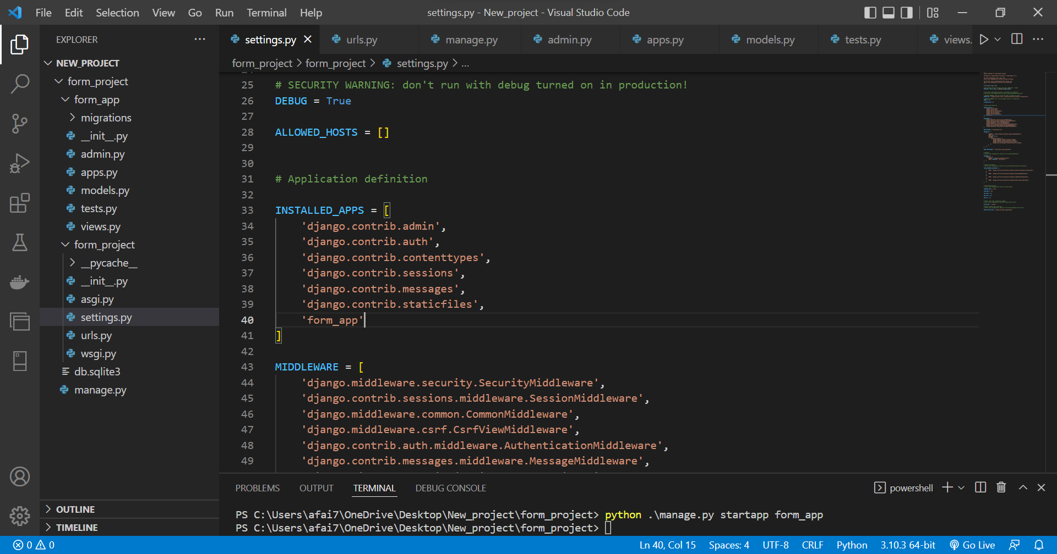
38

Slide 39

Github
You can download the sources in this Training from my GitHub account:
https://github.com/afai79/Django-Python
39

Slide 40
Thanks
Dr. Abdelhameed Fawzy

