Slide 1

Web Development with Python/Django
Dr. Abdelhameed Ibrahim
Assoc. Prof. of Computer Engineering

Slide 2
Learning Objectives
Then, you will learn
Creating a model
Using the Admin interface
Using Django Forms
Connect the form in the template
Accepting User Input and connect it to the database
2

Slide 3
Forms
First, create a forms.py file inside the application!
Create a form from a pre-existing model, use forms.ModelForm
Meta class provides information connecting the model to the form.
3

Slide 4
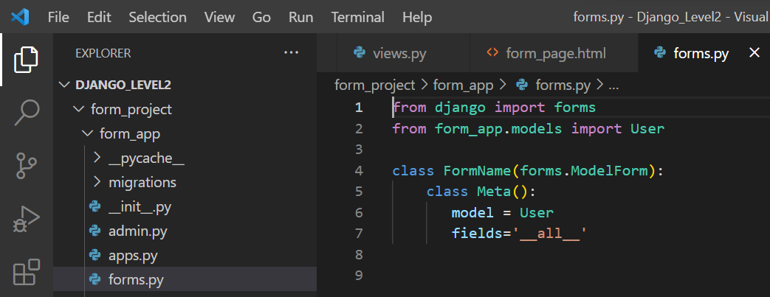
Forms
4

Slide 5
Learning Objectives
Then, you will learn
Creating a model
Using the Admin interface
Using Django Forms
Connect the form in the template
Accepting User Input and connect it to the database
5

Slide 6
Forms
Now we need to show form created inside the application’s forms.py file by using a view!
Inside our views.py file we need to import the forms
from .forms import FormName
6

Slide 7
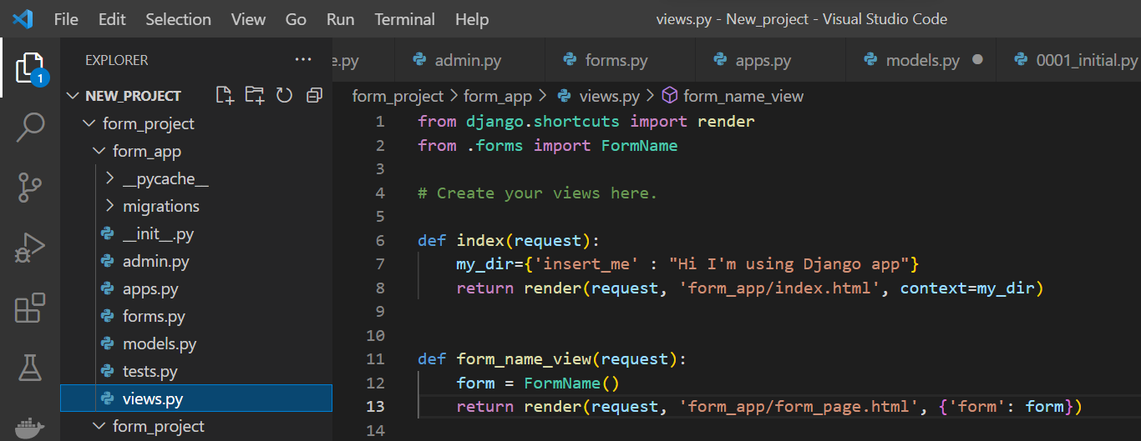
Forms, update views
7

Slide 8
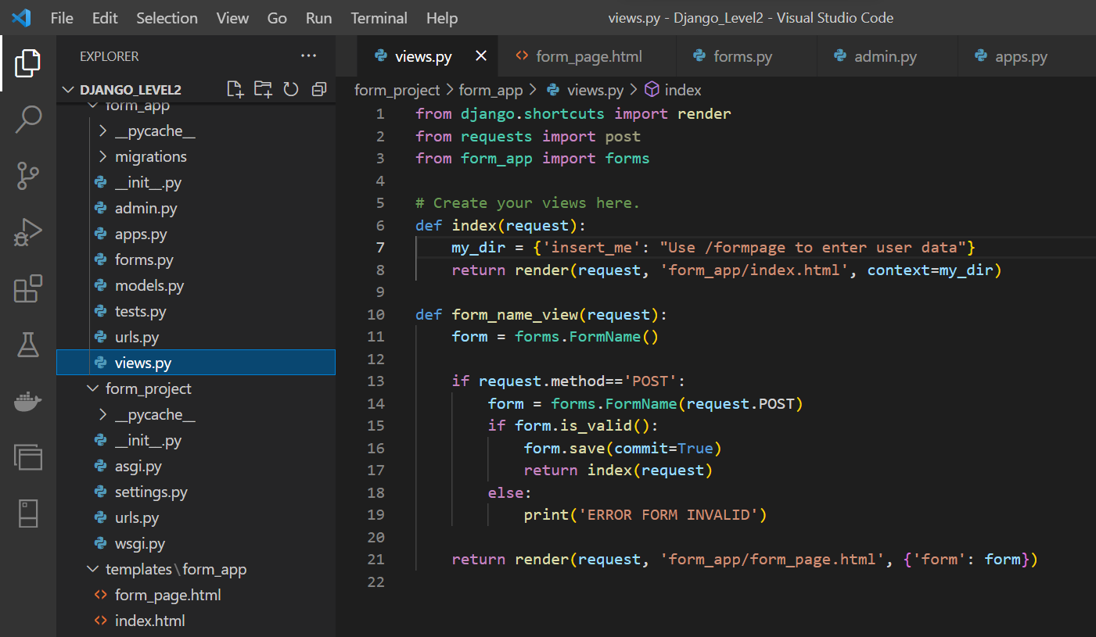

Slide 9
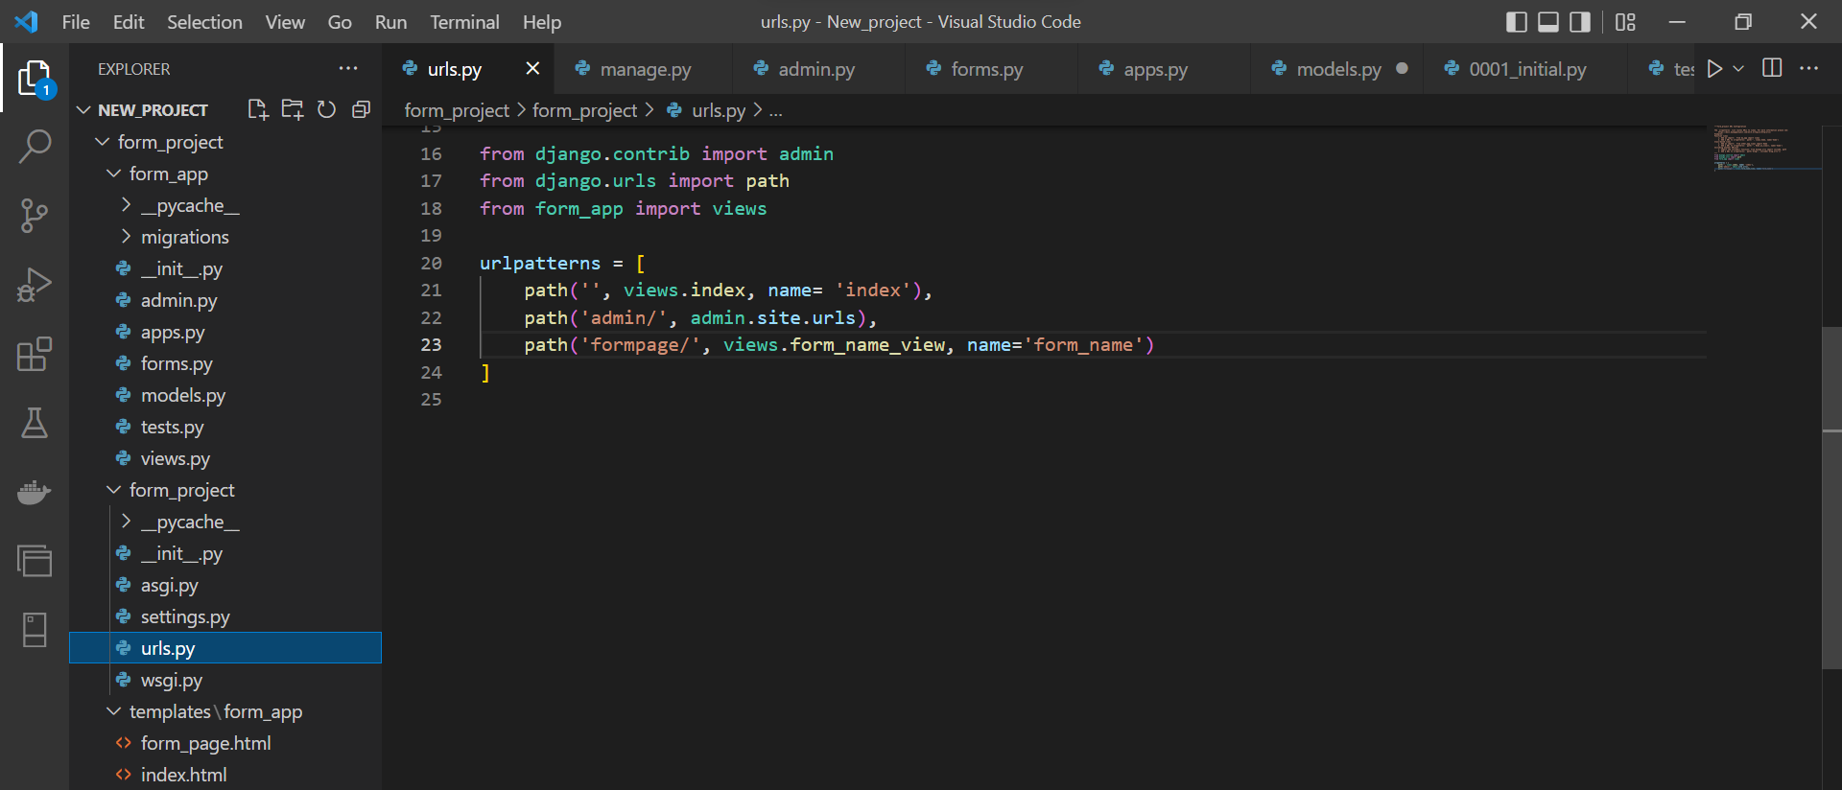
Forms, update urls

Slide 10
Forms
There are several ways you can “inject” the form using template tagging.
You can just pass in the key from the context dictionary:
{{ form }} or {{ form.as_p }}
10

Slide 11
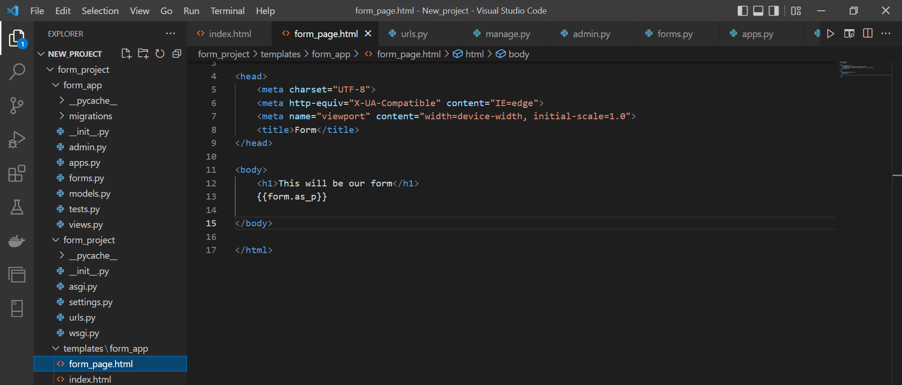
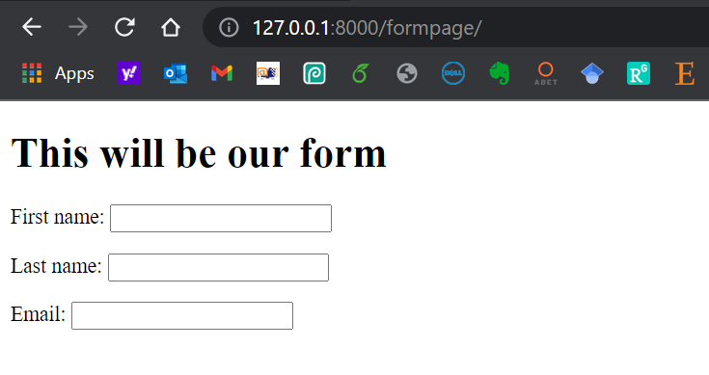
Forms

Slide 12
Learning Objectives
Then, you will learn
Creating a model
Using the Admin interface
Using Django Forms
Connect the form in the template
Accepting User Input and connect it to the database
12

Slide 13
Forms and Models
Adding form and button to the html file
Using Bootstrap to improve the shape of the website
13

Slide 14
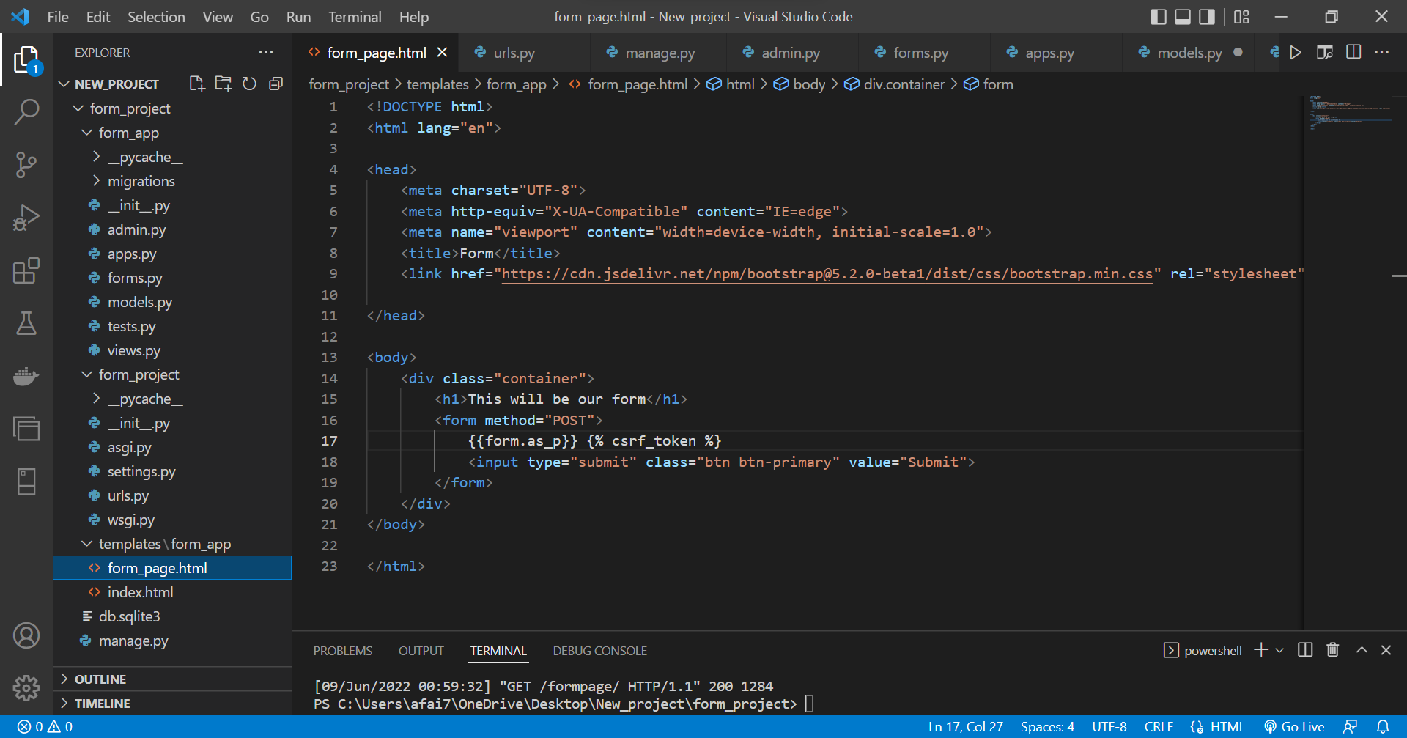

Slide 15
Forms and Models
Update views by this to save data
if request.method=='POST':
form = FormName(request.POST)
if form.is_valid():
form.save(commit=True)
return index(request)
else:
print('ERROR FORM INVALID')
15

Slide 16
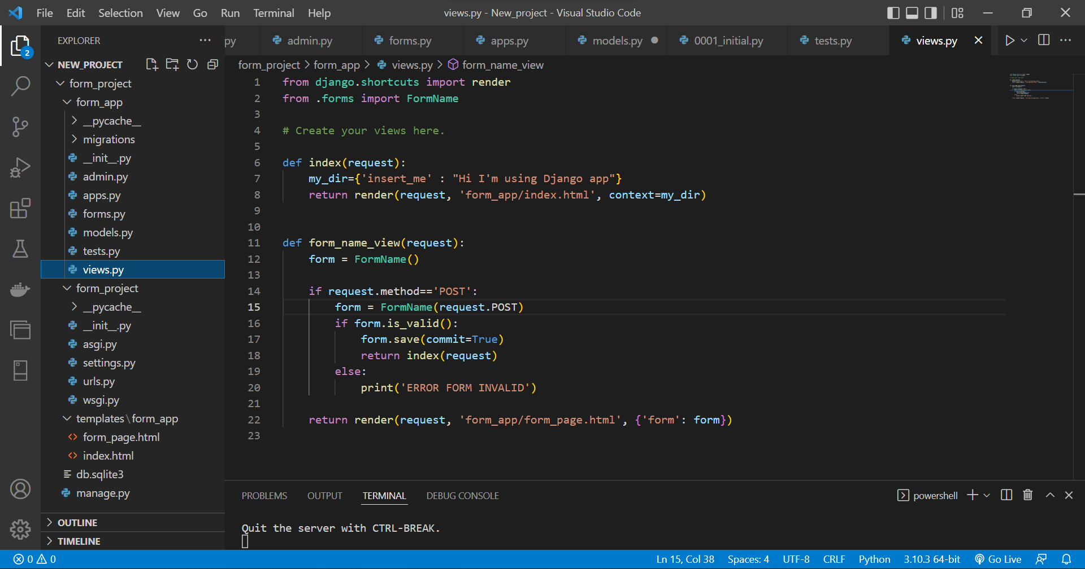

Slide 17
Model Forms - Run
17

Slide 18
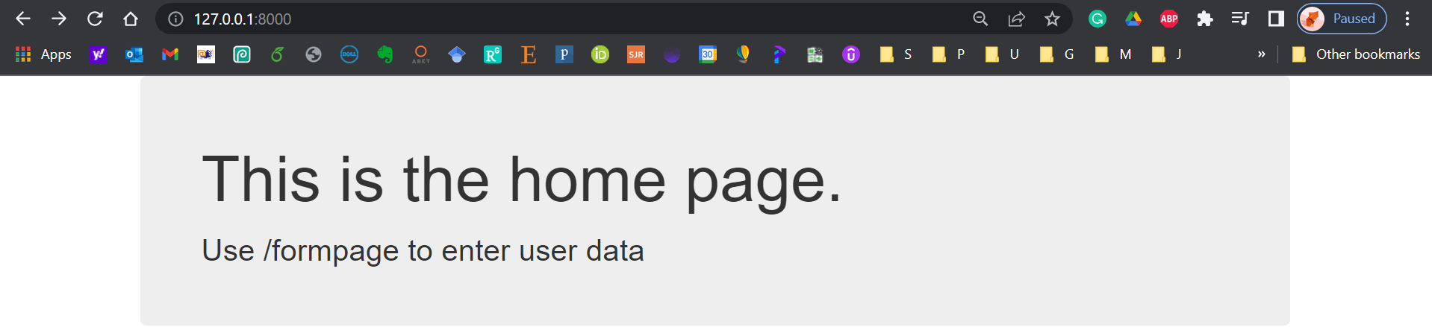
Home Page
18

Slide 19
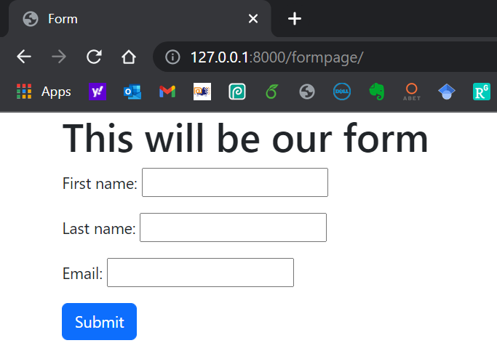
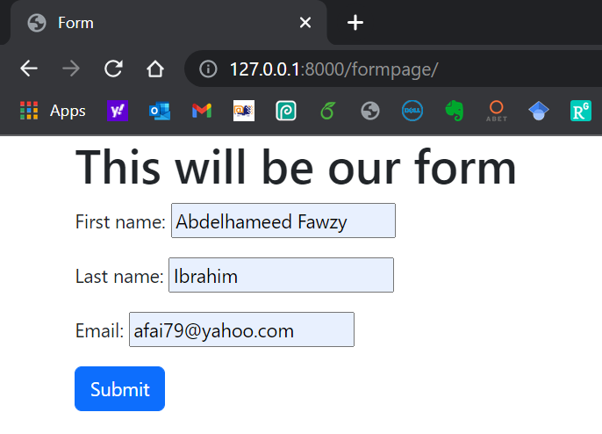
Form Page
19

Slide 20
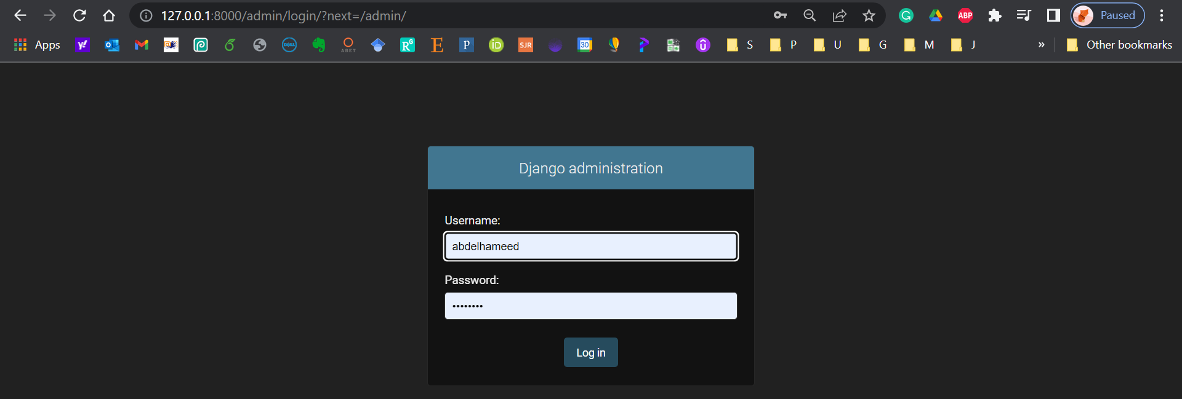
Django Admin
20

Slide 21
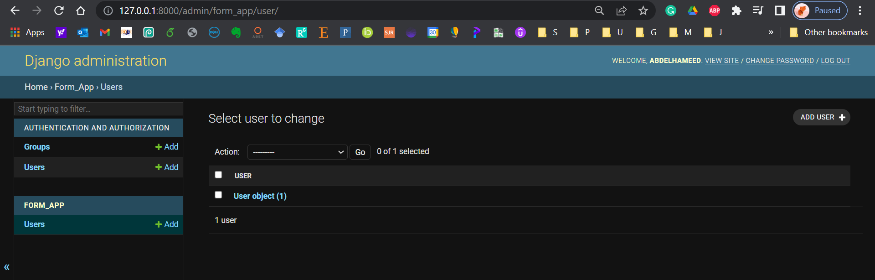
Django Admin
21

Slide 22
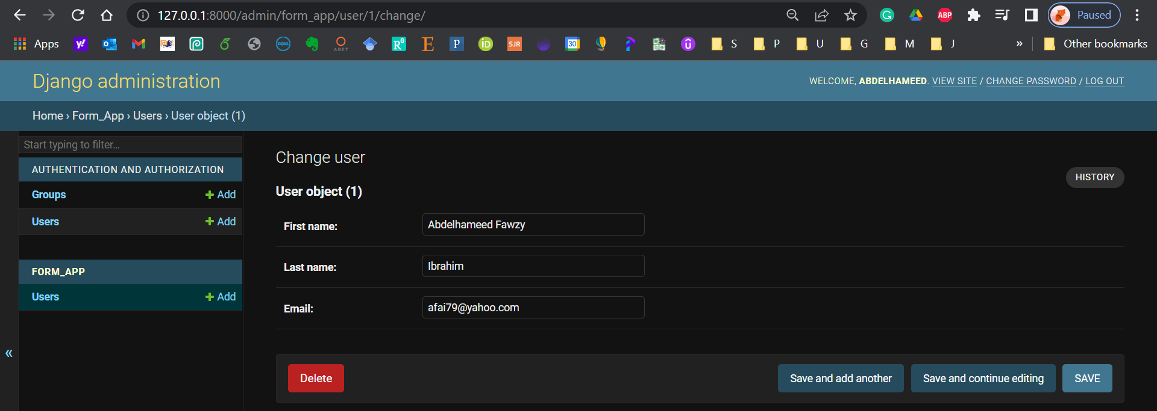
Django Admin
22

Slide 23
Learning Objectives - Confirm
You are now able to
Develop a web form that enables the user to insert data into the database using the form.
23

Slide 24

Learning Objectives - Confirm
You can download the code created in this Training from my GitHub account:
https://github.com/afai79/Django-Python
24

Slide 25
Django – Challenge 2
Model Forms
25

Slide 26
Challenge 2
Complete the following task:
Develop a Django web form that enables the user to insert data (username, password) into the database using a form (login).
26

Slide 27



Thanks
Dr. Abdelhameed Fawzy

