Slide 1

Web Development with Python/Django
Introduction
Dr. Abdelhameed Fawzy
Assoc. Prof. of Computer Engineering

Slide 2
Django Bootcamp
Objectives:
A brief overview of the training
Why we chose Django for the training?
2

Slide 3
Django Bootcamp
There are two main components of a website
The Front-End
The Back-End
3

Slide 4
Django Bootcamp
Front-End:
What you see as a user on the website.
Back-End:
The technology used to actually decide what to show you on the Front-End.
4

Slide 5
Front-End
Front-End revolves around four main technologies:
HTML
CSS
Javascript
Bootstrap
5

Slide 6
HTML
HyperText Markup language
Every website will have HTML, it is the structure of a page.
You can view it by right-clicking and selecting “View Page Source”
6

Slide 7
CSS
CSS - Cascading Style Sheets
CSS is the actual styling of the website.
Colors, fonts, borders, etc is all defined by CSS.
CSS is not mandatory, but almost all sites have it.
7

Slide 8
Javascript
Javascript allows you to add interactivity to the website, including programming logic.
Any site with interactivity uses Javascript in some way, otherwise the site is “static”.
8

Slide 9
Back-End
Back-End of a site has three components:
The Language
The Framework
The Database
9

Slide 10
Django Bootcamp
Our training Back-End uses:
Python as the language
Django as the Framework
SQLite as the Database
10

Slide 11
Django Bootcamp
Python is a great language to learn, it’s simple, powerful, and has many libraries.
Django is the most popular framework for Python, it’s fast, secure, and scalable.
SQLite comes with Django and Python making it an easy choice.
11

Slide 12
Why we chose Django for the training?
Django is an open-source and free web framework.
Django is server-side technology.
Many websites utilize it, including Instagram, BitBucket, the Washington Times, and Mozilla, among others!
12

Slide 13
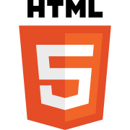
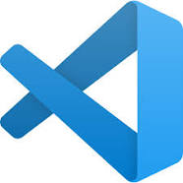
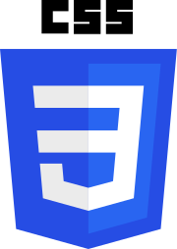
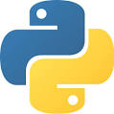
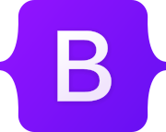


Thanks
Dr. Abdelhameed Fawzy

