Slide 1

Web Development with Python/Django Getting Started with Python in VS Code
Dr. Abdelhameed Fawzy
Assoc. Prof. of Computer Engineering

Slide 2

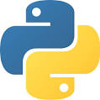

Getting Started with Python in VS Code
https://code.visualstudio.com/
https://marketplace.visualstudio.com/VSCode
https://www.python.org/
https://www.anaconda.com/products/individual
2

Slide 3
Python
Getting Started with Python in VS Code
Install Visual Studio Code
Install Python and Python Extension
Verify Python installation
py -3 --version
3

Slide 4
Python
Start VS Code in a project folder
Select a Python interpreter (Ctrl+Shift+P)
Create a Python source code file and Run
msg = "Hello World"
print(msg)
4

Slide 5
Python
Install and use packages
import matplotlib.pyplot as plt
import numpy as np
x = np.linspace(0, 20, 100)
plt.plot(x, np.sin(x))
plt.show()
5

Slide 6
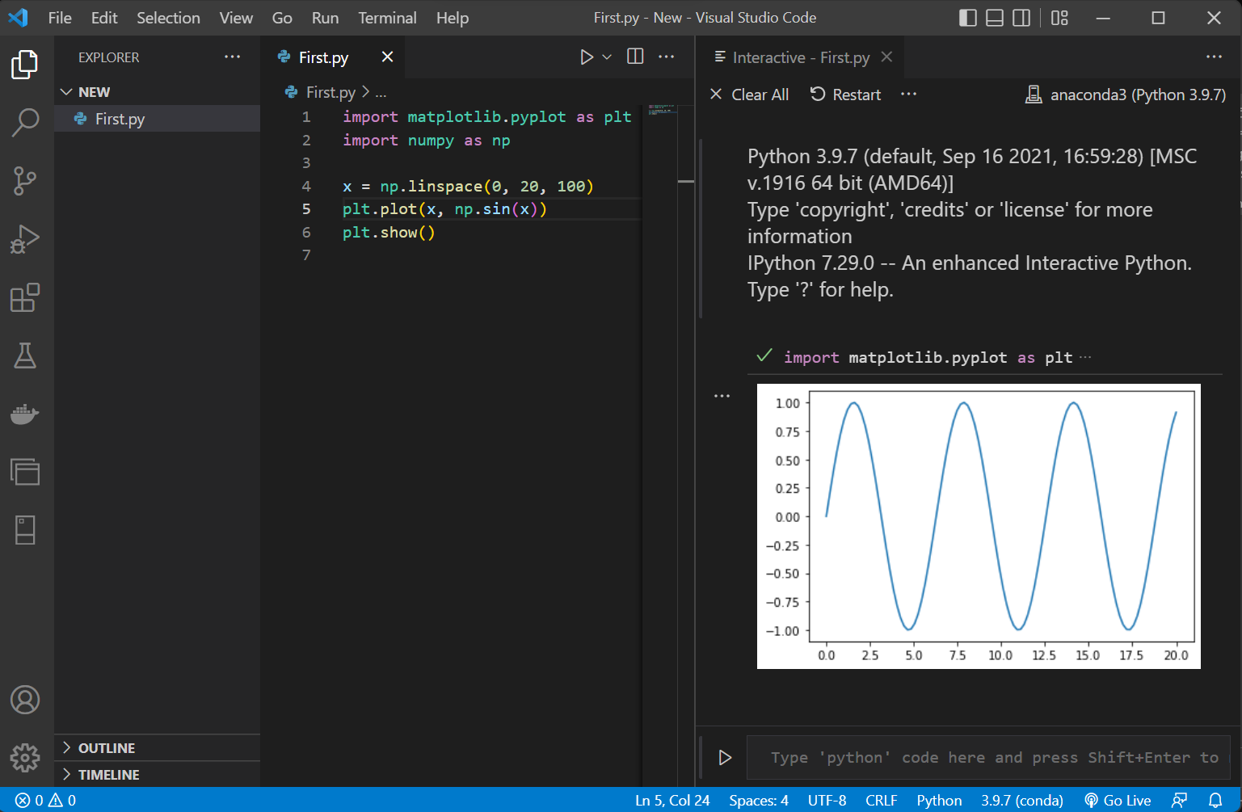

Slide 7
Thanks
Dr. Abdelhameed Fawzy

