Slide 1

Web Development with Python/Django Creating a virtual environment (Anaconda)
Dr. Abdelhameed Fawzy
Assoc. Prof. of Computer Engineering

Slide 2
Virtual environment
Anaconda makes this simple for us!
Virtual environment with conda, use this:
conda create --name myEnv Django
Here, we constructed a "myEnv" environment using a recent version of Django.
2

Slide 3
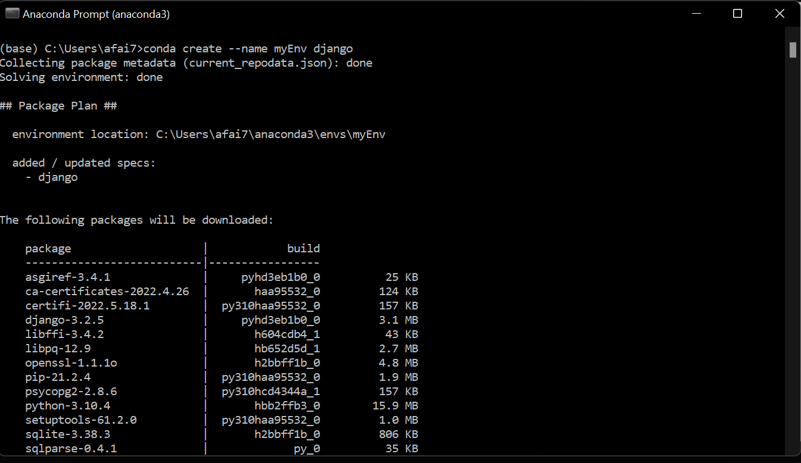
3

Slide 4
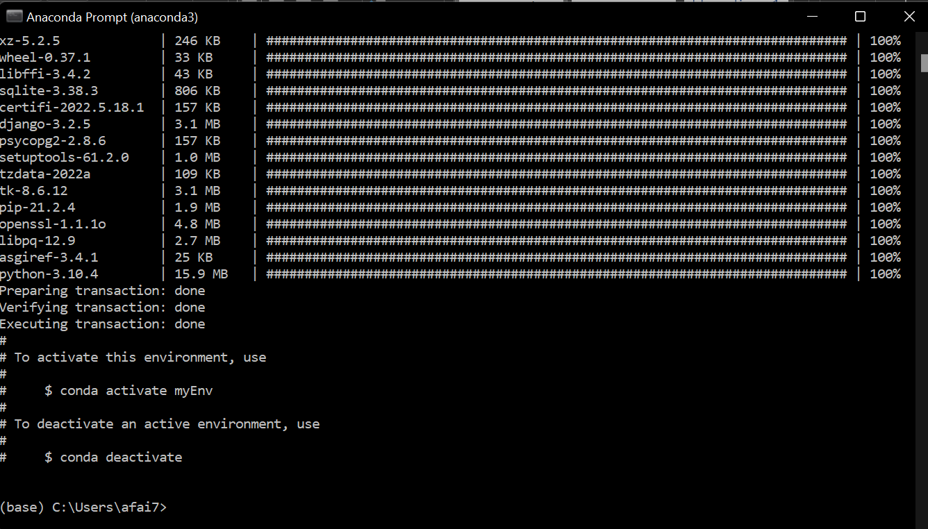
4

Slide 5
Virtual environment
Now, activate the environment:
conda activate myEnv
You can deactivate the environment.
conda deactivate
You can environment information.
conda info --envs
5

Slide 6
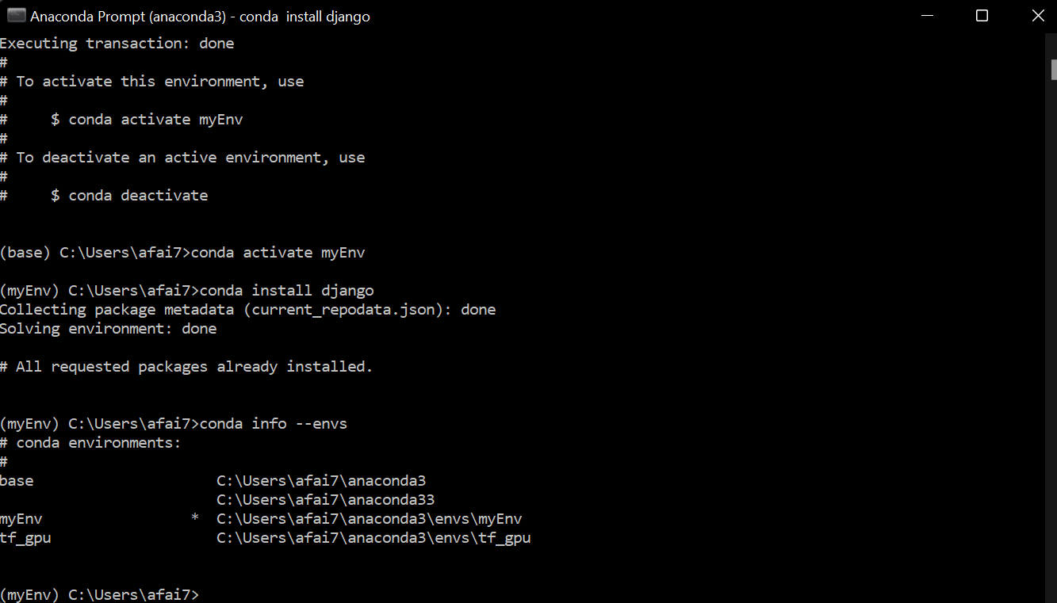
6

Slide 7



Thanks
Dr. Abdelhameed Fawzy

