Slide 1

Web Development with Python/Django Setting up Django Projects
Dr. Abdelhameed Fawzy
Assoc. Prof. of Computer Engineering

Slide 2
Django project
When you install Django, it installed a command line tool called:
django-admin
Let’s create our first project. Type:
django-admin startproject first_project
2

Slide 3
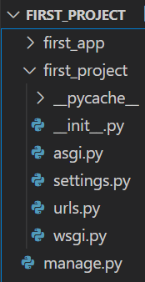
Django project
You will then receive something like this:
3

Slide 4
Django project
__init__.py
This is a blank Python script that due to its special name let’s Python know that this directory can be treated as a package
4

Slide 5
Django project
settings.py
This is where you will store all your project settings
5

Slide 6
Django project
urls.py
This is a Python script that will store all the URL patterns for your project. Basically the different pages of your web application.
6

Slide 7
Django project
wsgi.py
This is a Python script that acts as the Web Server Gateway Interface. It will later on help us deploy our web app to production
7

Slide 8
Django project
manage.py
This is a Python script that we will use a lot. It will be associates with many commands as we build our web app!
8

Slide 9
Django project
Let’s use manage.py now:
python manage.py runserver
9

Slide 10
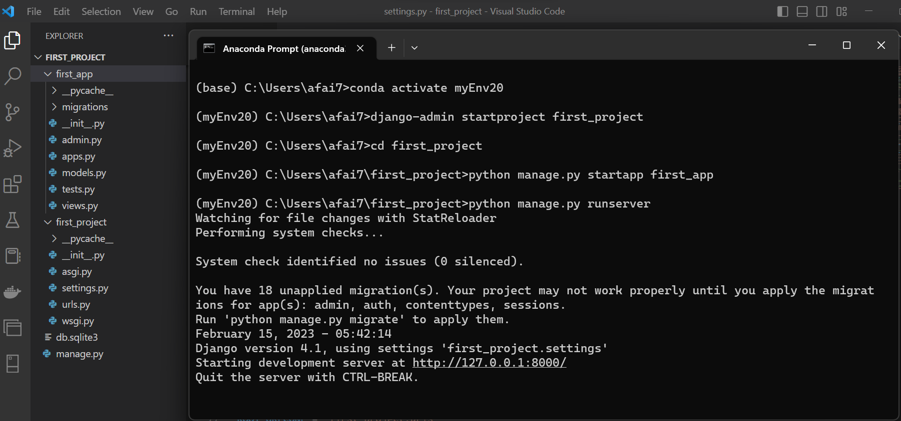
Django project

Slide 11
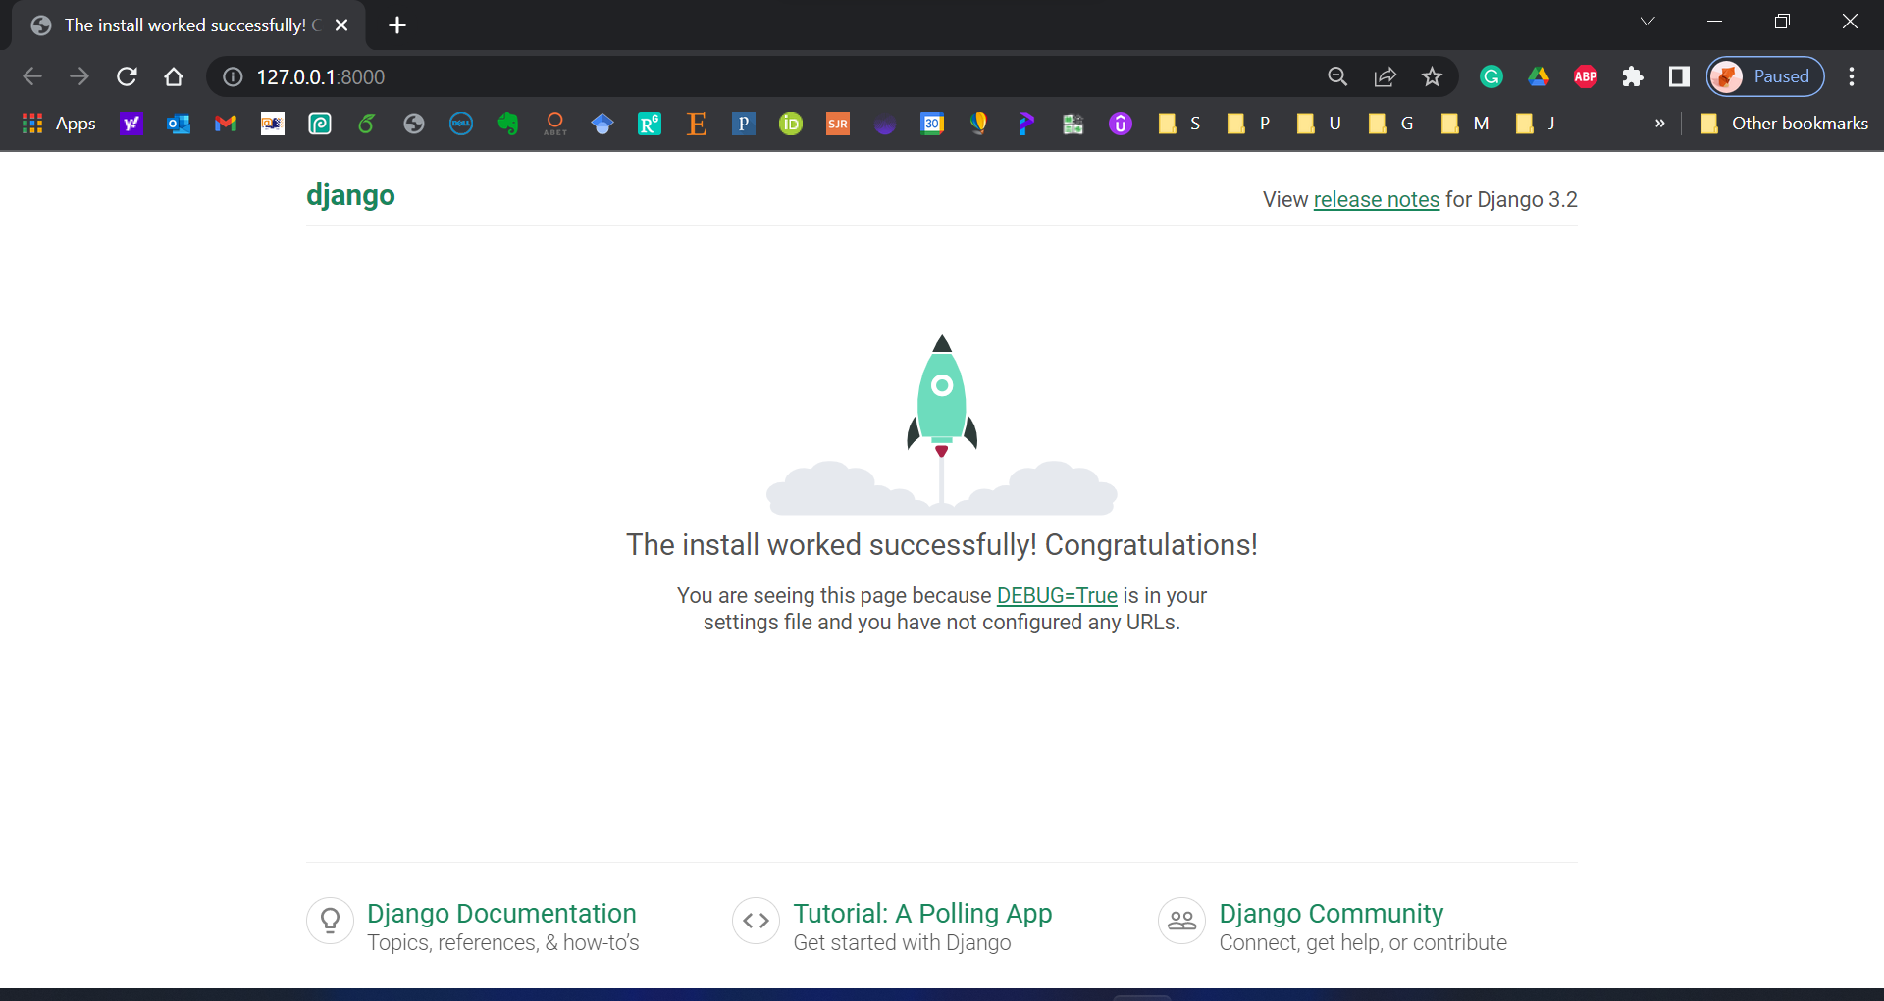
11

Slide 12


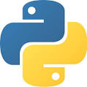
Thanks
Dr. Abdelhameed Fawzy

