Slide 1

Web Development with Python/Django Setting up Django Applications
Dr. Abdelhameed Fawzy
Assoc. Prof. of Computer Engineering

Slide 2
Django Application
Plug Django applications into other Django projects and reuse them! (Or use the applications of others)
Create a simple application by using:
python manage.py startapp first_app
2

Slide 3
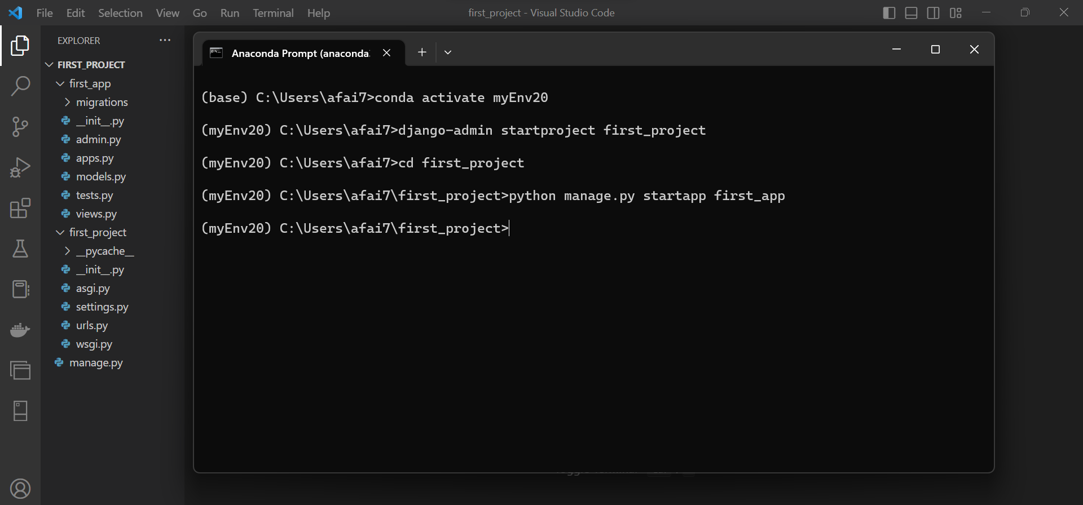
3

Slide 4
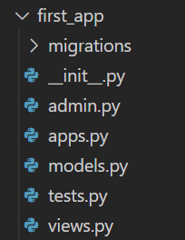
Django Application
Let’s quickly discuss all of these files!
4

Slide 5
Django Application
__init__.py
This is a blank Python script that due to its special name let’s Python know that this directory can be treated as a package
5

Slide 6
Django Application
admin.py
You can register your models here which Django will then use them with Django’s admin interface.
6

Slide 7
Django Application
apps.py
Here you can place application specific configurations
7

Slide 8
Django Application
models.py
Here you store the application’s data models
8

Slide 9
Django Application
tests.py
Here you can store test functions to test your code
9

Slide 10
Django Application
views.py
This is where you have functions that handle requests and return responses
10

Slide 11
Django Application
Migrations folder
This directory stores database specific information as it relates to the models
11

Slide 12
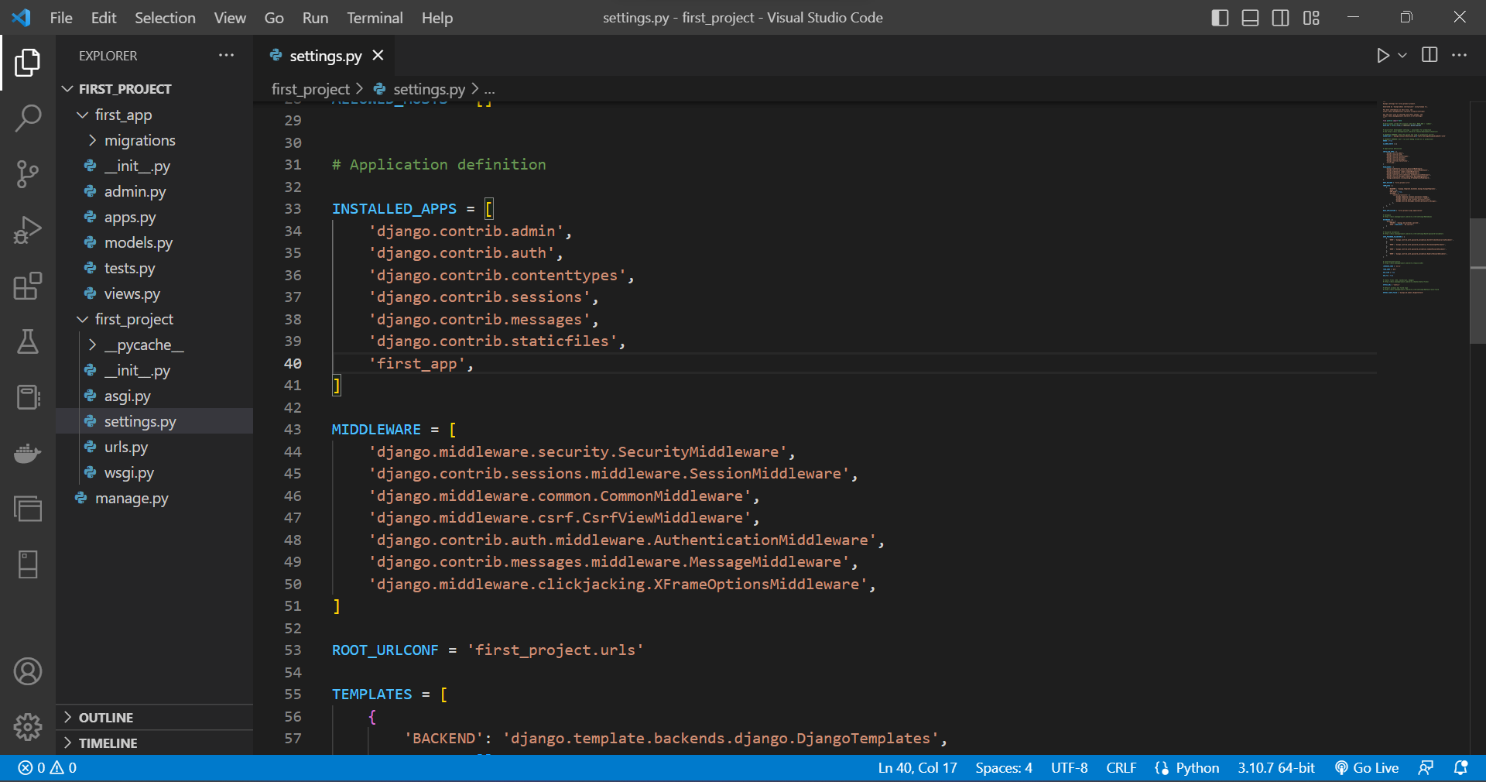
12

Slide 13


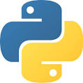
Thanks
Dr. Abdelhameed Fawzy

