Slide 1

Web Development with Python/Django Using simple Templates and tags
Dr. Abdelhameed Ibrahim
Assoc. Prof. of Computer Engineering

Slide 2
Using Templates
Understanding how Django functions and interacts with your website requires a thorough understanding of templates.
2

Slide 3
Using Templates
First build a templates directory followed by a subfolder for each app's templates.
It goes in your directory's top level:
first_project/templates/first_app
3

Slide 4
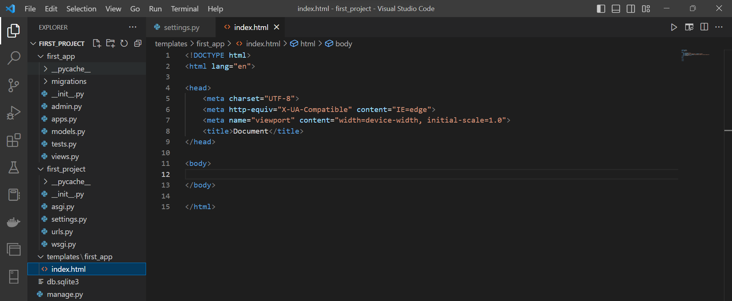
Using Templates

Slide 5
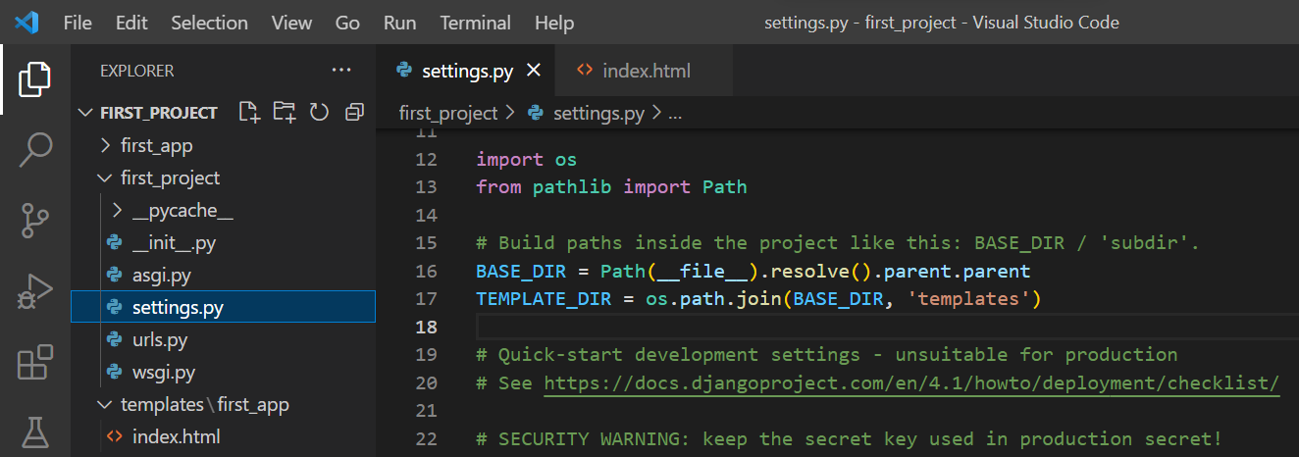
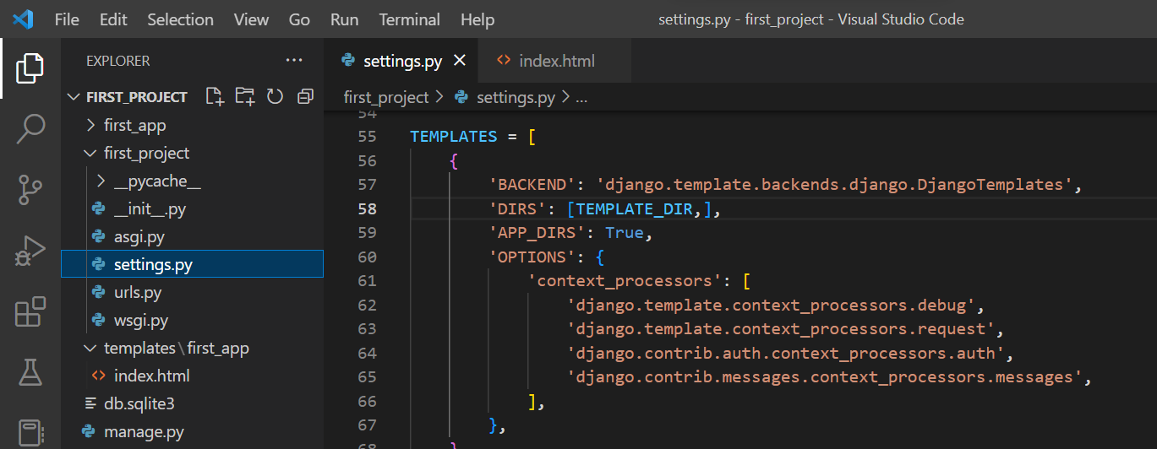
Using Templates
5

Slide 6



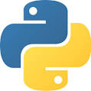



Thanks
Dr. Abdelhameed Fawzy

