Slide 1

Web Development with Python/Django Creating Views and Mapping URLs
Dr. Abdelhameed Ibrahim
Assoc. Prof. of Computer Engineering

Slide 2
Creating Views
Write the following code in the views.
def index(request):
my_dir={'insert_me' : "Hi, I'm using Django App"}
return render(request, 'first_app/index.html', context=my_dir)
2

Slide 3
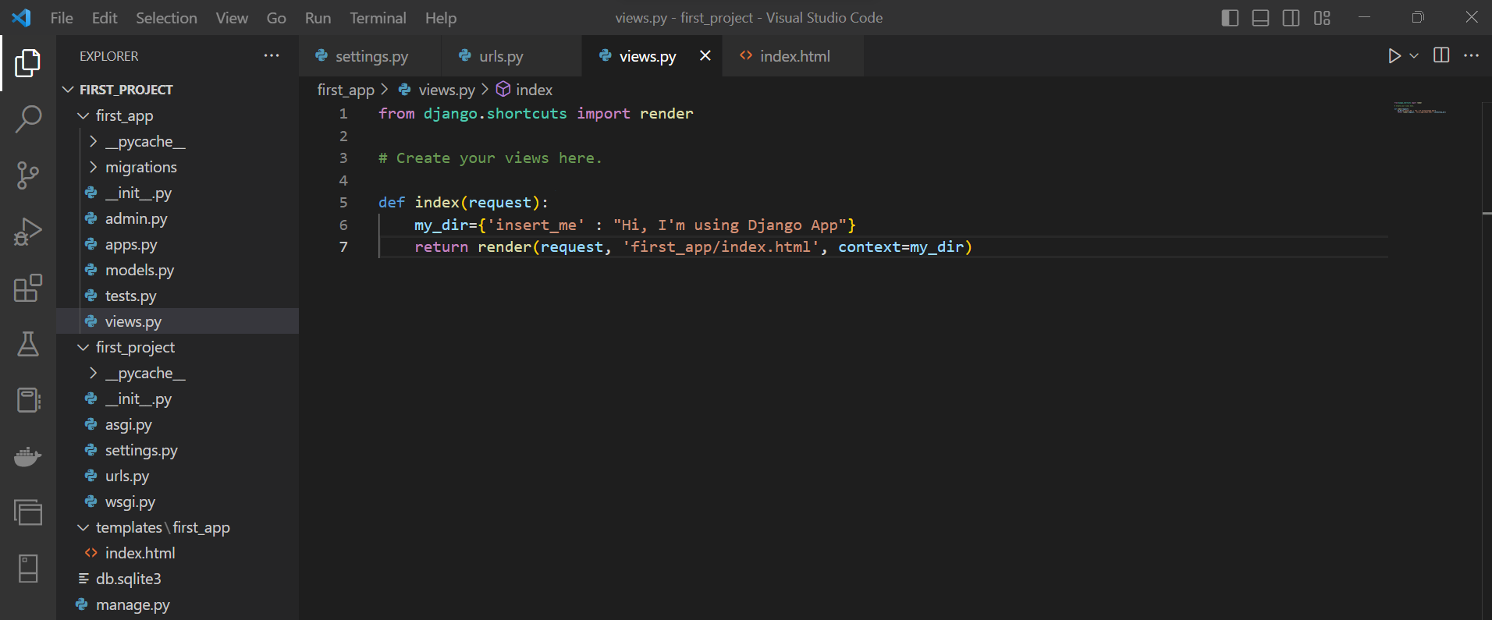

Slide 4
Mapping URLs
Write the following code in the urls.
from django.contrib import admin
from django.urls import path
from first_app import views
urlpatterns = [
path('', views.index, name='index'),
path('admin/', admin.site.urls),
]
4

Slide 5
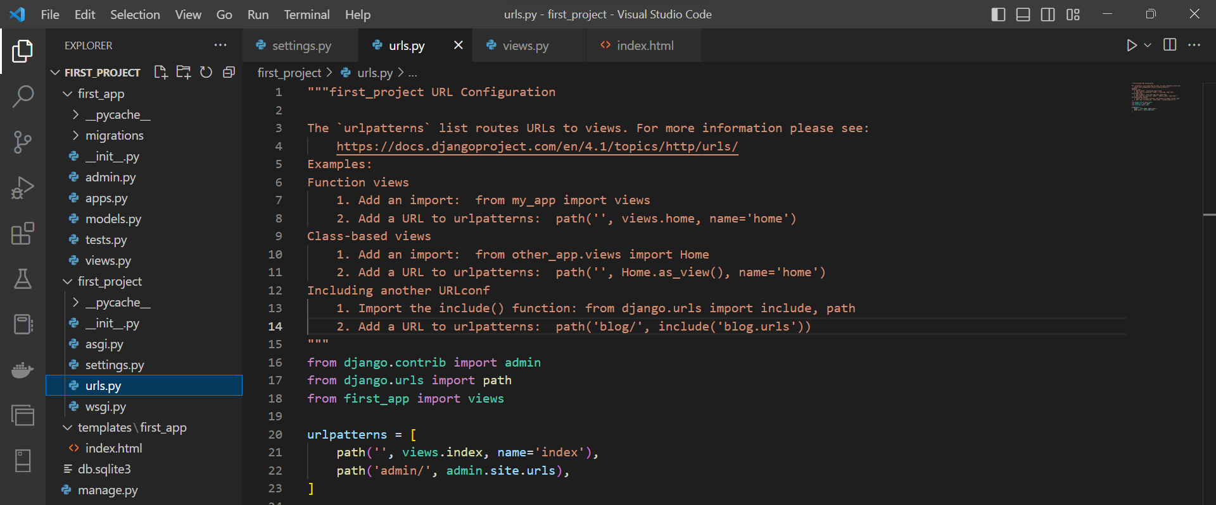

Slide 6
Update HTML file
Write the following code in the index.html
<body>
<p>My name is Abdelhameed</p>
{{insert_me}}
</body>
6

Slide 7
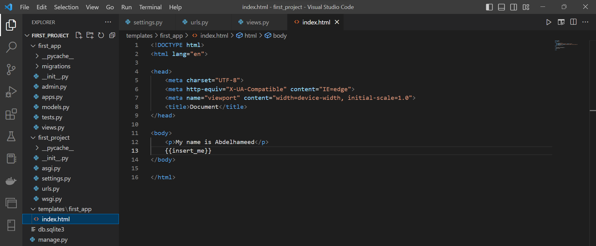

Slide 8
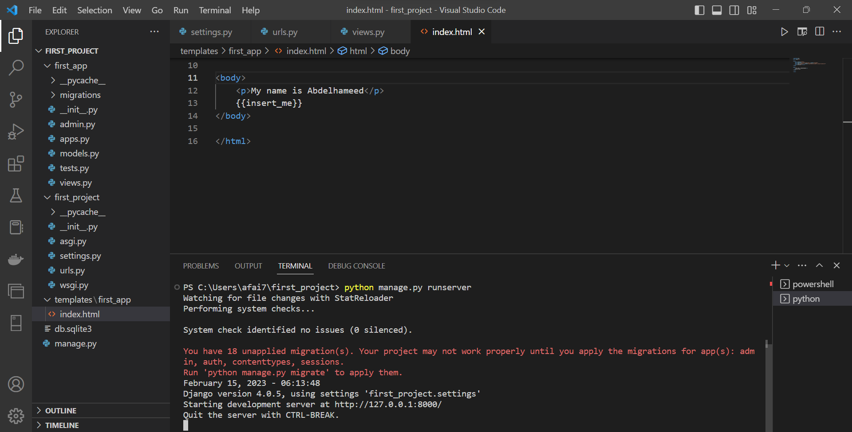
Run the project

Slide 9
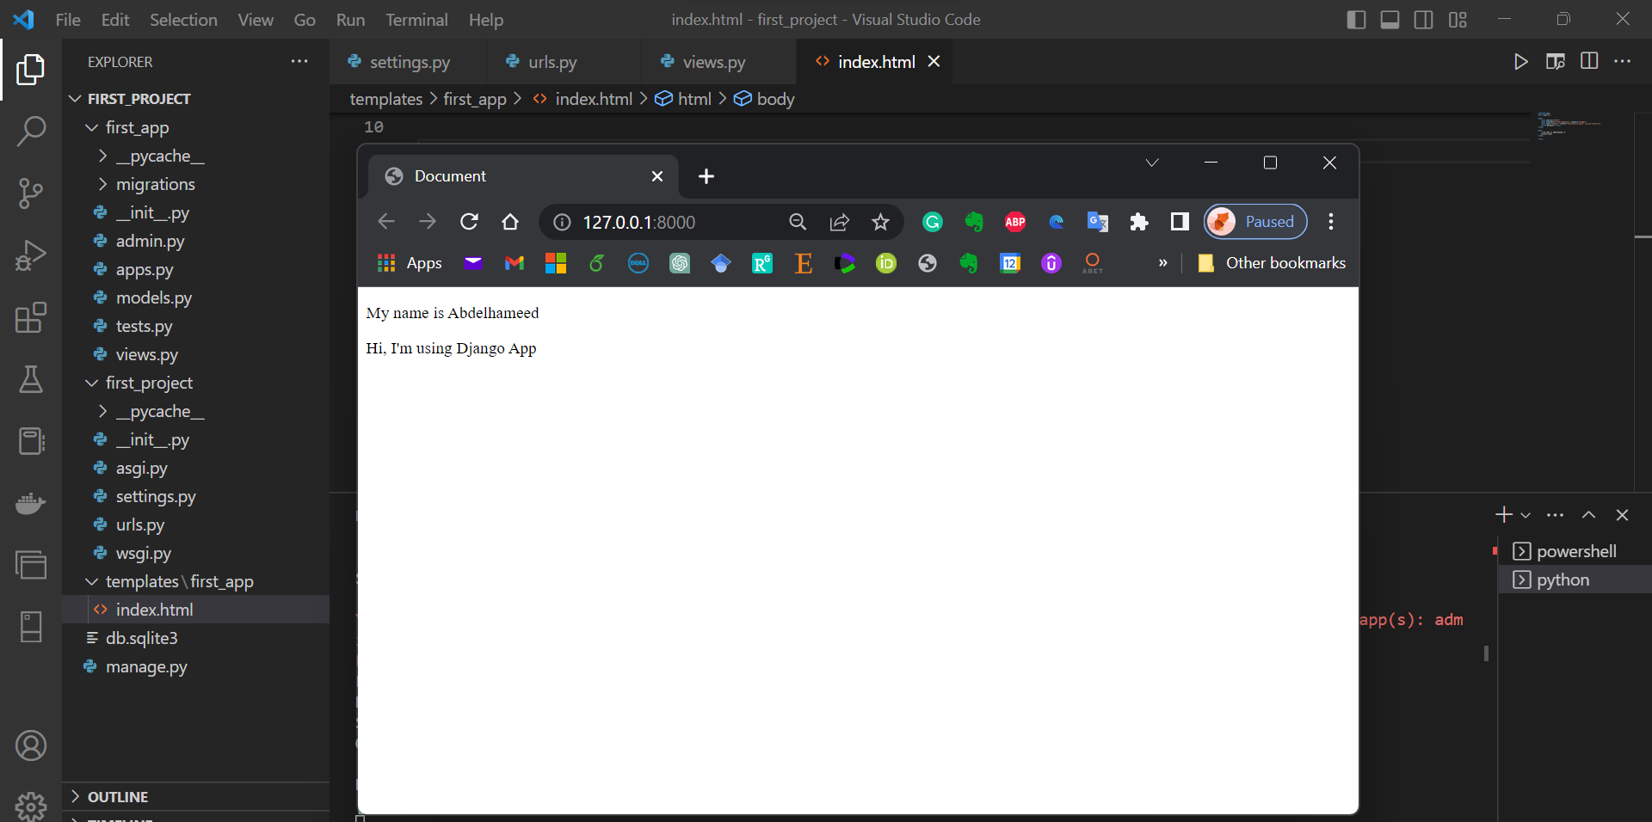

Slide 10
Django – Challenge 1
Time to put your skills to the test!
10

Slide 11
Challenge 1
Complete the following tasks:
Create a New Django Project
Create a New Django App
Create an Index View
Link this view to the urls.py file
Run the Django project.
11

Slide 12



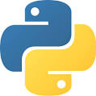



Thanks
Dr. Abdelhameed Fawzy

