Slide 1

Web Development with Python/Django Creating a model
Dr. Abdelhameed Ibrahim
Assoc. Prof. of Computer Engineering

Slide 2
Models
We use Models to incorporate a database into a Django Project.
To create a model, a class structure is used inside of the relevant applications models.py file
2

Slide 3
Models
This class object will be a subclass of Django’s built-in class:
django.db.models.Model
Then each attribute of the class represents a field
3

Slide 4
Models
Here is what you have to do:
Add a new model called User
It should have these fields:
First Name
Last Name
Email
4

Slide 5
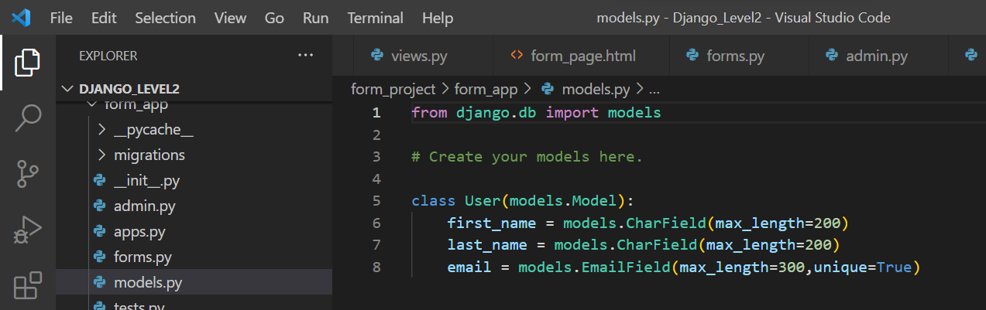
Models
5

Slide 6
Models
Migrate the database (creating databases that correspond to the models we created)
python manage.py migrate
python manage.py makemigrations form_app
python manage.py migrate
6

Slide 7
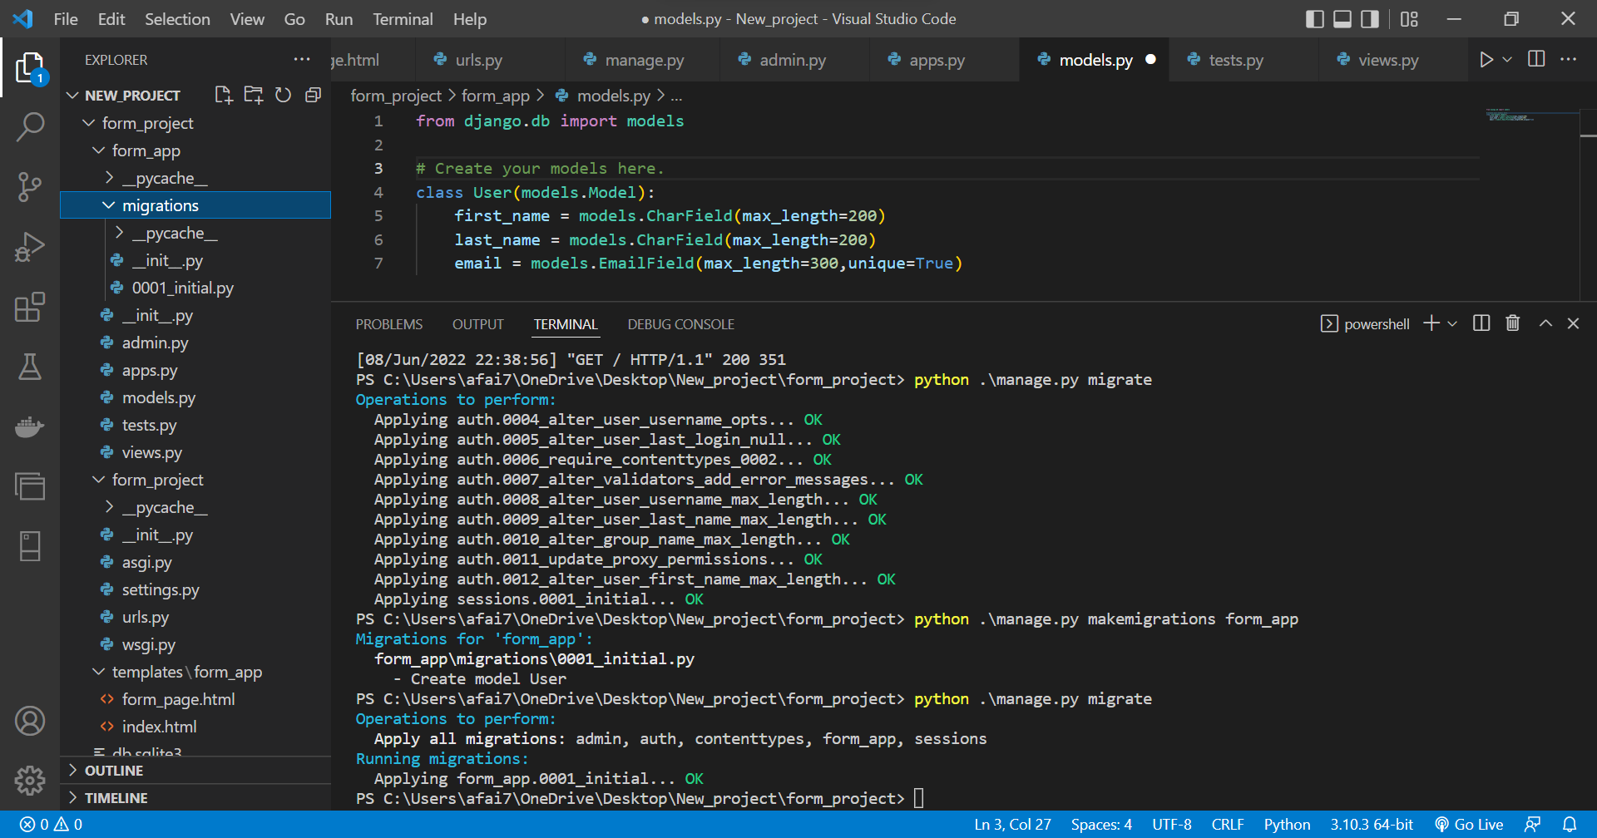

Slide 8
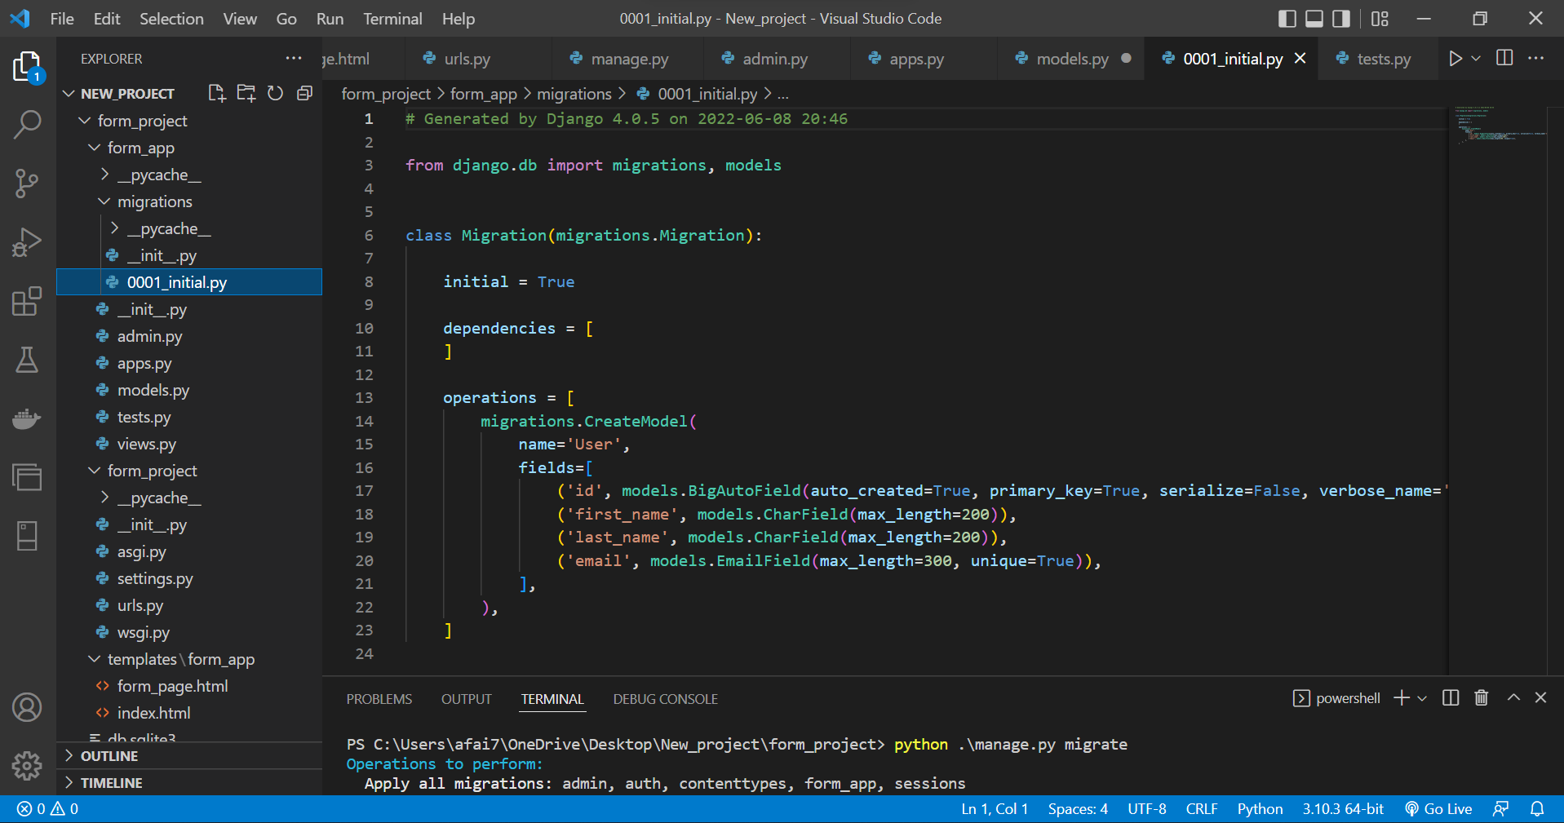

Slide 9



Thanks
Dr. Abdelhameed Fawzy

