Slide 1

Web Development with Python/Django Using the Admin interface
Dr. Abdelhameed Ibrahim
Assoc. Prof. of Computer Engineering

Slide 2
Django Admin interface
To use the Admin interface with the models, we need to register them to our application’s admin.py file.
admin.site.register(User)
This Admin interface is one of the key features of Django!
2

Slide 3
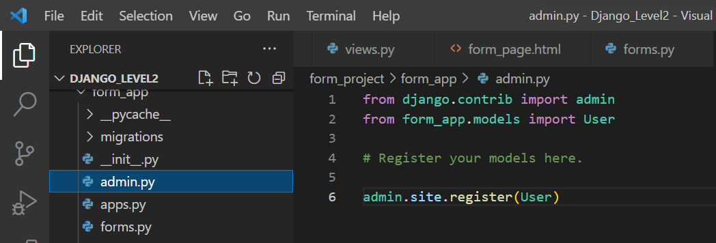
Django Admin interface
3

Slide 4
Django Admin interface
In order to fully use the database and the Admin, we will create a “superuser”
Providing a name, email, and password
Use:
python manage.py createsuperuser
4

Slide 5
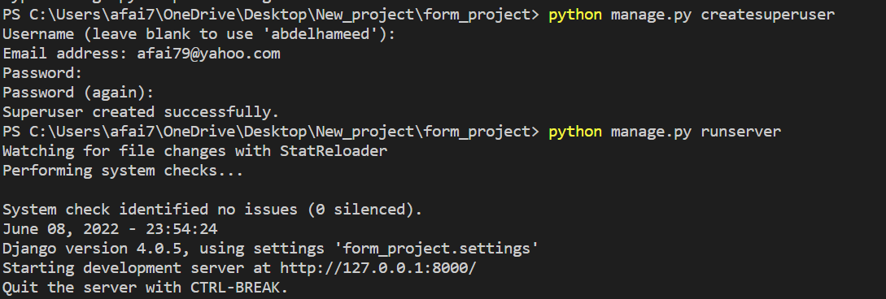
Django Admin interface
5

Slide 6
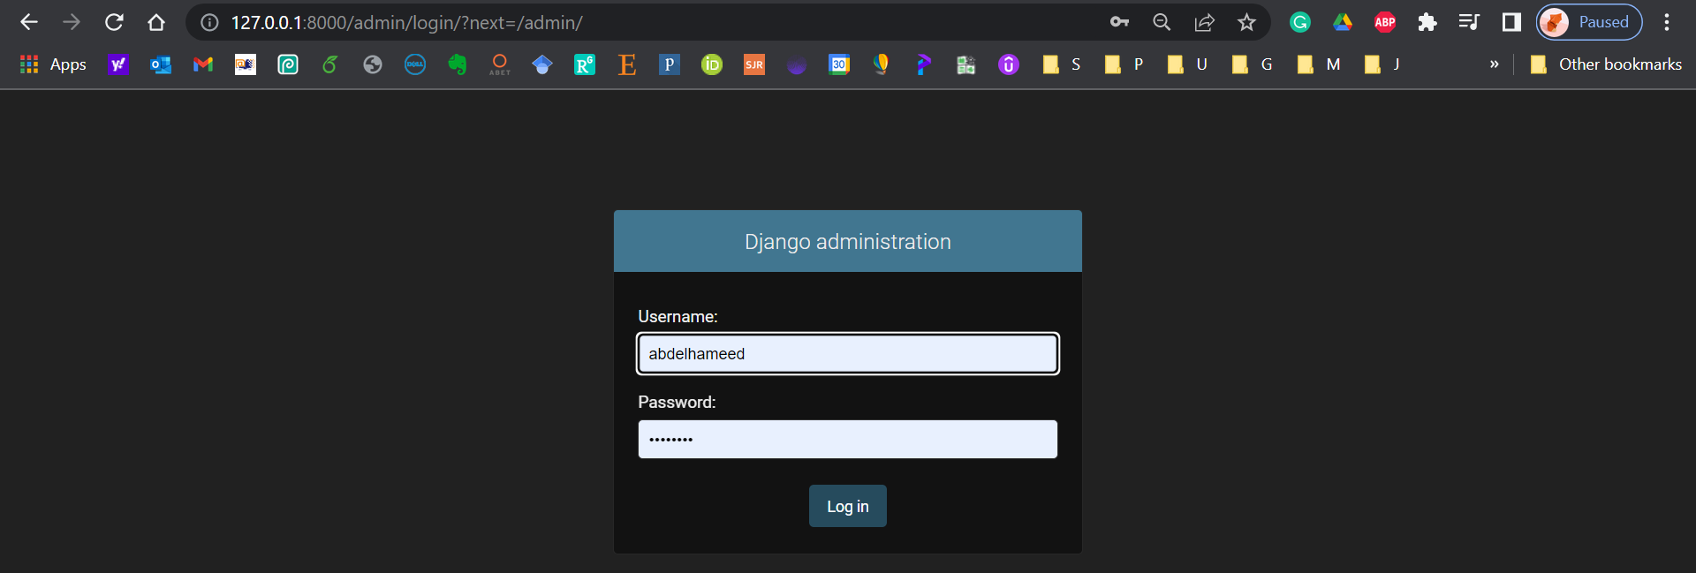
Django Admin interface
6

Slide 7
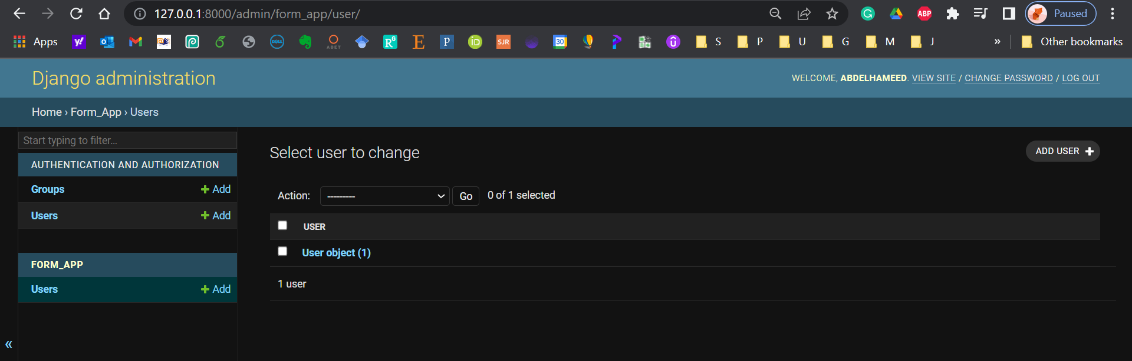
Django Admin interface
7

Slide 8



Thanks
Dr. Abdelhameed Fawzy

