Slide 1

Web Development with Python/Django Different views format
Dr. Abdelhameed Ibrahim
Assoc. Prof. of Computer Engineering

Slide 2
Project: Urls.py
from django.contrib import admin
from django.urls import path
from first_app import views
from django.conf.urls import include
urlpatterns = [
path('', views.index, name = 'index'),
path('first_app/', include('first_app.urls')),
path('admin/', admin.site.urls),
]
2

Slide 3
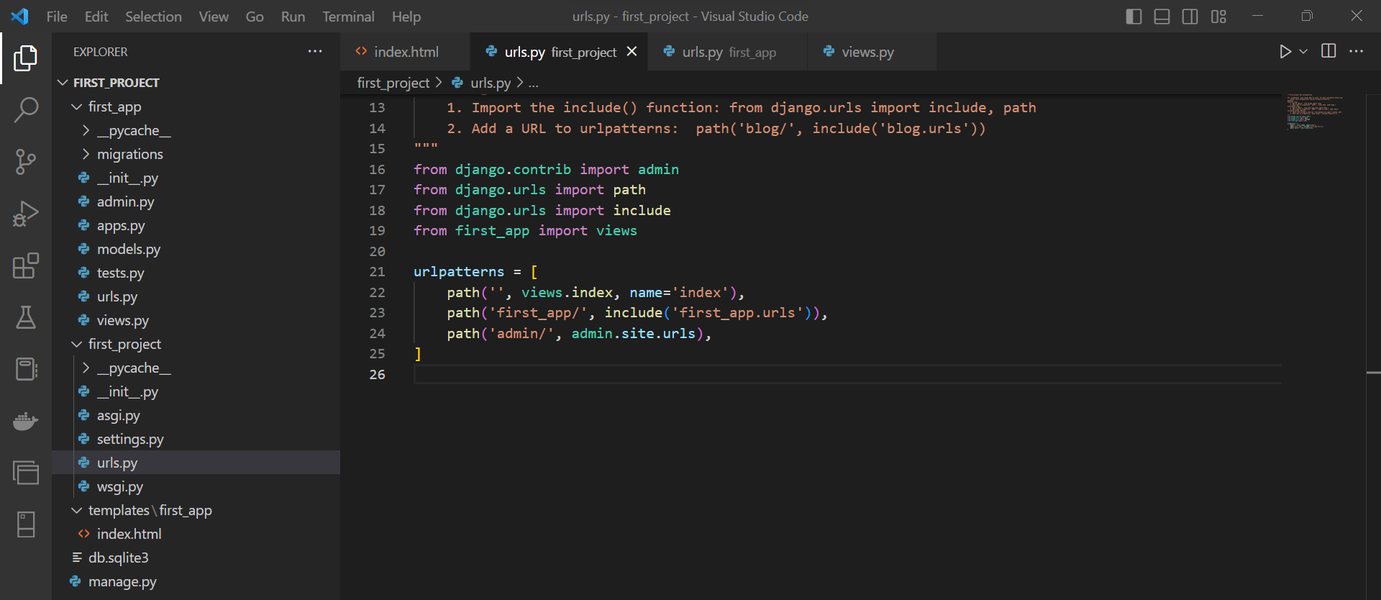
3

Slide 4
App: Urls.py
from django.urls import path
from first_app import views
urlpatterns = [
path('', views.index, name='index'),
]
4

Slide 5
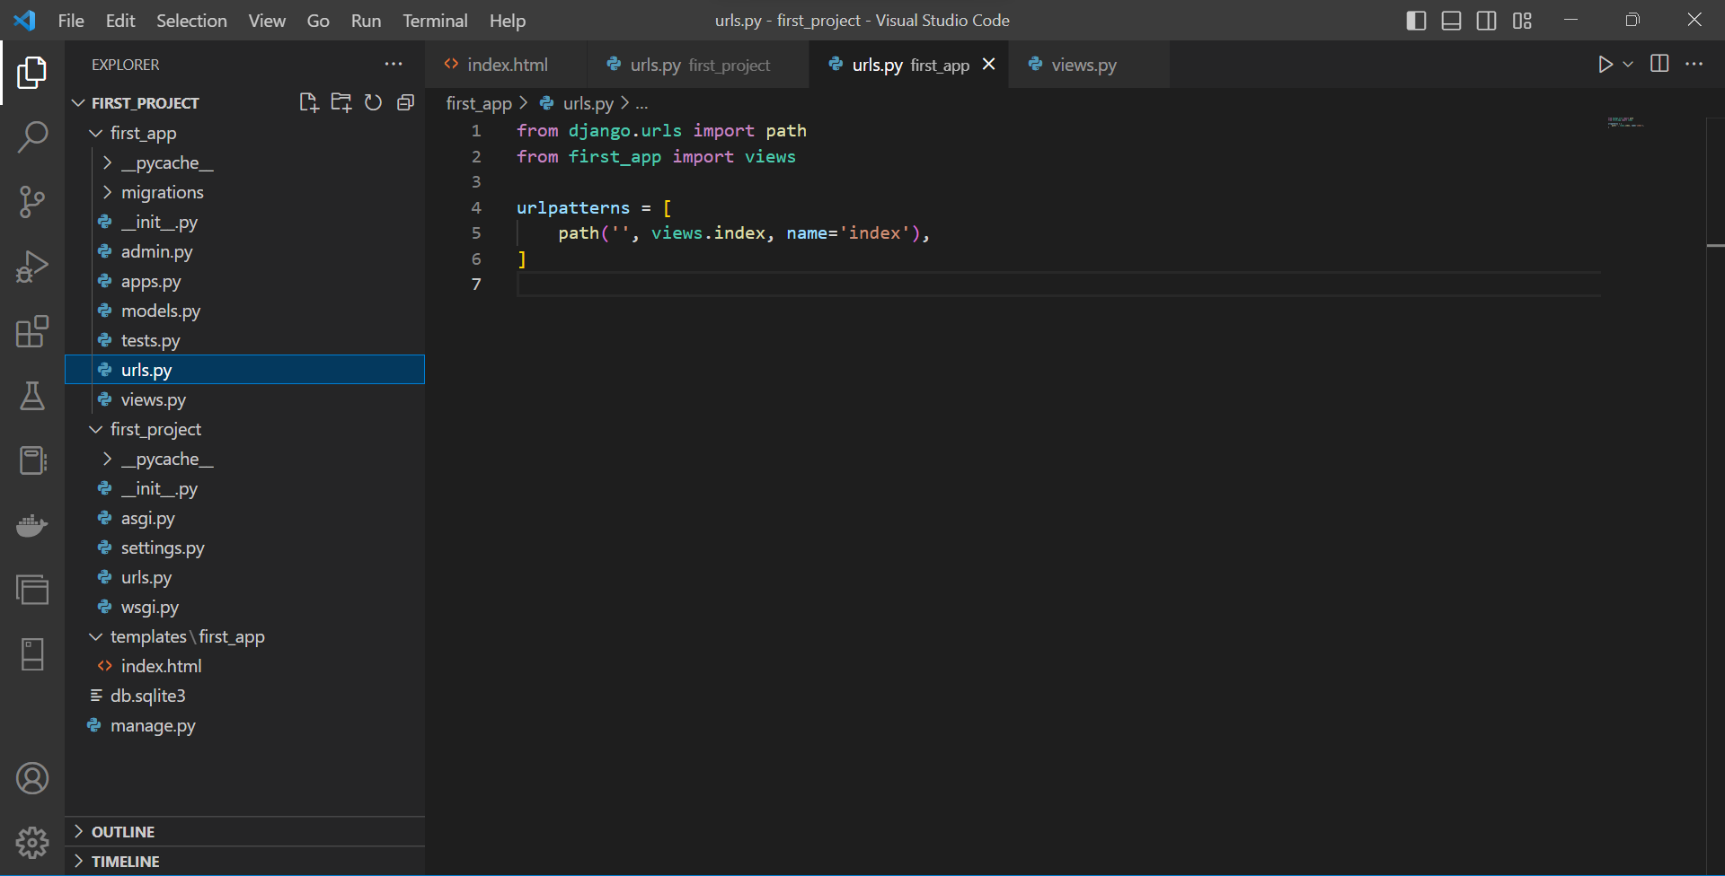
5

Slide 6
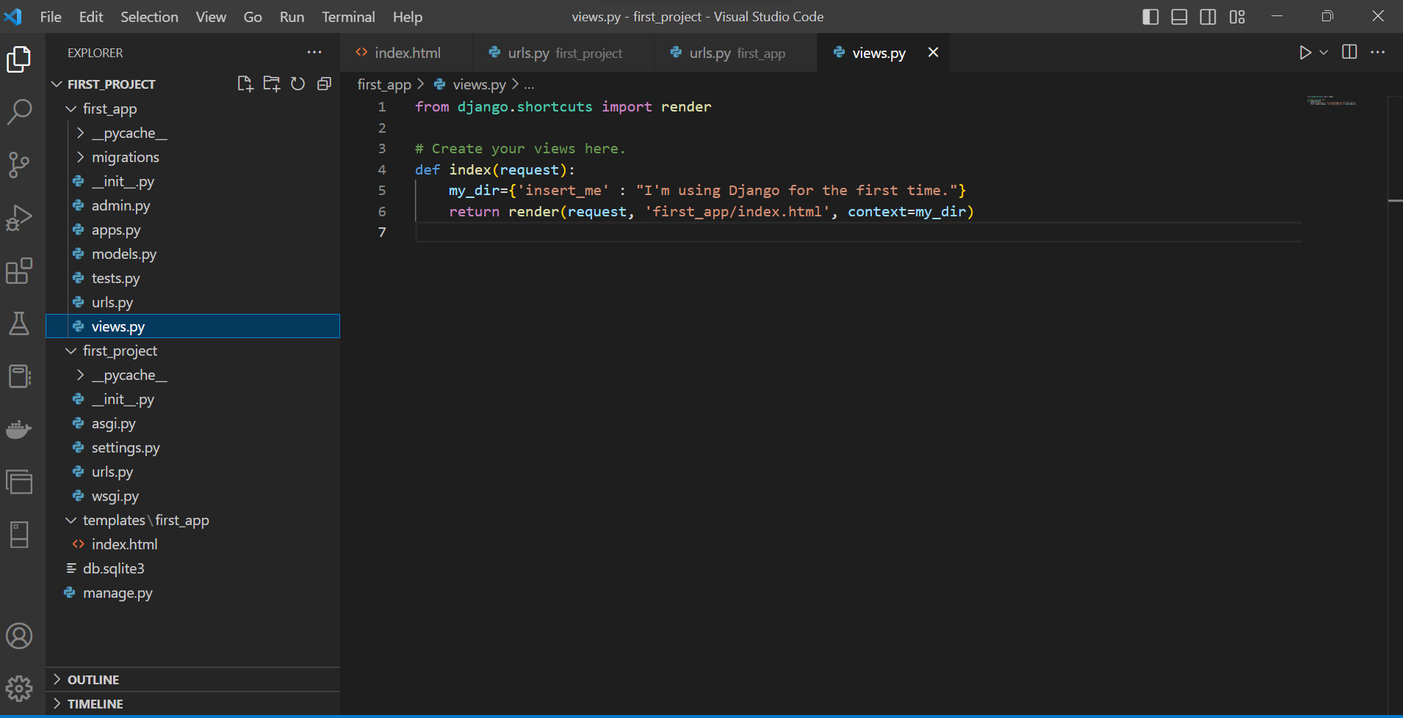
6

Slide 7
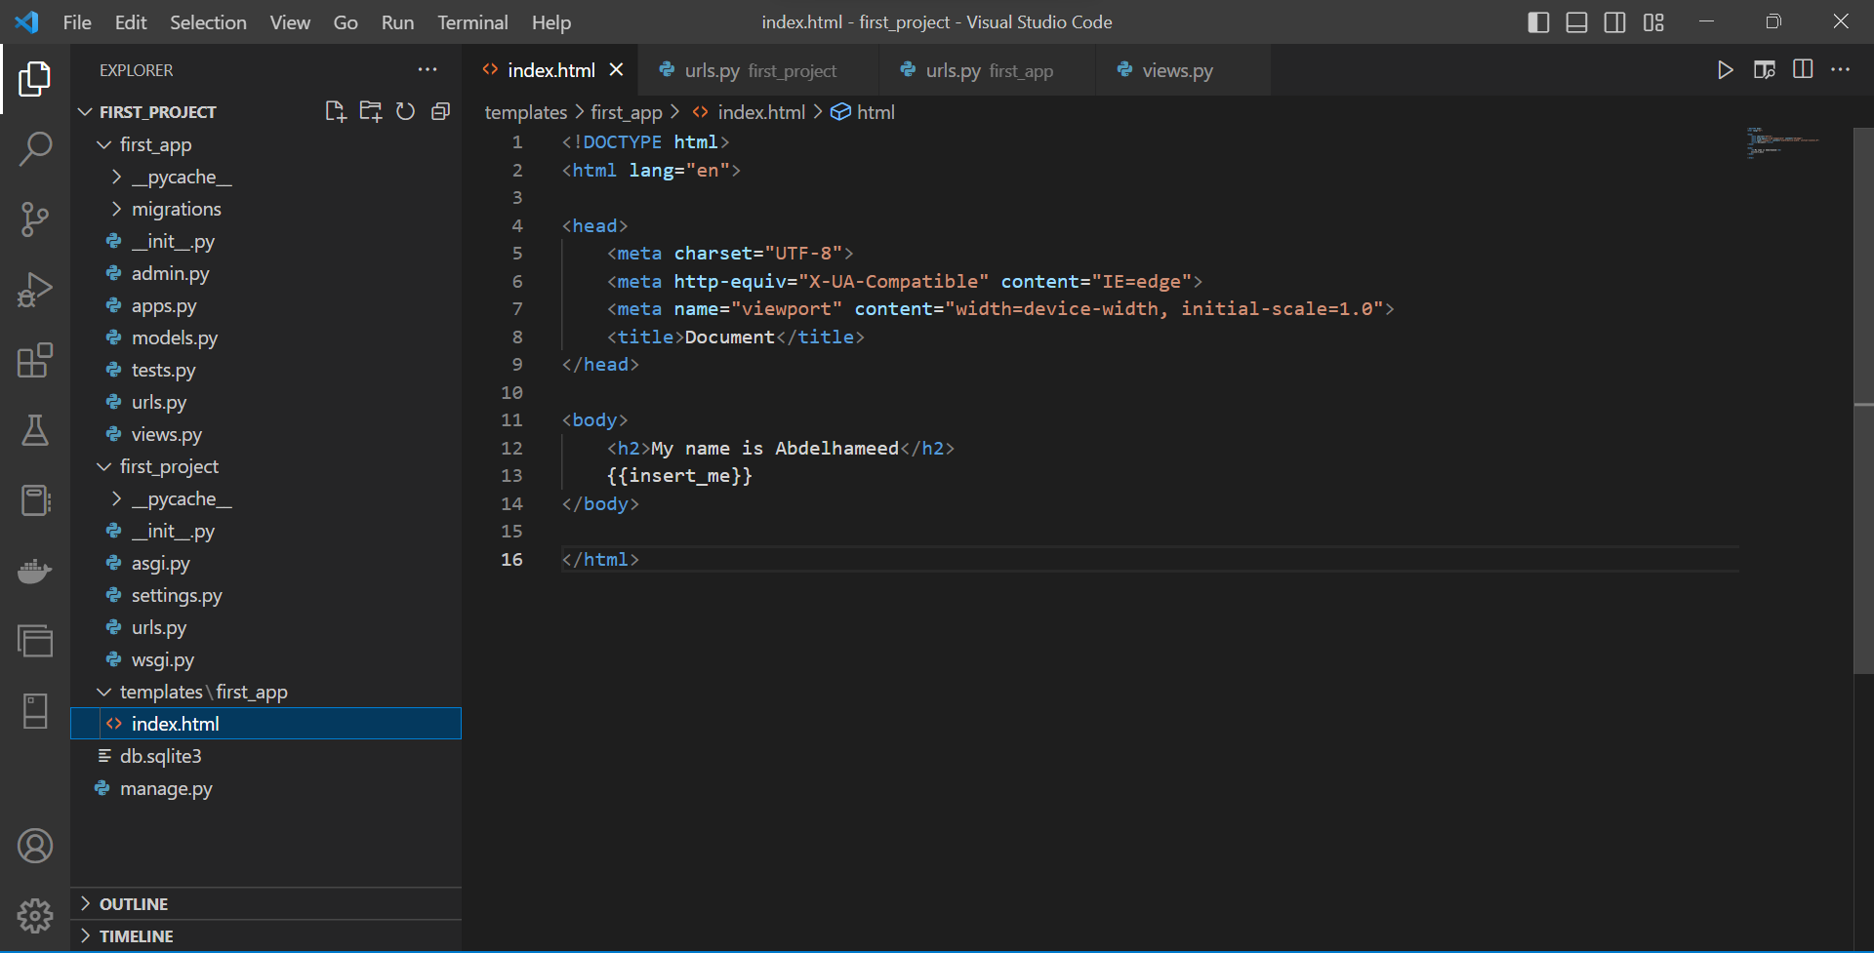

Slide 8



Thanks
Dr. Abdelhameed Fawzy

