Slide 1

Web Development with Python/Django Static directory
Dr. Abdelhameed Ibrahim
Assoc. Prof. of Computer Engineering

Slide 2
Using Static
First build a static directory followed by a subfolder for images, CSS, JS, etc.
It goes in your directory's top level:
For example
first_project/static/images
2

Slide 3
Project: settings.py
import os
STATIC_DIR = os.path.join(BASE_DIR, 'static')
STATICFILES_DIRS = [STATIC_DIR,]
3

Slide 4
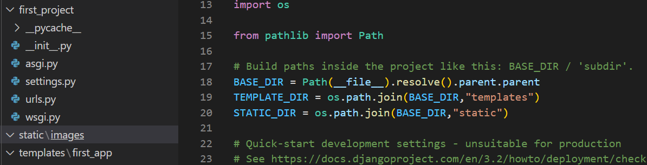
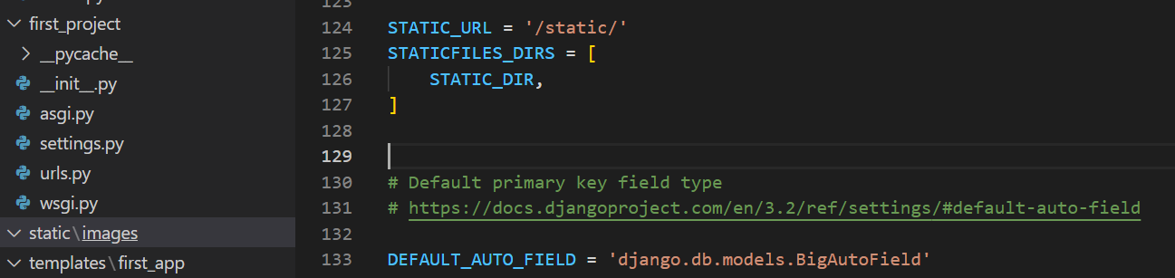
Static directory
4

Slide 5
Update HTML file
Write the following code in the index.html
{% load static %}
<body>
<p>My name is Abdelhameed</p>
{{insert_me}}
<img src="{% static 'images/amazing.jpg' %}" alt="Cannot load images">
</body>
5

Slide 6
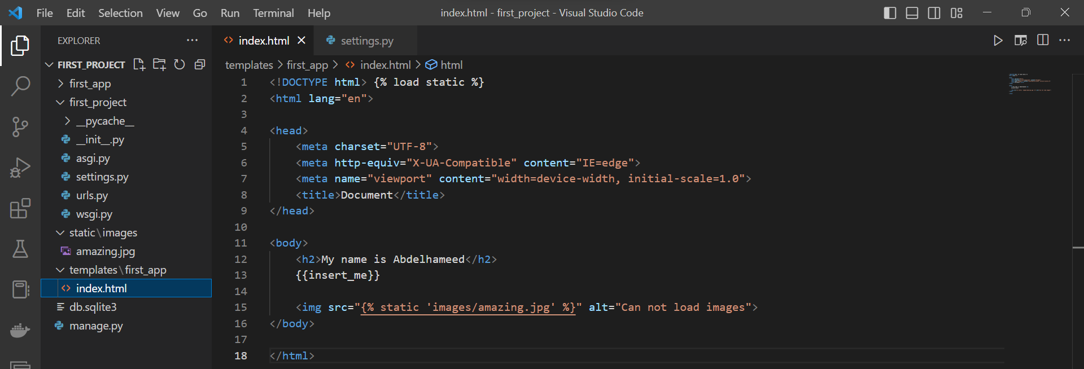
Update HTML file
6

Slide 7
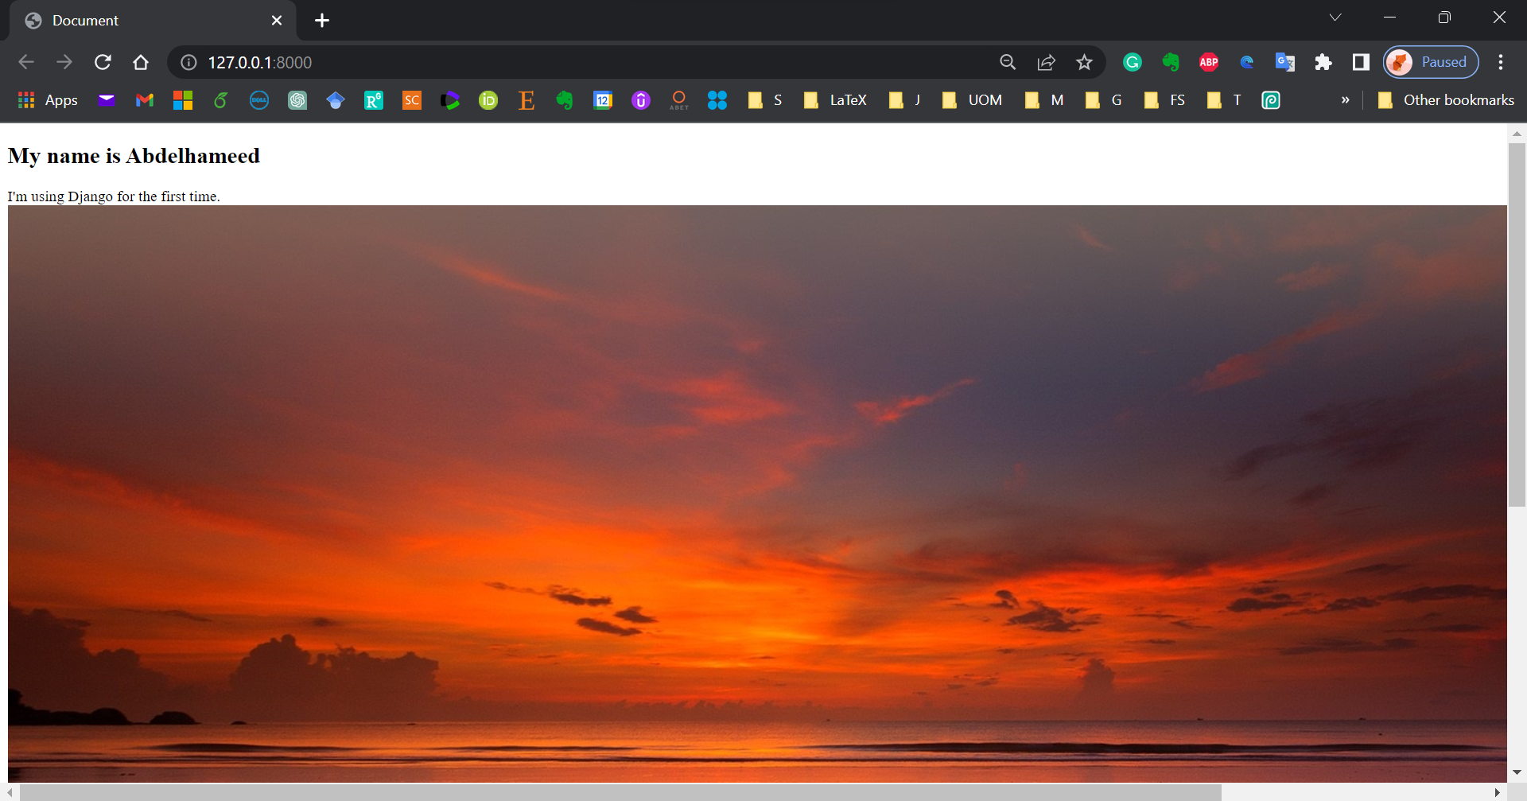
Run the project
7

Slide 8



Thanks
Dr. Abdelhameed Fawzy

