Slide 1
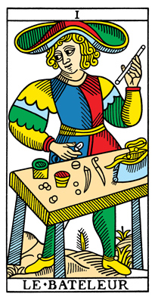
The Magician:
Create your own reality. This is the start of something new.

Slide 2
Future
Past
Present

