Slide 1
Event Management System
Team Members:
Afan Ahmad Khan
Jyothi Prasad
Rakesh Buchan
Sujith Narayan

Slide 2
Introduction
Event Management System is an online application which serves as a catalog of events
Being an online application helps event organizers to advertise their events and the users to know about the event details
A user of the application can browse for all the events from EMS database, find the details about the event and register for an event
Any registered user (participant) also has a privilege to add it’s event to EMS database which would be available for other users to register
Admin users help to maintain smooth operation of the application
The application acts as an event repository system which contains all the past and future events with their details, attendees and users who were interested.

Slide 3
Requirements
All users should be able to register as Participants
Only registered users can access the application
The user should register by providing it’s basic details
The system do not allow duplicate registration of the user by considering it’s email address and phone number as unique constraint
The participants will choose a username and password with which they login into the system
The participant can view all events, register for an event and also show interest for an event
EMS provides a feature for the user to list all his attending events, which helps in quick look up on it’s registered events for any updates
A participant can organize an event of his own
A user registered with EMS can organize an event which can be of type Sport, Music or Technology
Organizers can navigate to “Events I am organizing” section to view all events it is organizing, which eases the maintenance of it’s events
A participant organizing an event attains the role of an Organizer
EMS contains a repository of all events and their organizers
A participant attending an event attains the role of an Attendee
EMS also maintains a list of the event attendees and the event prospective attendees
EMS also maintains a repository of all events and their respective interested participants
*Please refer to Use-case document for detailed information

Slide 4
Requirements
A participant attending an event can also bring a fixed number of guests to the event
The user while registering for an event has an option to provide the number of guests who can accompany him for the event.
An event will have a fixed number of seats, as determined by the organizer.
Organizers when adding his event to EMS database has to provide details of the event like the date and time of the event, location of the event, in addition he has to provide total seats count which is the maximum number of attendees for an event.
An event can be an indoor event or an outdoor event, and is classified into three categories – Sport event, Music event and Technology event.
Organizers can add both indoor and outdoor events
Events added by organizers has to be of type:
Sport - Contains Game name
Music - Contains Genre and Artist name
Technology – Can be of category: Mobile, Robotics, Cloud.
A participant can also be an Admin in EMS.
EMS also facilitates Admin features to few users who can view all users registered with EMS and also has an option to remove a user and an event.
*Please refer to Use-case document for detailed information

Slide 5
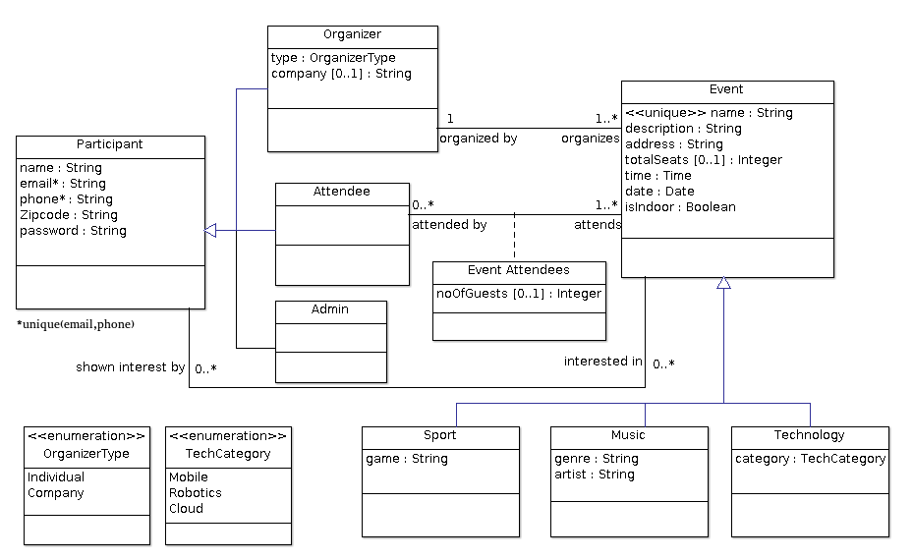
Design
UML Class Diagram

Slide 6
Implementation
Programming Language | Java/J2EE
Frameworks | Spring
Database | MySQL
Web Technology | JSP, jQuery and Bootstrap CSS
Tools | Eclipse, MySQL Workbench, ArgoUML

Slide 7
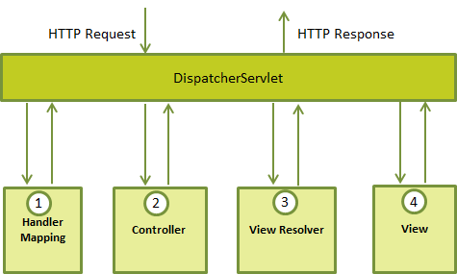
Implementation
3 – tier architecture of application

Slide 8
Discussion
The whole application is built following the MVC Design pattern – The most popular design choice while developing web applications.
· The software gives an option for one to set up the entire database automatically before deploying the application on the local server. This ensures that anyone who wants to setup the application does not face any schema level hassles
· The application is built keeping the Spring Framework design pattern in mind. This means that all the view pages, the java classes interacting with the database, and the model classes for the databases are properly grouped into the JSP files, the DAO files and the POJO files respectively
· The EMS system also ensures that the user does not have to make changes to the JDBC properties at multiple places. One just has to modify the context.xml file for the local server in order to set the application up and running

Slide 9
Future Work
EMS can be made more relevant to the user by adding browse feature based on the geographical location and it’s interests
Also providing event suggestions to the user based on it’s relevance feedback would make EMS more beneficial
The UI can be further improved to give a decent look and feel
The application can be integrated with some money merchants(apple pay/ google wallet) which can carry out financial transactions between organizers and attendees for a paid event

Slide 10
References:
Spring tutorial videos by ‘Javabrains’.
https://www.youtube.com/channel/UCYt1sfh5464XaDBH0oH_o7Q
Wikipedia
https://www.wikipedia.org/
Tutorials point
https://www.tutorialspoint.com/spring/spring_web_mvc_framework.htm

Slide 11
Thank You

