Slide 1
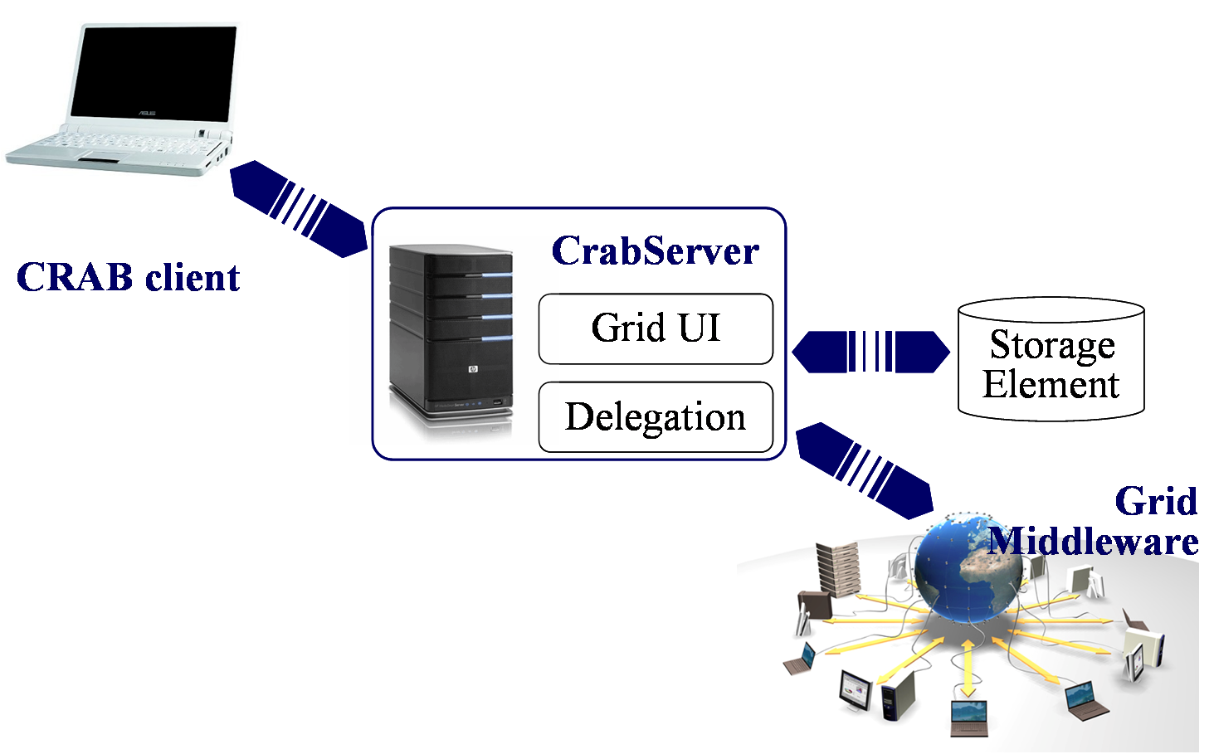
Data dicovery
and location
Job flow
CRAB UI
dataset
DBS
Data flow
Info flow
LFN, fileblocks
Local scope
DBS
fileblocks
PhEDEx
proxy
Job info
Storage Elements
Job status
Data publication
Tier2
direct
submission
Computing
Element
CRAB Server
Storage
Element
read
input
Storage
Element
Computing
Element
WMS
GridFTP
WN
remote Tier2
remote stageout

