Slide 1
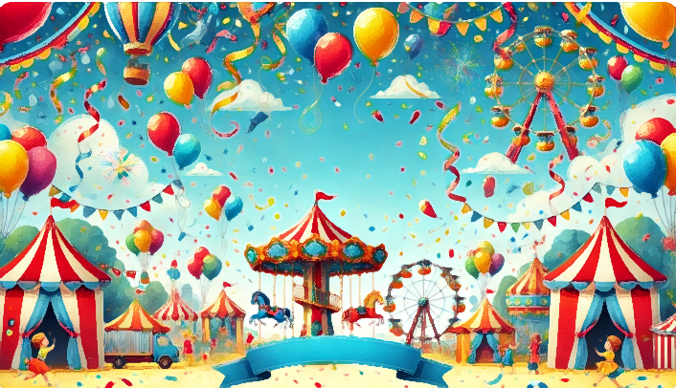
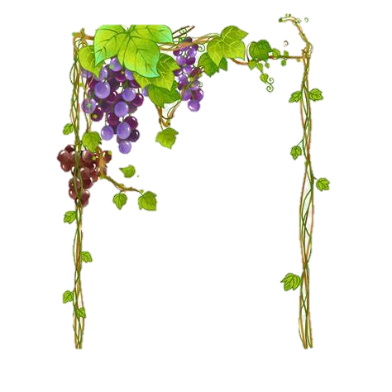






Happy
DAY
𝓐𝖈𝖙𝖎𝖛𝖎𝖙𝖎𝖊𝖘 𝕭𝖊𝖎𝖓𝖌 𝐇𝖊𝖑𝖉 :-
Children’s
-Carnival-
𝔽𝕦𝕟 𝔸𝕔𝕥𝕚𝕧𝕚𝕥𝕚𝕖𝕤 𝕒𝕟𝕕 𝔾𝕒𝕞𝕖𝕤: 𝕆𝕣𝕘𝕒𝕟𝕚𝕫𝕚𝕟𝕘 𝕚𝕟𝕥𝕖𝕣𝕒𝕔𝕥𝕚𝕧𝕖 𝕘𝕒𝕞𝕖𝕤 𝕒𝕟𝕕 𝕒𝕔𝕥𝕚𝕧𝕚𝕥𝕚𝕖𝕤 𝕥𝕠 𝕖𝕟𝕘𝕒𝕘𝕖 𝕔𝕙𝕚𝕝𝕕𝕣𝕖𝕟 𝕒𝕟𝕕 𝕞𝕒𝕜𝕖 𝕥𝕙𝕖 𝕕𝕒𝕪 𝕝𝕚𝕧𝕖𝕝𝕪 𝕒𝕟𝕕 𝕞𝕖𝕞𝕠𝕣𝕒𝕓𝕝𝕖.
ℂ𝕠𝕞𝕡𝕖𝕥𝕚𝕥𝕚𝕠𝕟𝕤: 𝕋𝕒𝕝𝕖𝕟𝕥 𝕤𝕙𝕠𝕨𝕤, 𝕕𝕣𝕒𝕨𝕚𝕟𝕘 𝕔𝕠𝕟𝕥𝕖𝕤𝕥𝕤, 𝕒𝕟𝕕 𝕠𝕥𝕙𝕖𝕣 𝕔𝕠𝕞𝕡𝕖𝕥𝕚𝕥𝕚𝕠𝕟𝕤 𝕥𝕠 𝕖𝕟𝕔𝕠𝕦𝕣𝕒𝕘𝕖 𝕔𝕣𝕖𝕒𝕥𝕚𝕧𝕚𝕥𝕪 𝕒𝕟𝕕 𝕤𝕜𝕚𝕝𝕝-𝕓𝕦𝕚𝕝𝕕𝕚𝕟𝕘.
ℂ𝕦𝕝𝕥𝕦𝕣𝕒𝕝 ℙ𝕣𝕠𝕘𝕣𝕒𝕞𝕤: 𝔻𝕒𝕟𝕔𝕖, 𝕞𝕦𝕤𝕚𝕔, 𝕒𝕟𝕕 𝕕𝕣𝕒𝕞𝕒 𝕡𝕖𝕣𝕗𝕠𝕣𝕞𝕒𝕟𝕔𝕖𝕤 𝕓𝕪 𝕔𝕙𝕚𝕝𝕕𝕣𝕖𝕟 𝕥𝕠 𝕔𝕖𝕝𝕖𝕓𝕣𝕒𝕥𝕖 𝕥𝕙𝕖𝕚𝕣 𝕥𝕒𝕝𝕖𝕟𝕥𝕤 𝕒𝕟𝕕 𝕥𝕖𝕒𝕞𝕨𝕠𝕣𝕜.
𝕊𝕥𝕠𝕣𝕪𝕥𝕖𝕝𝕝𝕚𝕟𝕘 𝕊𝕖𝕤𝕤𝕚𝕠𝕟𝕤: 𝔼𝕟𝕘𝕒𝕘𝕚𝕟𝕘 𝕤𝕥𝕠𝕣𝕪𝕥𝕖𝕝𝕝𝕚𝕟𝕘 𝕤𝕖𝕤𝕤𝕚𝕠𝕟𝕤 𝕥𝕙𝕒𝕥 𝕖𝕟𝕥𝕖𝕣𝕥𝕒𝕚𝕟 𝕒𝕟𝕕 𝕖𝕕𝕦𝕔𝕒𝕥𝕖, 𝕖𝕞𝕡𝕙𝕒𝕤𝕚𝕫𝕚𝕟𝕘 𝕞𝕠𝕣𝕒𝕝 𝕧𝕒𝕝𝕦𝕖𝕤 𝕒𝕟𝕕 𝕗𝕦𝕟 𝕝𝕖𝕒𝕣𝕟𝕚𝕟𝕘.
𝔾𝕚𝕗𝕥𝕤 𝕒𝕟𝕕 𝕋𝕣𝕖𝕒𝕥𝕤: 𝔻𝕚𝕤𝕥𝕣𝕚𝕓𝕦𝕥𝕚𝕟𝕘 𝕤𝕞𝕒𝕝𝕝 𝕘𝕚𝕗𝕥𝕤, 𝕥𝕣𝕖𝕒𝕥𝕤, 𝕠𝕣 𝕘𝕠𝕠𝕕𝕪 𝕓𝕒𝕘𝕤 𝕒𝕤 𝕥𝕠𝕜𝕖𝕟𝕤 𝕠𝕗 𝕝𝕠𝕧𝕖 𝕒𝕟𝕕 𝕒𝕡𝕡𝕣𝕖𝕔𝕚𝕒𝕥𝕚𝕠𝕟 𝕗𝕠𝕣 𝕥𝕙𝕖 𝕔𝕙𝕚𝕝𝕕𝕣𝕖𝕟. ℂ𝕠𝕞𝕞𝕦𝕟𝕚𝕥𝕪
𝕀𝕟𝕧𝕠𝕝𝕧𝕖𝕞𝕖𝕟𝕥: 𝕀𝕟𝕧𝕚𝕥𝕚𝕟𝕘 𝕡𝕒𝕣𝕖𝕟𝕥𝕤, 𝕥𝕖𝕒𝕔𝕙𝕖𝕣𝕤, 𝕒𝕟𝕕 𝕔𝕠𝕞𝕞𝕦𝕟𝕚𝕥𝕪 𝕞𝕖𝕞𝕓𝕖𝕣𝕤 𝕥𝕠 𝕡𝕒𝕣𝕥𝕚𝕔𝕚𝕡𝕒𝕥𝕖, 𝕤𝕥𝕣𝕖𝕟𝕘𝕥𝕙𝕖𝕟𝕚𝕟𝕘 𝕓𝕠𝕟𝕕𝕤 𝕒𝕟𝕕 𝕤𝕙𝕒𝕣𝕖𝕕 𝕛𝕠𝕪.
-Conducted and Sponsored by TiþLi LLC-
Why :-
"Every child iS A Different kind of flower, And together they Make this World a Beautiful Garden." 🌸 🌸 🌸
Children's Day is celebrated to honor children and their rights, recognizing their role as the future of society. It emphasizes the importance of providing children with a safe, nurturing, and supportive environment to grow and thrive. Different countries celebrate Children's Day on different dates, but the common goal is to promote the well-being, education, and happiness of children.
In many places, Children's Day also pays tribute to influential figures who advocated for children's rights. For instance, in India, it is celebrated on November 14th to honor the birthday of Jawaharlal Nehru, who was fondly known for his love for children.
-
-
“Let's Celebrate Childhood!”
altogether

Slide 2







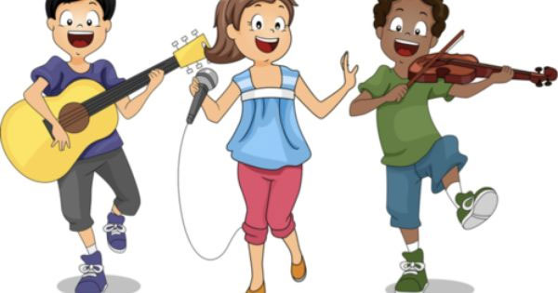

Main Events _-Being held-_
RuLeS To Be FoLLoWeD
When & Where
Punctuality: Arrive on time and follow the event schedule.
Respect for Everyone: Be kind, polite, and respectful towards others, including organizers, participants, and peers.
Participation: Actively participate in activities and competitions with enthusiasm and a positive attitude.
Safety First: Follow safety instructions and avoid actions that could harm yourself or others.
Cleanliness: Keep the event area clean by using designated bins for trash.
Listening to Organizers: Pay attention to announcements and instructions from organizers and volunteers.
The TiþLi LLC Children’s Carnival will be held on Children's Day (November 14th) from 10:00 AM to 4:00 PM on Saturday. The event will take place in the HILON Ground, Dubai ,UAE, offering a lively and safe environment for all students to enjoy.
Talent Showcase Gala: A platform for children to display their unique talents in singing, dancing, acting, and more. The event will end with awards and recognition for outstanding performances.
Magical Storytime Theater:
An enchanting event featuring captivating storytelling sessions with interactive performances. Children will be mesmerized as stories come to life, sparking their imagination and creativity.
Scan the QR code to get the google maps location
Science and Discovery Expo:
A hands-on event where kids can explore science experiments, innovative tech displays, and fun facts. It’s a day to ignite curiosity and learning in a playful way.
Follow Us On:
@TiþLi_LLC
TiþLi@children

