Slide 1

FYP-2 Final Evaluation
Team
Wajee ul Hassan
21F-9143
Om Parkash
21F-9272
Afaq Ahmed
21F-9298

Slide 2
Team Name:
Code Geass
Supervisor(s):
Dr. Rabia Maqsood
External-Supervisor(s):
Dr. Shah Nawaz
Project Name/Title:
Hateful Meme Detection in Multimodal Setting

Slide 3

LOGO

Slide 4
Outline
Introduction
Policies
Use Case Diagram
Domain Model
Component Diagram
Package Diagram
JSON Tree Diagram
System Sequence Diagrams
Activity Diagram
Data Flow Diagram
Architecture Diagram
Literature Review
Use Cases to Commit
Pipeline Diagram
Research work to Commit
Base Model Evaluation
References

Slide 5
Project Introduction
1
Objective 1
Analyze the Impact of Missing Modalities: Investigate how the absence of text or image data affects the performance of hate speech detection models.
2
Objective 2
Propose a Robust Solution: Develop a strategy for creating a more resilient detection system that can effectively handle missing modalities.
3
Objective 3
Explore the idea of integrating the proposed solution into a practical tool, such as a browser extension, to enhance user safety in real-world applications.

Slide 6
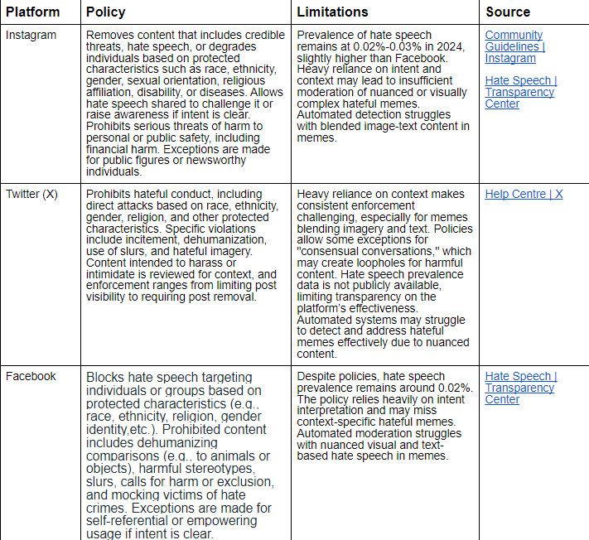
Policies
Table 1 Policies

Slide 7
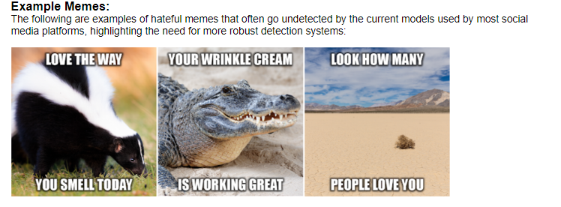
Policies

Slide 8
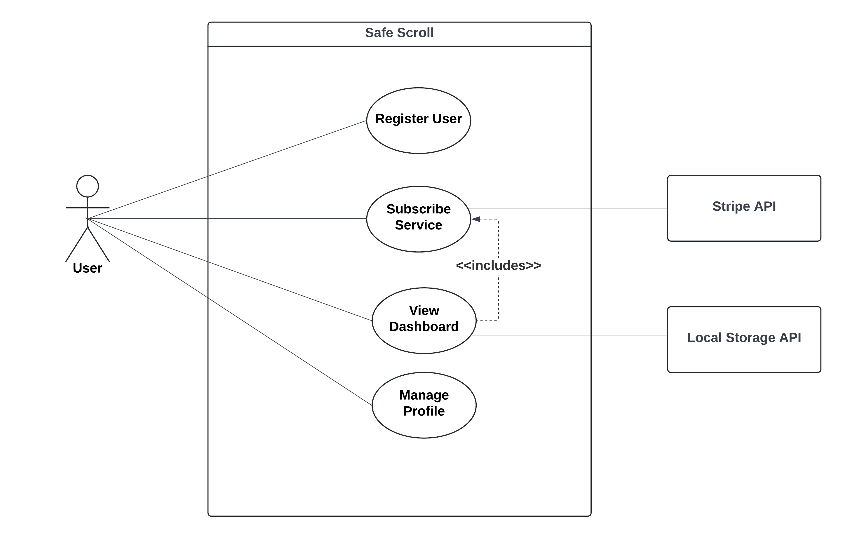
Use Case Diagram

Slide 9
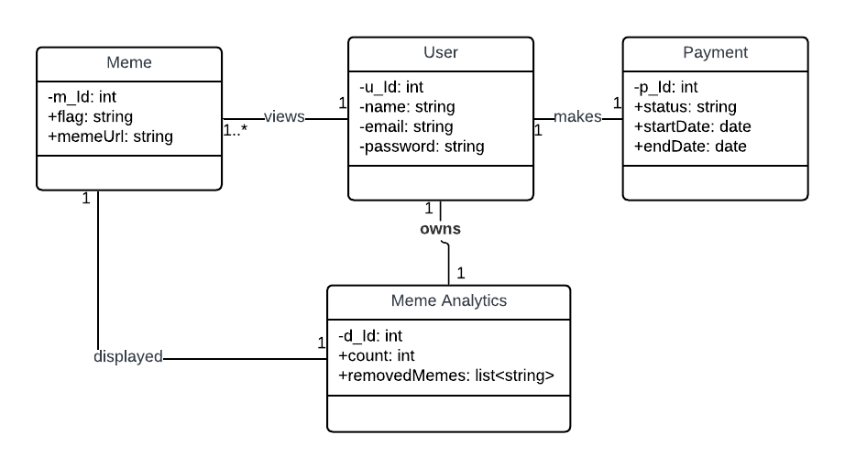
Domain Model Diagram

Slide 10
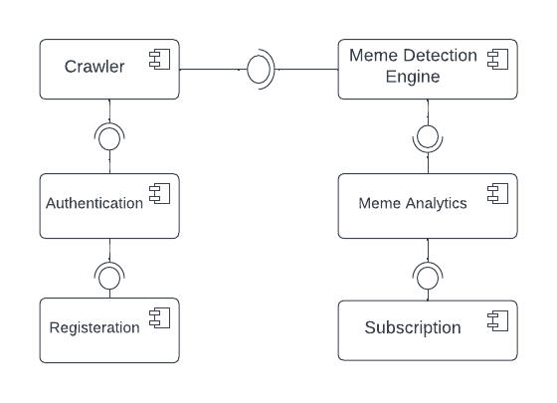
Component Diagram

Slide 11
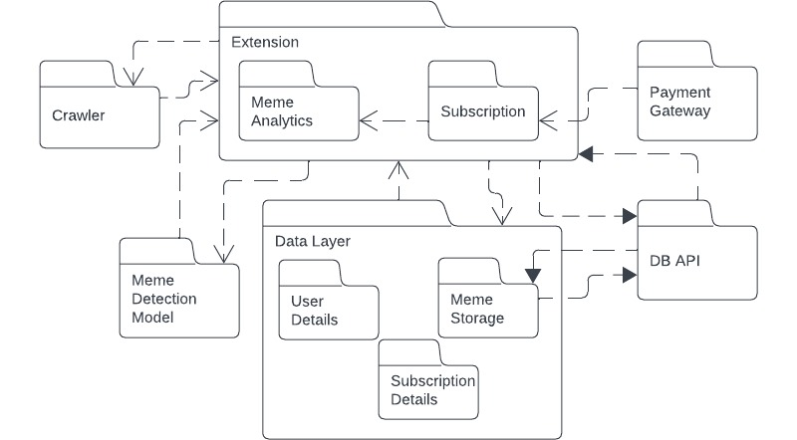
Package Diagram

Slide 12
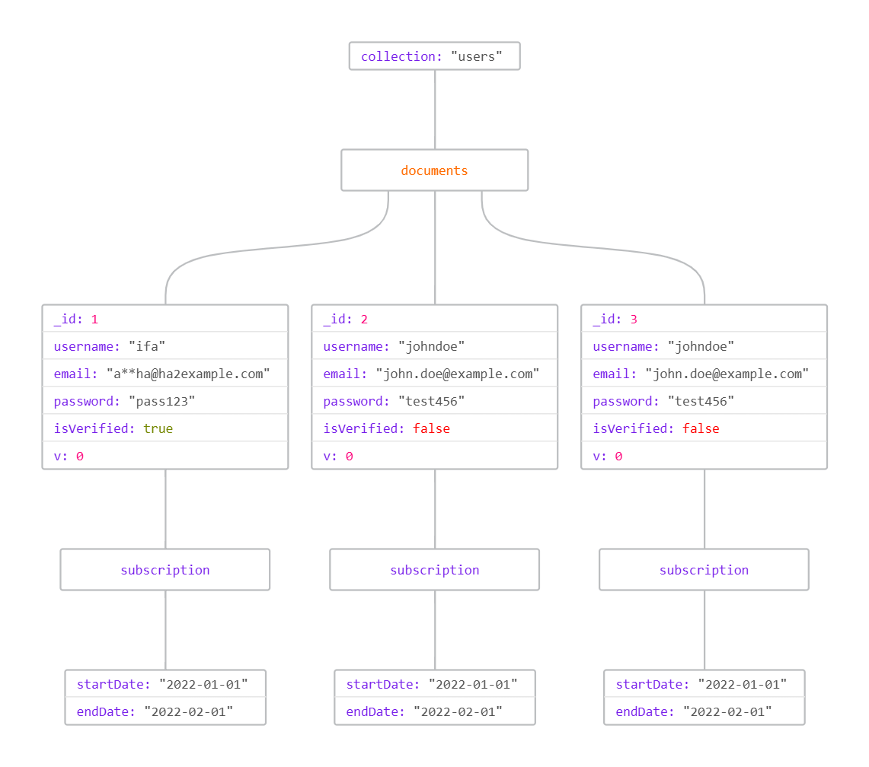
JSON Tree Diagram

Slide 13
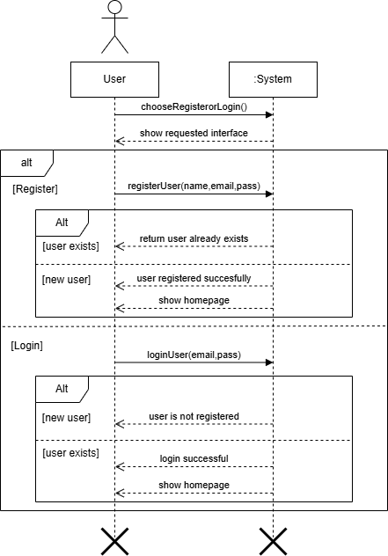
System Sequence Diagram
Figure: Sign In/Registration (SSD)

Slide 14
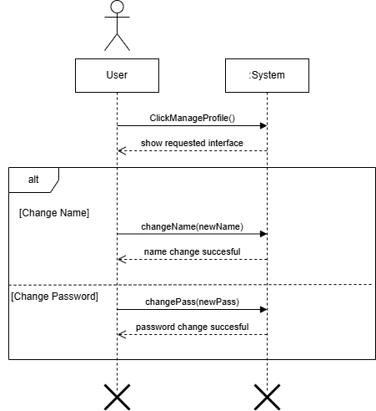
System Sequence Diagram
Figure: Manage Profile (SSD)

Slide 15
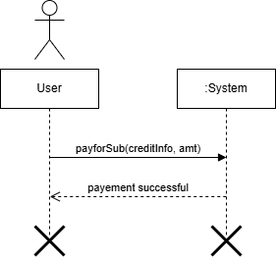
System Sequence Diagram
Figure: Buy Subscription (SSD)

Slide 16
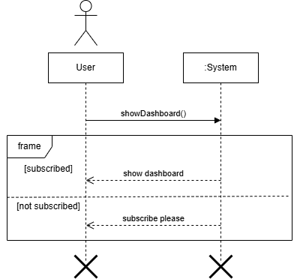
System Sequence Diagram
Figure: Meme Analytics (SSD)

Slide 17
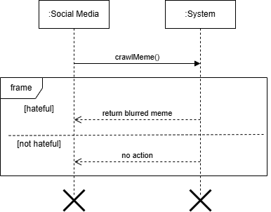
System Sequence Diagram
Figure: Meme Detection (SSD)

Slide 18
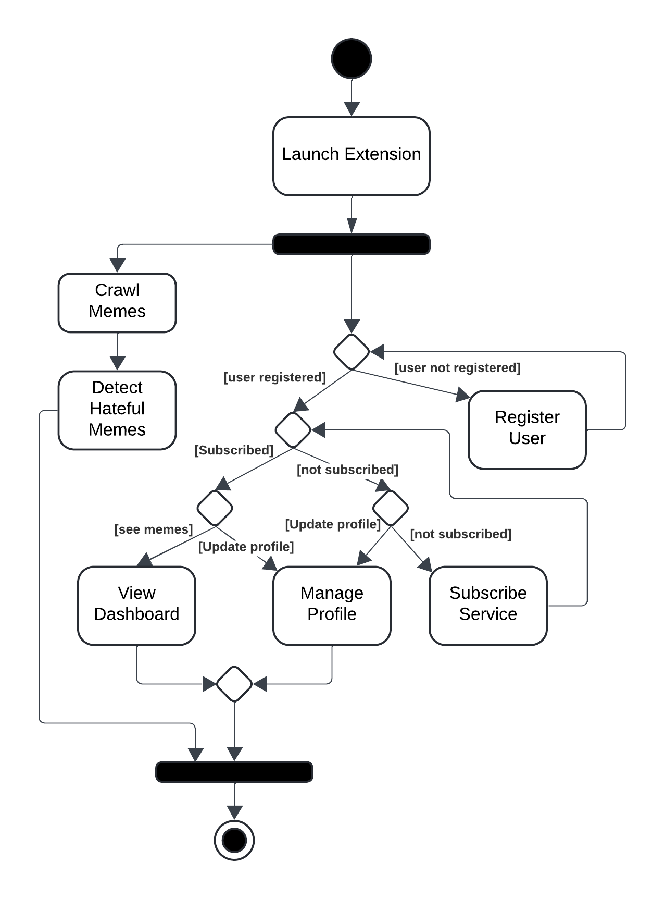
Activity Diagram
Figure: Activity Diagram

Slide 19
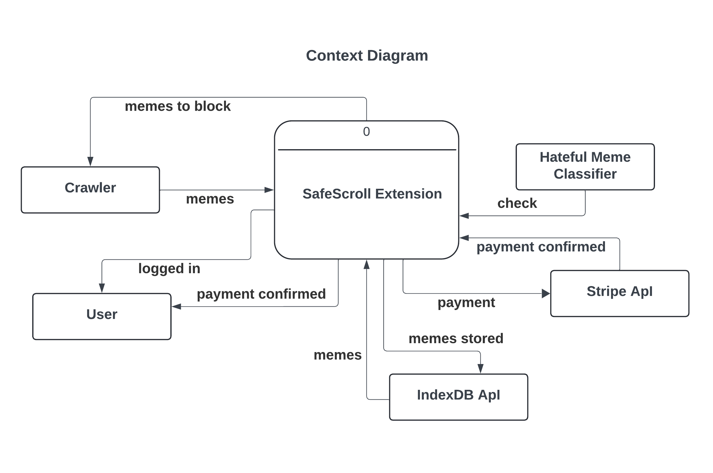
Data Flow Diagram

Slide 20
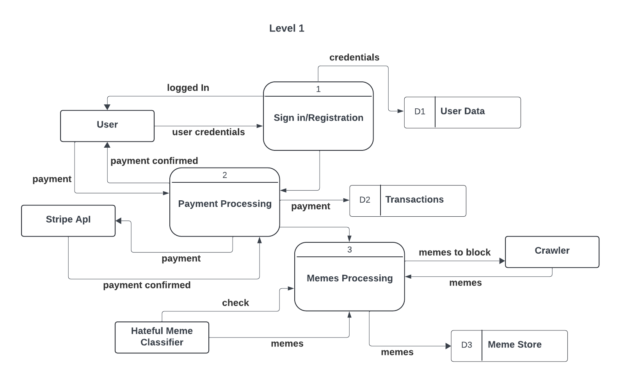
Data Flow Diagram

Slide 21
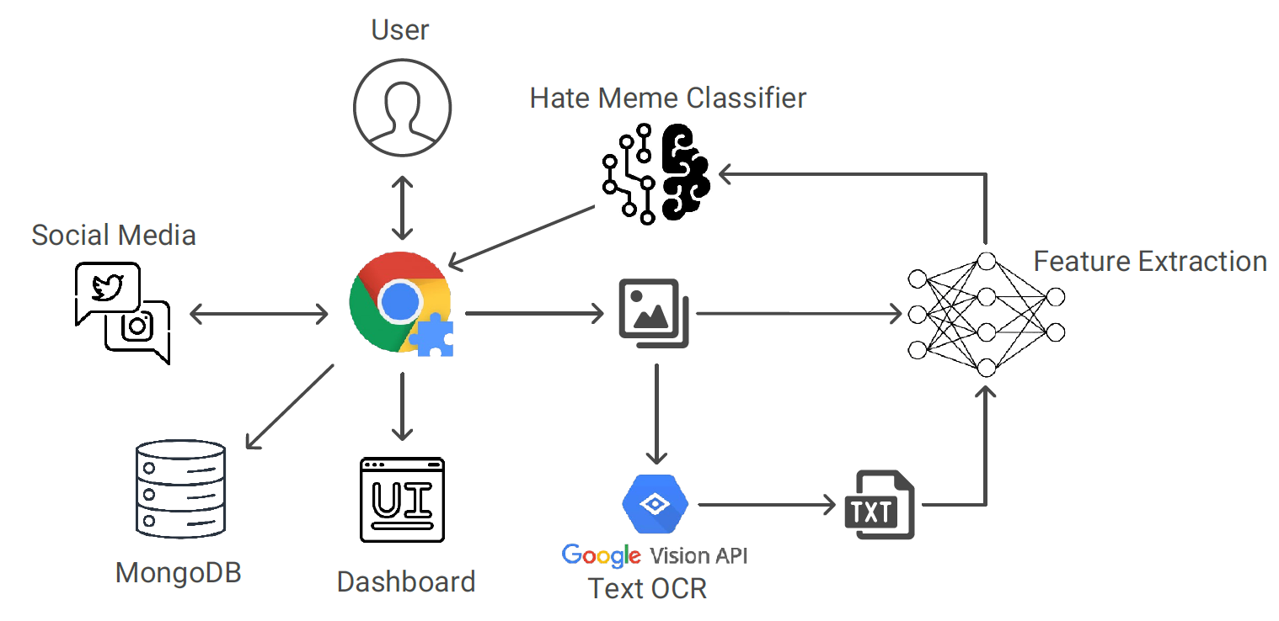
Architecture Diagram

Slide 22
Research
Problem Domain:
The rapid spread of hateful content, particularly in the form of memes, presents challenges across social media platforms. This content is complex, often combining text and imagery to convey harmful messages subtly. Current moderation tools struggle with multimodal content, which necessitates a sophisticated model capable of understanding both textual and visual components to detect and mitigate hate speech effectively.
Research Problem Statement:
This project focuses on enhancing the detection of hateful memes by improving current multimodal models and developing a Chrome extension to filter this content on social media platforms. By advancing the state-of-the-art models for hate detection in multimodal content, the project aims to create a tool that comprehensively identifies and obscures hateful memes in real-time.

Slide 23
Literature Review
MOMENTA: A Multimodal Framework for Detecting Harmful Memes and Their
Targets (Pramanick et al., 2021):
Summary of the Research Item:
The MOMENTA framework by Pramanick et al. introduces a multimodal architecture for detecting harmful memes and identifying their targeted entities, based on global and local information from both image and text. MOMENTA extends the HarMeme dataset with additional categories (e.g., US politics) and utilizes various multimodal pre-trained models (e.g., CLIP, VGG-19, and DistilBERT) to improve detection accuracy. This study emphasizes the role of contextual analysis in identifying subtle harmfulness that arises from the combination of text and images [4].
Critical Analysis
Strengths: MOMENTA’s hierarchical attention mechanism effectively captures both the localized and global contexts, improving its accuracy and interpretability.
Weaknesses: Despite MOMENTA’s robust performance, the reliance on specific pre-trained models (like CLIP) may restrict adaptability in real-time applications or for languages and contexts not covered by these models. Furthermore, the architecture’s complexity may limit its utility in lightweight, resource-constrained applications.
Relationship to the Proposed Research Work
The MOMENTA framework’s emphasis on context-aware multimodal fusion aligns well with our project’s objectives to filter out hateful memes accurately. Applying similar hierarchical and cross-modal attention mechanisms could enhance our Chrome extension’s capability to understand and block harmful content based on nuanced contextual cues.

Slide 24
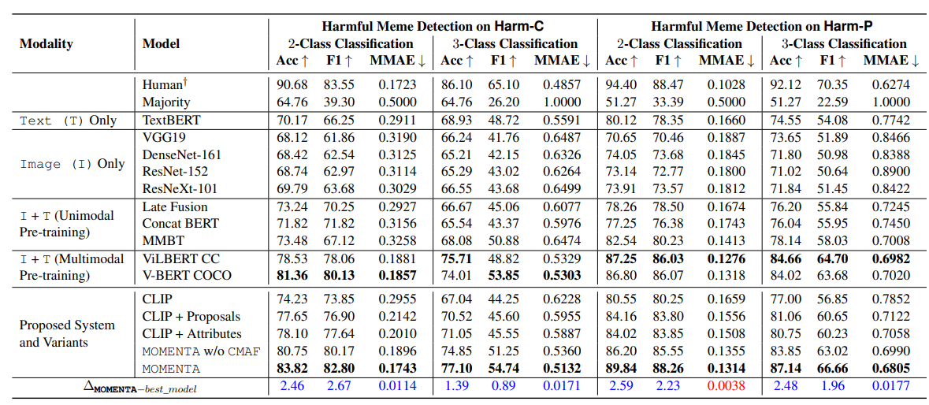
Literature Review
Performance:

Slide 25
Literature Review
Are Multimodal Transformers Robust to Missing Modality?
(Ma et al., 2022):
Summary of the Research Item:
This study investigates the robustness of Transformer-based models in multimodal tasks, especially under conditions where one modality (text or image) is missing. It examines various fusion strategies and concludes that Transformers show a notable decline in performance with missing modalities. The study also proposes an automated fusion strategy for optimal results in scenarios with incomplete modality information [4].
Critical Analysis (Strengths and Weaknesses):
Strengths: The study highlights the sensitivity of multimodal Transformers to missing data and offers insights into choosing appropriate fusion strategies for different datasets.
Weaknesses: This approach might require significant computational resources for fusion strategy optimization, making real-time detection challenging for resource-constrained applications.
Relationship to the Proposed Research Work:
This research is relevant for enhancing the robustness of our detection model, particularly for cases where either text or image information may be partially available or ambiguous. Leveraging insights from this study could improve model resilience in real-world settings where memes vary widely in structure.

Slide 26
Literature Review
Modality Invariant Multimodal Learning to Handle Missing Modalities (Saeed et al., 2024):
Summary of the Research Item:
This research proposes a modality-invariant approach to multimodal learning, enhancing robustness against missing data. By using a single-branch network with weight-sharing across modalities, the model adapts to incomplete multimodal inputs effectively, achieving high performance even with missing information. Extensive evaluations across datasets like Hateful Memes demonstrate the approach's effectiveness compared to traditional multi-branch fusion models [3].
Critical Analysis (Strengths and Weaknesses):
Strengths: The single-branch network structure significantly improves efficiency by reducing dependency on complete multimodal data, which is ideal for real-world applications with variable data availability.
Weaknesses: The single-branch approach, while robust, might underperform compared to more complex fusion strategies in cases where both modalities are present and highly informative.
Relationship to the Proposed Research Work:
The modality-invariant approach aligns well with our project’s goal to create a resilient hate meme detector. Implementing a similar single-branch model could enhance the Chrome extension's ability to filter content seamlessly, even in cases where meme data is incomplete or ambiguous.

Slide 27
Literature Review
A Multimodal Dataset for Detecting Hateful Memes (Hossain et al., 2022)
Summary of the Research Item:
The MUTE dataset by Hossain et al. targets hateful memes in Bengali and code-mixed languages (English-Bengali), filling a gap in resource-constrained languages. It contains 4,158 annotated memes and uses unimodal (CNN, BiLSTM) and multimodal (transformer-based) methods. Combining text and images improves accuracy by 3% over unimodal models .
Critical Analysis:
Strengths: This dataset highlights the importance of multimodal hate speech detection in low-resource languages. It also addresses the unique challenges of code-mixed language content, which is often overlooked in mainstream datasets and models.
Weaknesses: While the dataset and models provide a substantial contribution, their reliance on specific OCR and transformer-based language models limits flexibility across languages. The dataset also remains small relative to datasets in high-resource languages, potentially affecting model generalization.
Relationship to the Proposed Research Work:
This dataset serves as a crucial resource for understanding how multimodal detection can be adapted to diverse languages and contexts. Insights gained from the MUTE dataset can help improve our Chrome extension’s effectiveness in identifying hateful content, especially in multilingual and code-mixed contexts.

Slide 28
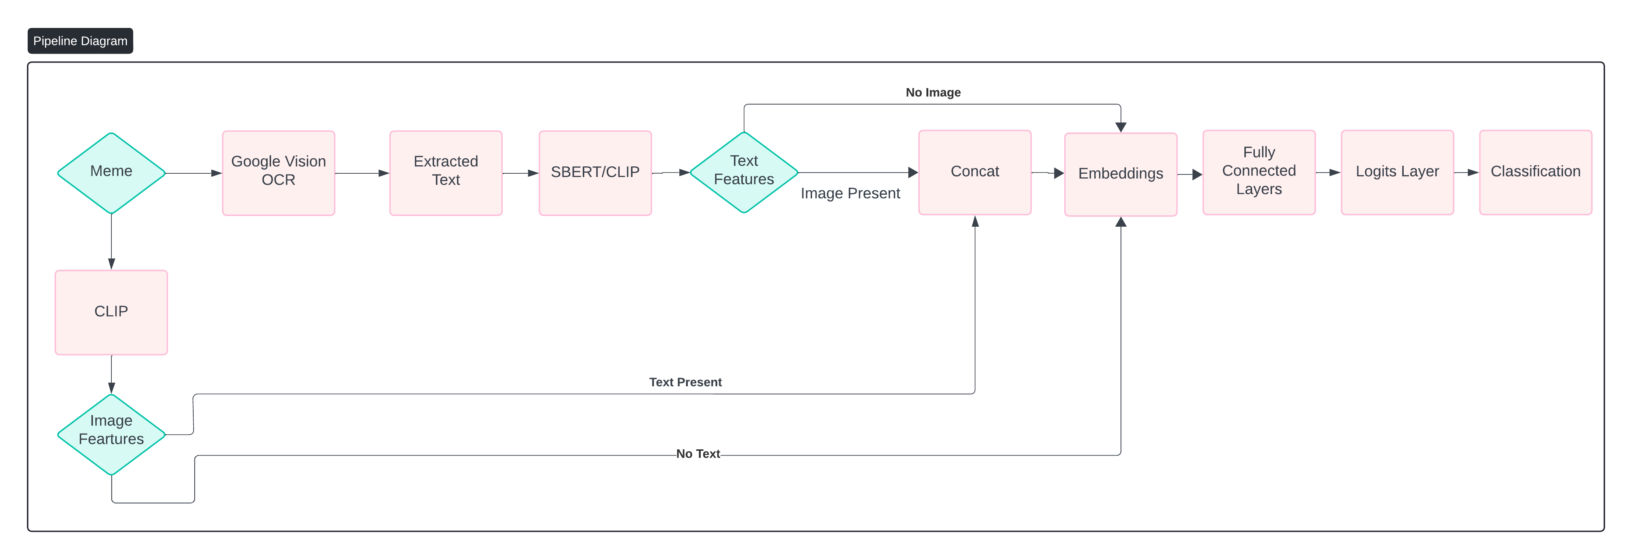
SBNET Diagram

Slide 29
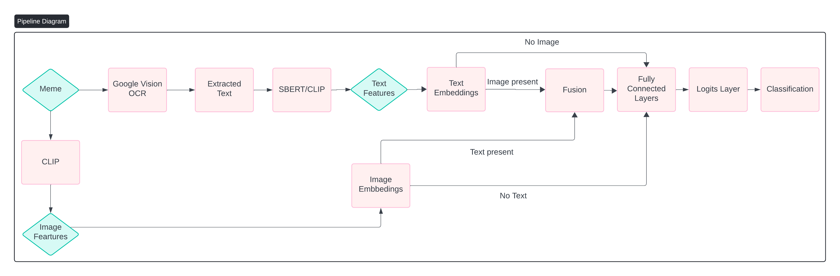
MBNET Diagram

Slide 30
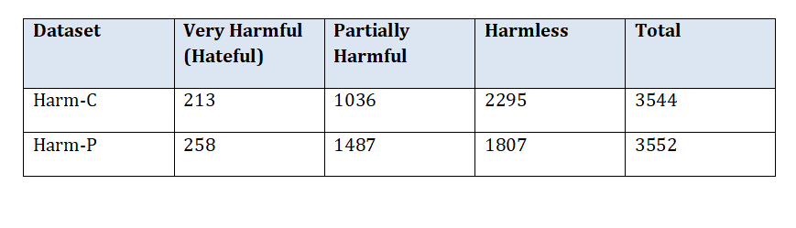
Dataset
HarmC:
A real-world dataset of COVID-19-related hateful memes.
HarmP:
A synthetic dataset focused on U.S. politics-related hateful memes.
Statistics:

Slide 31
OCR and Text Extraction
OCR Tools Evaluated:
We experimented with several OCR tools to extract text from memes and images:
TesseractOCR
DonutOCR (Microsoft)
EasyOCR
Paddle OCR
Google OCR
Best Performing OCR Tool:
After comparative testing, Google OCR was selected as the best-performing tool.
It consistently delivered high accuracy, even on noisy and complex meme text.
An example of the extracted text is provided for reference.

Slide 32

Examples
TesseractOCR:H Te DonutOCR:Thqu+ EasyOCR:thawt woul easier guxraian
Paddle OCR:1thqwt ifwoul4 peeasyer GoogleOCR:i thawt it would Pe easyer The Guardian

Slide 33
Feature Extraction Approaches
We explored multiple pre-trained models for feature extraction from both text and images.
Text Feature Extraction Models Used:
SBERT
DistilBERT
CLIP (Text)
Image Feature Extraction Models Used:
VGG19
ResNet152
CLIP (Image)
Combinations Evaluated:
A total of 9 combinations were evaluated for performance, combining each text and image feature extraction model.
Results were compiled to identify the best-performing combination.

Slide 34
Model Evaluation and Results
Evaluation Process:
Ran the model on all combinations of text and image features.
Compared performance across both datasets (HarmC and HarmP).
Selected the best-performing combination based on evaluation metrics.
Metrics Used for Evaluation:
Accuracy: Overall correctness of predictions.
Macro-F1 Score: Balance between precision and recall across all classes.
MMAE: Mean absolute error.
Precision: Proportion of true positives among predicted positives.
Recall: Proportion of true positives among actual positives.
AUC-ROC: Ability to distinguish between classes.

Slide 35
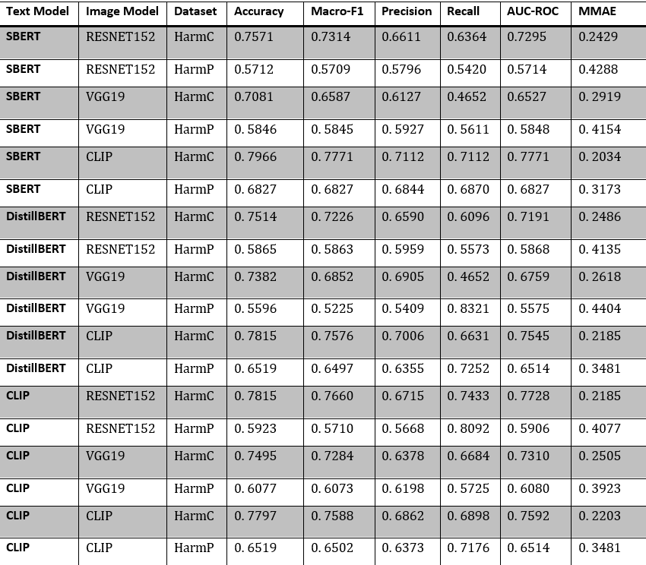
Selection of Feature Models

Slide 36
Single-Branch Network Results

Slide 37
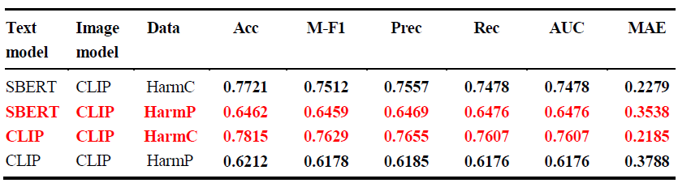
Evaluation with Complete Modality (768-dim, 2-class, V1)

Slide 38
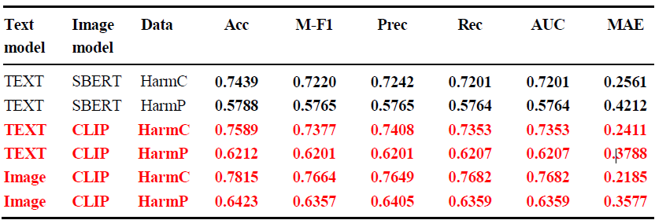
Evaluation with Missing Modality (768-dim, 2-class, V1)

Slide 39
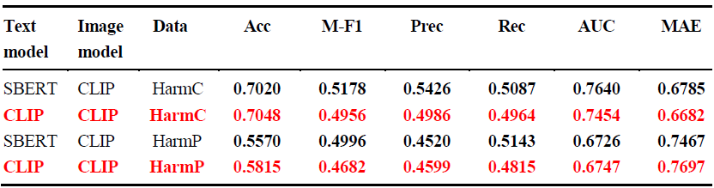
Evaluation with Complete Modality (768-dim, 3-class, V1)

Slide 40
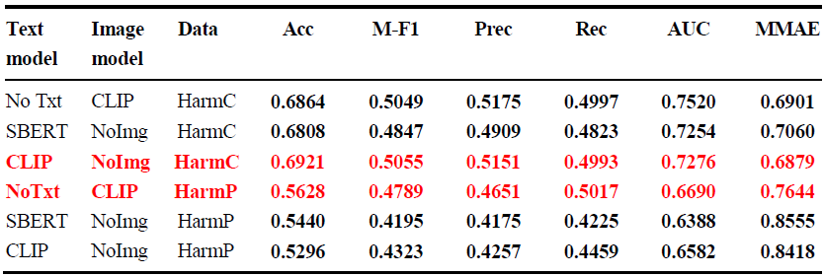
Evaluation with Missing Modality (768-dim, 3-class, V1)

Slide 41
Multi-Branch Network Results

Slide 42
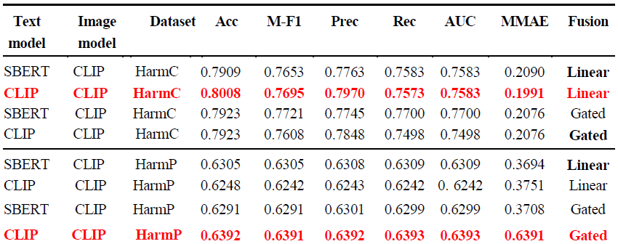
Evaluation with Complete Modality (768-dim, 2-class, V1)

Slide 43
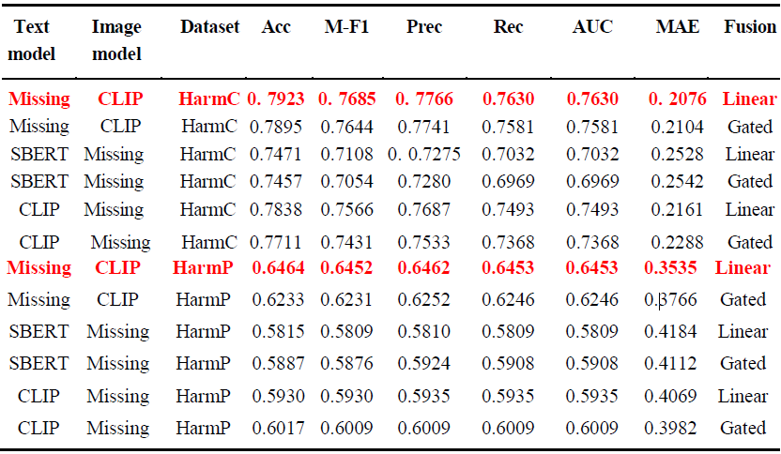
Evaluation with Missing Modality (768-dim, 2-class, V1)

Slide 44
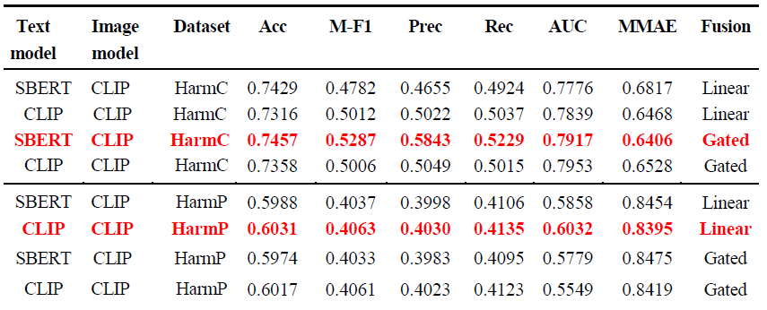
Evaluation with Complete Modality (768-dim, 3-class, V1)

Slide 45
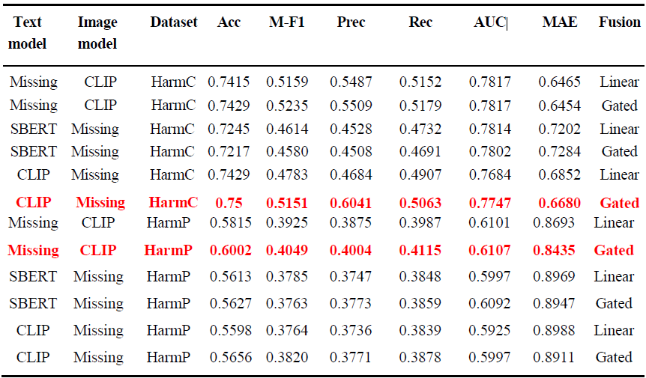
Evaluation with Missing Modality (768-dim, 3-class, V1)

Slide 46
Single-Branch and Multi-Branch Results on Roman-Urdu Memes

Slide 47
Roman-Urdu Memes Collection and Annotation Process
Stage | Process | Details
1. Data Collection | Collect memes from multiple platforms | Facebook, Instagram, Twitter, Pinterest. Total: ~781 memes (342 hateful, 439 non-hateful).
2. Data Filtering | Remove irrelevant or poor-quality data | - Low resolution/quality: Removed manually or during annotation phase. - Duplicates: Removed using Duplicate Image Finder. - Cartoon memes: Removed manually.
3. Phase-I Annotation | Initial meme labeling by 3 undergraduate annotators independently | Each meme labeled as: - Hateful - Non-Hateful - Neutral Final label decided via majority vote (at least 2/3 agreement).
4. Annotation Criteria | Defined guidelines for meme classification | Sentiment label: Hateful / Non-Hateful / Neutral b. Category label: Targeting a minority (gender/religion) Individual (public figure) Organization/Institute Sect (ethnicity/political) Other

Slide 48



Samples from Roman-Urdu Dataset
Hateful Memes

Slide 49



Samples from Roman-Urdu Dataset
Non-Hateful Memes

Slide 50
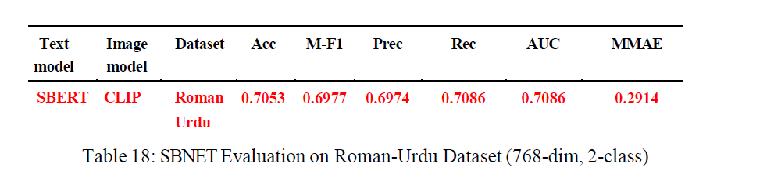
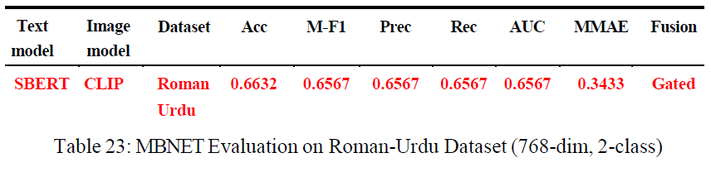
Evaluation of Models on Roman-Urdu Memes Dataset

Slide 51
SBNET Working
Input Processing
Features:
Text: SBERT or CLIP text embedding's (both typically 768-dimensional).
Image: CLIP (768-dimensional).
Modes:
Image-only
Text-only
Multimodal (both)
When both modalities are available, their feature vectors are concatenated (e.g., 768 + 768 → 1536) before feeding into the model.
2. Embedding Generation
Implemented via an EmbedBranch consisting of two fully connected layers:
Linear (feat_dim → embedding_dim), followed by BatchNorm1d, ReLU, and Dropout (p=0.5).
Another Linear (embedding_dim → embedding_dim), BatchNorm1d, ReLU, and Dropout.
The output is L2-normalized to produce a compact embedding vector.
3. Fusion
Concatenation Fusion: If both text and image features are present, they are simply concatenated.
4. Classification
A final linear layer (Linear(embedding_dim → n_classes)) outputs logits for either:
2-class (Hateful vs. Non-Hateful) or
3-class (Not Hateful, Somewhat Hateful, Hateful)
Trained with a cross-entropy loss. Early stopping is used based on validation loss to prevent overfitting.

Slide 52
MBNET Working
1. Input Processing
Features:
Text: CLIP Text Embeddings or SBERT (typically 768-dimensional).
Image: CLIP-ViT Image Embeddings (768-dimensional).
Modes:
Image-only
Text-only
Multimodal (both)
When both modalities are available, their feature vectors are fed separately into modality-specific branches and later fused.
2. Embedding Generation
Implemented via a modality-specific EmbedBranch, consisting of two fully connected layers:
Linear (feat_dim → embedding_dim)
BatchNorm1d
ReLU
Dropout (p=0.5)
Linear (embedding_dim → embedding_dim)
BatchNorm1d
ReLU
Dropout (p=0.5)
The final output is L2-normalized, producing a unit-length embedding vector.

Slide 53
MBNET Working
3. Fusion (Multimodal Mode Only)
If both image and text embeddings are present, fusion is applied via one of two methods:
Gated Fusion:
A gating layer learns sample-wise importance weights.
Gate vector z = sigmoid(W · concat([img_embed; text_embed]) + b)
Final fused vector: z ⊙ img_embed + (1 - z) ⊙ text_embed
Linear Fusion (α-weighted):
A scalar α ∈ [0, 1] is learned during training.
Final fused vector: α * img_embed + (1 - α) * text_embed
4. Classification
The resulting embedding (from image, text, or fused) is passed to a linear classifier:
Linear (embedding_dim → n_classes)
Outputs:
Binary: Hateful vs. Non-Hateful
Multiclass: Not Hateful, Somewhat Hateful, Hateful
Training:
Loss Function: CrossEntropyLoss
Early Stopping: Based on validation loss
Regularization: Dropout and BatchNorm included in branches

Slide 54
Observations
Final Observations & Key Insights
2-Class Classification (768-dim, V1)
Complete Modality:
MBNET outperforms all prior baselines.
Best overall: CLIP + CLIP on HarmC with MBNET (Linear fusion) → Acc = 0.8008, M-F1 = 0.7695.
For HarmP, MBNET also improves slightly over SBNET (Acc ≈ 0.6392, M-F1 ≈ 0.6391 using Gated Fusion).
SBNET remains strong but lags behind MBNET. Best results were with CLIP+CLIP on HarmC (Acc ≈ 0.7815, M-F1 ≈ 0.7629).
Missing Modality:
MBNET shows high robustness, especially on HarmC:
Using CLIP-only (Linear Fusion) → Acc = 0.7923, M-F1 = 0.7685.
Even with missing image, results stay strong (Acc ≈ 0.7471 with SBERT text).
HarmP remains consistently lower across all missing setups. Best MBNET result with missing text: Acc ≈ 0.6464, M-F1 ≈ 0.6452.

Slide 55
Observations
3-Class Classification (768-dim, V1)
Complete Modality (SBNET only):
Performance drops compared to 2class.
HarmC: SBERT+CLIP yields M-F1 = 0.5178; CLIP+CLIP gets slightly higher accuracy (~0.7048).
HarmP performs notably worse: Acc ~0.5570–0.5815, M-F1 well below 0.5.
Missing Modality (SBNET only):
HarmC is still relatively stable:
CLIP-only: Acc ≈ 0.6921, M-F1 ≈ 0.5055.
HarmP drops substantially:
Best M-F1 barely reaches 0.4789, worst dips to 0.4195 (text-only setup).
Roman-Urdu Meme Dataset (SBNET Only, 2-Class)
A promising new domain tested.
SBNET achieves strong performance:
Acc = 0.7053, M-F1 = 0.6977, indicating that the architecture generalizes reasonably well to multilingual/noisy-text meme data.

Slide 56
Conclusion
HarmC is consistently more learnable than HarmP across all setups, suggesting clearer semantics or more consistent annotation.
MBNET yields the best results, especially for 2-class classification, and shows graceful degradation in missing modality settings.
SBNET performs respectably and is valuable for benchmark comparison, especially in multimodal ablation scenarios.
CLIP+CLIP combinations dominate across models, indicating strong synergy between vision and CLIP’s textual embeddings.
The Roman-Urdu dataset serves as a viable testbed for language generalization, with potential for multilingual extension.

Slide 57
References
Pramanick, S., Sharma, S., Dimitrov, D., Akhtar, M. S., Nakov, P., & Chakraborty, T. (2021). MOMENTA: A multimodal framework for detecting harmful memes and their targets. arXiv preprint arXiv:2109.05184
Ma, M., Ren, J., Zhao, L., Testuggine, D., & Peng, X. (2022). Are multimodal transformers robust to missing modality?. In Proceedings of the IEEE/CVF Conference on Computer Vision and Pattern Recognition (pp. 18177-18186).
Saad Saeed, M., Nawaz, S., Zaigham Zaheer, M., Haris Khan, M., Nandakumar, K., Haroon Yousaf, M., ... & Schedl, M. (2024). Modality Invariant Multimodal Learning to Handle Missing Modalities: A Single-Branch Approach. arXiv e-prints, arXiv-2408.
Hossain, E., Sharif, O., & Hoque, M. M. (2022, November). Mute: A multimodal dataset for detecting hateful memes. In Proceedings of the 2nd conference of the asia-pacific chapter of the association for computational linguistics and the 12th international joint

Slide 58
References
Suryawanshi, S., Chakravarthi, B. R., Verma, P., Arcan, M., McCrae, J. P., & Buitelaar, P. (2020). A Dataset for Troll Classification of TamilMemes. In Proceedings of the WILDRE5– 5th Workshop on Indian Language Data: Resources and Evaluation (pp. 7–13). European Language Resources Association (ELRA). https://aclanthology.org/2020.wildre-1.2/
Ma, M., Ren, J., Zhao, L., Testuggine, D., & Peng, X. (2022). Are multimodal transformers robust to missing modality?. In Proceedings of the IEEE/CVF Conference on Computer Vision and Pattern Recognition (pp. 18177-18186).

Slide 59
Thank You

