Slide 1


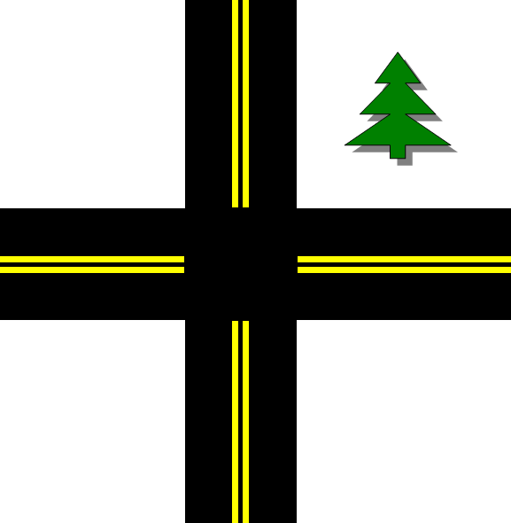


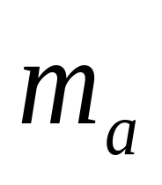
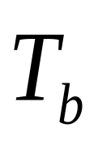





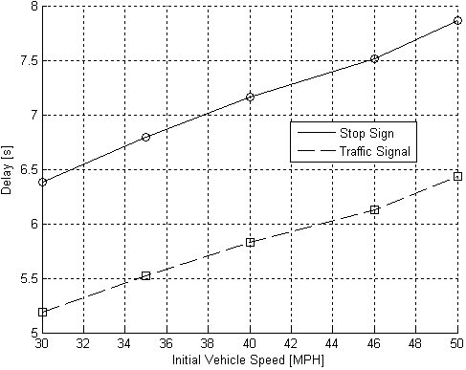
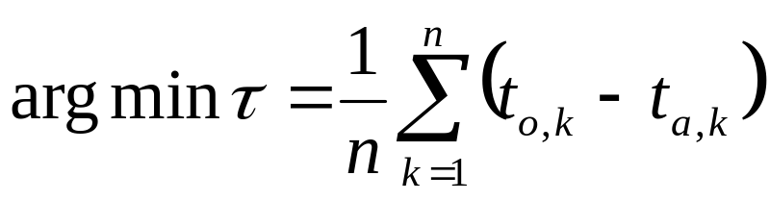
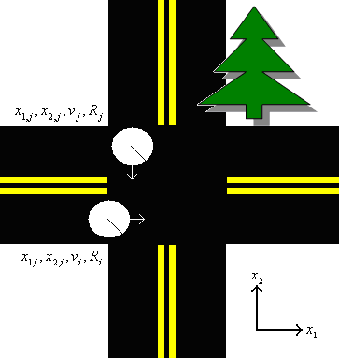

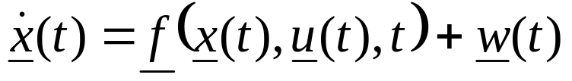
Cooperative decentralized intersection collision avoidance
using Extended Kalman Filtering
A. Farahmand and L. Mili
Virginia Tech-NVC, USA
We propose an adaptive, decentralized, cooperative collision avoidance (CCA) system that optimizes each vehicle’s controls subject to the constraint that no collisions occur. The system contributes a nonlinear 5-state variable vehicle model, a set of constrained, coupled EKFs, and a vehicular network based on the new WAVE standard. The system is compared to today’s common control devices.
Problem
Introduction
Stop signs and traffic signals are:
Unsafe – fail during disasters, power outages
Inefficient – cause excessive delays, waste fuel
Costly – installation, maintenance, electricity
Researchers have primarily focused on radar, optical [2], [3], or cooperative systems [4], [5] but these have limitations
Solution
A cooperative, decentralized intersection collision avoidance system comprising:
nonlinear 5-state variable vehicle model
set of coupled, constrained EKFs
wireless network for vehicular control
Vehicle Model
We expand the model developed in [1]
Mass of air in the intake manifold
Engine angular velocity
Brake torque
Throttle angle
Brake angle
Coupled, Constrained EKFs
State equation
Observation equation
Simulation Results
We determine the average additional delay caused by stop signs and traffic signals under sparse traffic conditions in comparison to the Sparse Traffic Optimization Algorithm at various velocities
losses
Interdependencies of vehicular dynamics
Vehicular Network
uses WAVE\DSRC (IEEE 1609 and 802.11p)
Low latency (50 ms), low interference
High range (1 km) and high rate (6-27 Mbps)
How Does System Work?
Observe vehicle states using GPS and sensors
Share control information among vehicles
Estimate states using coupled, constrained EKFs
Optimize vehicular controls
Automate controls according to optimization
Sparse Traffic Optimization Algorithm
Objective function:
Constraints:
Conclusions
The system is superior at minimizing average delay in comparison to current collision avoidance technologies
The system is more safe, efficient, and inexpensive than current devices
References
[1] J.K. Hedrick, D.H. McMahon,and D. Swaroop, “Vehicle modeling and control for automated highway systems”. California PATH Program, UC Berkeley, November 1993.
[2] P.N. Pathirana, A.E.K. Lim, A.V. Savkin, and P.D. Hodgson, "Robust video/ultrasonic fusion-based estimation for automotive applications". IEEE Transactions on Vehicular Technology, Vol. 56, No. 4, pp. 1631-1639, July 2007.
[3] S. Quinlan and O. Khatib, "Elastic bands: connecting path planning and control". Proceedings of IEEE International Conference on Robotics and Automation, Vol. 2, pp. 802-807, May 1993.
[4] L. Li and F.Y. Wang, "Cooperative driving at blind crossings using intervehicle communication". IEEE Transactions on Vehicular Technology, Vol. 55, No. 6, pp. 1712-1724, November 2006.
[5] K. Sung, J. Yoo, and D. Kim, "Collision warning system on a curved road using wireless sensor networks". IEEE Vehicular Technology Conference, pp. 1942-1946, September 2007.

