Slide 1
UTA DETECTOR FOUNDATION MODEL — FEASIBILITY REPORT
Toward a Detector Foundation Model
Jet calibration on two merged student pipelines — what we did, what we measured, what we learned
A quick feasibility pass on opportunistic Run 3 / HL-LHC subsamples — the groundwork for a properly scaled study.
187,652
1.20M
~115
× 0.50
calorimeter cells bridged exactly between the two formats
matched jets in the calibration datasets (620k light)
trainings across six gated study campaigns
JER vs the calibrated-jet baseline at 65–90 GeV
Amir Farbin · Umar (5D ntuples, b-tagging) · Mohammad Ali (Calo ntuples, foundation model) — UT Arlington, August 2026
DFM feasibility — UT Arlington · Aug 2026
1
Notes:
Framing: everything here is a feasibility pass on subsamples we happened to have from two student projects (different eras and productions). The point is that the merged pipeline works end to end and the studies are internally consistent — not that any number is a tuned performance claim.

Slide 2
CONTEXT & DATA SELECTION
Two student pipelines, two ntuple formats
5D ntuples — Umar / SLAC production (labeled)
Calo ntuples — Mohammad Ali / UTA production (unlabeled fuel)
Per-event tracks (16 stored vars + 2 derived significances), AntiKt4EMTopo jets with truth matching, truth record
Thinned calorimeter cells in GeV — no cell IDs, no stable ordering
17 t̄t files used: the labeled sample for every supervised study
All 187,652 cells per event (MeV, hash-ordered) + topoclusters
Precomputed cell neighbor graph — the geometry asset we transfer
Corpora: t̄t (1k events), single-π (5k), hh→bbττ (10k) for self-supervised pretraining
Feasibility framing — read every result with this in mind
These are subsamples we happened to have, from different eras (Run 3 / HL-LHC) and different productions. Generator, tune and pile-up provenance is still being collected from the producers. All comparisons are internally consistent — same jets, same estimators, same splits — but nothing here is a tuned-performance claim.
DFM feasibility — UT Arlington · Aug 2026
2
Notes:
The two codebases were merged into one shared package (dfm/) with a single encoder used by every study. The 5D sample provides labels; the Calo sample provides complete calorimeter context and the neighbor graph.

Slide 3
DATA ENGINEERING
The bridge: hacks that make two formats one dataset
1
Exact geometry match — per-layer KD-tree on cell (x, y, z) + sampling; coordinates are bit-identical across formats, recovering the hash index. Zero mismatches in 146k jets tested.
What the 5D thinning actually is — measured, not assumed
2
Persistent Cell-ID map — geometry resolves each new ID once; afterwards an O(1) lookup.
Cells kept: E > 0.5 GeV AND E > 2σ(noise), positive cells only
Retains 75.0% of jet cell energy — layer-dependent: EMB1/EMB3 ≈ 33%, Tile ≈ 81–86%
The model therefore sees a biased cell subset — documented and accepted for feasibility; only a new production fixes it
3
Units & ordering — MeV → GeV; hash order → compact indices of the processed cell corpus.
4
Graph transfer — the Calo neighbor graph, restricted to each jet’s (or event’s) matched cells by subgraph extraction — 5D cells get a graph they never had.
5
Noise guard — single-cell |E| > 100 GeV veto (forward pile-up noise, out-of-time undershoot) instead of event vetoes.
Lesson: geometry is a universal key between detector data formats.
DFM feasibility — UT Arlington · Aug 2026
3
Notes:
The matching is exact, not approximate: per sampling layer, cell centers agree to the bit between productions, so a KD-tree lookup recovers the hash identity. Everything downstream (graph transfer, corpus indexing) rides on that. The thinning law of the 5D format was measured against the full-cell format rather than trusted from documentation.

Slide 4
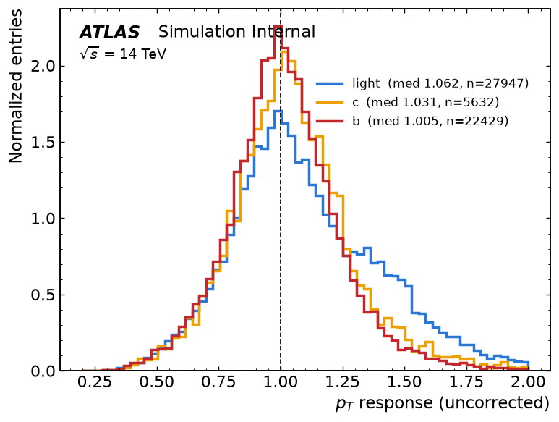
TASK & DATASET
The task: probabilistic jet-pT calibration
Item | Value
Light-jet campaign | 620k jets — 181k isolated training jets
Splits (by file) | 13 train / 2 validation / 2 test — test files never touched
All-flavor extension | 1.20M matched jets (light : c : b mix of t̄t)
Training weights | flat in log pT, 20–250 GeV, capped at 99th pct
Target y = ln(pT_true / pT_reco) → corrected pT = pT_reco · e^μ The model predicts (μ, σ): a correction and a per-jet uncertainty.
Jet selection
Truth-matched AntiKt4EMTopo jets; pT_true > 20 GeV; |η| < 2.5
ΔR(reco, truth) < 0.3 recomputed from kinematics + duplicate-match guard
Isolation flag stored — train on isolated jets, evaluate both populations (the non-isolated gap probes inter-cluster energy sharing)
Per jet: cone tracks · jet features · ΔR < 0.4 cells + transferred graph
DFM feasibility — UT Arlington · Aug 2026
Uncorrected response by flavor — the problem being fixed.
4
Notes:
The target is the log response, so the correction is multiplicative and symmetric in log space. Splits are by file, so test files are never seen by training or by any normalization fit. Isolation is a stored flag, not a cut: training uses isolated jets, and both populations are evaluated.

Slide 5
ARCHITECTURE & NOMENCLATURE
One shared encoder — the options and how we label them
Tracks (18f)
Cells (7f)
Jet feats
Label | Meaning
T / J | tracks in the jet cone (18 features) / jet-level features of the reco jet
C-graph / C-set | cone cells with the transferred neighbor graph / as a plain set
TJ, TC, TJC … | input combinations (token-set concatenation)
-pre / -probe | initialized from masked-cell pretraining / frozen encoder + linear head
-f0.01 / -f0.1 | trained on 1% / 10% of the labels (label-efficiency scans)
+fc | flavor-conditioned calibration (truth flavor as input)
+pan | panoptic head (p_b, p_c, p_light, μ, σ): tagging + calibration jointly
B0 | baseline: the ntuple’s own calibrated jets, evaluated identically
Per-modality embedding → 128-d tokens
Local context — tracks: kNN graph · cells: transferred neighbor graph (EdgeConv) · or none (“set”)
Cross-modality masked set attention (ISAB ×2) + pooled global token
Gaussian head → (μ, log σ²) per jet
≈ 1M parameters · identical backbone in every study — only the input set and the head change.
DFM feasibility — UT Arlington · Aug 2026
5
Notes:
Every study in this talk uses this one encoder; a configuration string like TJC-graph+pan fully specifies inputs, cell encoding, initialization, and head. That is what makes the comparisons clean.

Slide 6
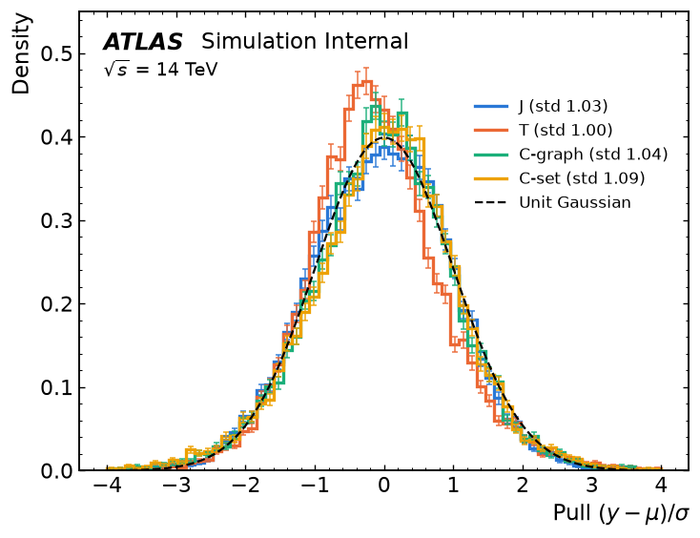
TRAINING PROTOCOL & METRICS
How the models are trained — and how we score them
Loss: short Huber warm-up (stability), then heteroscedastic Gaussian NLL: L = ½ ln σ² + (y − μ)² / 2σ²
Optimizer: AdamW + cosine schedule; early stopping on validation NLL
Weights: flat in log pT so no momentum region dominates the fit
Seeds: 3 per configuration; mean ± spread reported (10-seed convention planned)
Hygiene: splits by file; every normalization and weight fit on the training files only
Ops: shared university GPU node — thread-capped, nice’d, watchdog-guarded; ~100 trainings without incident after hardening
Metrics (per pT-true bin; also profiled vs η, φ)
JES = median r, r = pT_corr / pT_true JER = (q75 − q25) / 1.349 ÷ median — robust, tail-insensitive pull z = (y − μ)/σ → std ≈ 1 ⇔ honest uncertainties (we get 1.00–1.05) closure = RMS over bins of (JES − 1) Bins: 20–400 GeV, headline 65–90 · B0 measured identically on the same test jets · details in backup
Pull distributions — predicted σ matches observed spread.
DFM feasibility — UT Arlington · Aug 2026
6
Notes:
Two-stage loss: Huber gives stable early optimization, the Gaussian NLL then buys a per-jet uncertainty. Robust estimators (median, IQR) keep the metrics honest against non-Gaussian tails. The full walk-through of the metric construction is in the backup slides.

Slide 7
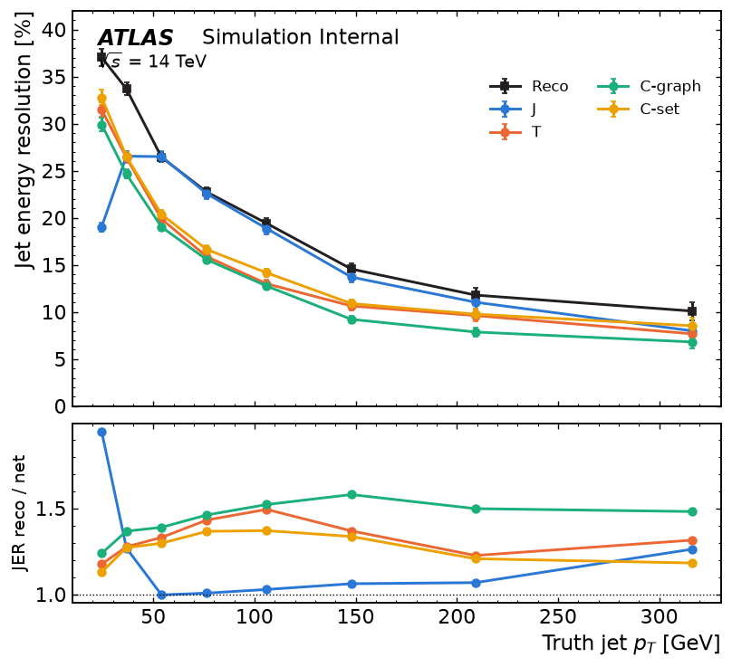
RESULTS I — INPUT COMPARISONS
Which inputs matter? (light jets, all 17 files)
Model | JER @ 65–90 | ÷ B0
B0 (calibrated jets) | 0.230 | 1.00
C-graph (cells only) | 0.158 | 0.69
T (tracks only) | 0.150 | 0.65
TC-graph | 0.130 | 0.57
TJ | 0.125 | 0.54
TJC-set | 0.116 | 0.51
TJC-graph | 0.115 | 0.50
Tracks are the backbone; cells pay off only with enough data. At 4 files cells added nothing over TJ — at 17 files they cut JER a further 8% (0.125 → 0.115). Ablation conclusions are scale-dependent.
Jet features still help (TC 0.130 → TJC 0.115): “J is learned from the cells” is not yet demonstrated at this scale.
Graph vs set: a near-tie at full data (0.115 vs 0.116); the graph mattered most in cell-only and low-data regimes.
JER vs pT, single-input models vs the stored calibrated jets (Reco); ratio below.
DFM feasibility — UT Arlington · Aug 2026
7
Notes:
Headline: the best configuration halves the resolution of the stored calibrated jets on this sample, with honest per-jet uncertainties. Equally important is the scale lesson: the 4-file campaign would have concluded that cells are useless — the 17-file campaign reverses that.

Slide 8
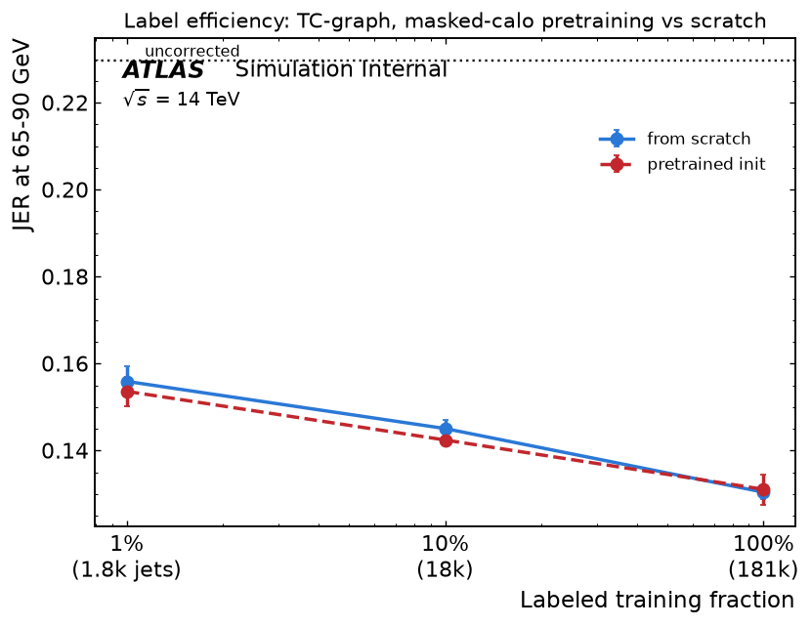
RESULTS II — CALO PRETRAINING
Does self-supervised pretraining transfer?
Pretext: mask groups of cell tokens on the Calo corpora and reconstruct their features; reconstruction QA validated against truth (Note 01 figure set).
Corpus scale helps: masked-reconstruction validation loss 0.507 (t̄t-only) → 0.347 with the 3-corpus mix (≈14k events).
Transfer is real: a linear probe on the frozen pretrained encoder matches full end-to-end training — JER 0.157 vs 0.158 (cells-only). The representation already carries calibration-relevant structure.
Label efficiency: with 1% / 10% of labels, pretrained initialization is consistently but modestly better (0.156 → 0.154, 0.145 → 0.142).
Caveat: pretraining and fine-tuning samples differ in (unverified) provenance — matched provenance and larger corpora are the obvious next step.
Label-efficiency scan: pretrained vs from-scratch at 1%, 10%, 100% of labels.
DFM feasibility — UT Arlington · Aug 2026
8
Notes:
This is the foundation-model claim in miniature: pretrain once on unlabeled full-calorimeter data, then a frozen encoder plus a linear head already matches supervised training. The absolute gains are modest at this sample size — the interesting regime is matched provenance at 10-100x the data.

Slide 9
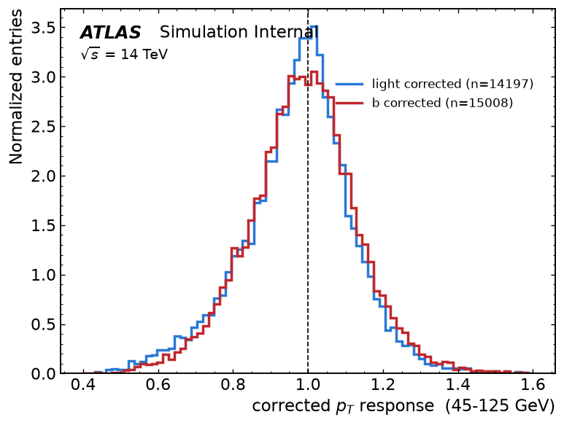
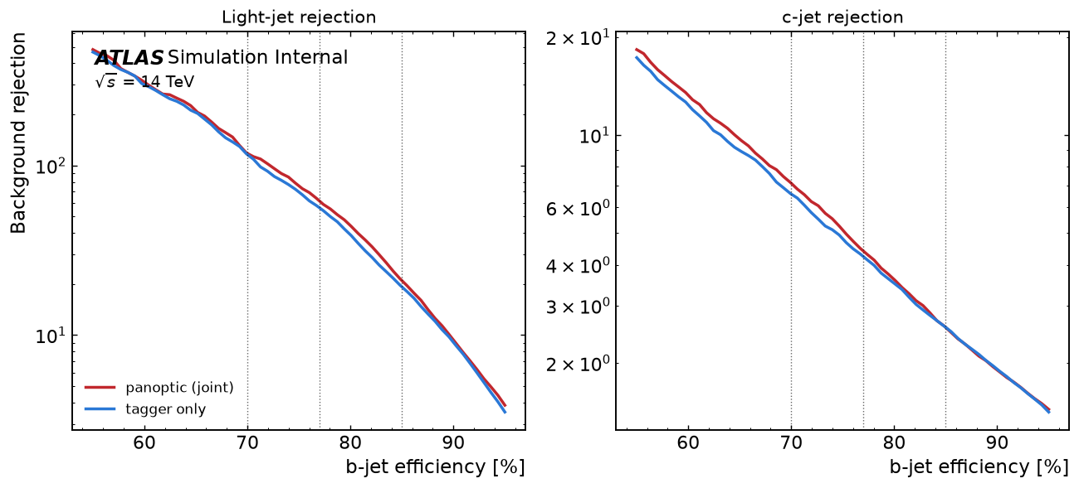
RESULTS III — FLAVOR & PANOPTIC (QUICK TOUR)
One model for flavors — one head for tagging + calibration
T1 — flavor-aware calibration (Note 02)
Dedicated per-flavor models lose to one shared model — JER c: 0.154 → 0.131, b: 0.138 → 0.128: cross-flavor statistics beat specialization at 10⁶ jets
Flavor-conditioned shared model is best overall (closure 3.9%)
b-response shoulder = semileptonic decays (physics, not a model artifact) → motivates mixture-density heads
T2 — panoptic reconstruction (Note 03)
b-jet response: the semileptonic shoulder.
One head outputs (p_b, p_c, p_light, μ, σ) — tagging and calibration jointly
AUC(b) 0.941 ± 0.001 vs 0.939 for an identical dedicated tagger; light rejection 117 ± 5 at the 70% WP; c-rejection consistently better
Calibration within ~2% of the truth-conditioned optimum (JER 0.126 vs 0.123) — the model supplies its own conditioning signal
Background rejection vs b-efficiency: panoptic = dedicated tagger.
DFM feasibility — UT Arlington · Aug 2026
9
Notes:
Two findings that shape the program: sharing beats specializing (for flavors and for tasks), and multi-task costs nothing — the panoptic head matches a dedicated tagger while calibrating within 2% of a truth-conditioned model. The b shoulder is real physics and sets up the mixture-density upgrade.

Slide 10
WRAP-UP
Lessons learned — and where this goes
1
Geometry bridges formats exactly — the neighbor graph transfers; two codebases now share one encoder.
The rest of the program
Done: cell-selection bias study · masking-pretraining QA · Notes 01–03 in LaTeX, in the repo
New: learned MET beats classical estimates by 37% (T3); one-shot DETR jet finding demonstrated (T4) — backup slides
Next: close the gap to ATLAS-PUB depth — mixture-density heads, coverage/pull validation, 10 seeds, HPO, provenance (phased, gated plan in repo)
2
ML calibration halves JER — 0.115 vs 0.230 at 65–90 GeV against the stored calibrated jets (indicative comparison).
3
Ablations are scale-dependent — cells looked useless at 4 files, essential at 17 — beware small-sample conclusions.
4
Pretraining transfers — a linear probe matches full training; corpus diversity helps; gains modest so far.
Asks
5
Sharing beats specializing — one model for all flavors, one head for tagging + calibration, at no cost.
Sample provenance metadata from both productions
A larger + second-process track-level (5D) production
A same-event track + cell corpus for matched pretraining
6
Shared-node ops need engineering — thread caps + watchdogs; ~100 trainings without further incident.
DFM feasibility — UT Arlington · Aug 2026
10
Notes:
Close on the asks: the feasibility phase is done and documented; scaling it properly needs provenance metadata, a larger and second-process track-level sample, and ideally a production where tracks and full cells come from the same events.

Slide 11
Backup
Measuring jet energy scale, resolution, and uncertainty honesty · event-level results (T3 MET, T4 jet finding)
DFM feasibility — UT Arlington · Aug 2026
11

Slide 12
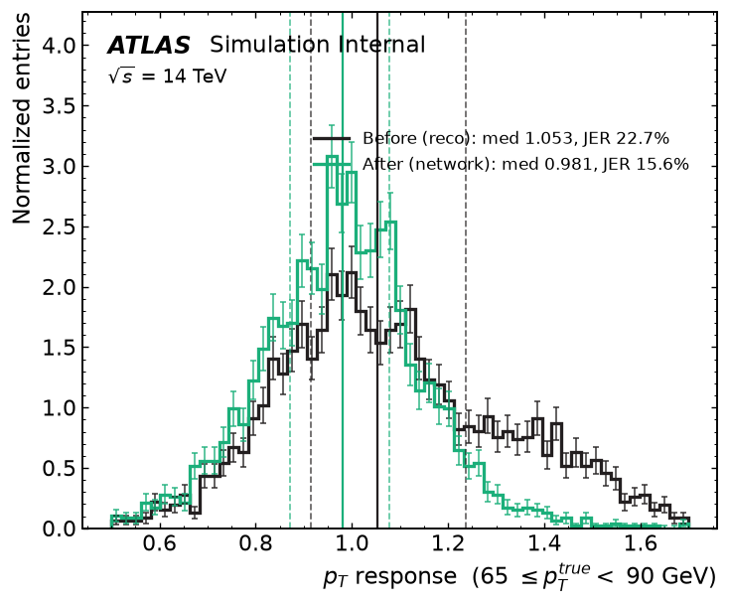
BACKUP
From per-jet predictions to JES and JER
1
Per jet — the model gives (μ, σ) for y = ln(pT_true/pT_reco); corrected pT = pT_reco · e^μ; response r = pT_corr / pT_true.
2
Bin — in pT_true with edges [20, 30, 45, 65, 90, 125, 175, 250, 400] GeV; also vs η (crack region its own bin) and vs φ.
3
Scale — JES(bin) = median(r) — robust location.
4
Resolution — JER(bin) = (q75 − q25)/1.349 ÷ median(r) — Gaussian-equivalent width, made fractional by the scale.
5
Uncertainties — spread across 3 training seeds (mean ± std); 10-seed convention planned.
Why robust estimators: response tails are non-Gaussian (semileptonic b, pile-up); mean/std would be tail-dominated. A mean-seeking loss variant (MAE study) shifts closure by ~2% — estimator and loss must agree.
Metric construction, step by step, on the test sample.
DFM feasibility — UT Arlington · Aug 2026
12

Slide 13
BACKUP
Uncertainty honesty and closure
Pull: z = (y − μ)/σ per jet. If the predicted σ is honest, z has unit width. Measured pull std: 1.00–1.05 across configurations.
Closure: RMS over pT bins of (JES − 1). Best configurations reach 3.9–4.4%; a known low-pT non-closure (20–30 GeV) remains — numerical inversion planned.
What this does not yet show: coverage diagrams, per-bin χ², and tail fractions P(|z| > k) — the PUB-note-grade validation suite. Scheduled in the gap-closure plan; it runs on archived predictions, no retraining needed.
Fit/apply hygiene: all normalizations, weights, and any rescaling are fit on training or validation files and applied frozen to test files.
Pull distributions vs a unit Gaussian, per configuration.
DFM feasibility — UT Arlington · Aug 2026
13

Slide 14
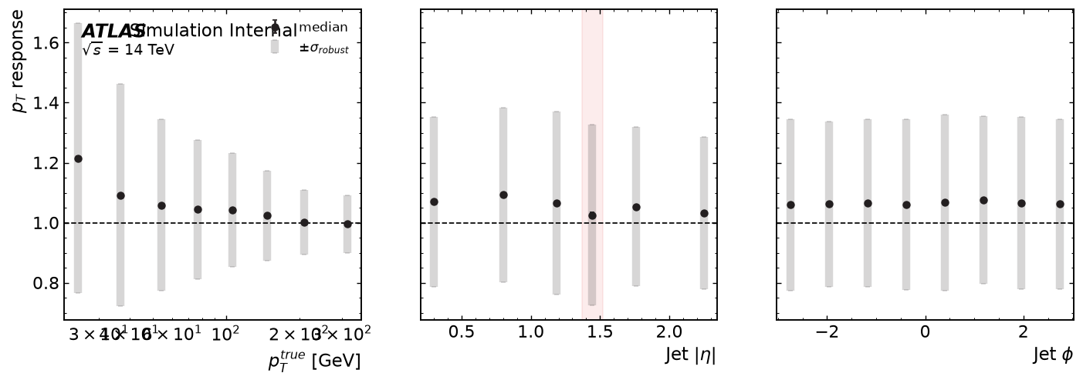
BACKUP
The B0 baseline and fair-comparison caveats
JES and JER profiles vs pT, η, φ — model vs the stored calibrated jets (B0), identical test jets and estimators.
B0 = the calibrated jet pT already stored in the ntuple, evaluated with the identical binning and estimators on the identical test jets.
Caveats: that calibration was derived elsewhere (different target, samples, estimator conventions); our sample is t̄t-only and, for the headline, light-quark isolated jets; aggregation is jet-weighted.
Therefore “JER × 0.50” is an internally consistent, indicative comparison — not a claim against the official in-situ calibration chain.
DFM feasibility — UT Arlington · Aug 2026
14

Slide 15
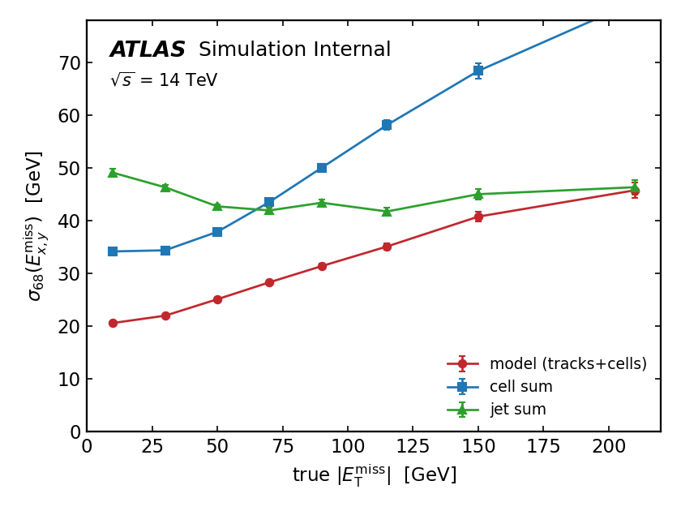
BACKUP — EVENT-LEVEL TASKS
T3: MET estimation from tracks + cells
Target: truth MET = vector sum of truth-record neutrinos. One sample = one event: all PV/unassociated tracks (pT > 0.5 GeV, ≤500) and all matched cells with the transferred event neighbor subgraph.
Head: pooled global token → (MET_x, MET_y); Huber loss on MET/100 GeV.
Baselines: negative vector sums of tracks / cells / matched jets, computed on the identical test events.
Estimator | σ68 per component [GeV]
track sum | 60.6
cell sum | 43.2
jet sum | 44.2
model, tracks only | 49.5 — collapsed to constant output
model, tracks + cells | 27.0 ± 0.1 (3 seeds) −37% vs best classical
Resolution vs true |MET|: learned estimate vs classical vector sums, identical test events.
Improvement is uniform over the full MET range; the cell-sum baseline degrades steeply once true MET is large.
DFM feasibility — UT Arlington · Aug 2026
15
Notes:
The learned MET is better everywhere, and dramatically so at high true MET where the cell sum fails. The tracks-only row is the interesting negative result — covered on the next slide.

Slide 16
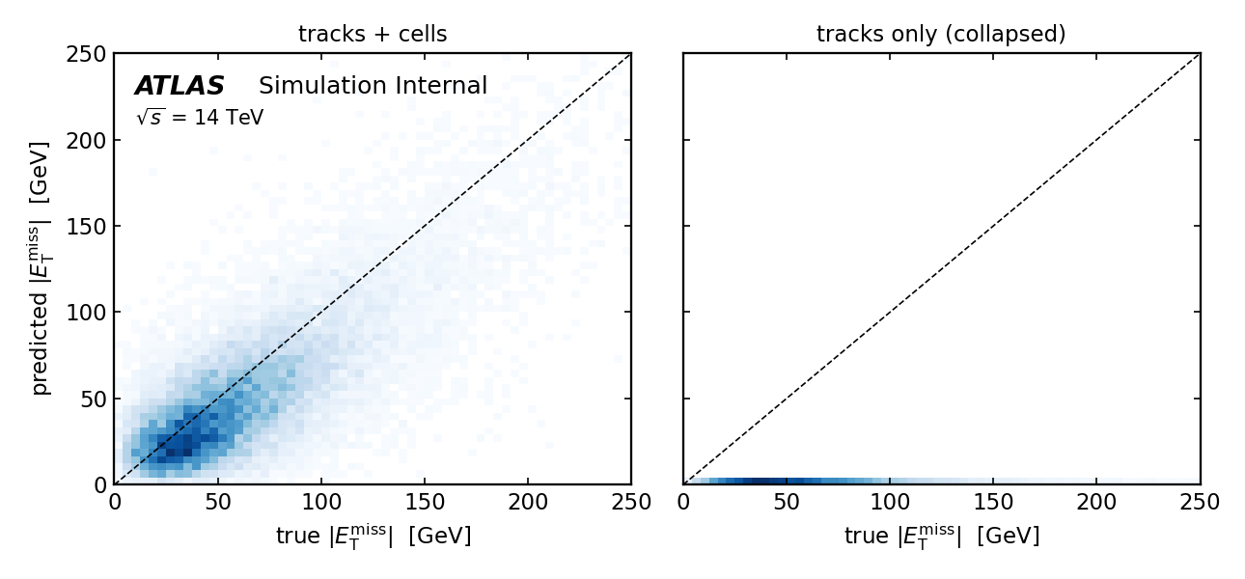
BACKUP — EVENT-LEVEL TASKS
T3: where the MET information lives
Predicted vs true |MET|, test events: the same encoder with cells (left) and without (right).
Tracks alone collapse: every seed converges to a near-constant output (prediction spread ≈ 0, correlation ≈ 0) — charged recoil carries almost no extractable neutrino information at this scale, and the optimizer finds the trivial minimum.
Cells flip the outcome: the identical encoder, given the matched cells and their transferred neighbor graph, correlates strongly with truth — MET is a calorimeter measurement, and the event-level graph the cell-matching bridge enables is doing real work.
DFM feasibility — UT Arlington · Aug 2026
16

Slide 17
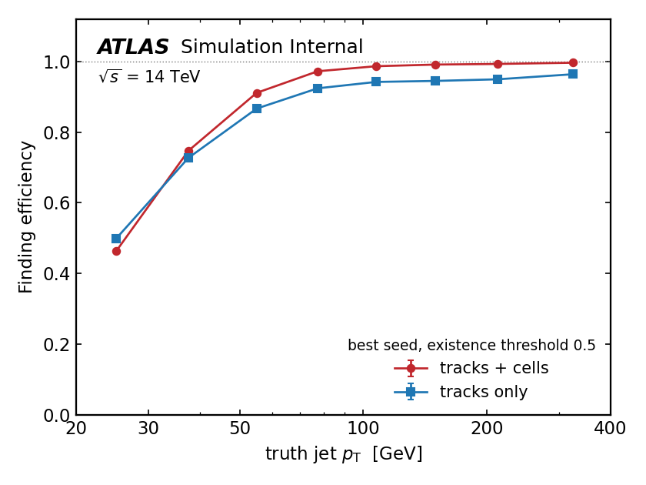
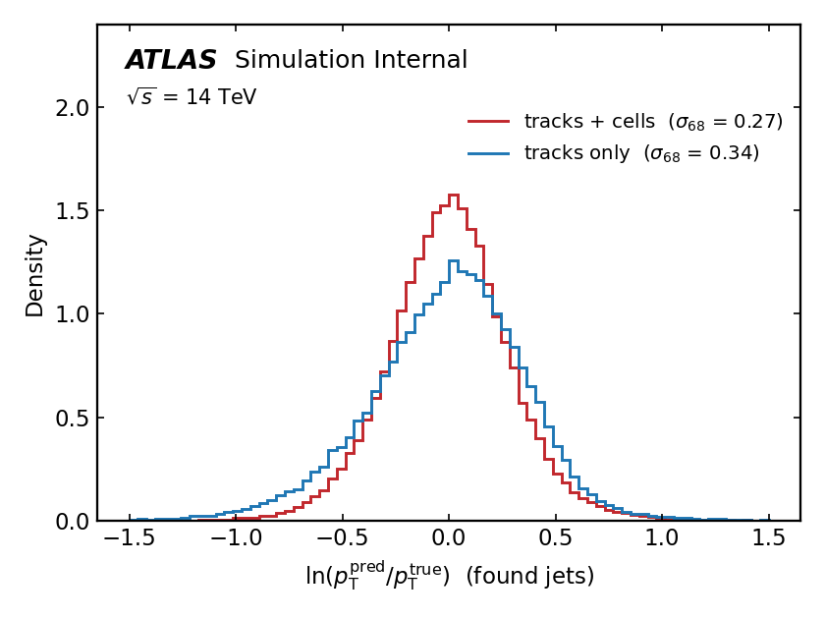
BACKUP — EVENT-LEVEL TASKS
T4: one-shot jet finding via set prediction
Method (DETR-style): 12 learned queries cross-attend to the event tokens; per query (existence, log pT, η, φ). Hungarian-matched set loss: existence BCE + kinematic L1 on matched pairs. Truth: hard-scatter jets, pT > 20 GeV.
Metric (3 seeds) | tracks | tracks + cells
efficiency (pT > 20) | 0.789 ± 0.010 | 0.759 ± 0.052
fake rate | 0.125 ± 0.021 | 0.110 ± 0.016
log-pT MAE (found) | 0.293 ± 0.010 | 0.238 ± 0.015
Read the profile, not the integral: the scalar efficiency is dominated by the 20–30 GeV turn-on; at plateau (> 80 GeV) the best seed reaches 0.99 with cells vs 0.95 without, and cells sharpen the found-jet kinematics.
DETR instability is real: large seed variance with cells (best-seed val 1.31 vs 1.71) — matching-stabilization techniques are the known fix and the obvious next step.
Rerun note: TC seeds trained under torch 2.13 after the reboot-forced venv rebuild; no checkpoints cross versions.
Top: finding efficiency vs truth pT (best seed). Bottom: log-pT residual of found jets.
DFM feasibility — UT Arlington · Aug 2026
17
Notes:
One shared encoder does event-level set prediction out of the box. The efficiency turn-on at low pT and the DETR seed variance are both expected at this scale and are the first things the scaled study should attack.

