Slide 1
Jet reconstruction as a global correction
one detector backbone, many tasks
Jet energy · flavor · joint tagging + calibration · missing ET · jet finding
HL-LHC full simulation — with the evidence for each claim
UTA · SLAC — DFM working group · August 2026

Slide 2
APPROACH
Compensate hadronic shower fluctuations, globally
• JER is limited by per-jet fluctuations: charged fraction, shower composition, out-of-cluster losses, pileup.
• Networks see the jet's own constituents → per-jet multiplicative correction: y = ln(pT_truth / pT_reco), with a (μ, σ) head — an uncertainty per jet.
• GLOBAL correction: all effects at once — no per-constituent confusion term. The modern extension of GSC; complementary to particle-flow.
• Targets are particle-level (matched truth jets). Out-of-cone / parton effects are physics, not calibration.
Read every result with this in mind: the target is a correction ON TOP of the calorimeter jet. "Tracks only" = tracks correcting the calo jet. Every table starts from the uncorrected calo-jet row.

Slide 3
DATA & MECHANICS · 1/4
Sample: HL-LHC Run-4 full simulation
• mc21_14TeV.601229 — Powheg+Pythia8 A14 ttbar (hdamp 1.5 mt), single-lepton filter.
• AOD e8481_s4446_r16176: full Geant4, geometry ATLAS-P2-RUN4-03-01-00 (ITk tracker).
• Provenance traced through the PanDA production record (task 50733453).
• In hand: 17 ntuple files = 340k events → 1.24M selected jets.
– 0.6% of a 44.7M-event production — a 10× extension is in transfer.

Slide 4
DATA & MECHANICS · 2/4
What the model sees, per jet
• Cells: cone ΔR<0.4, significance selection |E/σ_noise| > 2 (physics-motivated, topocluster-threshold-like), with their calo-geometry neighbor graph.
• Tracks: ghost-associated; 18 features — kinematics, impact parameters + significances (from covariances), hit counts, fit quality.
• Jet features (J): η, sin φ, cos φ, log pT, log m, log(1 + n_constituents).
• Selection: truth-matched, pT_true > 20 GeV, ΔR(reco,truth) < 0.3, |η| < 2.5, duplicate-truth guard. Cutflows archived per file.
• Isolation (training population): no other reco jet pT > 15 GeV within ΔR < 0.8; no other matched truth jet within ΔR < 1.0.

Slide 5
DATA & MECHANICS · 3/4
One shared encoder; inputs are the experiment
• SharedEventEncoder: constituents as typed tokens → local mixing per modality → global mask-aware attention (ISAB), cross-modality → jet queries pool → (μ, log σ²), Gaussian NLL. dim 128, ~1M params.
• Config grammar = input ablation: subsets of {T, J, C}. Same encoder, same training — only the inputs differ.
• C-graph vs C-set — the topology test:
– graph: cells first mix locally over the fixed calo-neighbor edges (SAGE-style), then global attention
– set: cells go straight to global attention, no geometric edges
– the pair asks: does calorimeter topology add information beyond per-cell features?

Slide 6
DATA & MECHANICS · 4/4
Training and evaluation conventions
• AdamW; flat-pT reweighting on train; normalization fit on train only; train on isolated jets, evaluate both populations.
• 3 seeds per config — every number shown is mean ± sd over seeds.
• Estimators, both reported:
– robust JER = IQR / 1.349 / median, in truth-pT bins
– ATLAS-convention iterative Gaussian-core fits as cross-check
• Closure = RMS of (median corrected response − 1) over 20–250 GeV. Pull std tests the σ's.
• Honesty budget: 3 seeds is thin — 10-seed re-runs under a pre-registered protocol are in progress.

Slide 7
RESULT 1 · JET ENERGY
The input ladder — core configs (light jets, 620k)
config | JER@65 | NLL | closure RMS | pull std
uncorrected calo jet | 0.2298 | — | 0.0877 | —
C-graph (cells only) | 0.1584 | −1.086 | 0.0687 | 1.000
T (tracks only) | 0.1504 | −1.058 | 0.0298 | 1.010
TC-graph | 0.1304 | −1.241 | 0.0442 | 1.012
TJ (tracks + jet kin.) | 0.1254 | −1.364 | 0.0454 | 1.028
TJC-graph ◀ best | 0.1150 | −1.422 | 0.0395 | 1.036
TJC-set (no cell graph) | 0.1162 | −1.416 | 0.0424 | 1.029
Mean of 3 seeds; JER@65 seed spread ≤ ±0.003 for every config (per-seed files archived).

Slide 8
RESULT 1 · JET ENERGY
Pretraining and label efficiency (TC-graph family)
config | JER@65 | vs no pretraining
TC-graph (100% labels) | 0.1304 | —
TC-graph-pre (100% labels) | 0.1311 | neutral
TC-graph @10% labels | 0.1451 | —
TC-graph-pre @10% labels | 0.1424 | better
TC-graph @1% labels | 0.1559 | —
TC-graph-pre @1% labels | 0.1536 | better
C-graph-pre-probe (frozen encoder + probe) | 0.1566 | ≈ full finetune (0.1580)
"@N% labels" = trained on a random N% of the labeled jets — does masked pretraining help when labels are scarce?

Slide 9
RESULT 1 · OBSERVATIONS I
Inputs and topology
• Every input adds: C 0.158 → T 0.150 → TC 0.130 → TJ 0.125 → TJC 0.115 (uncorrected: 0.230).
• Tracks and cells are complementary — tracks resolve the low-pT charged-fraction fluctuation; cells keep improving where tracking saturates.
• Graph ≈ set: 0.1150 vs 0.1162, overlapping spreads.
– Explicit calo topology adds little beyond per-cell features — for significance-selected cells, per-jet scope.
– Untested where it should matter most: full granularity, event scope (clustering).
• The learned correction closes the response to 2–4% with no explicit closure term (uncorrected: 9%).

Slide 10
RESULT 1 · OBSERVATIONS II
Pretraining and uncertainties
• Masked pretraining is neutral at full labels (0.1304 vs 0.1311).
• It helps when labels are scarce: +1.5% relative at 1% labels, +1.9% at 10%.
• A frozen pretrained encoder with a linear probe nearly matches full finetuning (0.1566 vs 0.1580) — the representations transfer.
– The foundation-model value case lives in the low-label / transfer regime — being staked there with pre-registered margins.
• Per-jet σ's are honest to first order: pull std 1.00–1.05 across all configs.
– Deeper validation (coverage, tails) later in the talk — with a measured surprise.

Slide 11
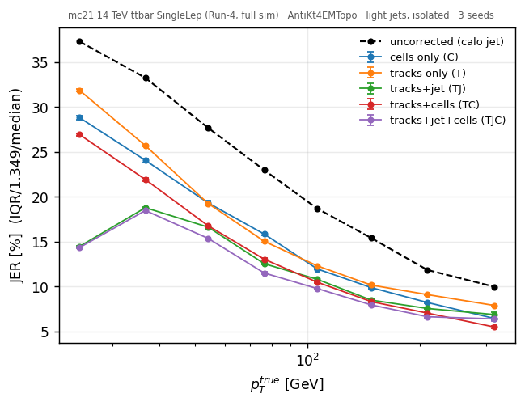
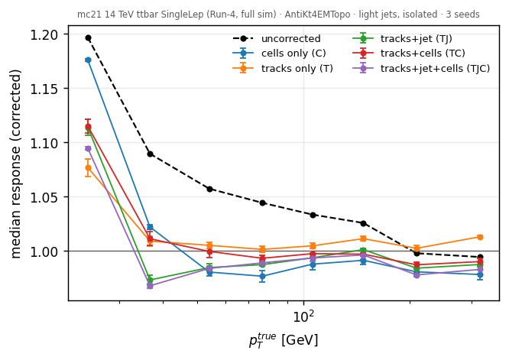
RESULT 1 · EVIDENCE VS PT
Where each input contributes
Left: JER vs truth pT (seed spread as bars) — tracks dominate below ~100 GeV; cells extend gains to high pT. First bin is clipped by the 20 GeV reco floor: diagnostic only. Right: uncorrected response is 3–20% high; all configs close to 2–4%.

Slide 12
RESULT 1 · ROBUSTNESS
Independently replicated at SLAC
inputs | SLAC pipeline | this work
tracks only | 34.0% | 34.5%
tracks + cells | 42.7% | 43.3%
• Fully independent pipeline: cone (not ghost) constituents, 26 track / 25 cell features, two-stream transformer, Huber loss, Gaussian-core estimator.
• Same pT structure found: track gains fade above ~100 GeV; cell gains persist (N/S/C: cells fix stochastic + constant terms).
• Estimator reconciliation: 13.5% vs 13.1% inclusive Gaussian-core.
Relative JER improvement over the same-jets uncorrected default — the one directly comparable number.

Slide 13
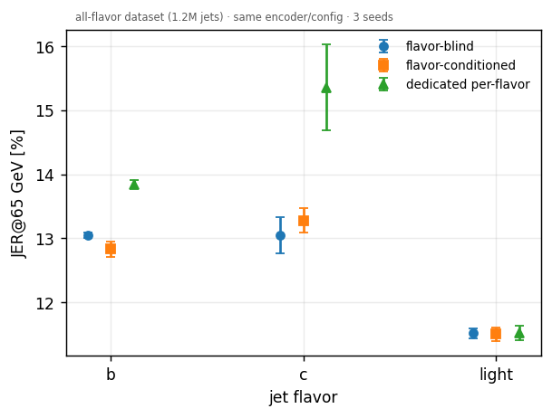
RESULT 2 · FLAVOR (1.2M ALL-FLAVOR JETS)
Shared training beats dedicated per-flavor models
• Shared model beats dedicated models where statistics are limited:
– b: 12.8 ± 0.1 vs 13.9
– c: 13.3 ± 0.2 vs 15.4 ± 0.7 (dedicated c-model starves on 150k jets)
• Explicit flavor conditioning ≈ flavor-blind — the encoder infers flavor structure from the constituents.
• Ordering light < b < c matches expectation (semileptonic decays, shower composition).

Slide 14
RESULT 3 · JOINT TAGGING + CALIBRATION
One head, both tasks, no degradation
config | calib NLL | JER@65 | b-AUC | light rej @70%
calibration-only | −1.421 | 0.1244 | — | —
joint (panoptic) | −1.406 | 0.1264 | 0.941 ± 0.001 | 117 ± 5
tagging-only control | +0.154 | 0.4728 | 0.939 ± 0.001 | 122 ± 10
• Calibration intact (ΔNLL 0.015 ≈ 1 seed sd) and tagging intact (rejections indistinguishable, also at 77/85% WPs).
• The tagging-only control (JER 0.47) shows calibration is earned by the NLL term, not free.
Internal comparison only — production taggers reach light rej O(400)–O(10³) at 70% on Run-2 samples [2211.16345, 2505.19689]; not comparable (Run-4 detector, selected cells, no FTAG features). Like-for-like anchor = GN2 on these ntuples: branches exist, unfilled — rerun requested.

Slide 15
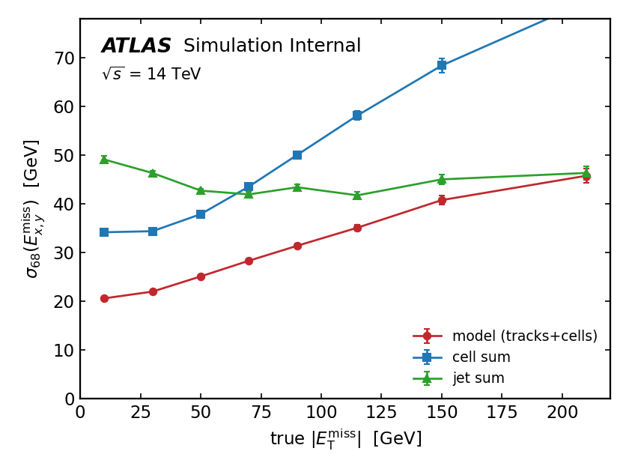
RESULT 4 · EVENT-LEVEL MISSING ET
MET from available detector subsets
estimator | resolution [GeV]
−Σ tracks | 60.6
−Σ jets | 44.2
−Σ cells | 43.2
model, tracks only | 49.5 ± 0.01
model, tracks + cells | 27.0 ± 0.1
First event-level model: all tracks + selected cells → truth MET (ν vector sum; validated). No reco soft term exists — "MET from what we have" vs baselines with the same information. Tracks-only model collapses toward a constant.

Slide 16
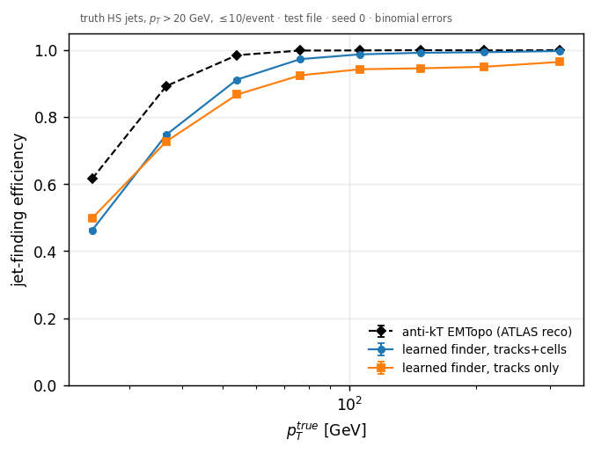
RESULT 5 · SET-PREDICTION JET FINDING
Learned finder vs the ATLAS reco baseline
finder | overall eff | plateau
anti-kT EMTopo (reco) | 0.892 | ≈0.999
learned, tracks | 0.789 ± 0.008 | ≈0.95
learned, tracks+cells | 0.759 ± 0.042 | ≈0.99
Learned queries + existence head + Hungarian matching to truth HS jets (pT>20, ≤10/event). Cells sharpen kinematics: log-pT MAE 0.238 ± 0.012 vs 0.293 ± 0.008.

Slide 17
RESULT 5 · HONEST READ
Not yet competitive — and where the gap is
• Overall: anti-kT 0.892 vs learned 0.76–0.79 — the gap is entirely low-pT.
• At the plateau the learned finder comes within a few % (0.99 with cells vs 0.999).
• Tracks+cells has real, unresolved seed variance (±0.04) — a stability study (more seeds, matching diagnostics) is queued before stronger claims.
• Fake rates are NOT compared: 57% of reco jets are pileup jets at μ=200 — anti-kT "fakes" are PU, learned-finder fakes are algorithmic. Different things.
• Why it matters anyway: constituents-in → jet-set-out removes the seeding assumption every per-jet result above inherits.

Slide 18
THE WIDER TASK PORTFOLIO
Other tasks on the same backbone: honest status
task | status | one-line verdict
Topocluster formation (cell-edge classification, full 187k-cell granularity) | PARKED | All GNN variants plateau — cluster membership is long-range reachability, mismatched to fixed-depth message passing. Revisit as set prediction on full-granularity data.
Masked pretraining | IN USE | The "-pre" rows: neutral at full labels, gains at 1–10%.
Event-level b-tagging | EVOLVED | Its encoder/decoder became the track path + jet-query head here.
Jet finding & MET | SHOWN | Results 4–5.
Pileup-jet ID; timing-aware reco | QUEUED | Enabled by newly verified branches (PU truth jets; cell time/quality).

Slide 19
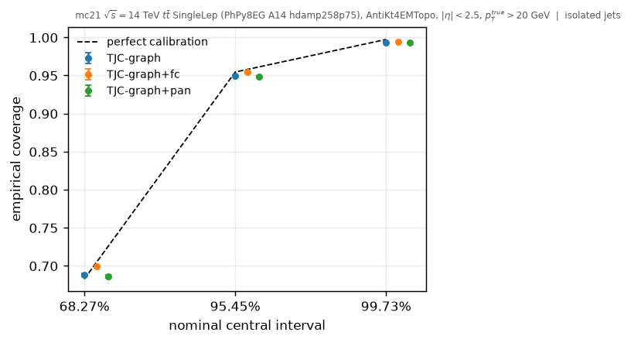
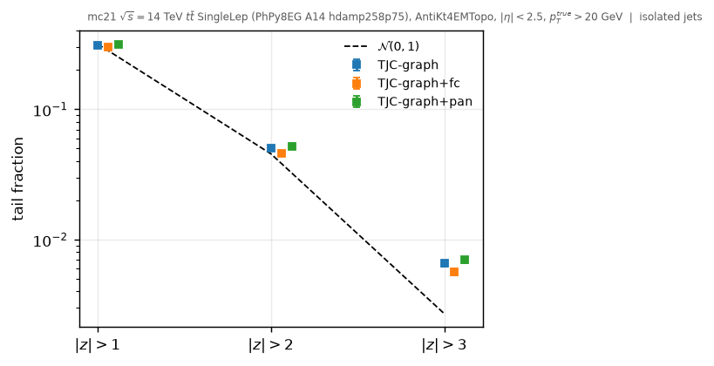
UNCERTAINTY VALIDATION
The σ's are honest in the core — not in the tails
Coverage ~67.4% at 68.27% nominal (mildly overconfident). P(|z|>3) ≈ 0.8% vs 0.27% Gaussian — a 3× tail excess, identical across models. Measured motivation for the mixture-density study now starting.

Slide 20
LIMITATIONS
What these results are not
• All calibrations are corrections to the calo jet — no standalone single-modality measurement claimed.
• 3 seeds per config (spreads shown); 10-seed pre-registered re-runs in progress.
• Single process (ttbar) — sample dependence unmeasured until VBF H→inv (in transfer) and dijet/Z+jets.
• 5.3% of "light" jets overlap the hard truth electron (measured) — veto in progress.
• No production-tagger baseline (GN2 unfilled); no reco-MET soft term — internal comparisons where noted.

Slide 21
NEXT STEPS & ASKS
Validation program, and three requests
• In progress:
– 10-seed re-runs; frozen splits; test blinding — every number here is a pre-registered hypothesis
– Mixture-density heads (the tail evidence)
– Feature ladder from jet(pT, η, φ)-only upward
– Failure-mode event displays
– Classical baselines: numerical inversion, GSC-like MLP
• Asks:
– SLAC: prediction files (common-jets evaluation); SuperHJD source; gluon labeling; GN2 rerun?
– Transfer (script ready): VBF H→inv, then +150 ttbar files (10× stats)
– Decisions: |η|>2.5 (defer?); electron veto (yes?); freeze dataset for re-runs, 10× for scaling

